Slide 1
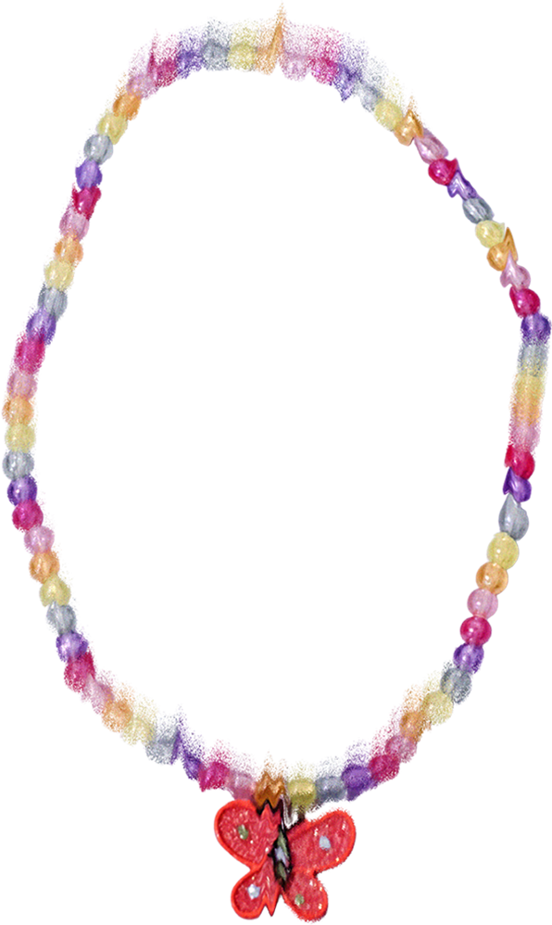

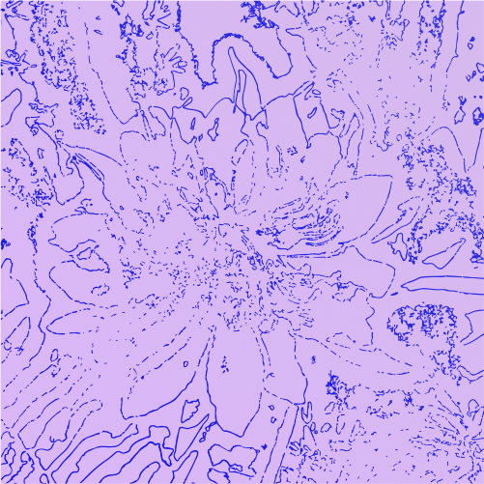

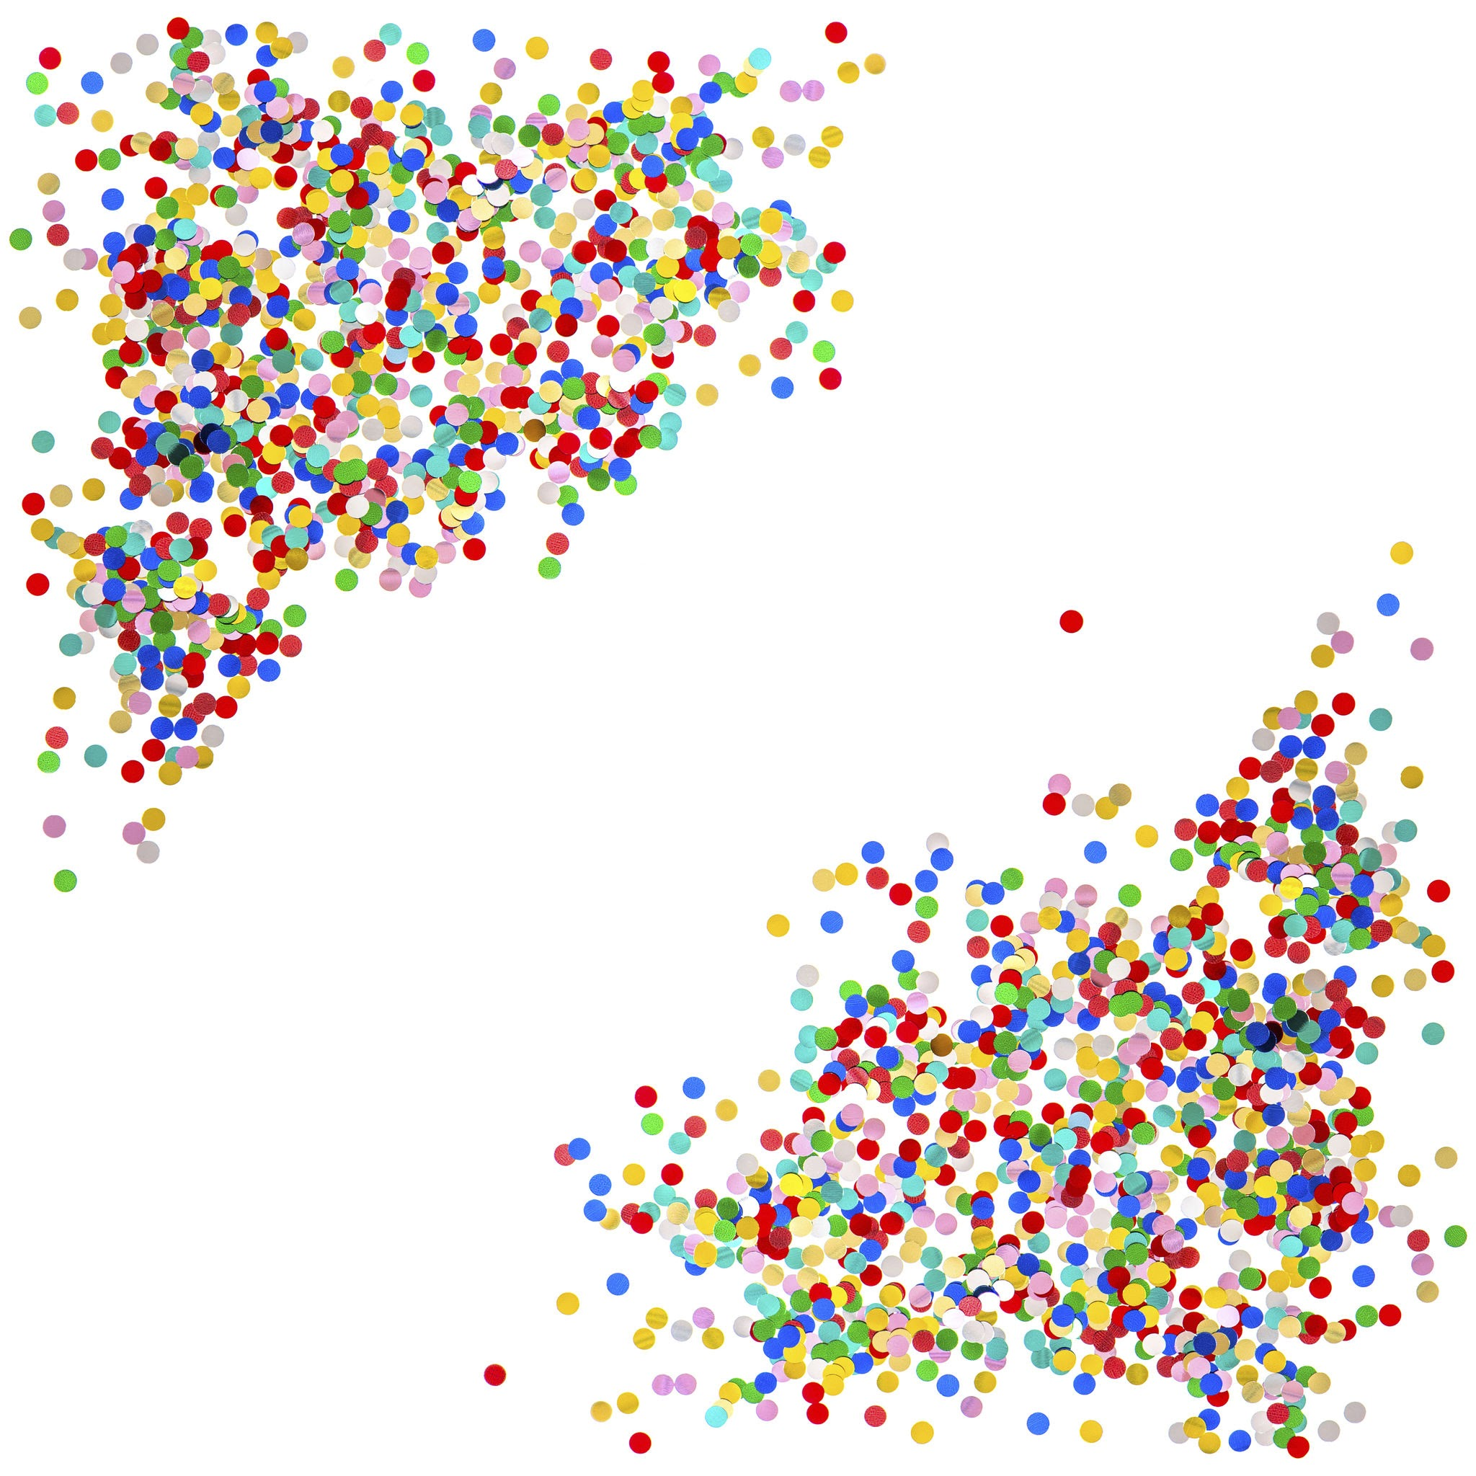



Clustering
Megh
Ellie
Nathan

Slide 2



Clustering
Purpose:
Our algorithms:
finding patterns in data
locating natrual groups
useful in marketing
K-means
K-medoids
Hierarchical Agglomerative Clustering [HAC]
Particle Swarm Optimization [PSO]

Slide 3



Overview
Data sets:
Language:
Synthetic data set: Scikit’s blobs translated to c++
Real data set: Mall customers
C++
Python (Graph)

Slide 4




Research Questions
For fixed input size, how do K-means, k-medoids, and PSO-based clustering trade off solution quality versus runtime as the number of clusters k increases?
How does runtime and memory usage of K-means, K-medoids, and Hierarchical Agglomerative Clustering scale as input n increases?
For PSO-based clustering, what is the trade-off between solution quality and computational cost as PSO parameters change?

Slide 5
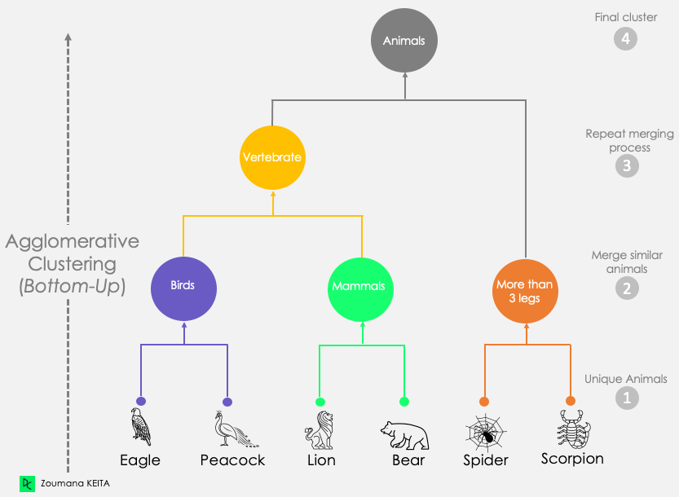


HAC -Bottom up
Merge
starts with n clusters
Dendrograms
->
https://medium.com/@prasanth32888/agglomerative-hierarchical-clustering-ahc-e9e7a48cb042

Slide 6

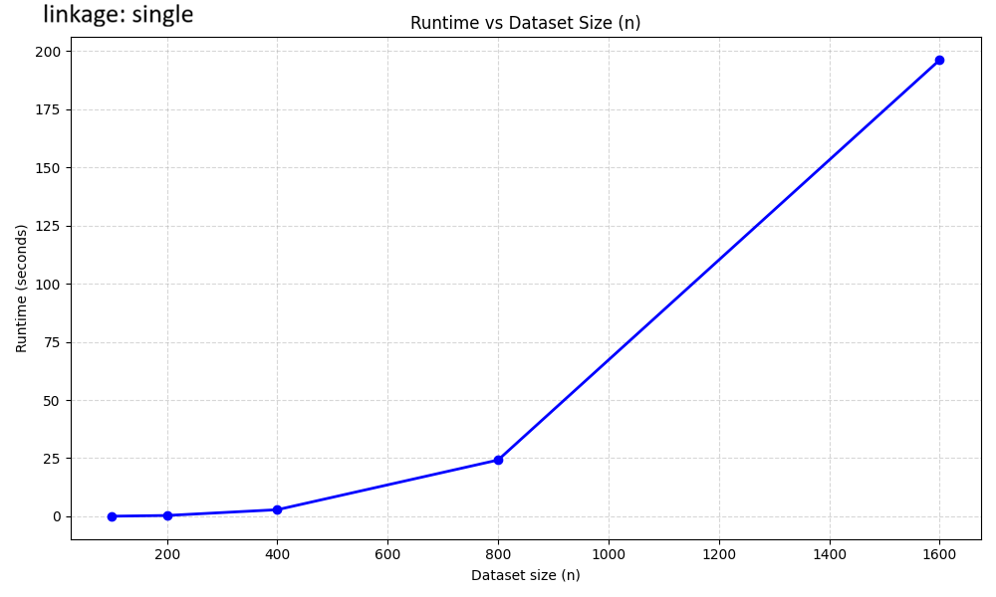
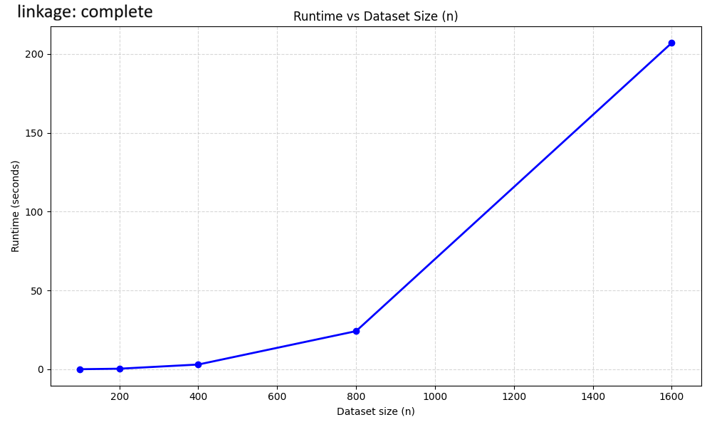
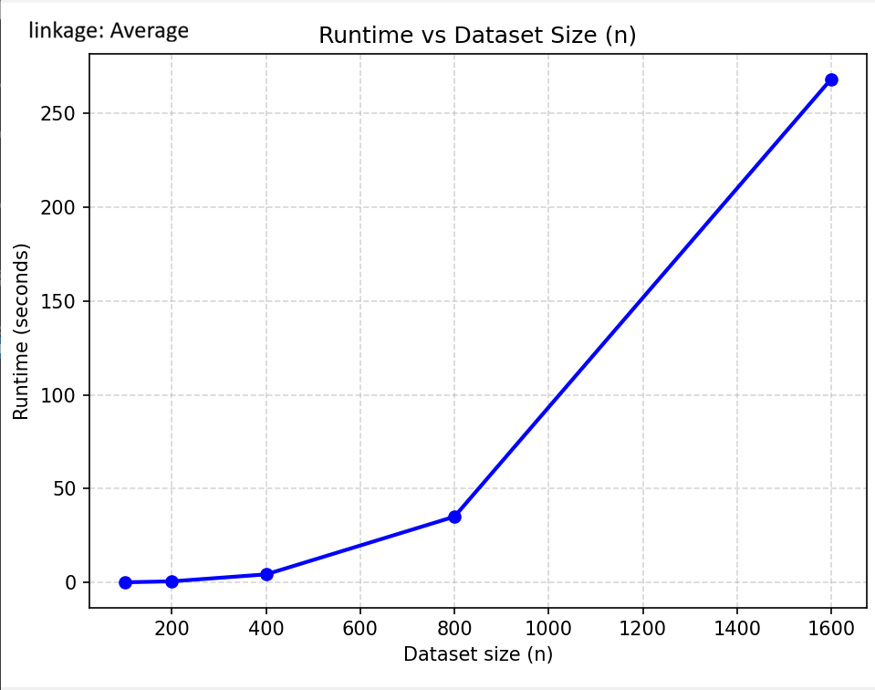

Analysis
info
code:
Runtime:
AI generated, tested on exponentially increasing n
O(n^3)
Real Data runtime:
0.555495 sec

Slide 7
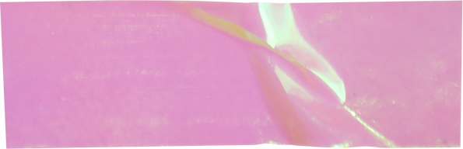

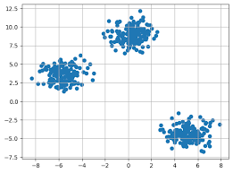

ALGORITHM:
K-Means
A cluster center
https://www.geeksforgeeks.org/machine-learning/k-means-clustering-introduction/

Slide 8
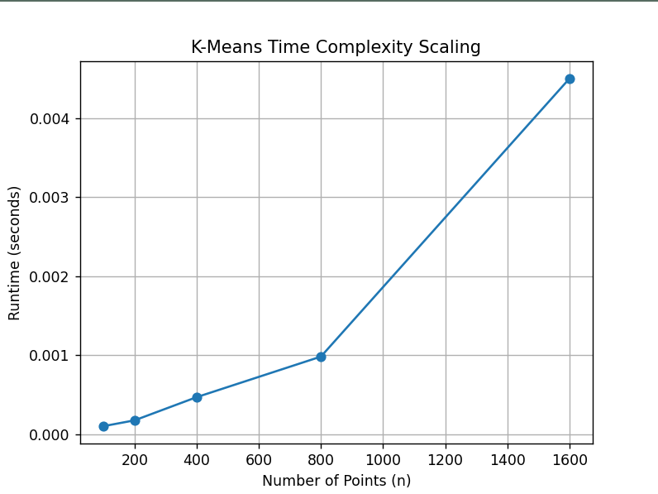
Analysis
Code:
Runtime/expectations:
θ(nkdt) n=points, k=clusters, d=dimensions, t=iterations
AI generated code
Exponential points
Real data runtime:
0.00046126

Slide 9

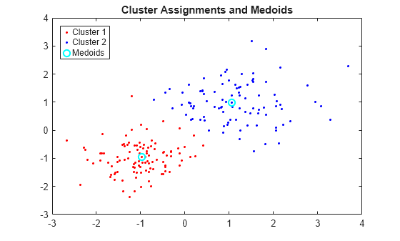
ALGORITHM:
K-Medoids
a real data point
https://www.mathworks.com/help/stats/kmedoids.html

Slide 10
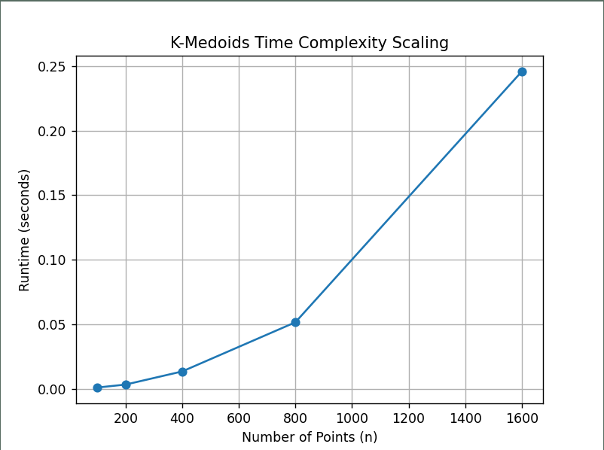
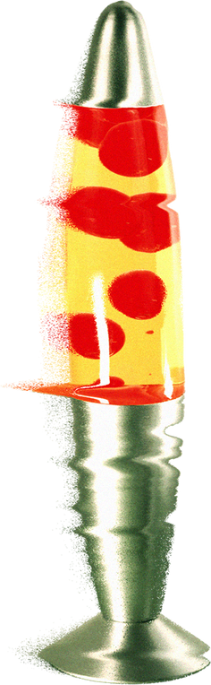

Analysis
code:
Synthetically generated code similar to k-means
Runtime:
θ(n²kt) n = # of points, k = clusters, and t = iterations.
Real Data runtime:
0.00490905 sec

Slide 11

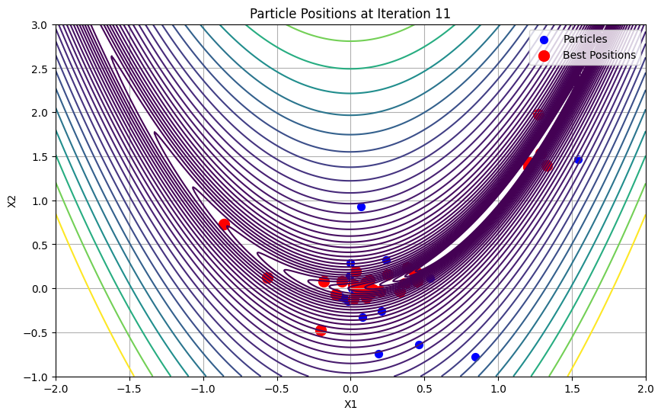

ALGORITHM:
PSO
A nature-based algorithm inspired by the movement of bird flocks.
https://www.linkedin.com/pulse/particle-swarm-optimization-pso-ali-karazmoodeh-tcbvf

Slide 12
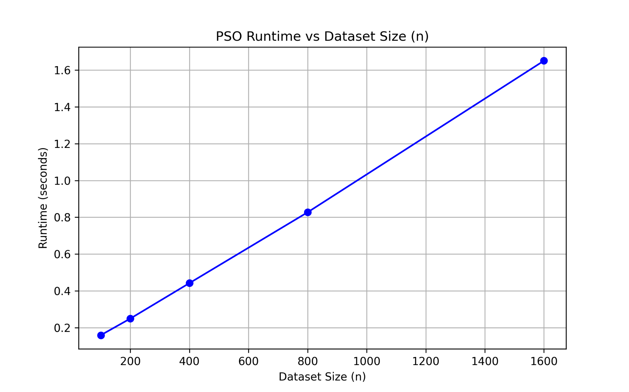
Analysis
Code
AI generated, fixed swarm size + fixed iterations
Runtime / expextations
PSO = θ(n · S · t), n = points, S = swarm size, t = iterations
Real Data
≈ 0.249456 seconds (200‑point mall dataset)

Slide 13
Research Answers
K-means is fastest, but least efficient.
K-medoids better clusters, but slower
PSO gives the best solution but takes far longer
K-means scales the best O(n)
K-medoids is worst but more robust O(n^2) HAC has the worst efficiency
The trade-off is linear. Changing the perameters to get a better output raise the runtime and computational costs

Slide 14

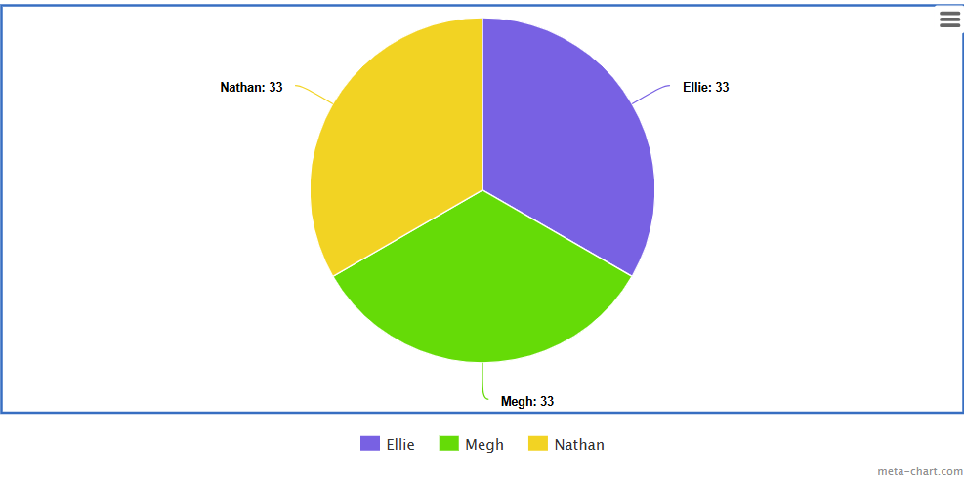

Work Split

Slide 15

sources:
https://www.kaggle.com/datasets/shwetabh123/mall-customers
https://www.meta-chart.com
https://www.geeksforgeeks.org/machine-learning/k-means-clustering-introduction/
https://www.geeksforgeeks.org/machine-learning/k-medoids-clustering-in-machine-learning/
https://www.geeksforgeeks.org/machine-learning/k-means-vs-k-medoids-clustering/

