Slide 1
Travel Delay Across
Airports & Carriers
Team 2: Kairan Zhong, Polaris Chen, Sunny Sun, Xiran Li, Yue Zhang

Slide 2
Table of Contents
01
02
03
04
Business Problem & Dataset
Data Models Showcase
Data Analysis
Business Insights & Solution

Slide 3
Business Problem & Dataset
Initial Statement & Current Statement & Data Overview

Slide 4

Business Problems
Initial Statement
Data Processing
Current Statement
For carriers and airports in the U.S:
Scalable, self-service business intelligence solutions
decrease airline delay rates, cut operating costs, and increase customer satisfaction
Shift the perspective to the passenger side:
build a recommendation engine for passengers
provide them with travel advice that can effectively avoid the risk of delays
After Data modeling, ETL and Data visualization:
no positive relationship between delay rates and carriers’ operating costs

Slide 5
Dataset Overview
On-time performance for over 100K Domestics Flights across 23 airports and 20 carriers in United States & 1100 Associated Financial Reports from 2017 -2022
Dataset | Description | Data Source | Data Period | Anomalies
Airline_Delay_Cause, T_T100_MARKET_ALL_CARRIER, T_SCHEDULE_T3 | On-time performance of domestic flights operated by large air carriers | The U.S. Department of Transportation's Bureau of Transportation Statistics | 2017 -2022.05 | High in analytical maturity, N.A. values account for less than 0.1%
T_F41SCHEDULE_B1 | Quarterly operating balance statements for U.S. Air carriers

Slide 6
Data Models
Conceptual Model & Logical Model & Physical Model

Slide 7
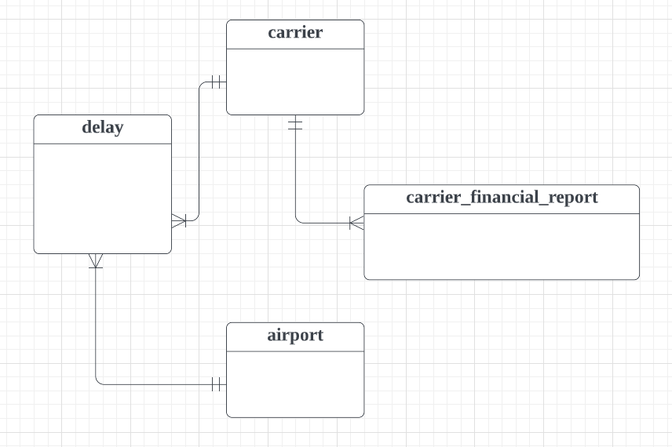
Conceptual Model

Slide 8
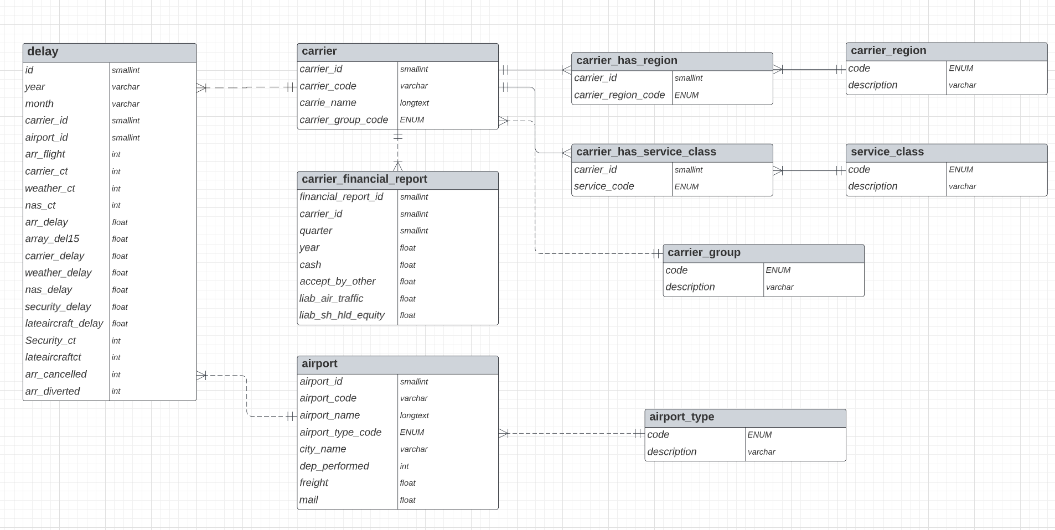
Logical Model

Slide 9
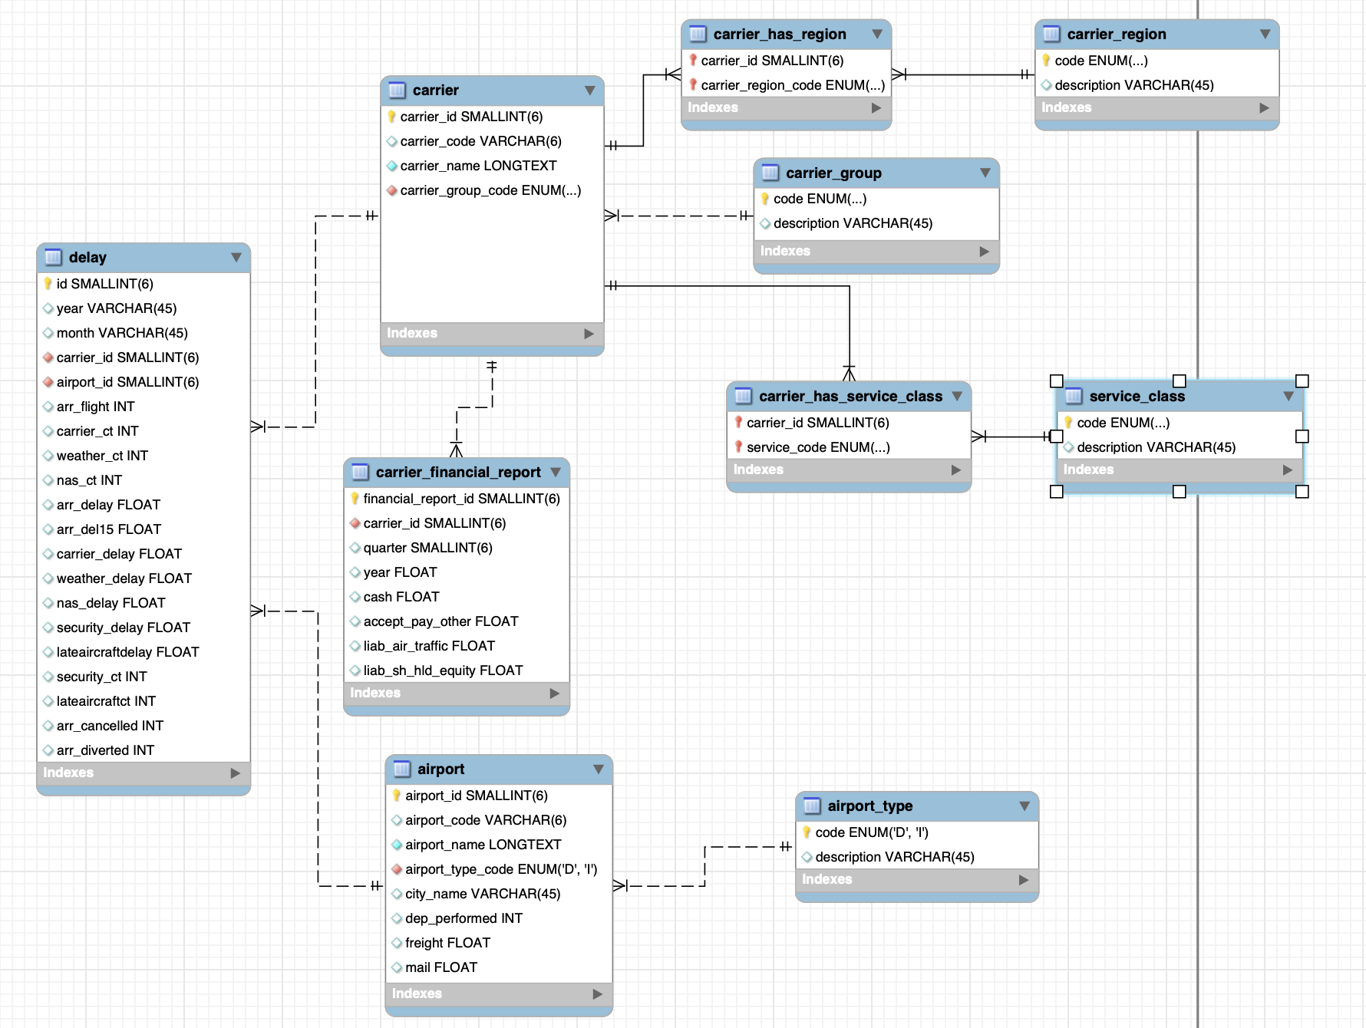
Relational Model

Slide 10
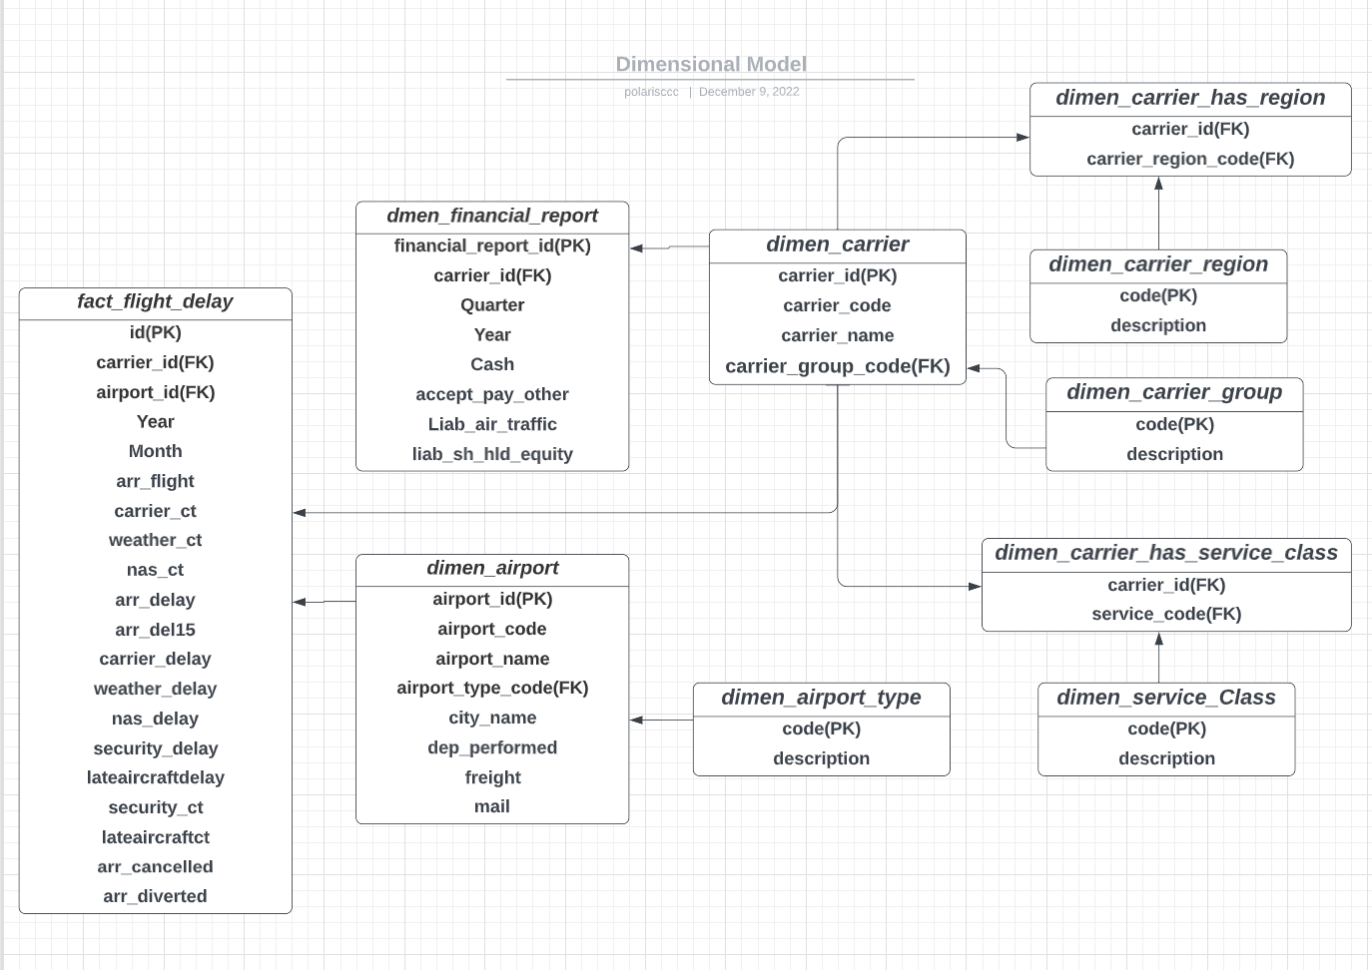
Dimensional Model

Slide 11
Implementation of ETL
Ingestion & Transformation & Loading & Cleaning

Slide 12
ETL: Data Issues
Problem
Solution
Carrier has M-M relationship with region and service class
Add third table for connection
Original Dataset contains more information than needed
Filter data when loading into dataset

Slide 13
ETL: Process
EER Diagram
Load Dataset
Forward Engineering
Process Dataset

Slide 14
ETL: Lesson Learned
Add surrogate key for easier import
Normalize dataset into 3NF before loading data
Use data type LONGTEXT to store long strings

Slide 15
Data Analysis
Airline Delay Records & Airline Financial Statements

Slide 16
Main Reasons of Delay
Air Carriers (no crew)
~ 35.8% of Delay Time
Weather
~ 5.7% of Delay Time
Security Breach
~21.6% of Delay Time
Previous Late Flight
~36.7% of Delay Time

Slide 17
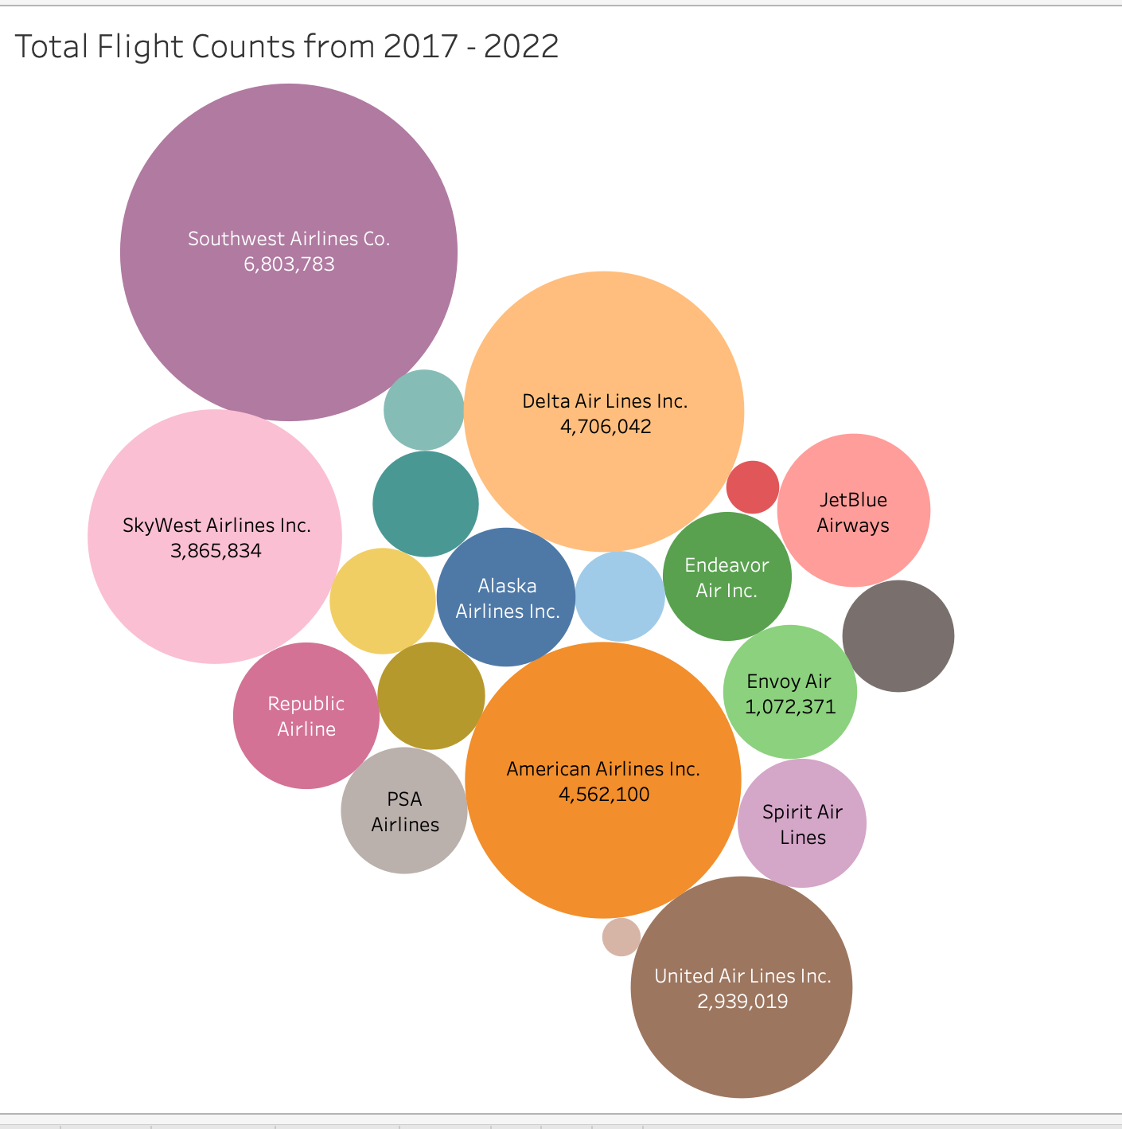
Main Air Carriers

Slide 18
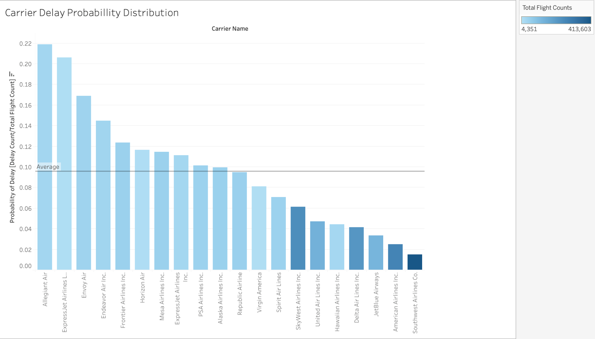
Carrier Delay Data Analysis
Allegiant Air:
Highest delay rate
Low flight counts
Southwest Airline:
Highest flight counts
Lowest delay rate

Slide 19
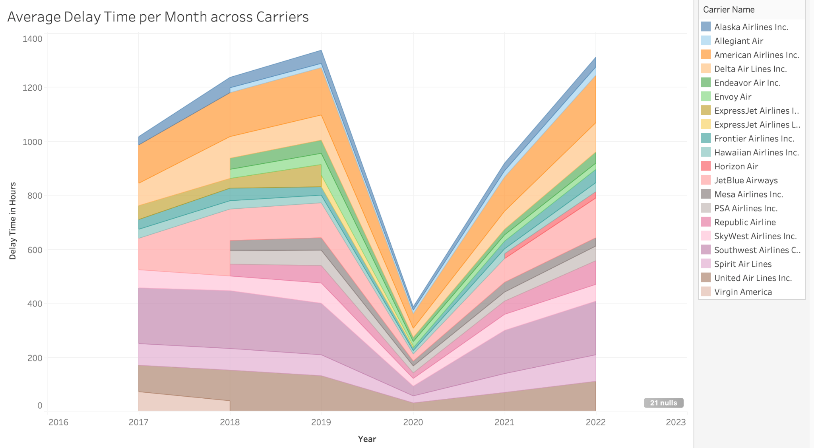
Carrier Delay Time
Allegiant Airline has 2nd highest average delay time.
Southwest has close to the least average delay time.

Slide 20
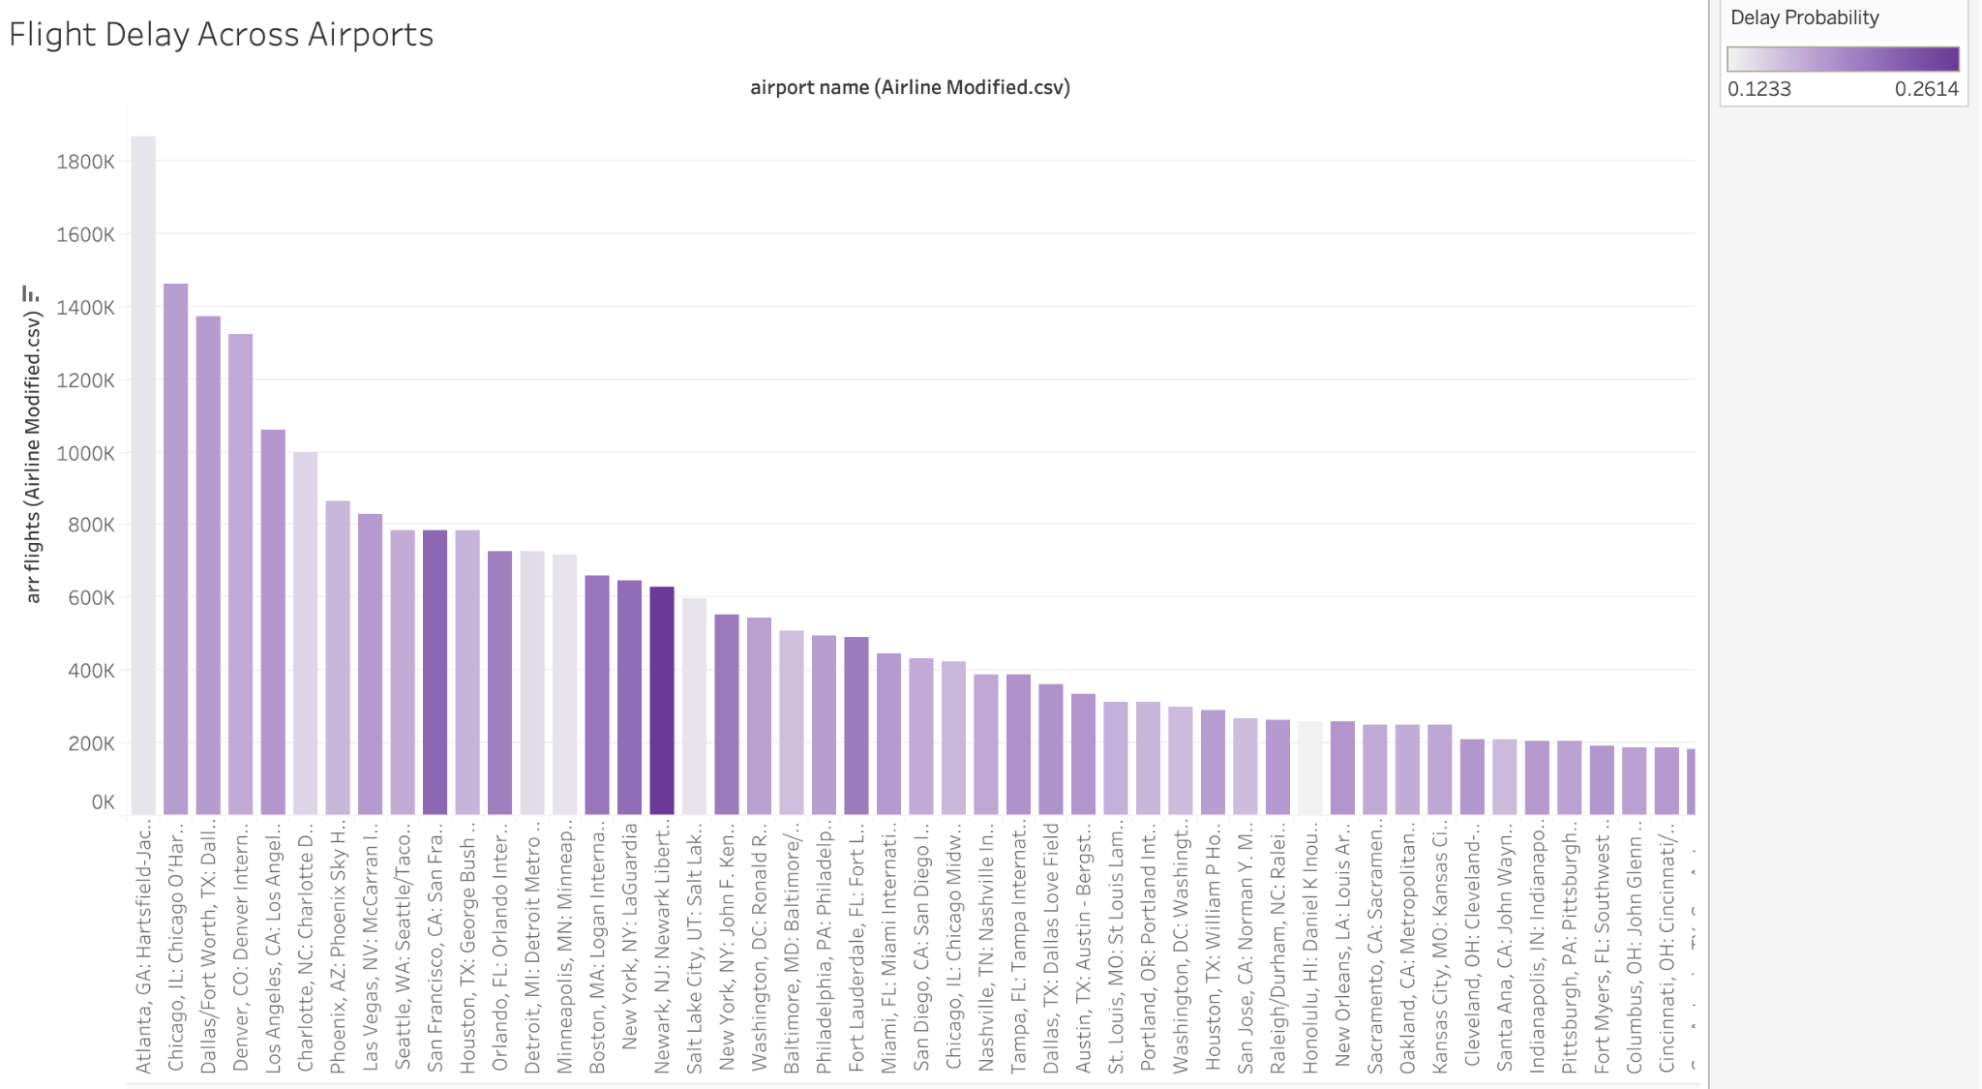
Airport Delay Analysis
Airport to fly from
Worst:
Newark Liberty International Airport
Best:
Hartsfield-Jackson Atlanta International Airport

Slide 21
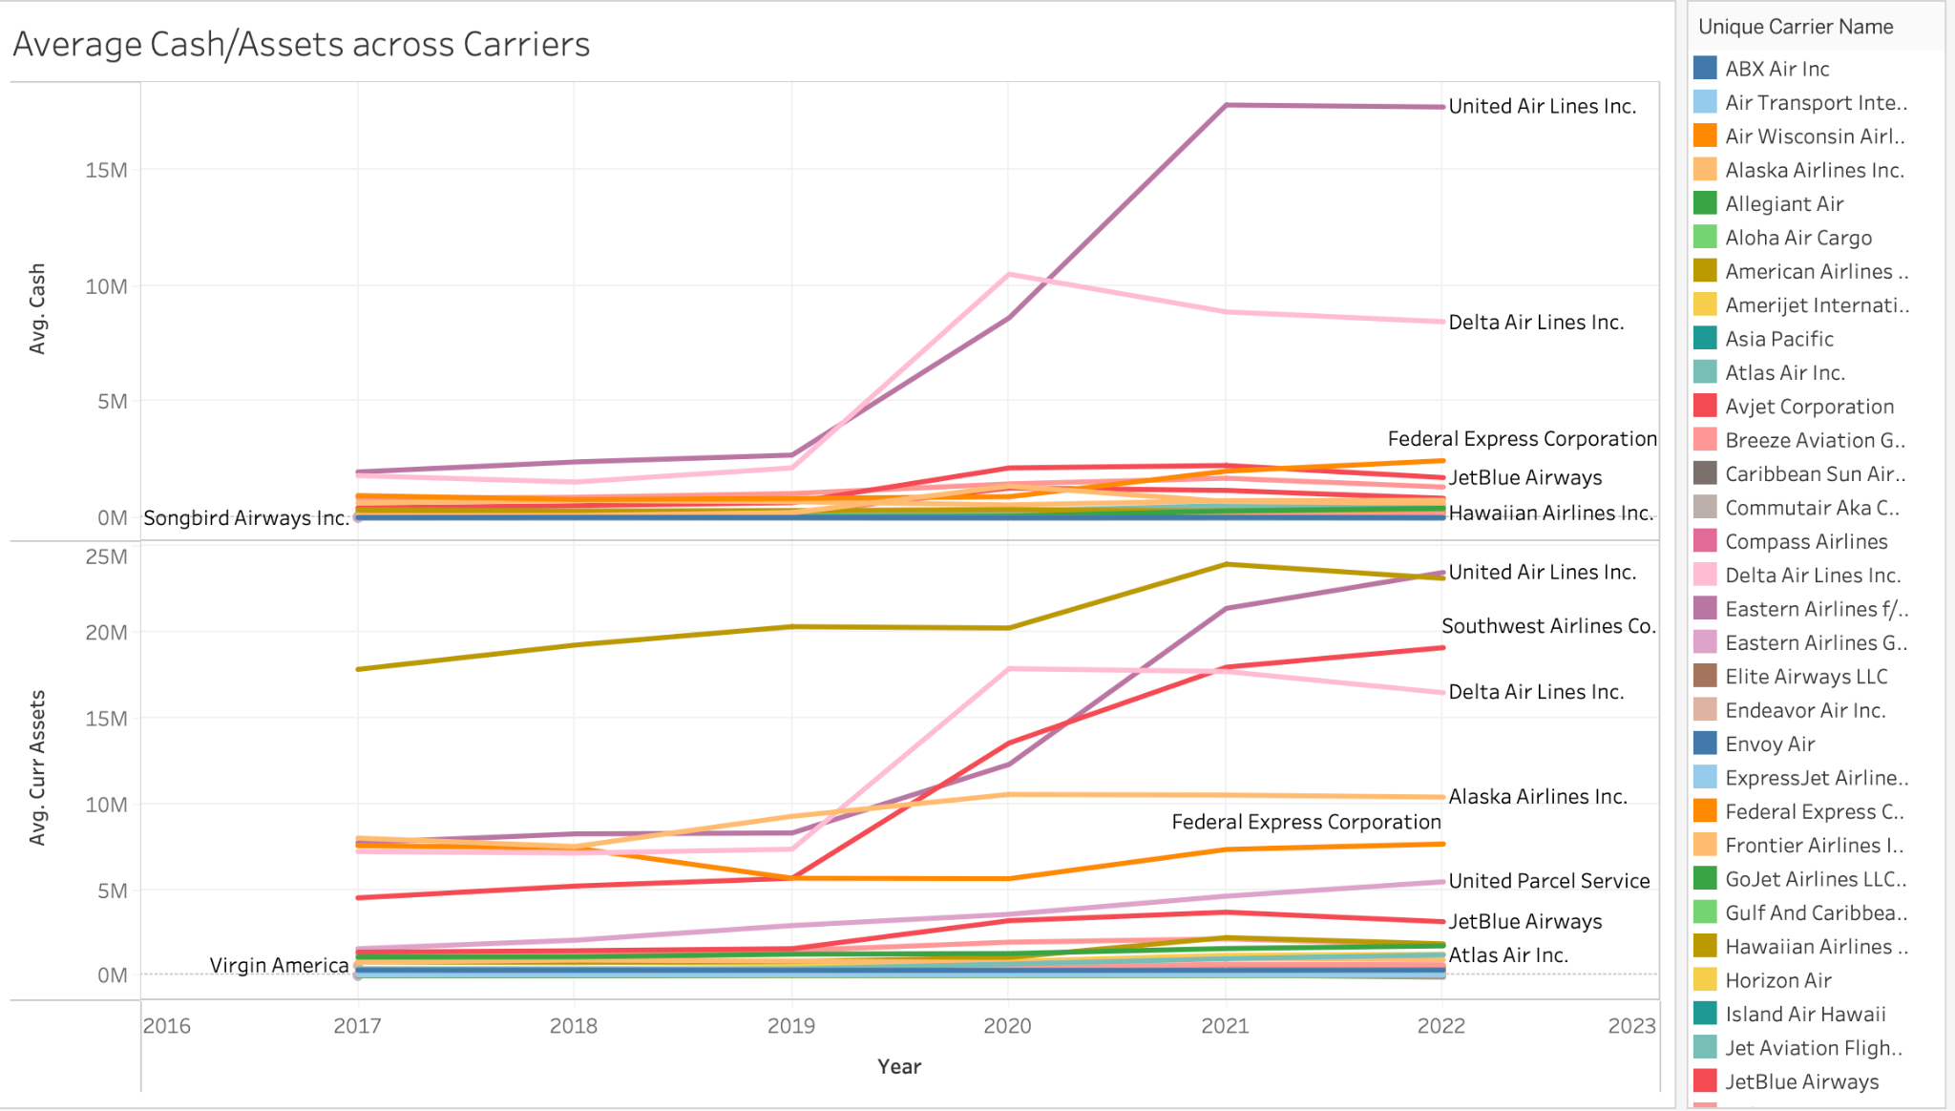
Carrier’s Cash Trend
United Air, Delta Air & Southwest
all have
low delay rate
& high volume

Slide 22
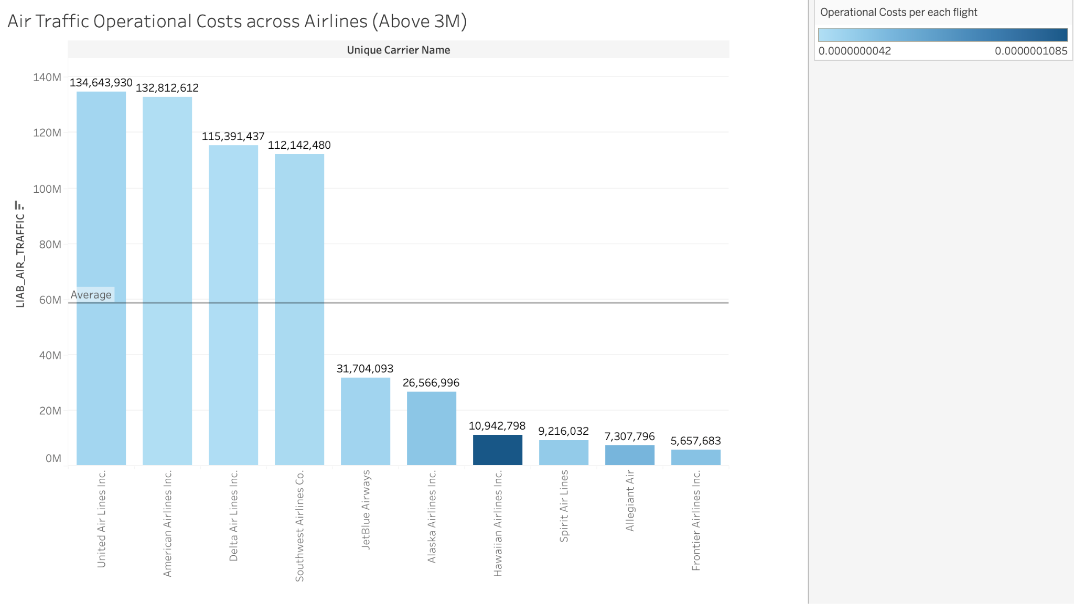
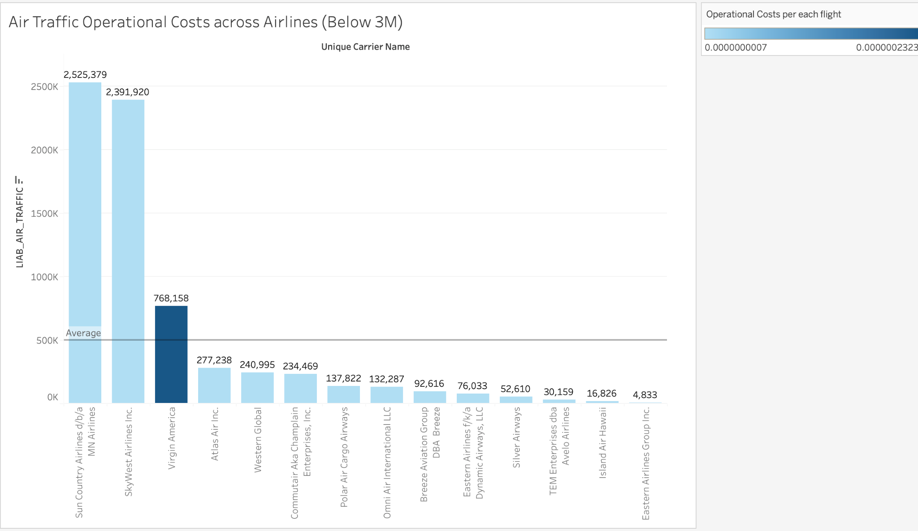
Air Traffic Operational Costs
Despite that Allegiant Air has the highest delay rate, it has similar cost per flight as other major carriers.

Slide 23
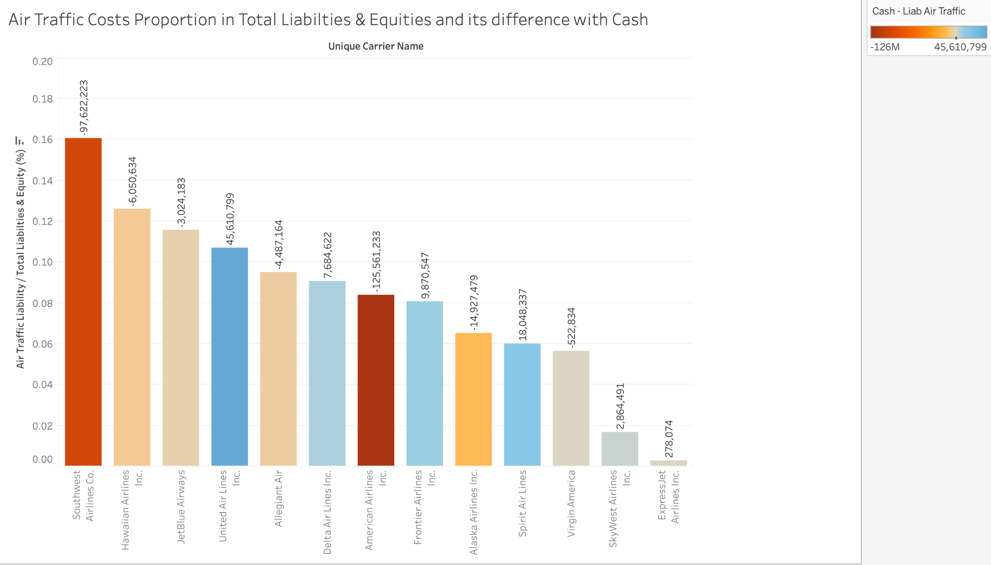
Air Traffic Costs Comparison
Southwest spends the most on air traffic costs and has little cash.
United Airlines spends less on air traffic costs and has much more cash.

Slide 24
Business
Insights & Solution
Airport & Carrier Recommendation Engine for Customers

Slide 25
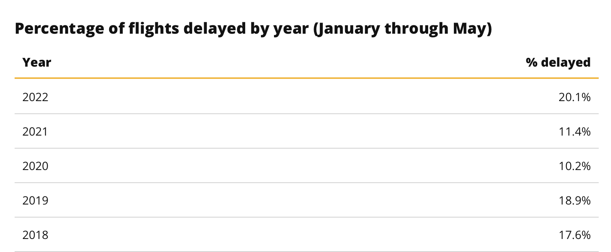
BI & Solution
Insights
Solution
Carrier delay time and delay probability has risen to a new high in 2022.
Carrier with high delay rate may not have high air traffic cost (no compensation for customers)
Southwest is the top carrier.
Carrier Recommendation Engine
Input: Departure Airport, Available Carriers
Export: Best Recommended Carrier with low delay rate & short delay time.
Notes:
Bibliography: https://www.valuepenguin.com/travel/delays-cancellations-bags-study

Slide 26
Thanks for Listening
Questions?

