Slide 1
Neopets® Stuck Pet Finder yes really
Emily Liu
https://github.com/Ellime/NeopetsStuckPetFinder
Last updated: 01/04/2021

Slide 2

Contents
Overview
Technical Outline

Slide 3
Overview

Slide 4


In short
A tool that finds Neopets in the Pound
Neopets still exists

Slide 5
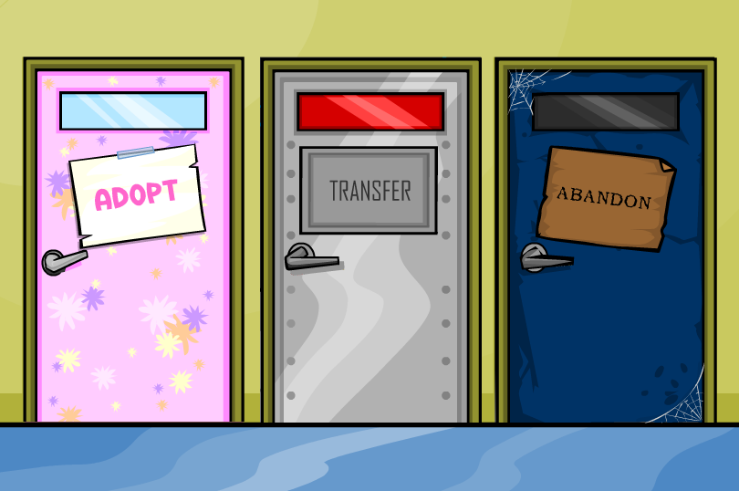
Context
Neopets.com is a game website about owning virtual pets that has a Pound (think animal shelter) with unowned pets.
Players are supposed to refresh the Pound site for pets to adopt.
Some pet names are impossible to find via refreshing – referred to as “stuck” pets. You must directly search them by name.

Slide 6
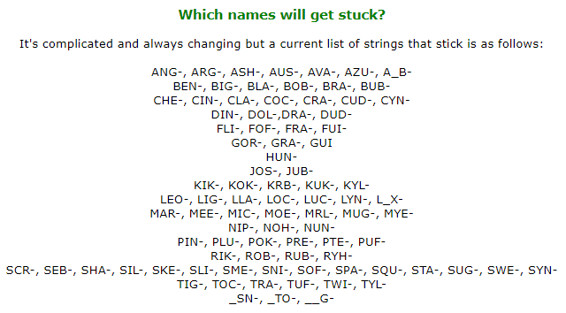
Names that “stick”
More info at:
http://www.neopets.com/~Megablade
http://www.neopets.com//~Lorrenn

Slide 7
How to use
Enter your first account’s username and password as two lines in credentials.txt
Login to a second account on your default browser
Launch the program
Set up the rules you want to use when generating pet names
Hit “0” to run

Slide 8
Breakdown of program
Generate potential pet names
Search each name using the Pound search
Check if the search returned a pet
For names that returned a pet, open that link in the browser and save the name and color/species to a file
NOTE: Searches are throttled – purposefully slowed down – so the website isn’t overwhelmed.
Generate
Search
Check

Slide 9
Methodology (with Neopets lingo)
The Pound search is the only guaranteed way to check if a pet is in the Pound and adoptable
Although default petpages can indicate if a pet is unowned, owned pets may have modified petpages, causing the response body to be unpredictable.
The petlookup indicates if a pet is unowned, but the URL is actually a redirect and some pets are glitched (have a lookup but cannot be adopted).
Limitation: Viewing Pound requires being logged in
Same goes for the above sites.
The account must also be > 4 months-old (or some pets won’t show up).
Alternative: Instead of checking if pet is in Pound, check if pet exists by querying its image file.
But this will return pets that are not in the Pound (are owned/frozen/glitched).

Slide 10

Impacts
Pros
Cons
Can find some lonely pets.
Without limiting the number of requests, can overload the server and create a DoS attack
Can cause a DDoS if multiple people run it together
Can be misused by people selling pets/accounts for real $ which is against the ToU and ruins things for innocent players

Slide 11
Is it allowed? (Probably not)
This program is fan-made and not officially recognized.
Neopets.com ToU is outdated and useless.
Neopets has stated all programs/scripts are disallowed.
http://www.neopets.com/ntimes/index.phtml?section=editorial&week=383
http://www.neopets.com/ntimes/index.phtml?section=editorial&week=797
Small hope: there is an approved manual search method, even though it can potentially send hundreds of requests a second.
http://www.neopets.com/~Megablade

Slide 12
Tips
Having two accounts is best – one is used by the program and the other allows you to see the pets in your browser as it runs. If you just have one account you will have to check out the pets in your own time.
Keep in mind what name formats to expect! The machine-suggested names follow the following format: “dragon_12” or “dragon_12_1”

Slide 13
Final words
The project code is not publicly available. This is a fanmade project that has not been acknowledged by Neopets.com.
I am willing to discuss the project but will not share the code privately nor publish it unless it is officially supported.

Slide 14
Technical Outline

Slide 15
Tech
Language: Java SE 8
Libraries:
jsoup – for parsing HTML in response bodies

Slide 16
Program steps
GET
To login page
POST
To login page
Parameters: USERNAME and PASSWORD
GET
To Pound site
Parameters: PETNAME
Send GET to login URL
Send POST to login URL and store the returned session ID
Generate strings
Send GETs to Pound URL while passing one string at a time

Slide 17
Package/class hierarchy
Settings
stringgenerator
Generator
NeopetsStuckPetFinder
httprequester
Requester

Slide 18
String generation
String generation is modified from https://github.com/Ellime/StringGenerator
Settings: Saving/setting string generation setup
Generator: Generates strings
NeopetsStuckPetFinder: main() and console output
Modifications:
Can include ‘_’ in the range of available chars
Option 0 includes generating strings and calling functions from Requester

Slide 19
HTTP request handling
Requester: Handles HTTP requests/responses, plus what to do with found pets

Slide 20
Login
Credentials stored in credentials.txt
Send GET to http://www.neopets.com/login/
Prepare username and password as parameters to send in POST
Send POST to http://www.neopets.com/login.phtml
Save the cookies for future requests

Slide 21
Search
Send GET to http://www.neopets.com/pound/adopt.phtml?search=PETNAME
Use jsoup to check if PETNAME is a pet in the Pound
If valid, open the link in the browser and save the name

Slide 22
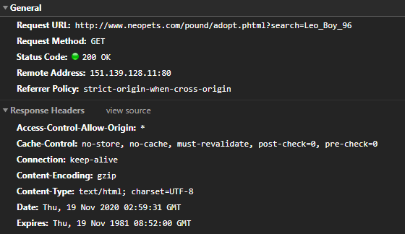
How the search works

Slide 23
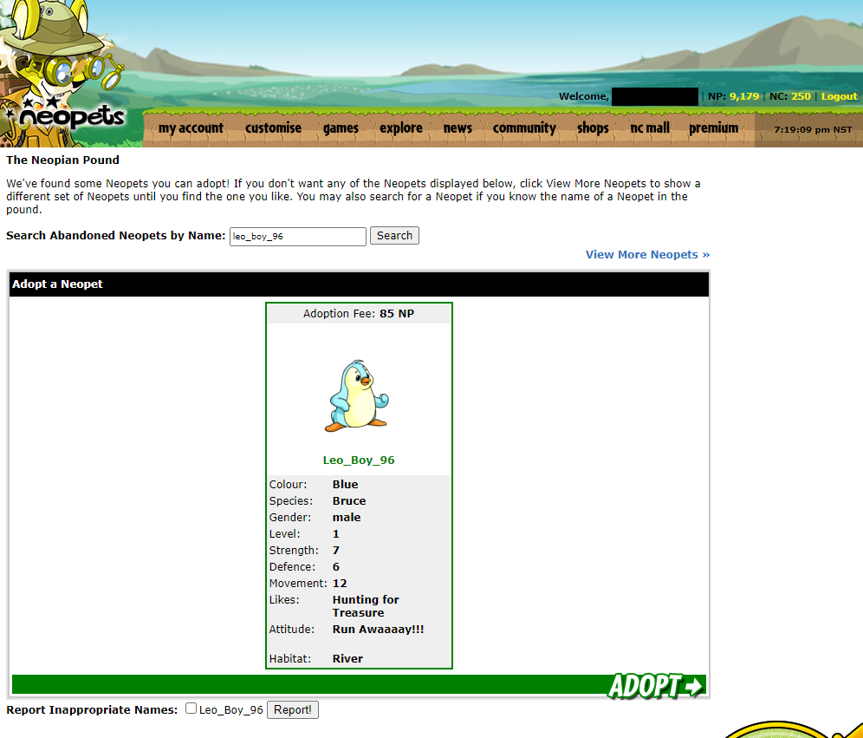
Pet found in the Pound
Pet names are unique and caps-insensitive so a query returns at most one pet.
(The site is designed so up to three pets can be displayed, which we will see in the HTTP response body.)

Slide 24
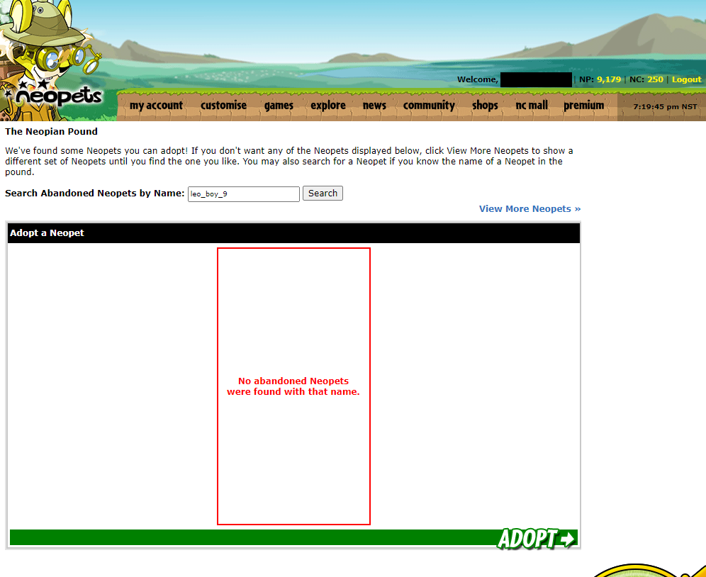
Pet not in Pound
The difference is reflected in the HTTP response body.

Slide 25
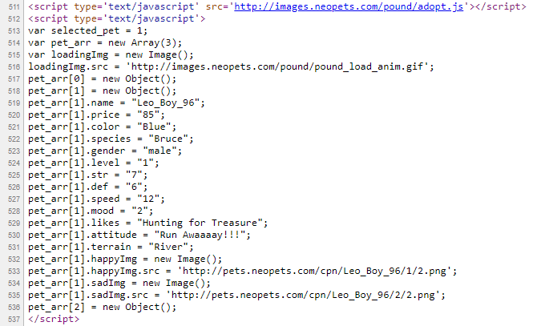
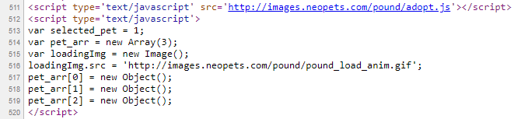
HTTP response body (JS)
Pet found: Its features are initialized as the second (middle) Object.
Pet not found: Objects remain undefined.

Slide 26
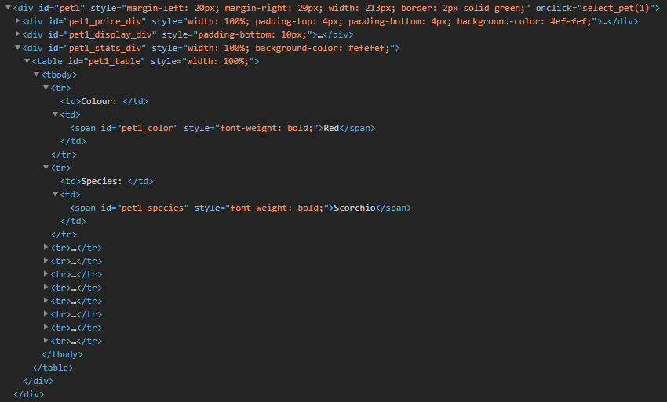
HTTP response body (HTML)
jsoup will read pet1_color and pet1_species.
The absence of pet1_table tells jsoup we didn’t find a pet.

Slide 27
Server behavior
Login POST request returns a 403 – which is fine since all that’s needed are the authentication cookies
The reason for the 403 is because the URL we send the POST to is not a URL we can actually “visit”.
A 503 is returned if too many requests have been sent recently
Throttling is required to avoid this.

Slide 28
Request throttling
Pauses are implemented between searches to prevent flooding the server with requests.
For example:
Every 2 searches: Wait .5 sec
Every 20 searches: Wait 20 sec
Every 100 searches: Wait 1 min
If a 503 is encountered, the program will wait 1 min before retrying the name it failed to search.

