Slide 1
C++ Programming 2020/05.27
주차 : 11
학번 : 20195124
이름 : 김민석
학과 : 소프트웨어융합 대학
분반 : 01

Slide 2
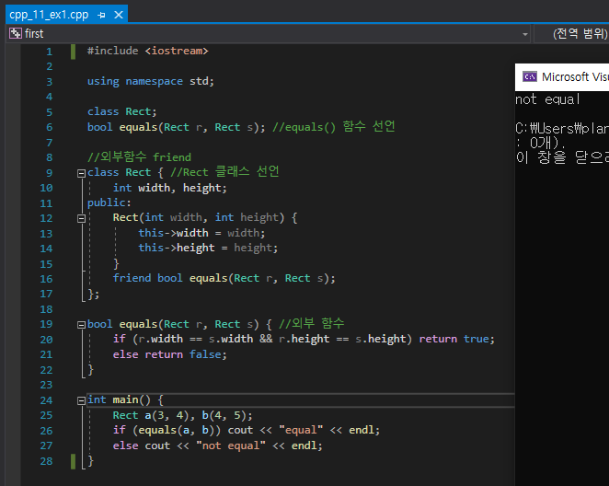
C++ 11 ex_1 code & output

Slide 3
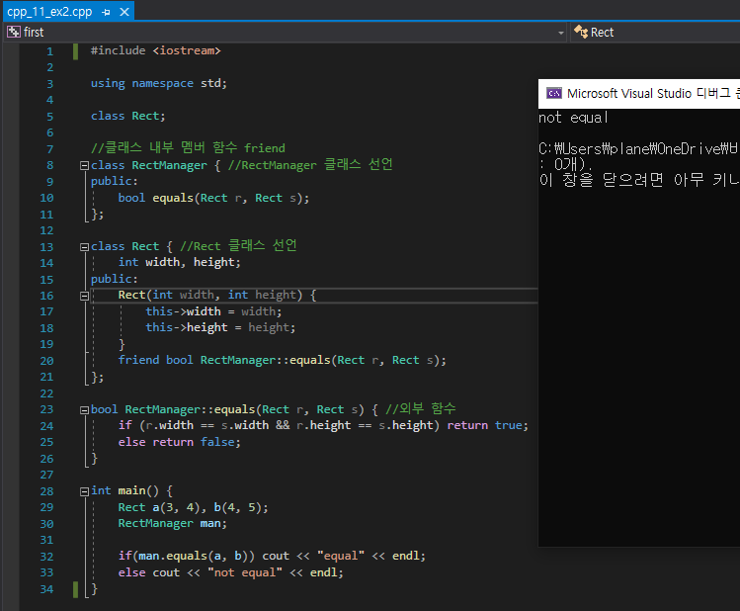
C++ 11 ex_2 code & output

Slide 4
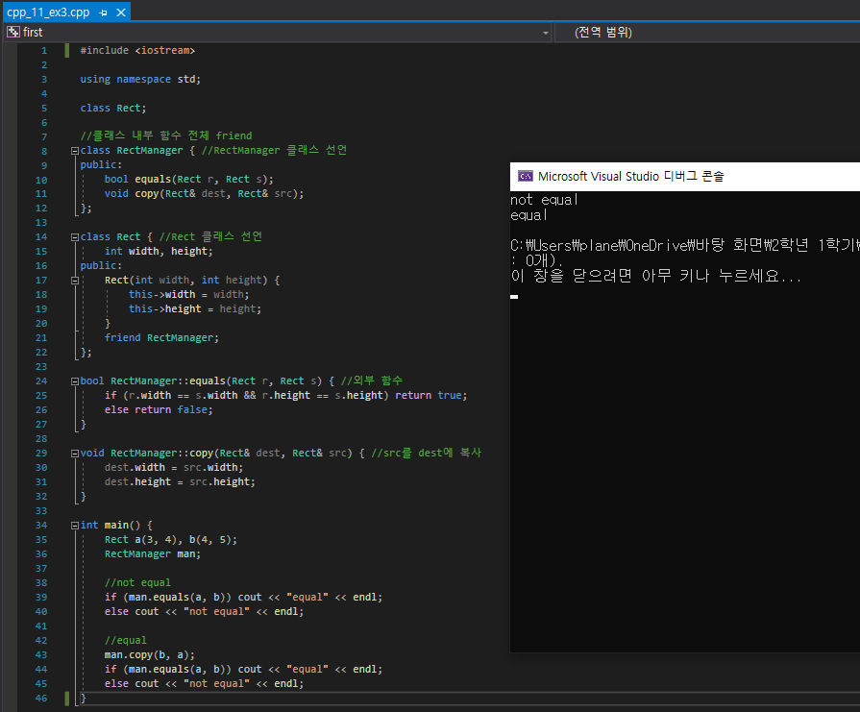
C++ 11 ex_3 code & output

Slide 5
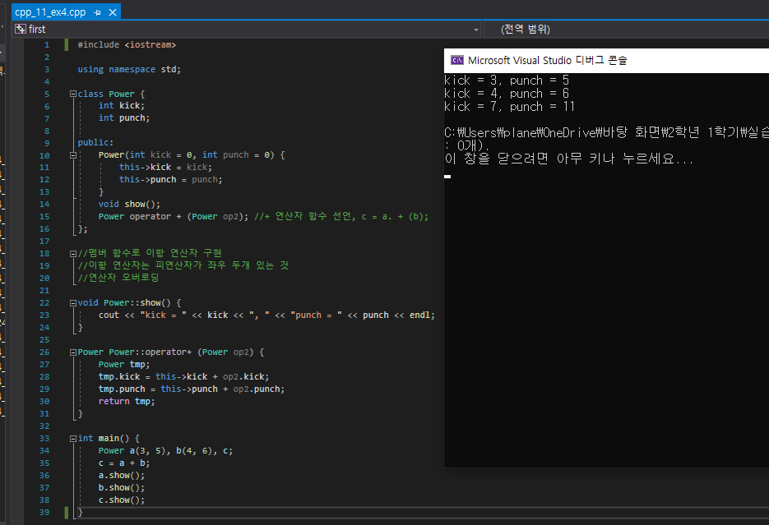
C++ 11 ex_4 code & output

Slide 6
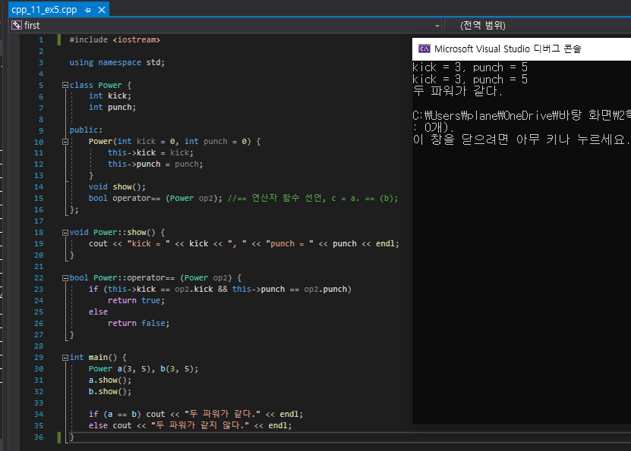
C++ 11 ex_5 code & output

Slide 7
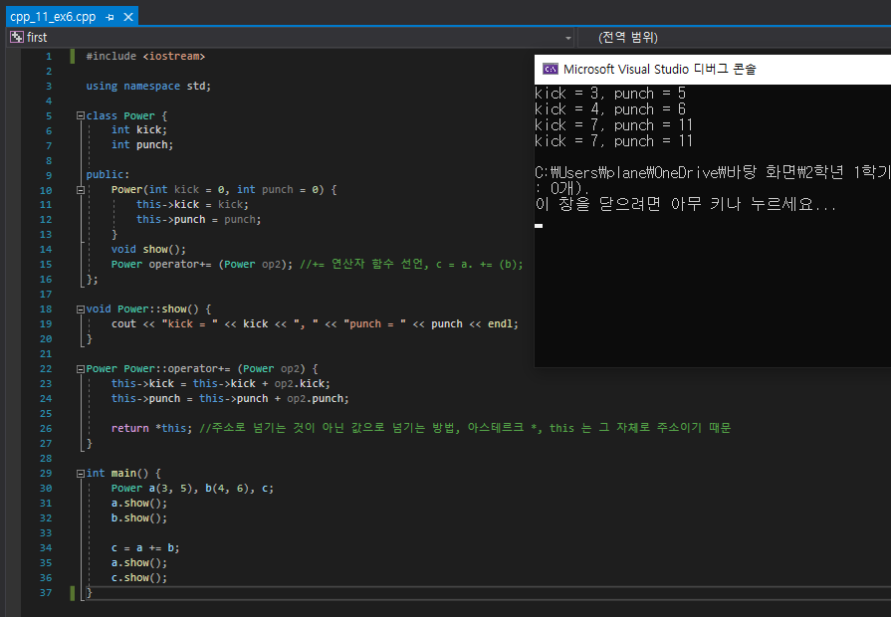
C++ 11 ex_6 code & output

Slide 8
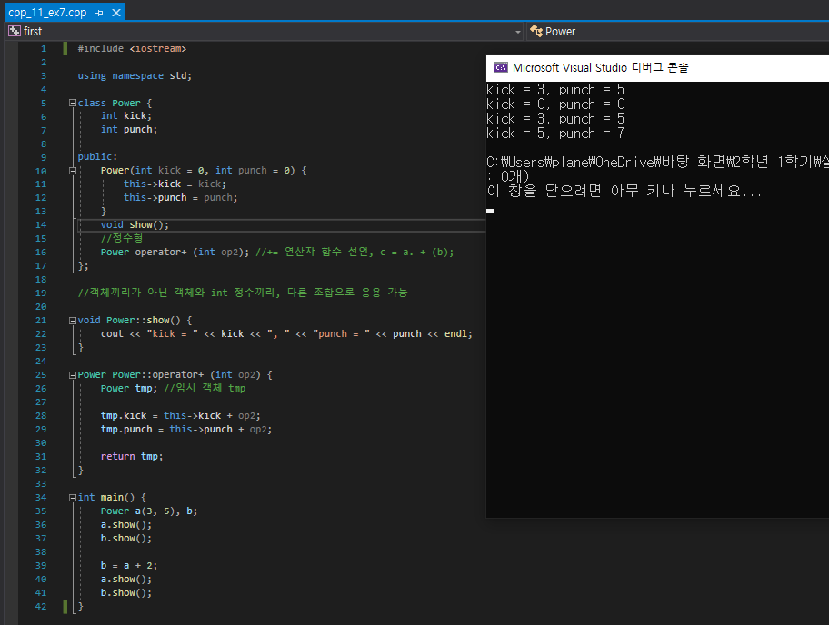
C++ 11 ex_7 code & output

Slide 9
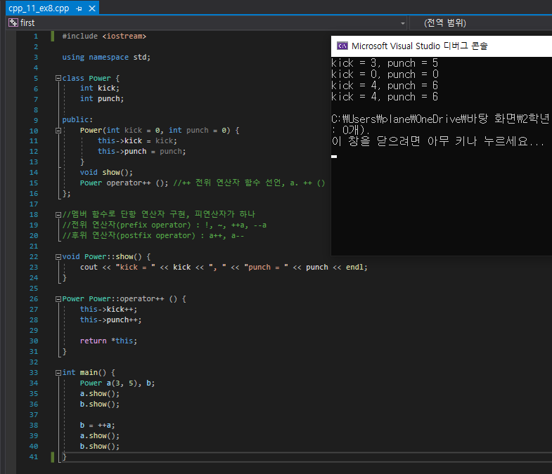
C++ 11 ex_8 code & output

Slide 10
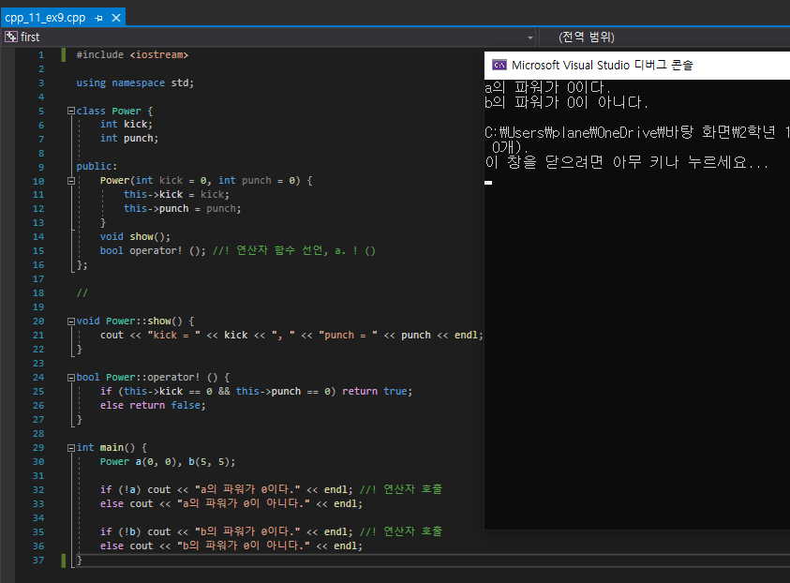
C++ 11 ex_9 code & output

Slide 11
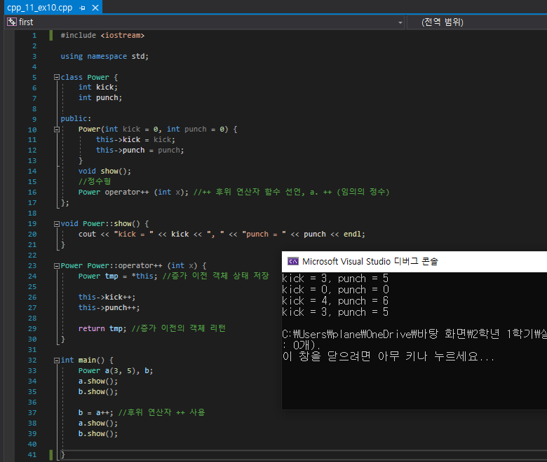
C++ 11 ex_10 code & output

Slide 12
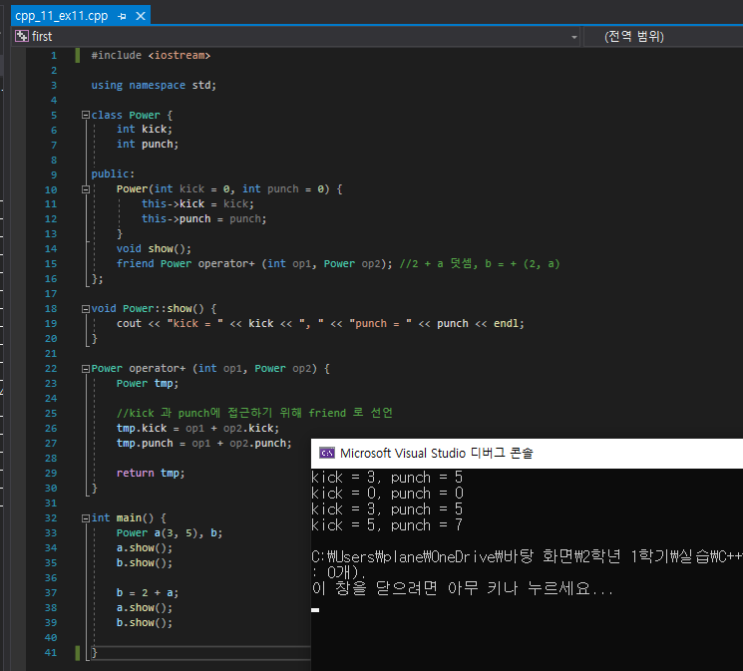
C++ 11 ex_11 code & output

Slide 13
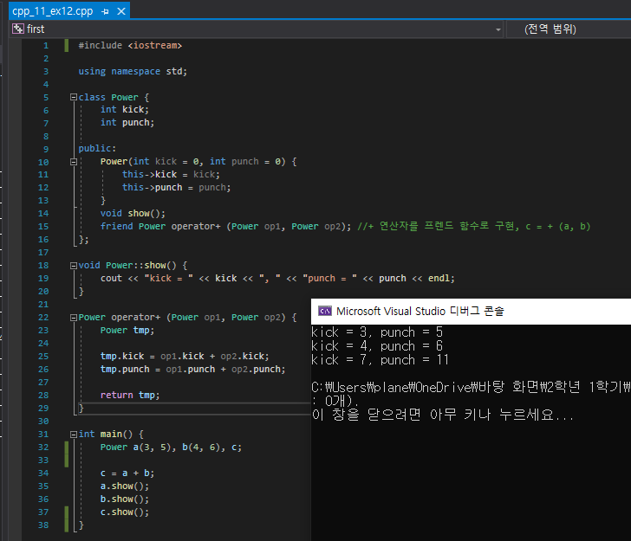
C++ 11 ex_12 code & output

Slide 14
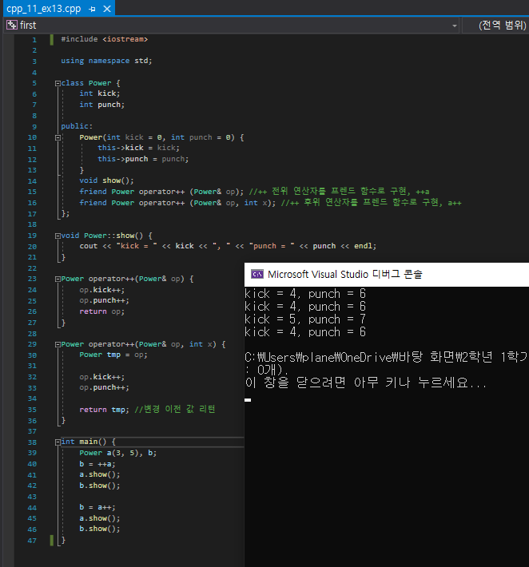
C++ 11 ex_13 code & output

