Slide 1
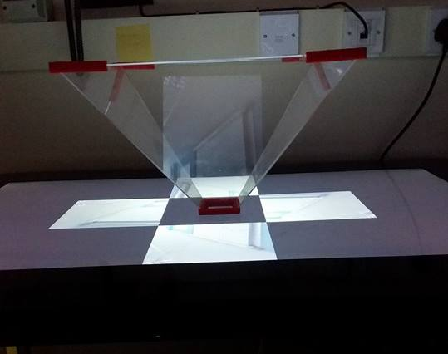
Creating real-time holograms using the Pepper’s Ghost technique
Elliot Oram - elo9@aber.ac.uk
Background and Introduction
This project is to produce real-time holograms using the Pepper’s Ghost technique originally created for use in theatre productions. The product will be used at Aberystwyth science week, enabling the audience to create real-time holograms that can be viewed using the Pepper’s Ghost pyramid. The pyramid is an open square based pyramid normally made from Perspex or clear acrylic, with sides angled 45 degrees from the normal [1]. A video (or collection of images) is positioned under each side of the pyramid and is reflected into the centre of the pyramid creating a holographic illusion.
At present, a system has been created to capture a video feed from a camera attached to a computer. This video feed is then processed, which duplicates the video feed into four copies, and positions them at each side of the pyramid. Lastly, each copy is rotated to face in towards the centre of the pyramid creating a hologram-like illusion in the centre of the pyramid.
Hologram
Image
Technical Information
The application for video processing is written in python 2.7 using the precompiled binaries for OpenCV 2.4. It consists of one package containing the VideoProcessor class that deals with the main workflow of the product, as well as two other modules; helper functions and parsers for input variables.
The application currently relies on a black background to get the desired impact for the hologram. The black background is obtained by filming the actor in front of a black screen. To improve the product, an initial background subtraction technique is being implemented to allow a green screen to be used as the background. Using a green screen would allow for a Chroma key algorithm to remove the background programmatically from the video frame. This will lead to a more consistent black background being produced.
The application is tested using the continuous integration tool, Jenkins, which at present runs unit tests (using the nosetest framework), pylint tests to check that the code is compliant with the PEP8 programming standard, and a coverage test to ensure that unit tests cover as much of the code base as possible. These tests are run every time a new feature is developed, and all tests must pass before the code is merged with the functional system.
Future Work
A charades game to accompany the hologram will be developed. This will allow the actor in the staging area to choose a phrase and act it out in front of the camera. The data on the topic will then be passed to devices in the viewing area and the hologram of the actor will be displayed to the viewers. The viewers will then attempt to guess the phrase being acted and swap places with the actor if they guess correctly.
There are two key points for future development. These are, improving the background subtraction, and hosting the video feed online to allow it to be viewed on various devices at the same time.
As mentioned above, the background subtraction is currently reliant upon a black background and, by the conclusion of this project, will also be compatible with a green screen. However, using a combination of background subtraction techniques, it should be possible to take a picture of a static background and then remove it from each frame, leaving only the foreground (actor).
Currently the application is capable of outputting the processed video feed in various sizes and resolutions. If the content was hosted online, this could mean that the hologram could be viewed on multiple device in different locations simultaneously.
Topic: Film and Book
Words in phrase: 7
Current word: 4
Time until round ends: 0:15
Next letter revealed in: 0:05
W
i
Submit guess
Keyboard
Mock Design for Charades game android application
[1] B. Costa, “Explaining the Pepper’s Ghost illusion with Ray optics”, Comsol, 11 January 2016. Available: https://www.comsol.nl/blogs/explaining-the-peppers-ghost-illusion-with-ray-optics/. [Accessed 05 03 2017].

