Slide 1
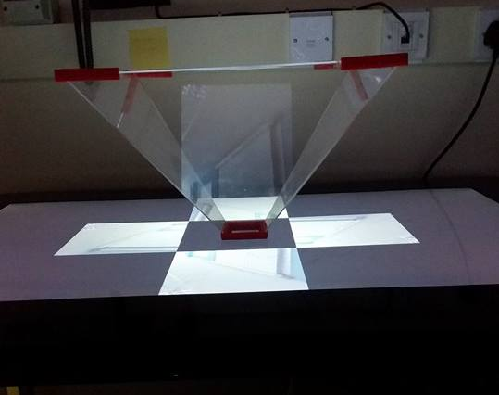
Creating real-time holograms using the Pepper’s Ghost technique
Elliot Oram - elo9@aber.ac.uk
Background and Introduction
This project is to produce real-time holograms with the Pepper’s Ghost technique originally used for theatre. The product will be used at Aberystwyth science week allowing the audience to create real-time holograms that can be viewed in a separate area of the room. The Pepper’s Ghost pyramid is an open square based pyramid normally made from Perspex or clear acrylic with sides angled 45 degrees from the normal [1]. The video is positioned under each side of the pyramid and it is then reflected into the centre of the pyramid making a holographic illusion.
At present, a system has been created to capture a video feed from a camera attached to a computer. This video feed is then processed which duplicates the video feed into four copies, and each copy is rotated to face in towards the centre of the pyramid. Finally, a video feed is positioned on each side of the pyramid.
The system has a fully documented design and an accompanying test suite to ensure that the functionality is correct.
Hologram
Image
Technical Information
The application for video processing is written in python 2.7 using the precompiled binaries for OpenCV 2.4. It consists of one package containing the VideoProcessor class that deals with the main workflow of the product. The other two modules, contain helper functions and parsers for variables.
The application is currently being developed to use a background subtraction technique to ensure only the foreground object is displayed from the video feed. The technique being used for this is a green screen as the background which is then removed programmatically from the video frame. This, when complete will use the Chroma Key technique to change the background to black.
The application is tested using the continuous integration tool Jenkins which at present runs tests unit tests (using the nosetest framework), pylint tests to check that my code is compliant with the PEP8 programming standard, and a coverage test to ensure that unit tests cover as much of the code base as possible.
Future Work
A charades game to accompany the hologram will be developed. This will allow the actor in the staging area to choose a phrase and act it out in front of the camera. The data on the topic will then be passed to device in the viewing area and the hologram of the actor will be displayed to viewers. The viewers will then attempt to guess the phrase being acted and swap places with the actor if they guess correctly.
There are two key points for future development which are, improving the background subtraction and hosting the video feed online to allow it to be viewed on various devices at the same time.
The background subtraction is currently reliant on the green screen in order to work. However, using a combination of background subtraction techniques, it should be possible to take a picture of a static background and then remove it from each frame.
Currently the application is capable of outputting the processed video feed in various sizes and resolution. If the content was hosted online, this could mean that the hologram could be viewed on multiple device in different locations.
Topic: Film and Book
Words: 7
Current word: 4
Time until round ends: 1:00
Next letter revealed in: 0:05
W
i
Submit guess
Keyboard
Mock Design for Charades game android application
[1] B. Costa, “Explaining the Pepper’s Ghost illusion with Ray optics”, Comsol, 11 January 2016. Available: https://www.comsol.nl/blogs/explaining-the-peppers-ghost-illusion-with-ray-optics/. [Accessed 05 03 2017].

