Slide 1
Predicting calorie expenditure
Elliot Blackstone

Slide 2

Agenda
Topic one
Topic two
Topic three
Topic four

Slide 3

The power of communication

Slide 4

Overcoming nervousness
Confidence-building strategies

Slide 5

Engaging the audience
Make eye contact with your audience to create a sense of intimacy and involvement
Weave relatable stories into your presentation using narratives that make your message memorable and impactful
Encourage questions and provide thoughtful responses to enhance audience participation
Use live polls or surveys to gather audience opinions, promoting engagement and making sure the audience feel involved

Slide 6
Selecting visual aids
Enhancing your presentation

Slide 7
Effective delivery techniques
This is a powerful tool in public speaking. It involves varying pitch, tone, and volume to convey emotion, emphasize points, and maintain interest.
Pitch variation
Tone inflection
Volume control
Effective body language enhances your message, making it more impactful and memorable.
Meaningful eye contact
Purposeful gestures
Maintain good posture
Control your expressions

Slide 8
Navigating Q&A sessions
Know your material in advance
Anticipate common questions
Rehearse your responses
Maintaining composure during the Q&A session is essential for projecting confidence and authority. Consider the following tips for staying composed:
Stay calm
Actively listen
Pause and reflect
Maintain eye contact

Slide 9
Speaking impact
Your ability to communicate effectively will leave a lasting impact on your audience
Effectively communicating involves not only delivering a message but also resonating with the experiences, values, and emotions of those listening

Slide 10
Model performance
Feature selection and hyperparameter tuning is performed via Optuna.
Model | Feature Engineering | RMSLE | LB (out of 4318)
Linear Regression | No | 0.45056 | 4103
LR w/ feat. selection | No | 0.34825 | 4083
LR w/ feat. selection | Yes | 0.08976 | 3812
GAM | No | 0.08945 | 3811
GAM | Yes | 0.06949 | 3605
XGBoost | Yes | 0.05922 | 1324
LightGBM | Yes | 0.05921 | 1314
CatBoost | Yes | 0.05906 | 1090
Ensemble | N/A | 0.05879 | 678
AutoGluon | No | 0.05846 | 4

Slide 11
Model performance
Model
Feature Engineering
RMSLE
LB (out of 4318)
Linear Regression
No
0.45056
4103
LR w/ feat. selection
No
0.34825
4083
LR w/ feat. selection
Yes
0.08976
3812
GAM
No
0.08945
3811
GAM
Yes
0.06949
3605
XGBoost
Yes
0.05922
1324
LightGBM
Yes
0.05921
1314
CatBoost
Yes
0.05906
1090
Ensemble
N/A
0.05879
678
AutoGluon
No
0.05846
4

Slide 13
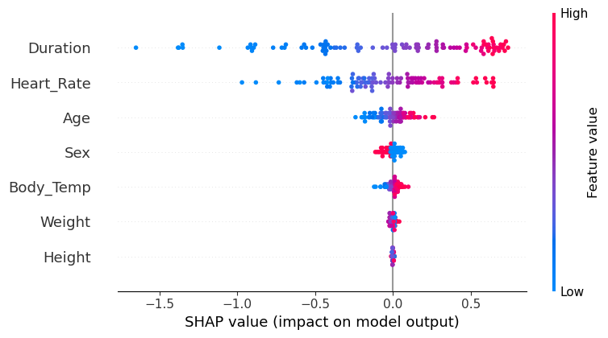
Explainability
How to understand the contributions of each feature towards a prediction made by a machine learning model? We can use SHAP values!

Slide 14
Final tips & takeaways
Seek feedback
Reflect on performance
Explore new techniques
Set personal goals
Iterate and adapt

Slide 15
Speaking engagement metrics
Impact factor | Measurement | Target | Achieved
Audience interaction | Percentage (%) | 85 | 88
Knowledge retention | Percentage (%) | 75 | 80
Post-presentation surveys | Average rating | 4.2 | 4.5
Referral rate | Percentage (%) | 10 | 12
Collaboration opportunities | # of opportunities | 8 | 10

Slide 16

Thank you
Brita Tamm
502-555-0152
brita@firstupconsultants.com
www.firstupconsultants.com

