Slide 1
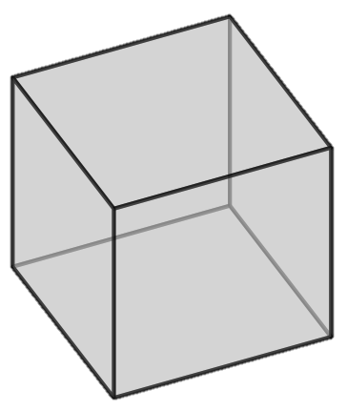
Crystal orientation
Define as a rotation from a known reference coordinate system (sample coordinates) to the crystal coordinates
Passive convention – changing coordinates systems to describe fixed objects
Active convention – rotating an object in a fixed coordinate system

Slide 2
Representing rotations
Euler angles – 3 rotations around the coordinate directions
Lots of conventions (usually Bunge convention in materials (ZXZ))
Can’t apply calculations
Axis-angle – single rotation around an axis
Rotation matrix
Can represent more than a rotation so generally need more operations to perform an equivalent calculation than with a quaternions
Quaternions
Have nice properties for calculating changes in orientation, averaging and interpolating
Others – Rodrigues-Frank vectors, ﻿homochoric vectors

Slide 3
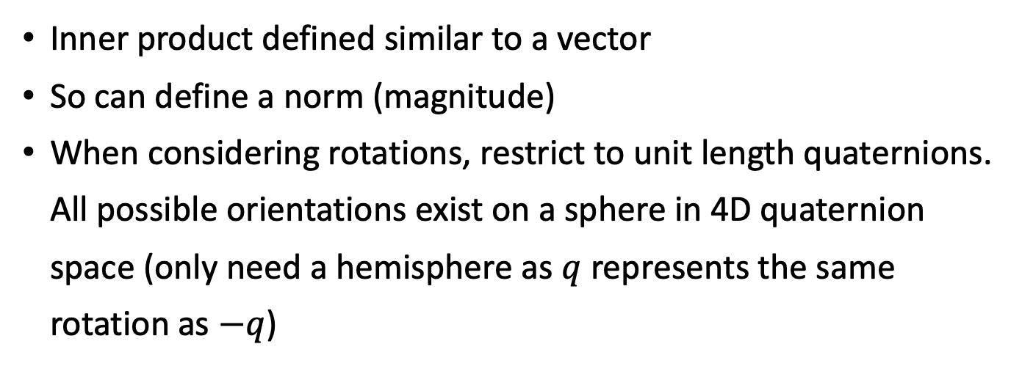
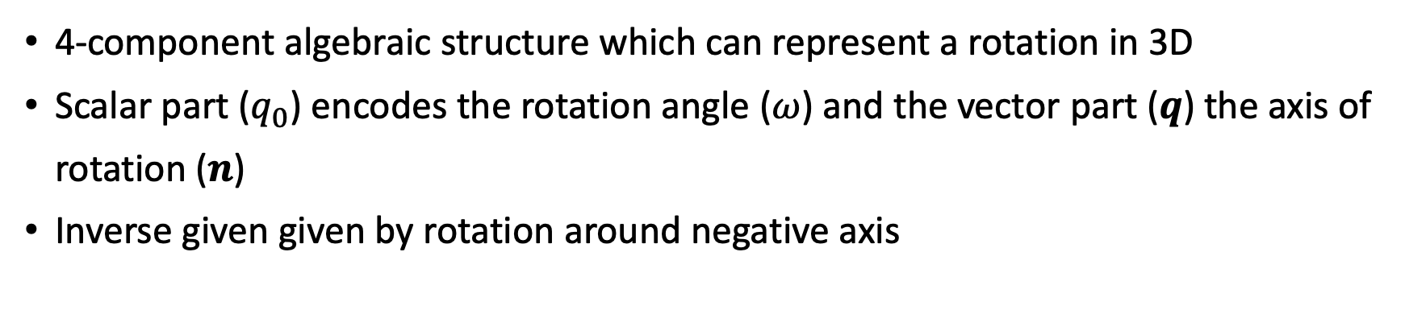
Unit quaternions
4-component algebraic structure which can represent a rotation in 3D
Scalar part ($q_{0}$) encodes the rotation angle ($ω$) and the vector part ($q$) the axis of rotation ($n$)
Inverse given given by rotation around negative axis
Inner product defined similar to a vector
So can define a norm (magnitude)
When considering rotations, restrict to unit length quaternions. All possible orientations exist on a sphere in 4D quaternion space (only need a hemisphere as $q$ represents the same rotation as $−q$)

Slide 5
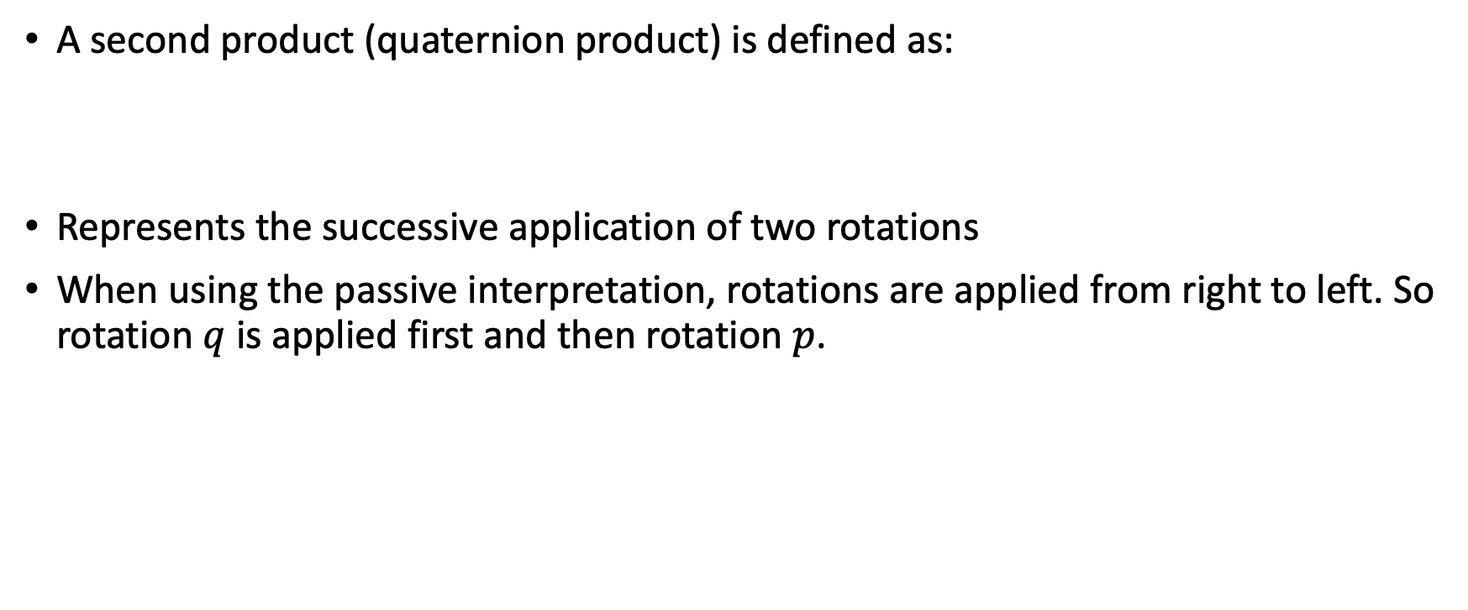
Quaternion product and combining rotations
A second product (quaternion product) is defined as:
Represents the successive application of two rotations
When using the passive interpretation, rotations are applied from right to left. So rotation $q$ is applied first and then rotation $p$.

Slide 6
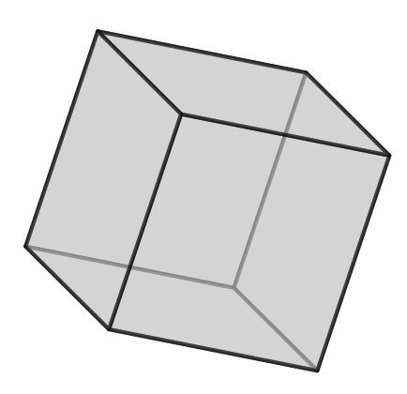
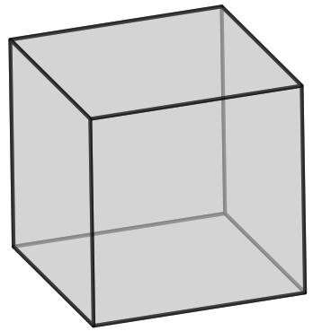




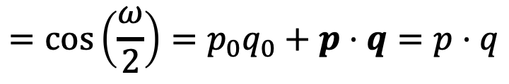



Calculating misorientation
Misorientation is the difference between two orientations. Expressed either as an angle or a rotation between two orientations.
$$p$$
$$q$$
Misorientation angle can be calculated noting the definition of the scalar part of a quaternion
So misorientation angle is
$$Δ(p,q)$$
scalar part
$$=cos\left(\frac{ω}{2}\right)=p_{0}q_{0}+p⋅q=p⋅q$$
$$p^{−1}$$
$$q$$
$$ω=2arccos\left(p⋅q\right)$$

Slide 7
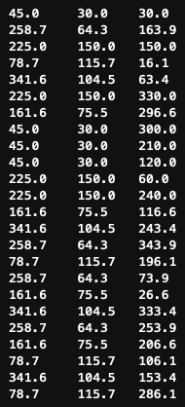

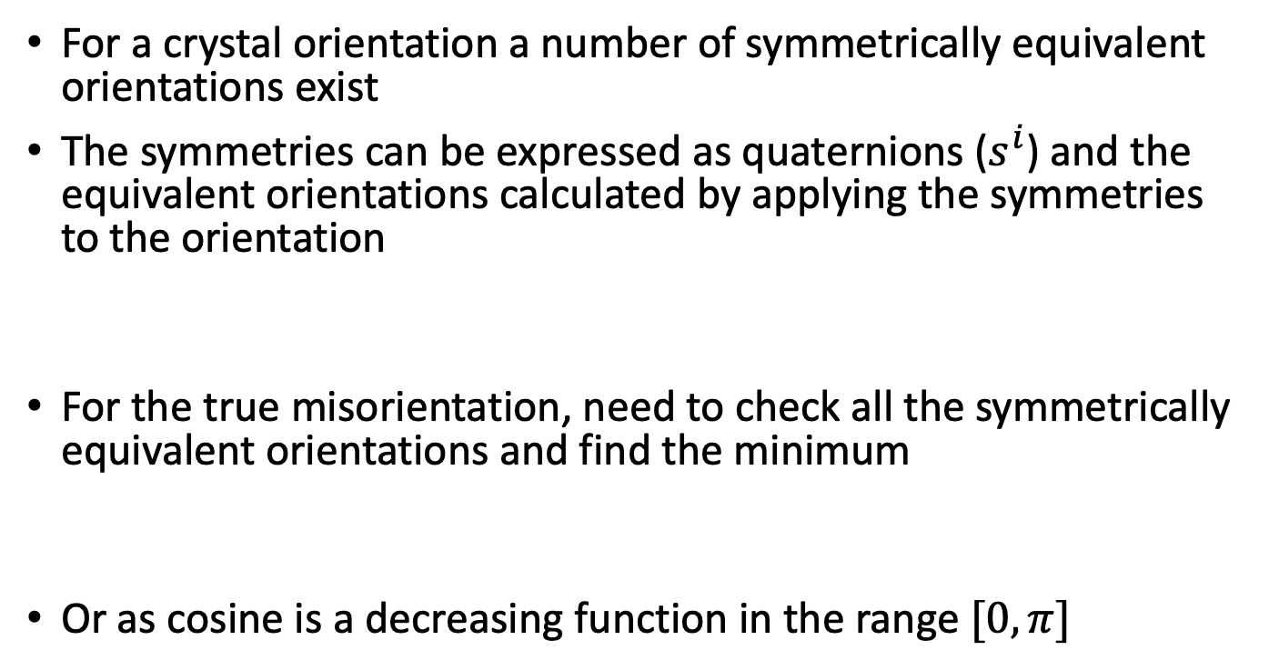



Minimum misorientation and symmetry
For a crystal orientation a number of symmetrically equivalent orientations exist
The symmetries can be expressed as quaternions ($s^{i}$) and the equivalent orientations calculated by applying the symmetries to the orientation
For the true misorientation, need to check all the symmetrically equivalent orientations and find the minimum
Or as cosine is a decreasing function in the range $[0, π]$
$$φ_{1}$$
$$Φ$$
$$φ_{2}$$
$${p(sym)=s}^{i}p$$

Slide 8
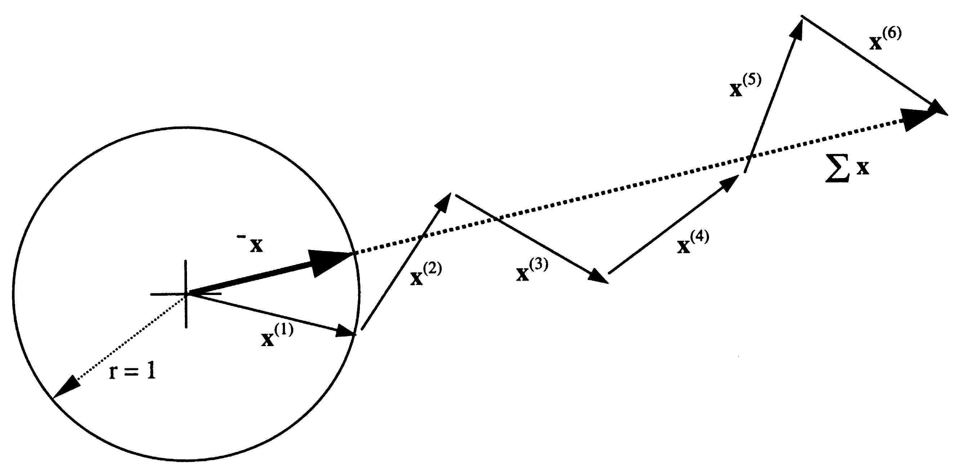
Averaging rotations/orientations
The average of a set of orientation is the component-wise sum of the quaternions normalised to unit length (see [3] for derivation)
Need to consider the crystal symmetries to ensure the correct orientation is included in the average
Use an cumulative averaging approach and find the symmetric equivalent with minimum misorientation to the current mean to include in the average
From [2]
Notes:
From [2]

Slide 9

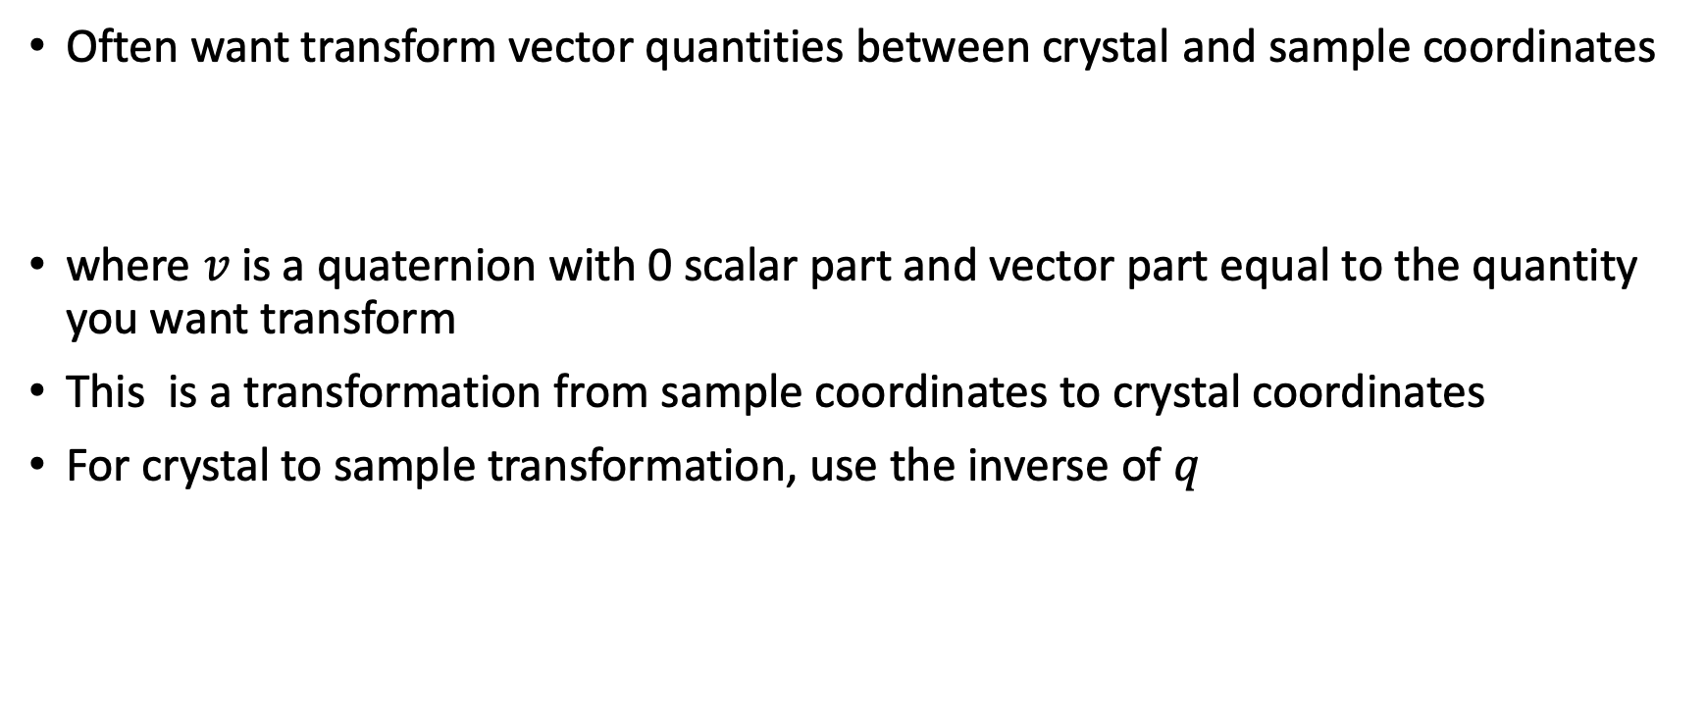

Transforming vectors between coordinates
Often want transform vector quantities between crystal and sample coordinates
where $v$ is a quaternion with 0 scalar part and vector part equal to the quantity you want transform
This is a transformation from sample coordinates to crystal coordinates
For crystal to sample transformation, use the inverse of $q$
$$v^{′}=qvq^{−1}$$
$$v=(0, v)$$

Slide 10
Some useful references
[1] D. Rowenhorst et al., “Consistent representations of and conversions between 3D rotations,” Model. Simul. Mater. Sci. Eng., vol. 23, no. 8, p. 83501, 2015.
[2] F. J. Humphreys, P. S. Bate, and P. J. Hurley, “Orientation averaging of electron backscattered diffraction data,” J. Microsc., vol. 201, no. 1, pp. 50–58, 2001.
[3] M. Humbert, N. Gey, J. Muller, and C. Esling, “Determination of a Mean Orientation from a Cloud of Orientations. Application to Electron Back-Scattering Pattern Measurements,” J. Appl. Crystallogr., vol. 29, pp. 662–666, 1996.
[4] J.-H. Cho, a. D. Rollett, and K. H. Oh, “Determination of a mean orientation in electron backscatter diffraction measurements,” Metall. Mater. Trans. A, vol. 36, no. 12, pp. 3427–3438, 2005.
[5] A. Melcher, A. Unser, M. Reichhardt, and B. Nestler, “Conversion of EBSD data by a quaternion based algorithm to be used for grain structure simulations,” Tech. Mech., vol. 30, no. 4, pp. 401–413, 2009.
[6] Randle and Engle - Introduction to texture analysis
[7] U. F. Kocks, C. N. Tomé, H. R. Wenk, A. J. Beaudoin, and H. Mecking, “Texture and Anisotropy: Preferred Orientations in Polycrystals and Their Effect on Materials Properties,” Cambridge University Press, 1998.

