Slide 1


FILM PRODUCTION VENTURE
WOODGROVE BANK
Exploring what makes profitable films

Slide 2
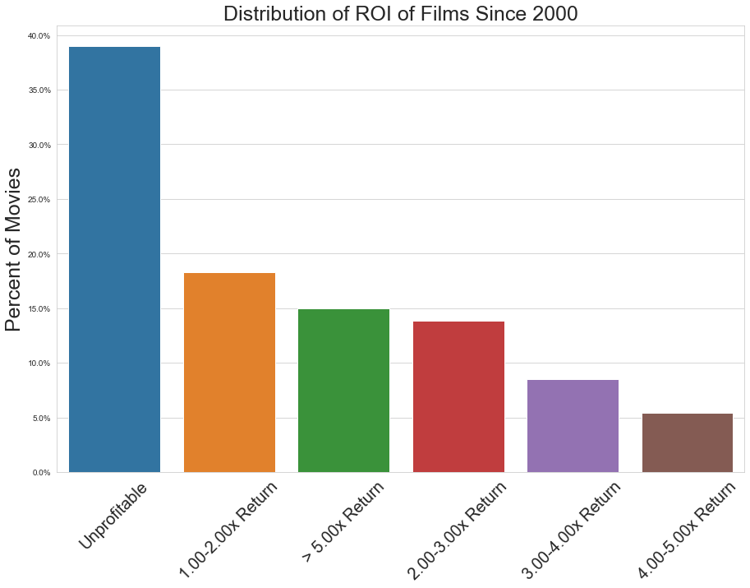
Profitability of films since 2000
“Film is a battleground.” – Sam Fuller,

Slide 3
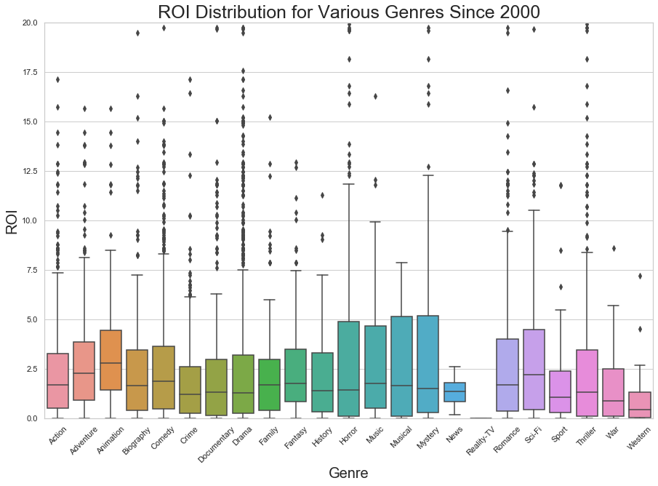
Select the right type of films to produce
“Everything has already been done, every story has been told, every scene has been shot – it’s our job to do it one better.” – Stanley Kubric
Top Genres (median ROI)
Animation (2.78x)
Adventure (2.26x)
Sci-Fi (2.20x)

Slide 4
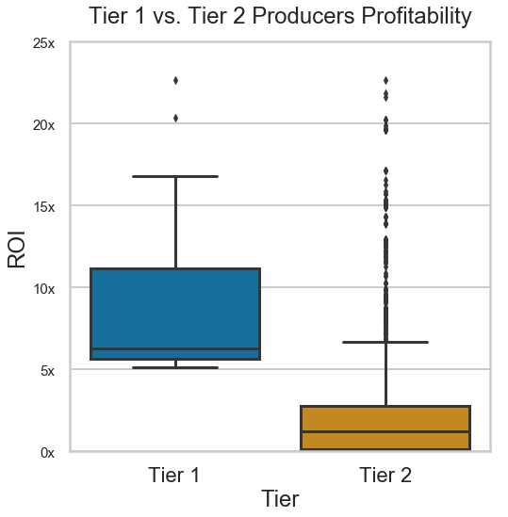
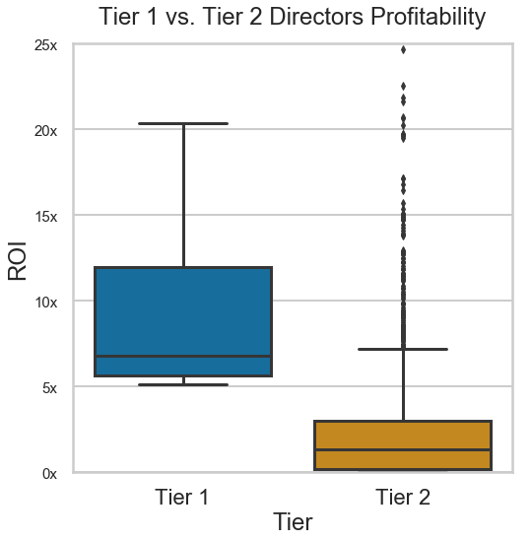
Hire great people to make them
“The best films are because of nobody but the director.” – Roman Polanski

Slide 5
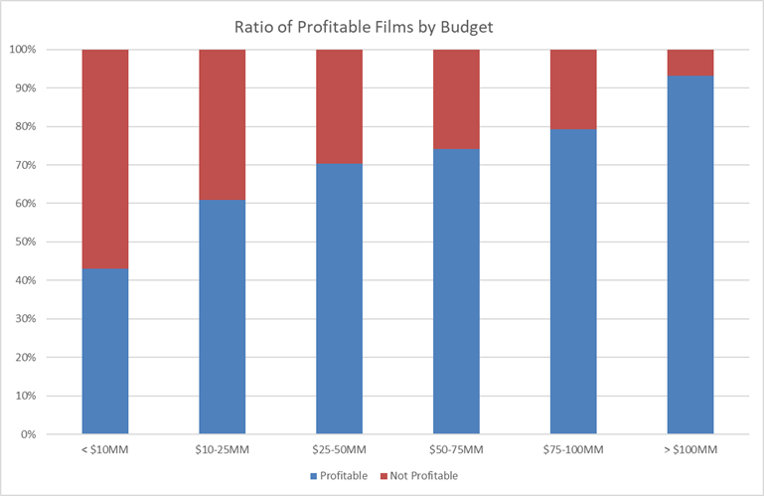
Don’t skimp on the budget
“If you think hiring a professional is expensive, wait till you hire an amateur” – Red Adair

Slide 6
Future work
Scrape for More Financial Data
Solidify Distribution Model
Preferred Genres of Producers / Directors
Financial data from more films
Promotional budgets
Other sources of revenue
Streaming movies on own video subscription service (i.e. Netflix)
Look at metrics for movie / series popularity
What genre films are select directors / producers best at making?

Slide 7



THANK YOU
“The way to get started is to quit talking and begin doing.” – Walt Disney
Braydon Charles Janecek
braydoncharlesjanecek@gmail.com
https://bcjanecek.github.io/

Slide 8
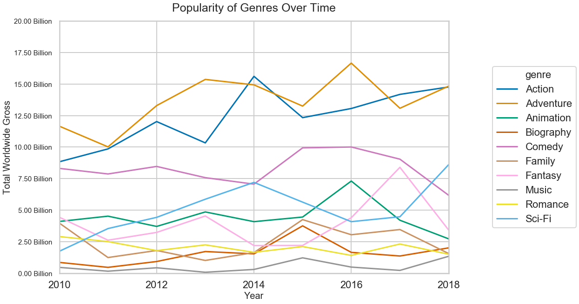
Appendix: popularity trends most profitable genres

