Slide 1
Face Recognition
Gerard Burgués
Elliot Rogie

Slide 2
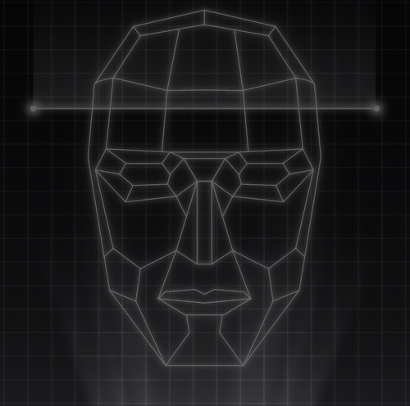
Content
Problem + Solution
Goals
Research
Algorithms:
SIFT
LBPH
Caption

Slide 3
Problem & Solution
A lot of pictures of vacation, friends, family, evens, etc.
How can we organise those pictures?How can I classify those pictures?
Using Face Recognition will help us to organise and classify all our images. Each person will have an specific folder.

Slide 4
Research
A comparative study of CFs, LBP, HOG, SIFT, SURF, and BRIEF techniques for face recognition
By Yassin Kortli, Maher Jridi, Ayman Al Falou, Mohamed Atri
Goal : Test different recognition face algorithms
Approach :
Using a PHPID (Pointing Head Pose Image Database) to recognize the face after.
Resize the picture to use always the size (154x188 px)
Notes:
Link :

Slide 5
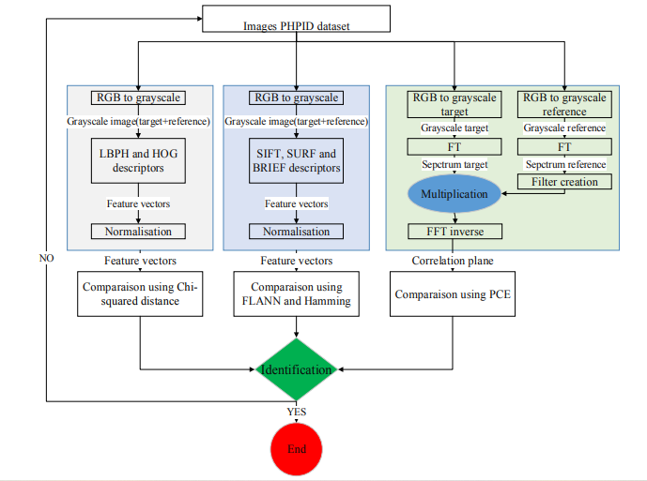
Research
A comparative study of CFs, LBP, HOG, SIFT, SURF, and BRIEF techniques for face recognition

Slide 6
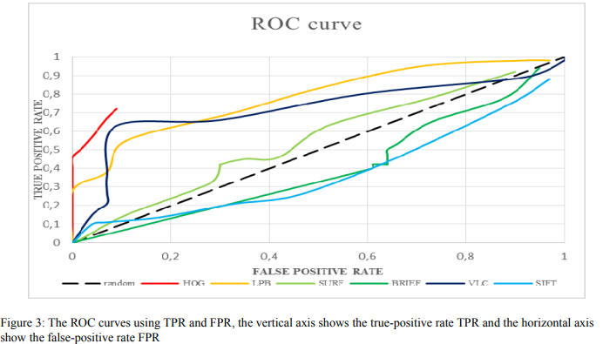
Research
A comparative study of CFs, LBP, HOG, SIFT, SURF, and BRIEF techniques for face recognition
Result :

Slide 7
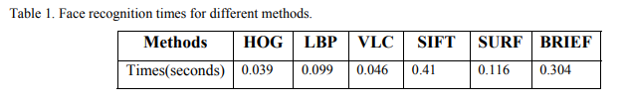
Research
A comparative study of CFs, LBP, HOG, SIFT, SURF, and BRIEF techniques for face recognition
Result :
Best algorithms is VLC and LBPH
Sift algorithm is the more longer algoritm.

Slide 8
Research
A comparative study of CFs, LBP, HOG, SIFT, SURF, and BRIEF techniques for face recognition
Conclusion:
See that LBPH and VLC are the better algorithms and using less time than the others
For this study the SIFT, SURF and BRIEF algorithms is not working well because the face recognition base on frontal face picture so the different rotation don’t count.

Slide 9
Research
Face Recognition Based on Improved SIFT Algorithm
By EHSAN SADEGHIPOUR, NASROLLAH SAHRAGARD
Goal : Test an new algorithms base on Shift algorithms and compare it with different other methods.
The proposed algorithms :
the number of picture in a octave
Different way to calculate the keypoint descriptor
Approach :
Use ORL database (400 picture/person, 40 person, different rotation and light intensity) to test algorithms
Test Gabor, GPCA, GLDA, LBP, GLBP, KGWRCM, SIFT algorithms
Notes:
Gabor method: Pre-processing + Haar-detection + Gabor + Cosine similarity;
LBP method: Pre-processing + Haar-detection + LBP + Cosine similarity;
GPCA method: Pre-processing + Haar-detection + Gabor + PCA + Cosine similarity;
GLDA method: Pre-processing + Haar-detection + Gabor + LDA + Cosine similarity;
GLDP method: Pre-processing + Haar-detection + Gabor + LDP + Cosine similarity;
KGWRCM method: Pre-processing + Haar-detection + Gabor + PCA + Cosine similarity;
.

Slide 10
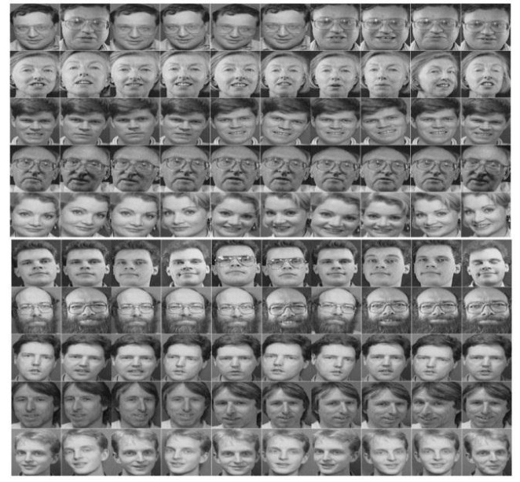
Research
Face Recognition Based on Improved SIFT Algorithm
By EHSAN SADEGHIPOUR, NASROLLAH SAHRAGARD

Slide 11
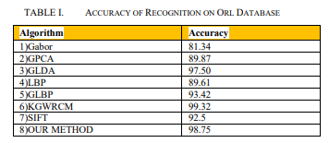
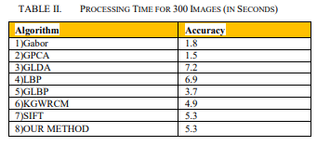
Research
Face Recognition Based on Improved SIFT Algorithm
By EHSAN SADEGHIPOUR, NASROLLAH SAHRAGARD
Result :
The best algorithm is KGWRCM for the recognition
See also that LBP (with gabor filter) method is quite good and processing time is less than Sift method.

Slide 12
Research
Face Recognition Based on Improved SIFT Algorithm
By EHSAN SADEGHIPOUR, NASROLLAH SAHRAGARD
Conclusion:
Complete algorithm to find the best one
See that LBP algorithm is pretty good with different picture in term of rotation

