Slide 1
Face Recognition
Gerard Burgués
Elliot Rogie

Slide 2
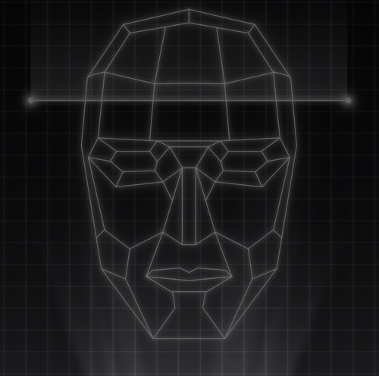
Content
Problem + Solution
Goals
Research
Algorithms:
SIFT
LBPH
Caption

Slide 3
Problem & Solution
A lot of pictures of vacation, friends, family, evens, etc.
How can we organise those pictures?How can I classify those pictures?
Using Face Recognition will help us organise and classify all our images. Each person will have a specific folder.

Slide 4
SIFT-Algorithm
STEPS
Finding Scale-space: We will use Difference of Gaussian (DoG)
Key point localisation and filtering
Orientation assignment
Key Point Descriptor
Key point match: Match by identifying their nearest neighbours
https://medium.com/data-breach/introduction-to-sift-scale-invariant-feature-transform-65d7f3a72d40

Slide 5
SIFT-Results

Slide 6
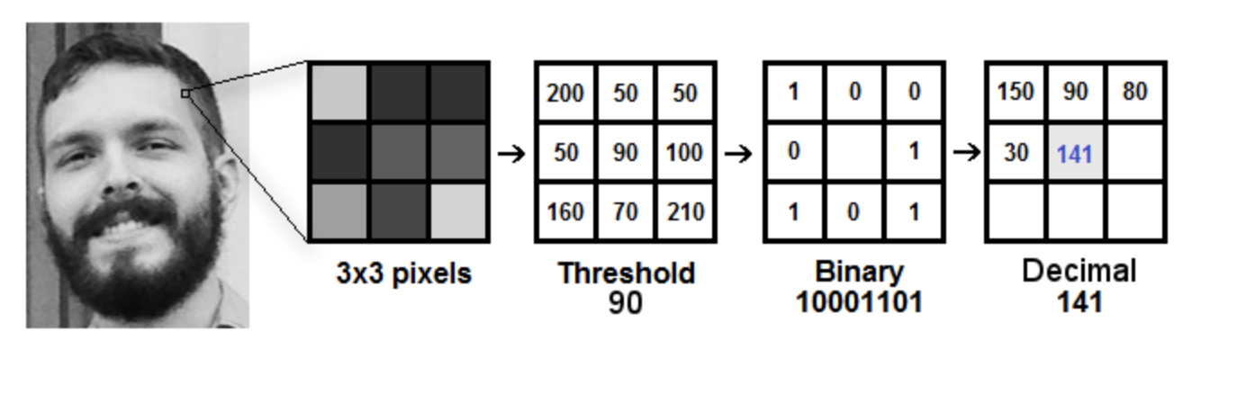
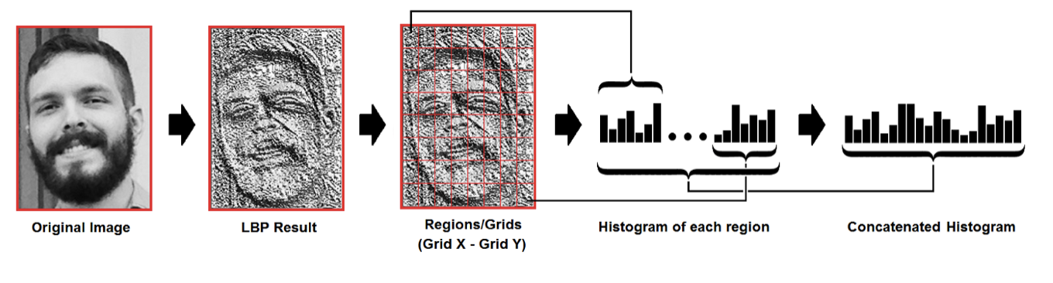
LBPH-Algorithm
Steps
Save same person image with same ID
LBP operation:
Extract of histograms:
Perform of face recognition (match):
We will use euclidian distance
https://towardsdatascience.com/face-recognition-how-lbph-works-90ec258c3d6b

Slide 7
LBPH-Results

