Slide 1
Face Recognition
Gerard Burgués
Elliot Rogie

Slide 2
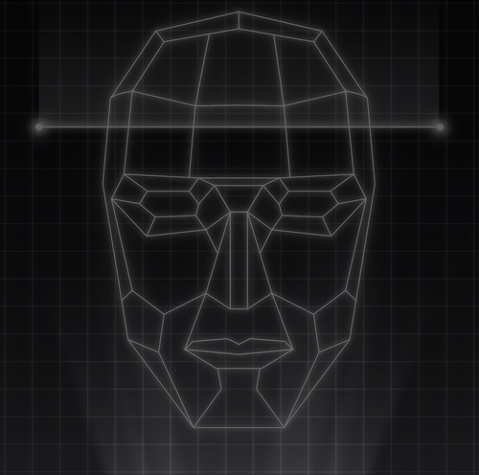
Content
Problem + Solution
Goals
Research
Algorithms:
SIFT
LBPH
Caption

Slide 3
Problem & Solution
A lot of pictures of vacation, friends, family, evens, etc.
How can we organise those pictures?How can I classify those pictures?
Using Face Recognition will help us to organise and classify all our images. Each person will have an specific folder.

