Slide 1
Calls DeleteGate
Calls AddGate
DDLG_GateInfo
1
1
DLG_Home
1
1
Widget_AllGates
(Or other gate selection widgets)
Calls setGate
1
Call functions like ResetToPreviousClickMode, SetCurrentClickMode, SendUserMessage, EditTextLabel
Calls functions like SetZoomLevel, Redo, Undo, AddGate
*
GateFeild
1
Call functions like EditTextLabel
Call functions like UpdateGraphics, Delete,
Save, GetClickedNode
*
Gate

Slide 2
User requests to create a new task (either circuit or truth table)
DLG_CircuitTaskDesignerSetup
User enters number of inputs and outputs of task
DLG_TruthTableTaskDesigner
User designs a truth table
DLG_CircuitTaskDesigner
User designs a circuit
Task saved to file
Task saved to file

Slide 3
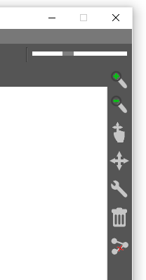
Zooming in & out
Dragging gates
Panning around the gatefield
Editing a gates state (ie. switching a toggle)
Deleting a gate
Removing a link between gates

Slide 4
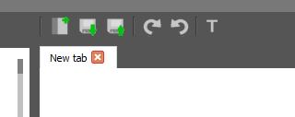
Creating a new gatefield tab (opens a dialog requesting the name of the new gatefield)
Undo/redo operations on actions performed in the gatefield
Saving a gatefield
Loading a gatefield (opens up a file explorer dialog)
Opens the task manager dialog

