Slide 1
predict DIABETEs
DIABETES DATASET
Koch Elliot

Slide 2
TABLE OF CONTENTS
01
02
ABOUT DATASET
Pre-processing
03
04
Training
improvements
DATA VISUALISATION
PREPARE DATASET FOR PREDICTION STEP
PREDICTING DIABETES USING DIFFERENT METHODS
FINAL RESULTS / WORDS ON THE PROJECT
T
0

Slide 3
01
About DATASET
DATA VISUALISATION
T
1

Slide 4
Dataset columns (50)
Insuline, AC1 result, metformin…
31 columns
Medical Info
Patient info
Diabetes
Age, Weight, Admission_type…
18 columns
DiabetesMed 1 column
T
2

Slide 5
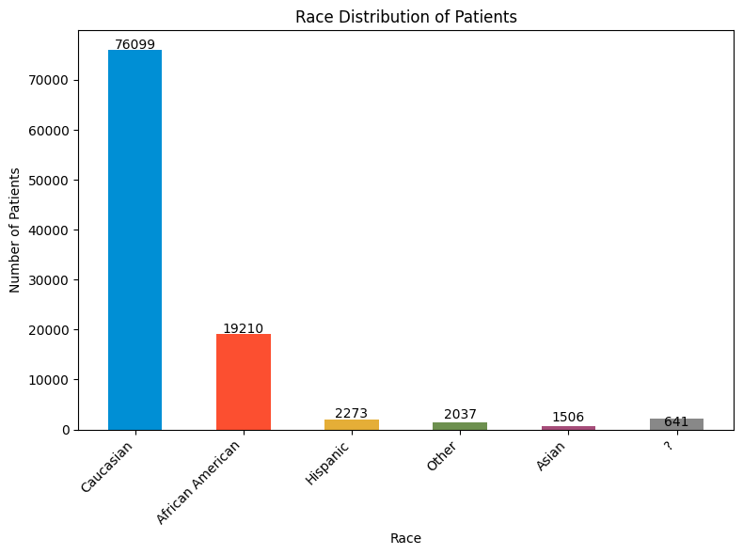
Patient informations
~101K patients inside the dataset (rows)
Caucasian → 76k
African American → 19k
Hispanic → 2k
Other → 2k
Asian → 1.5k
? → 700
T
1

Slide 6
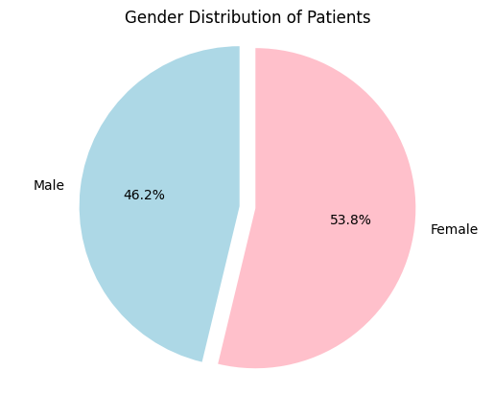
Patient informations
Male → 46k
Female → 55k
T
1

Slide 7
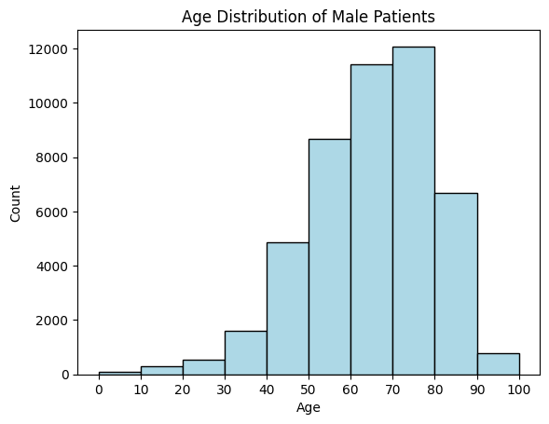
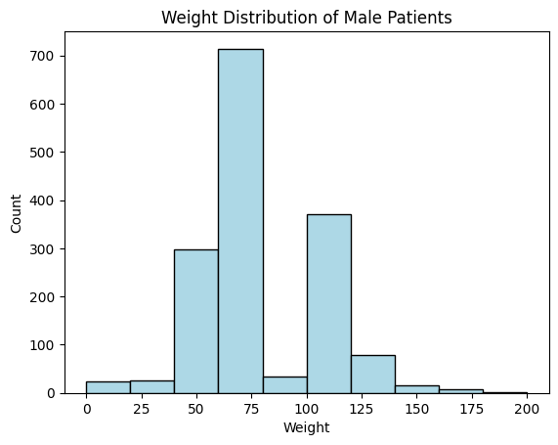
Males Patient
T
1

Slide 8
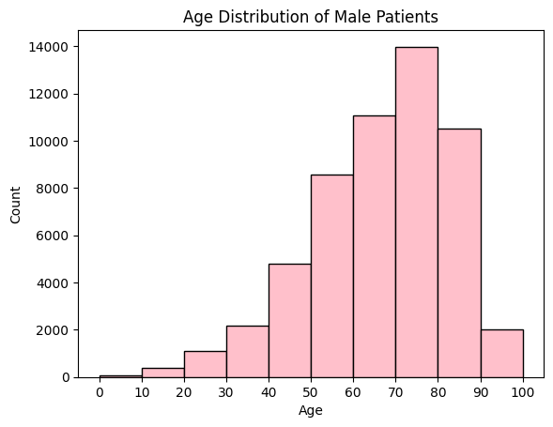
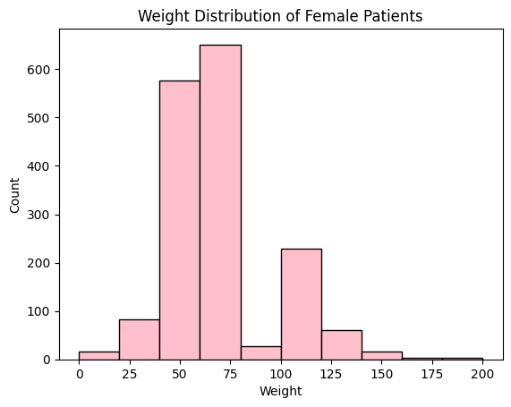
feMales Patient
T
1

Slide 9
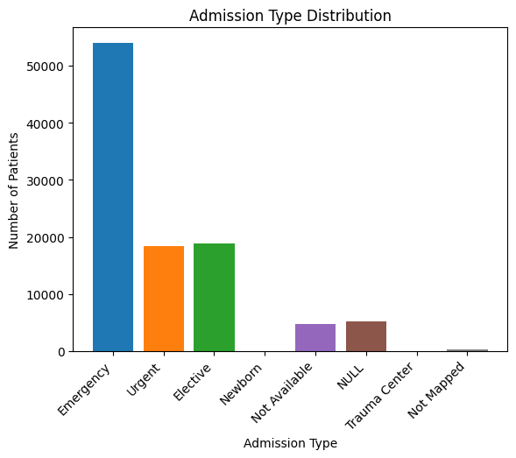
Patient: Admission type
~101K patients inside the dataset (rows)
Emergency → 54k
Urgent → 18k
Elective → 19k
Null → 5k
…
T
1

Slide 10
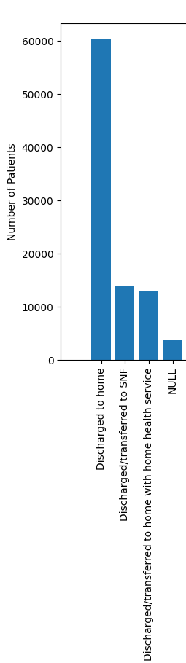
Discharge disposition
Discharged to home → 60k
Discharged to SNF → 14k
Discharged to home with home healthy services → 13k
Null→ 4k
…
T
1

Slide 11
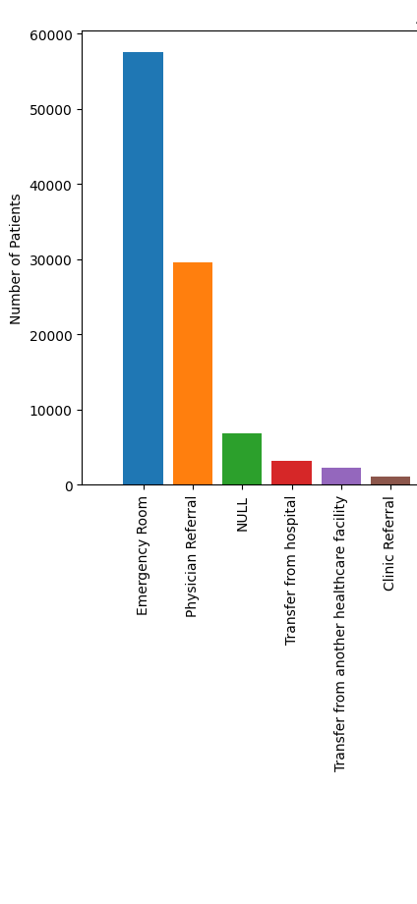
Admission source
Emergency room → 58k
Physician referral → 30k
Null→ 7k
…
T
1

Slide 12
02
pre-processing
PREPARE DATASET FOR PREDICTION
T
2

Slide 13
Dataset
Remove “?” value
Dataset 1
dataset 2
Select Admission Type / Source and Discharge disposition
One Hot Encoder
Correlation Matrix to select “k” features
Normalise the columns (0,1)

Slide 14
Dataset 1
T
1

Slide 15
One-Hot-Encoder
Type: STRING
Insuline | Insuline_yes | Insuline_no
Yes | 1 | 0
No | 0 | 1
Yes | 1 | 0
No | 0 | 1
T
2

Slide 16
Correlation matrix
1
Target
Here the target column is the the DiabetesMed one.
2
method
Spearman method because the data are not normally distributed
3
Top “k”
Select the top “k” columns with the highest correlation coefficient with the target column → In our case k = 30
T
5

Slide 17
Dataset Normalisation
Min-Max Scaler
The datasets have some column (diag_1…) related to the patients diagnoses which is about float value
For each column, it maps the smaller value to 0 and the higher to 1. And maps the other between [0,1]
100 150 200
0 0.5 1
T
3

Slide 18
summary
Dataset | DATASET 1 | DATASET 2
Before pre-processing | 101’766 x 50 | 101’766 x 50
Before One-hot-encoder | 63’685 x 50 | 89’782 x 50
Before Matrix correlation | 63’685 x 105 | 89’782 x 105
After Pre-processing | 63’685 x 30 | 89’782 x 30
T
4

Slide 19
03
Training
PREDICTING DIABETES USING DIFFERENT METHODS
T
4

Slide 20
Summary of training
ACCURACY
 | DATASET 1 | DATASET 2
Logistic regression | 0.99905 | 0.99504
Decision trees | 0.99897 | 0.99515
SVM | 0.99921 | 0.99532
Deep Learning | 0.9960 | 0.99590
Missing: Gradient Boosting Machines
T
4
Missing: Random Forest, K-means
Notes:
We used several supervised learning techniques. Supervised learning is machine learning paradigm where the data used as given labeled examples, which is the case here as we use à training and test set
Logistic regression is a model that models the probability for an event taking place, so here it would be if there is diabete or no
Decision trees is model that is used to make decisions using à tree like graph, each node represents à test on an attribute
SVM is à model using vectors in order to separate data points in groups
We use deep learning, typically à neural netowrok
We also used confusion matrices for the Logistic regression, dt and svm
TP FN
FP TN

Slide 21
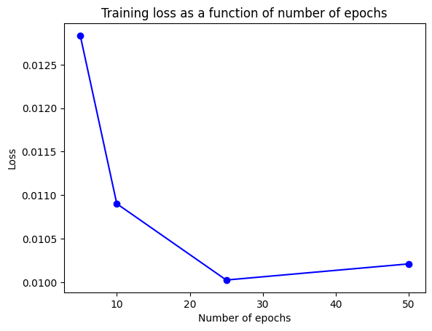
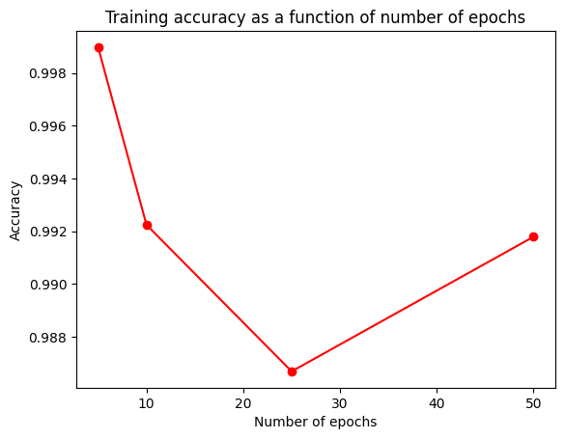
Dl optimisation: epochs
T
1
Notes:
We then starting to optmize the network by testing different values for the epoch which is a complete cycle trough the batch we chose
Here we chose 50

Slide 22
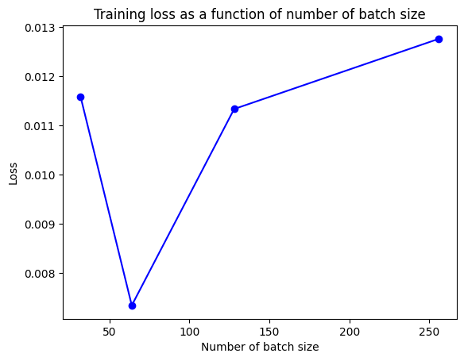
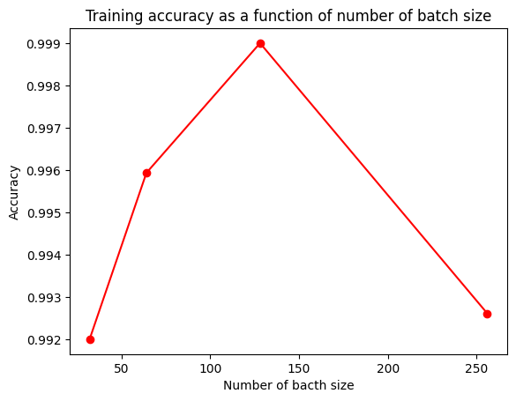
Dl optimisation: Batch
T
1
Notes:
Here we did the same thing for the batch size
Here 128

Slide 23
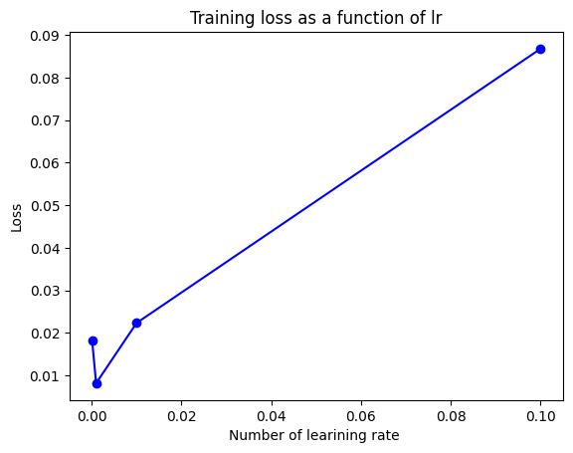
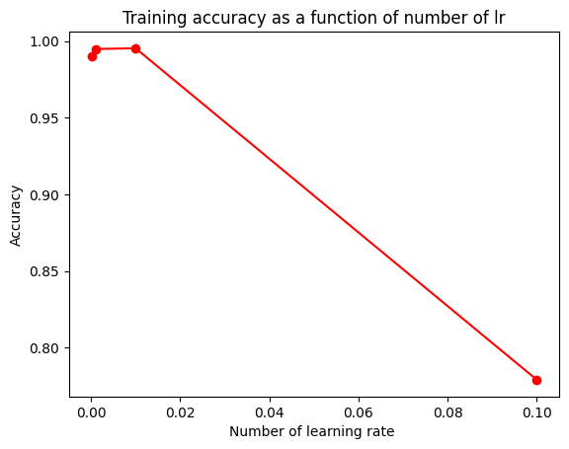
Dl optimisation: L_R
T
1
Notes:
And for the learning rate, here we chose 0.001

Slide 24
Deep learning summary
 | DATASET 1
Before optimisation | Accuracy: 0.9960 Loss: 0.0022
After optimisation | Accuracy: 0.9989 Loss: 0.0008
T
4

Slide 25
Activation FUnction and Dropout
Added dropout
Choose relu as activation functions
Huber Loss function → less sensitive to outliers in data
Notes:
Using Huber used in robust regression, that is less sensitive to outliers in data than the squared error loss.
We could possibly use mean absolute error

Slide 26
06
improvements
FINAL RESULTS / WORDS ON THE PROJECT
T
6

Slide 27
Possible improvements
Visualisation
Enhance data visualization by categorizing patients based on whether they have diabetes or not.
pre-processing
Training
Replace ‘?’ with values similar to the rows (data) they most closely resembled by taking an average.
Dataset 2: Optimizing hyperparameters for the deep learning model
Choose a different number of columns (k) to select from the correlation matrix.
Deep-Learning: Optimize the number of layers and nodes per layers
T
6

Slide 28
Conclusion
Data Visualisation
Data pre-processing
Data Prediction
Understand the dataset
Visualise important columns
Help the pre-processing
Manage the “?”
Apply O-H-E, Corr-Matrix
Normalise all the data
Use several methods
Focus on deep learning (Dataset 1)
Hyperparameters optimisation
T
3

Slide 29
Thanks!
T
6

