Slide 1
01 • PURPOSE
Project Objectives
• Simplify tool sign-in and sign-out for operators
• Allows operators to work from a single sheet.
• Improve visibility into tool activity.
TOOL SIGN-OUT SYSTEM • MANAGEMENT OVERVIEW
02

Slide 2
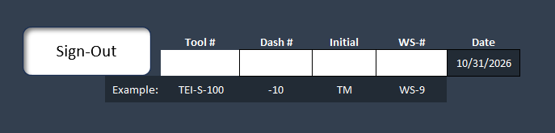
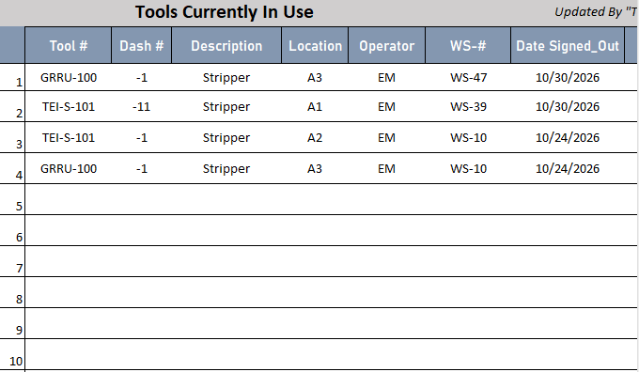
03 • OPERATOR WORKFLOW
Sign-Out Operation
• Enter the tool number, a dash number when applicable, initials, and workstation number.
• Searches inventory and adds the matching tool to the Tools In Use Table .
TOOL SIGN-OUT SYSTEM • MANAGEMENT OVERVIEW
04

Slide 3
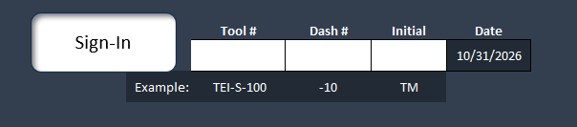
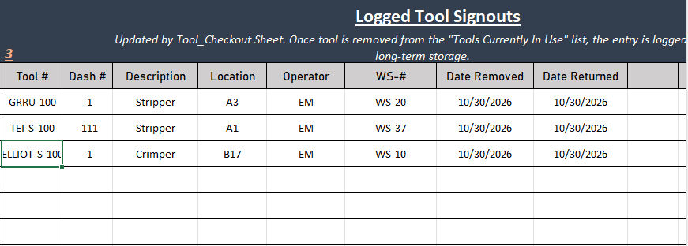
04 • OPERATOR WORKFLOW
Sign-In Operation
• Searches the Tools In Use Table for provided tool number, a dash number when applicable, and initial.
• Extracts and deletes details from the table to the Log.
• Remove the returned tool from the active-use table
Tools In Use Table
TOOL SIGN-OUT SYSTEM • MANAGEMENT OVERVIEW
05

Slide 4
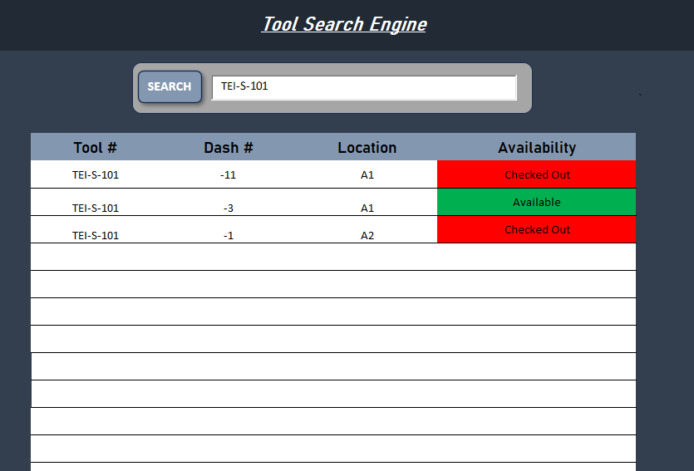
05 • INVENTORY VISIBILITY
Search Operation
• Searches across entire workbook using a tool number.
• Displays the tool number, dash numbers, location, and availability.
• If the tool is in the Tools In Use Table, then it will display as “Checked Out”.
TOOL SIGN-OUT SYSTEM • MANAGEMENT OVERVIEW
06

Slide 5
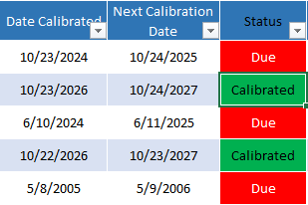
06 • ERROR PREVENTION
Additional information
Input values for sign-out, sign-in, and search operations follow strict formats, preventing operators from entering incomplete or incorrect values.
Example for tool: [A-Z0-9] - [A-Z0-9] ( -[A-Z0-9] ) TEI-C-100 or
GRRU-100
Example for Initial: 2 Letters EM.
Example for dash number: -Numbers -12
Example for workstation: 2 Letters - Numbers WS-23
Messages will be displayed when the format doesn’t match and will identify which input was incorrect.
Calibration status automatically displayed .
Number of Log entries are tracked, with a maximum of 100.
Added tracker for number of tools due for calibration at the top of each tool sheet.
Message will be displayed if the search table result exceeds length of the table (18 cells in length).
TOOL SIGN-OUT SYSTEM • MANAGEMENT OVERVIEW
07

Slide 6
09 • FUTURE OPPORTUNITIES
Next Steps
Archiving logged entries.
Potential Next Steps
• Automatically highlight tools in Tools In Use Table if sign-out date exceeds a specific duration.
• Add section for all tools past calibration date. Another for nearest calibration date.
• Restyle sheets (see next slide)
TOOL SIGN-OUT SYSTEM • MANAGEMENT OVERVIEW
10

Slide 7


