Slide 1
Advancing scBERT: Innovative Annotation Method for Single-Cell RNA-Sequencing Data
Xiaohu Zhu, Oliver Li, Elliot Xie

Slide 2
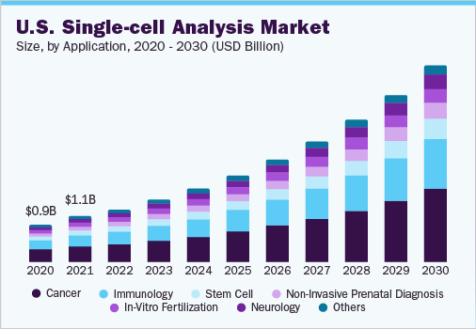
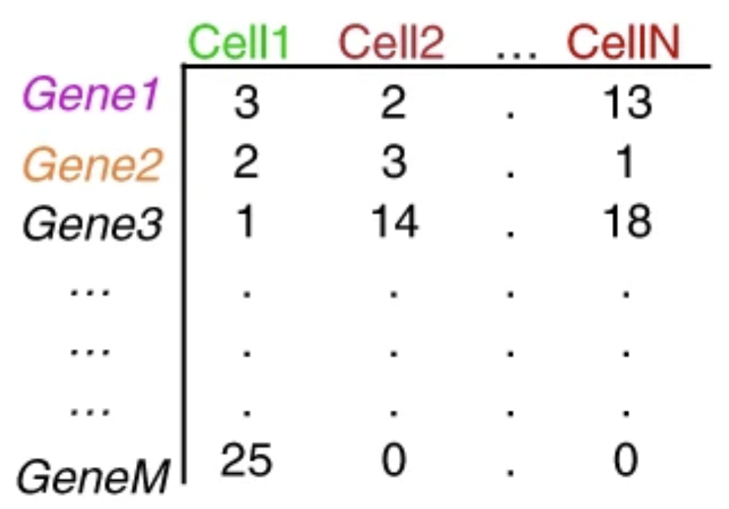
Introduction to Single Cell RNA-seq (scRNA-Seq)
Notes:
What are the research problem

Slide 3
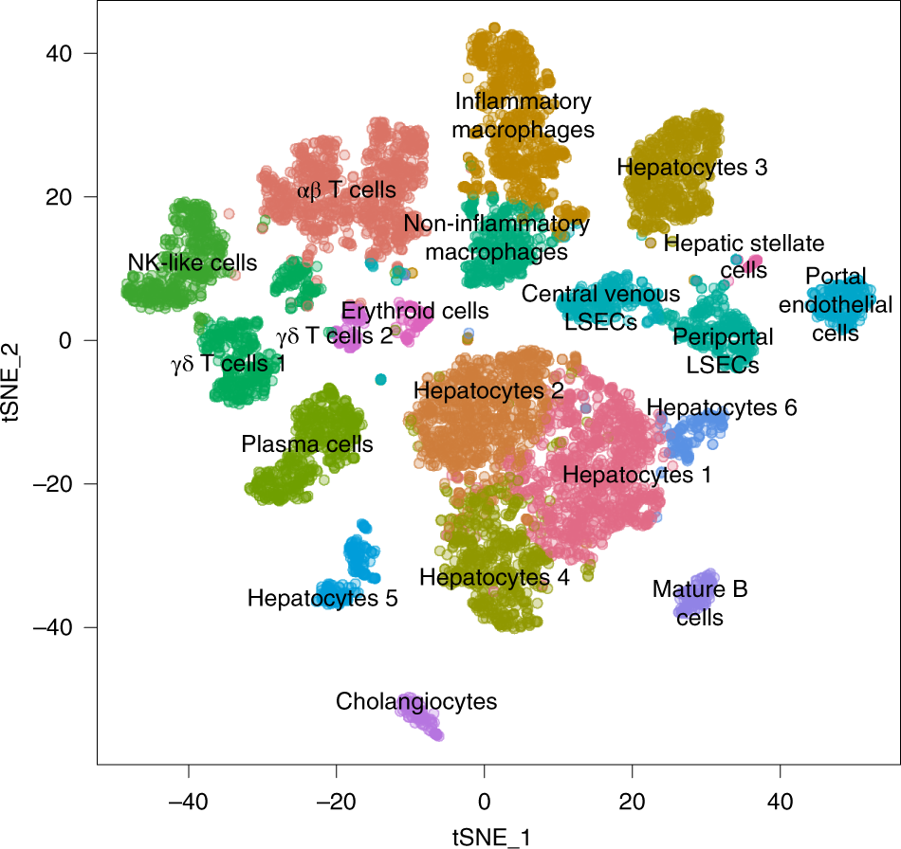
Research Problem- Cell Type Annotation
Notes:
What are the research problem

Slide 4
Challenge and Analysis of Recent Approaches
Annotation using marker genes (Seurat)
Rely on prior knowledge and is labor-intensive
Very subjective
Annotation by supervised classification (SingleR)
Rely on high quality reference dataset
Batch effects across platforms and experiments
Rely on HVG selection and dimensionality reduction, which can introduce biases, lose critical high-dimensional information.
A new method with improved pattern recognition capabilities is needed to overcome the aforementioned problem of inadequate fitting to large-scale datasets.

Slide 5
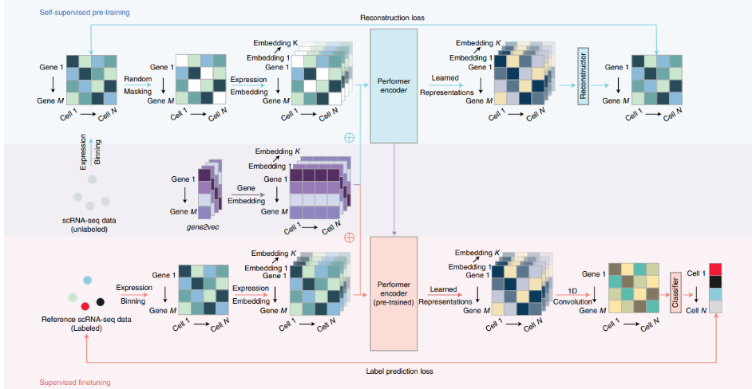
Introduction to scBERT
Pre-training and Fine-tuning
Contextual Embedding
Uncertainty Management
Handling Uncertainty
Innovative Design

Slide 6
Introduction to scBERT
Transformers capture global information and long-range gene-gene interactions
scBERT uses the Performer instead of the standard Transformer encoder
scBERT retains full gene-level interpretability, avoiding HVG and dimensionality reduction
Gene embedding
Expression embedding

Slide 7
Improving the Pretrain Process
Incorporating an extra type of embedding
Get Gene summary data using NCBI API
Convert gene summary data to embedding using OpenAI embedding API
Reduced the dimension of embedding from 1536 to 200 using LDA
Add to the gene2vec embedding to create a new embedding

Slide 8
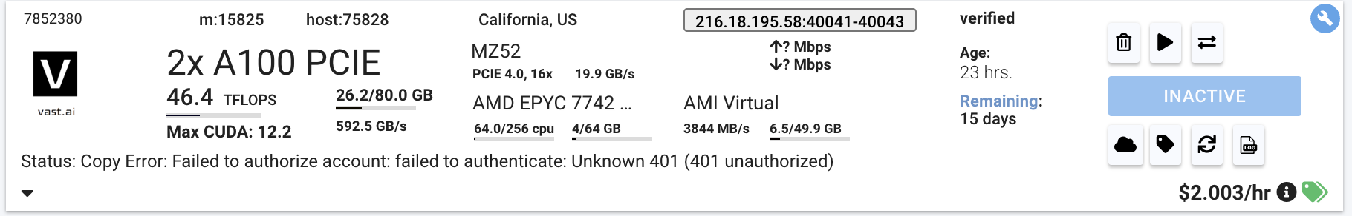
Improving the Pretrain Process
Training Detail
Outdated packages and problematic code from original version
Memory intensive
Slow in speed

Slide 9
Processing Large-Scale Datasets
scRNA-seq datasets are not only high-dimensional but also large in volume.
New_dataset: preprocessed original dataset.
New_subsampling: reducing the number of cells to 300 of all cell types.
New_oversampling: augmenting the number of BP and MoP to 4600 cells using SMOTE algorithm, function fit_resample and seed=2021.
New_randomoversampling: augmenting the number of BP and MoP to 4000 cells using RandomOverSampler algorithm, function fit_resample and seed=2021.
These new datasets were divided into training (size 70%) and test (size 30%) data using the function StratifiedShuffleSplit and seed=2021.

Slide 10
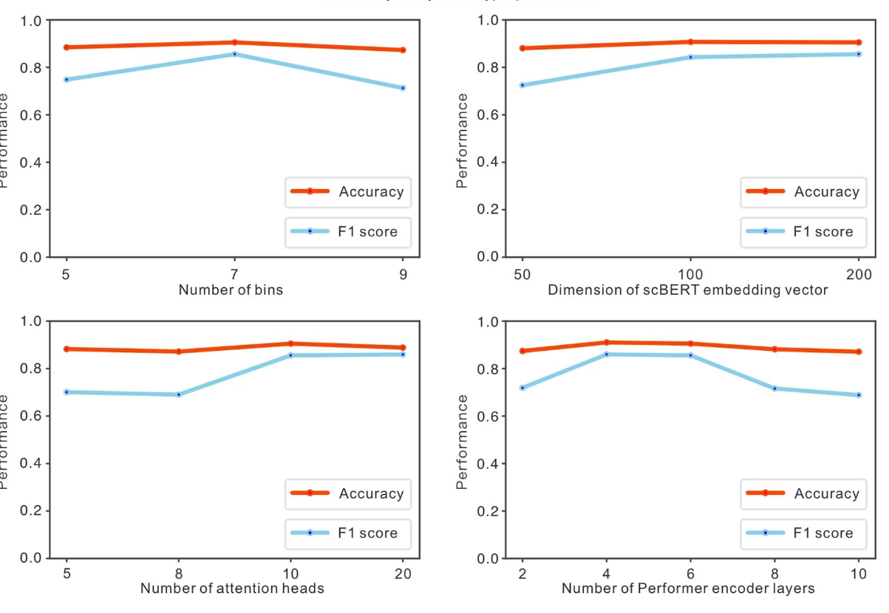
Performance

Slide 11
Cross-layer-parameter sharing
The same parameters (like weights and biases) are used across multiple layers, rather than each layer having its own distinct set
Reduce the overall number of parameters, lower memory and computational demands
A form of regularization, help to prevent overfitting
Benchmark: input - 512 - 512 - 10
Cross-layer: input - 512 (shared) - 512 (shared) - 10
Both have F1 score 0.7

Slide 12

Learning rate
Testing different initial learning rates
When initial learning rate too large, the learning process may overshoot, and result in poor performance; On the other hand, if learning rate too small, it will be computationally expensive
Cosine Annealing Warm Restarts scheduler
First_cycle_steps ∈ [5, 10, 15, 20]; cycle_mult ∈ [1, 2, 3]; max_lr ∈ [10−3, 10−4, 10−5]; warmup_steps ∈ [3, 5, 7, 9]
Optimal: first_cycle_steps = 15, cycle_mult = 2, max_lr = 10−4, and warmup_steps = 5
F1 = 0.71

Slide 13
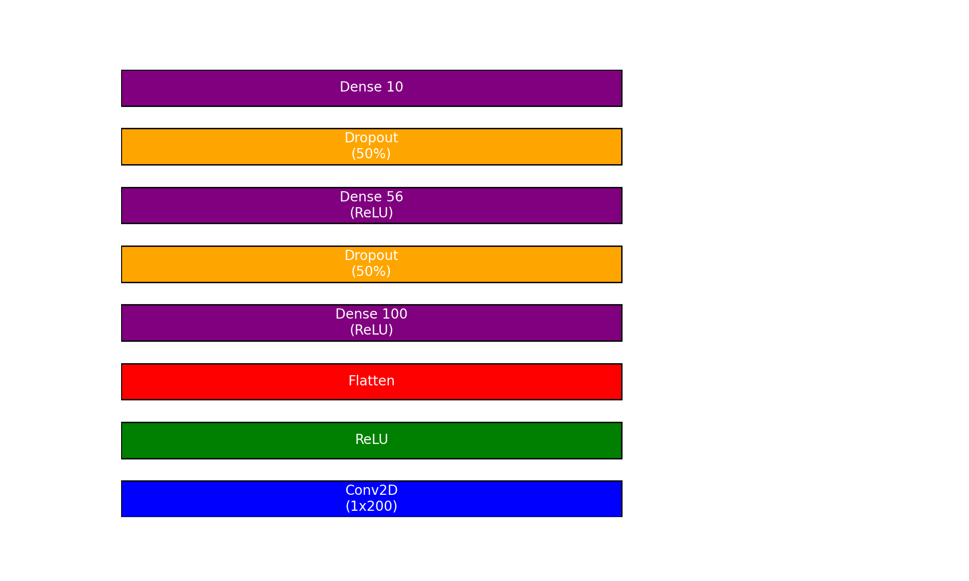
Knowledge Distillation
Teacher’s Model:
Input-512-100-Output
F1: 0.71
Student model:
Input-100-56-Output
F1: 0.64

Slide 14
Thank you for your attention!

