Slide 1
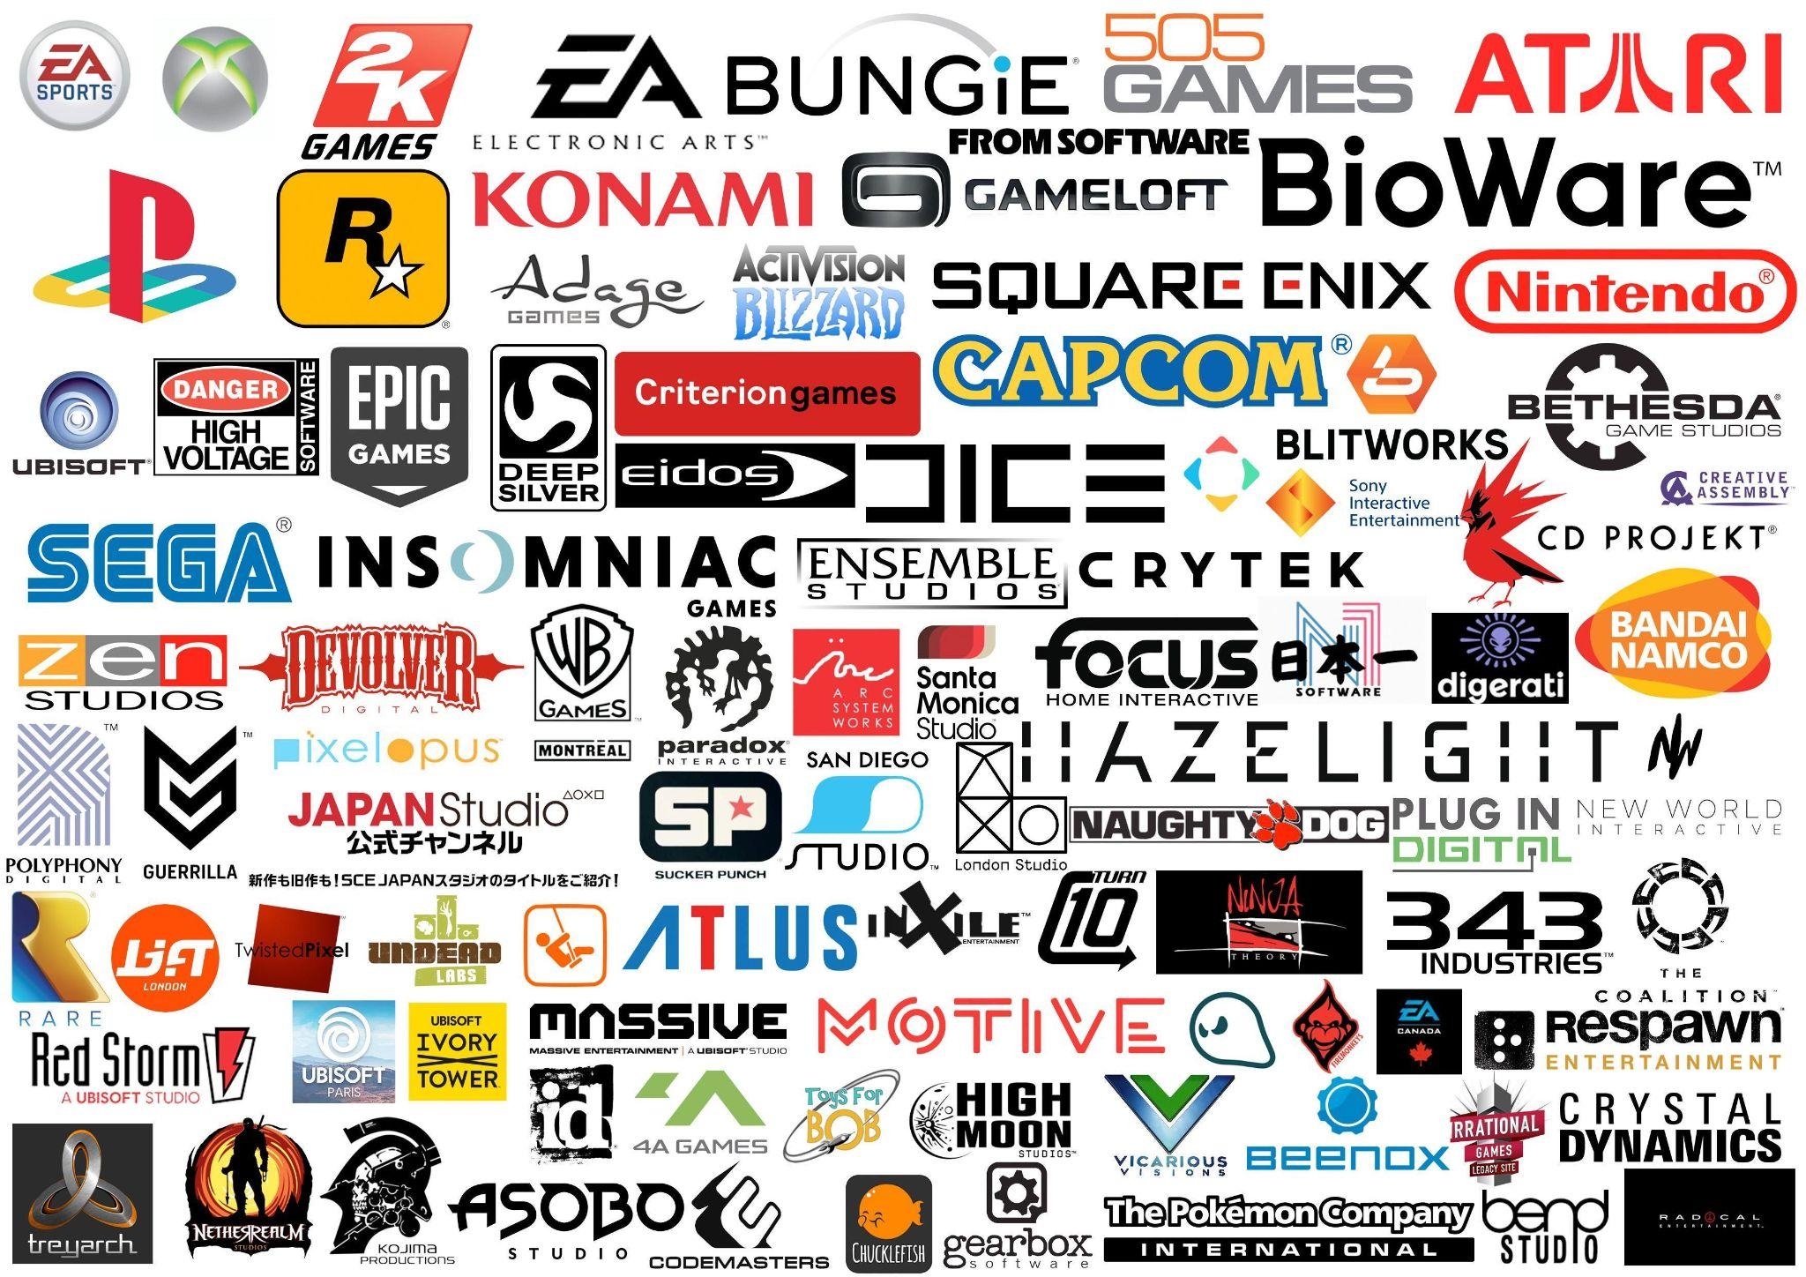
Analysis of Video Games Sales
Team Members: Samantha Meza, David Einstein, Elliott Einstein, Stephanie Betanzo
Netflix Data Science Foundations Boot Camp Midterm Project

Slide 2
Data Overview
Information in the dataset:
28 Different Platforms
Platform Sales
Game Sales
Publisher Sales
Critic & User Scores
User Ratings
Sales in NA
Sales in EU
Sales in JP
Problems with the Dataset:
Thousands of NaN values

Slide 3
Project Overview
Our purpose is to analyze platform, genre, game rating, user score, and regional user-preferences to video games for effective marketing strategies
Relationships to be analyzed
Regions : Platform Sales
Genre : Critic Ratings
Genre : User Ratings
User Scores: Sales
Platforms : Global Sales
Genre Rankings

Slide 4
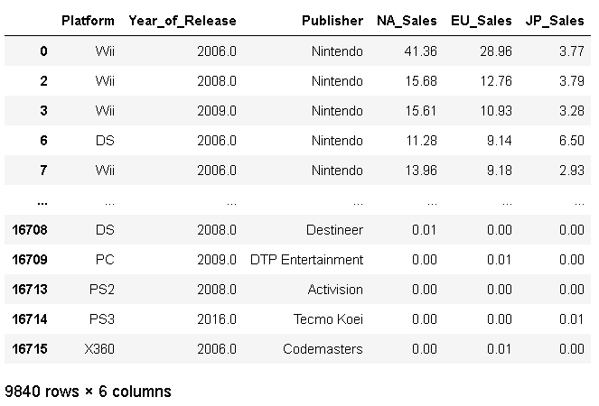
What are the demands in each region for the different game platforms?
Table showing cleaned data with the values that are relevant.

Slide 5
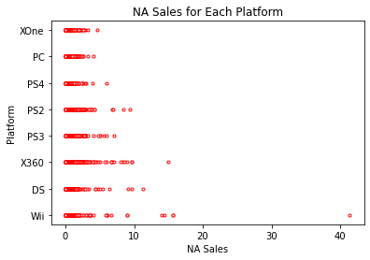
Question continued
In North America, sales across each platform are similar.
Wii hits the highest number of sales, with Xbox360 coming in second.

Slide 6
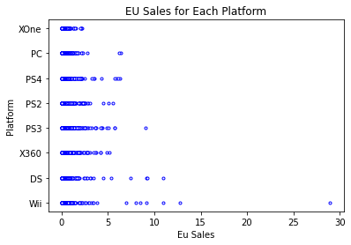
Question continued
In the EU, the sales pattern looks similar to how they are in NA, but are less of what NA is.
Wii has the highest sales like NA.
DS comes in second in the EU unlike Xbox360 in NA.

Slide 7
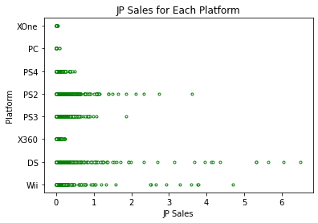
Question Continued
In Japan sales differ extremely from NA and EU.
Wii, DS, PS2, and PS3 sales are the majority of sales.
Sony and Nintendo are Japanese companies, which can explain their high sales in the region.

Slide 8
Question Summary
NA and EU are similar in their pattern of sales, with NA having higher sales and EU having lower sales in general. It may be important to note that NA provides a larger profit margin.
Considering this information, advertising non-Japanese products in the Japanese market may not be beneficial for non-Japanese companies.
Market competition for platforms is more evenly distributed in NA and EU.

Slide 9
How do components such as Genre and Critic Rating change over time?
Action 3370
Sports 2348
Misc 1750
Role-Playing 1500
Shooter 1323
Adventure 1303
Racing 1249
Platform 888
Simulation 874
Fighting 849
Strategy 683
Puzzle 580
Name: Genre, dtype: int64
Table Showing popularity of video game genres by category title and across time.The top 5 genres are highlighted.
Total of 12 Genre categories.

Slide 10
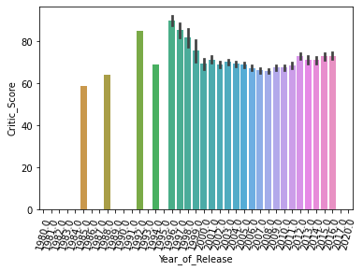
Question Continued
Analyzing whether or not critics “harshness” changed over time.’
Starts from 1984-2016
From 1996-1999 there was a peak where critic rating appeared to get harsher, then remained relatively consistent.

Slide 11
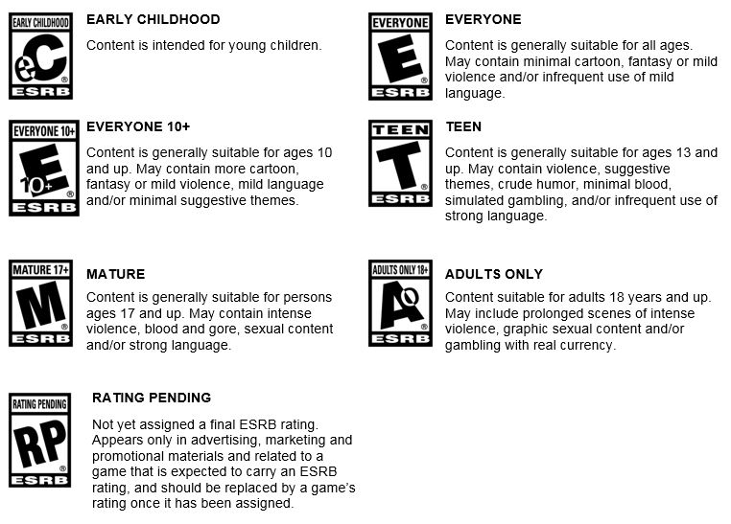
Video Game Rating System
Questions to be answered by analysis
Entertainment Software Rating Board (ESRB)
What is the highest user score by genre filtered by rating?
If the user score for a particular game is higher, is a game more likely to be purchased?

Slide 12
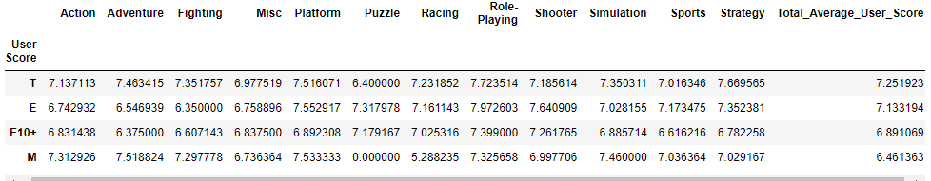
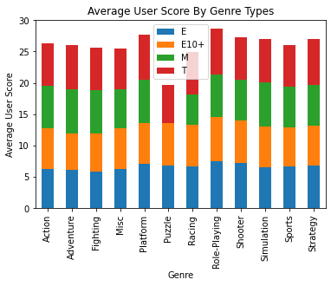
What is the highest and lowest user score by genre filtered by rating?
Question Summary:
The genre “role-playing” had the highest user score.
The puzzle genre “Puzzle” had the least user score.
The highest average user score by rating was ‘T’ (teen, content for 13 years old and up).
The lowest average user score by rating was ‘M’ (mature, content for 17 years old and up).

Slide 13
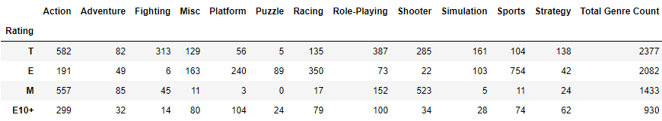
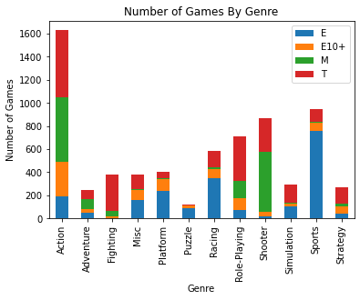
What is the highest and lowest purchased game by genre filtered by rating?
Question Summary:
The genre “Action” had the highest amount of games purchased.
The puzzle genre “Puzzle” had lowest amount of games purchased.
The highest games purchased by rating was ‘T’ (teen, content for 13 years old and up).
The lowest games purchased by rating was ‘E10+’ (pre-teen, content for ages 10 years old and up).

Slide 14
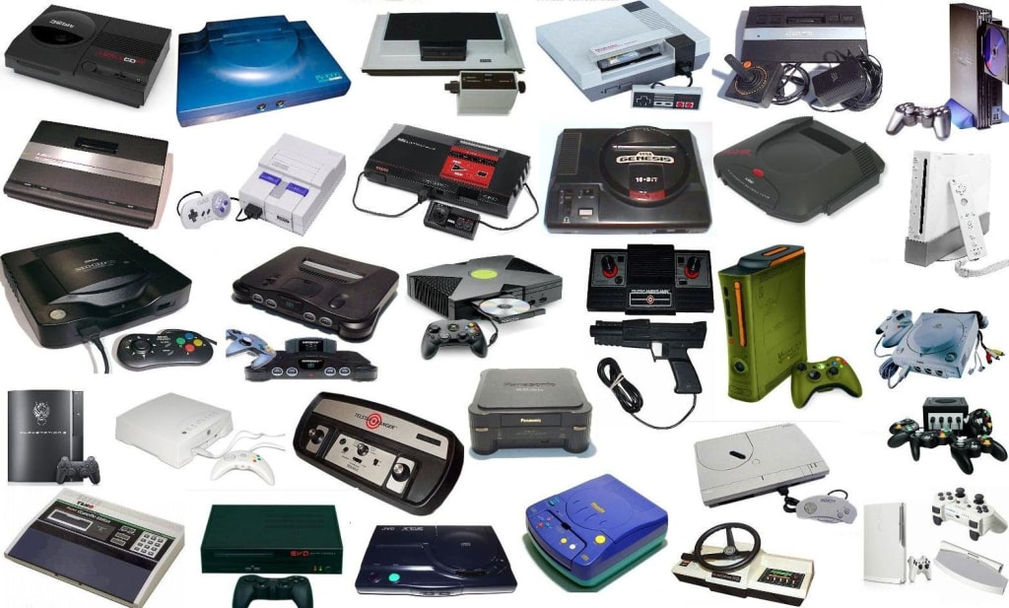
Genre/Platform Popularity
Questions to be answered by analysis
Which platform (game console) has the highest global sales per genre?
What is the ranking order by genre in NA, EU, and Japan?
Data collected from 1984 to 2016
Notes:
What is the significance? Giving marketing strategies to gaming companies looking to try to choose the genre for their game? More revenue, the more profitable company.

Slide 15
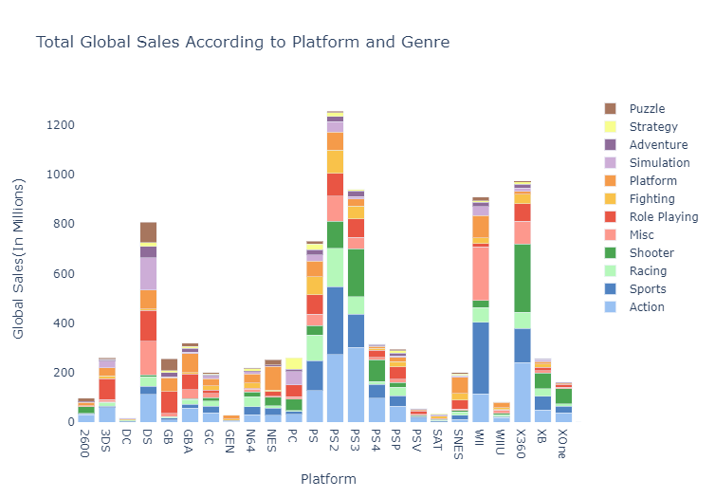
Which platform (game console) has the highest global sales?
Top 3 Genre Ranking by Game Consoles:
XOne - Shooter, Action, Sports
PC - Simulation, Shooter, Role Playing
PS4 - Shooter, Action, Sports
PS3 - Action, Shooter, Sports
PS2 - Action, Sports, Racing
Xbox360 - Shooter, Action, Sports
Scope of Analysis:
Game Product with particular Genres and Platforms. What is the projected Global Sales?

Slide 16
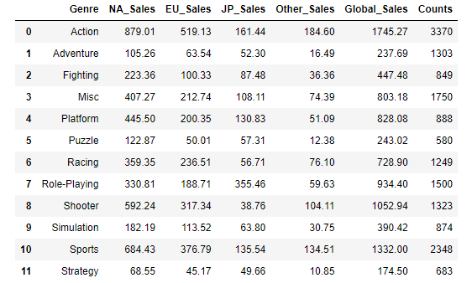
Which platform (game console) has the highest global sales?
Top 3 Genre Ranking:
NA_Sales - Action, Sports, Shooter
EU_Sales - Action, Sports, Shooter
JP_Sales - Role-Playing, Action, Sports
Other_Sales - Action, Sports, Shooter

Slide 17
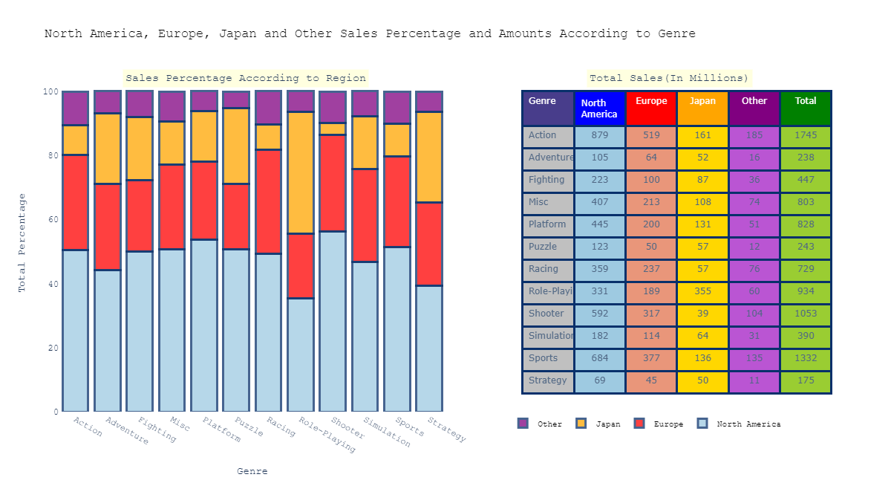
What is the ranking order of Genre in NA, EU, and Japan?
Ranking of Sales Percentage According to Region:
North America, Europe, Japan, Other
Top 3 Genre Ranking:
NA - Action, Sports, Shooter
EU - Action, Sports, Shooter
JP - Role-Playing, Action, Sports
Other - Action, Sports, Shooter
Assumption of Percentage Differences:
Culture: More gamers in NA despite fewer people versus Europe and Japan.

Slide 18
Summary
Which platform (game console) has the highest global sales?
PS2, X360, PS3
What is the ranking order of Genre in NA, EU, and Japan?
Action, Sports, and Shooter in NA and EU are the Top 3 Genres.
Role Playing, Action, and Sports in Japan are the Top 3 Genres.

Slide 19
Summary
Understanding user trends is necessary for effective marketing strategies to target audiences and appeal to their preferences.
There are similar platform preferences in NA and EU regions and Japanese game-markets unfavor non-Japanese game-products (Ref: Slides 3 - 7)).
The critic ratings across time appeared to change at one point in time from 1996 but afterwards remained relatively consistent. In a similar manner, across time the Action Genre, was the most popular among the 12 categories (Ref: Slides 8-9).
This study shows the indication of which games are more likely to be rated based on genre filtered by the rating, and the number of game purchased by genre filtered by the rating (Ref: Slides 10 - 12).
This study discusses descriptive models for game sales of global, north american and japanese game market in an attempt to provide information for the video game sales business (Ref: Slides 13-17).

Slide 20
Problems Encountered
One issue we faced with our data is determining the accuracy among age groups to rating categories. The rating categories suggest age appropriateness but are not an accurate representation of user age. We were unable to find data that collected user age.

Slide 21

Future Considerations.
We cannot make concrete conclusions due to using descriptive statistics and not statistical evidence, future research ought to incorporate statistical analysis.

