Slide 1
Supersonic Engine Design
A Comparative Study of Turbojet Engines for Supersonic Flight
Elliott Arpino - AER710 – Propulsion | Fall 2025

Slide 2
Problem Description
Design “fictional” supersonic inlet and engine capable of flying from NY to London in under 3 hours.
Perform a parametric cycle analysis on the “fictional engine”.
Compare the “fictional” supersonic engine, to an “off-the-shelf” supersonic engine.
Mission Requirements
Flight Mach (M1) | 3.2
Normal Shock Downstream Mach (M4) | 1.3
# of Shocks at inlet | 4 ( 3 oblique, 1 normal)
Ratio of Specific Heats (γ) | 1.4

Slide 3
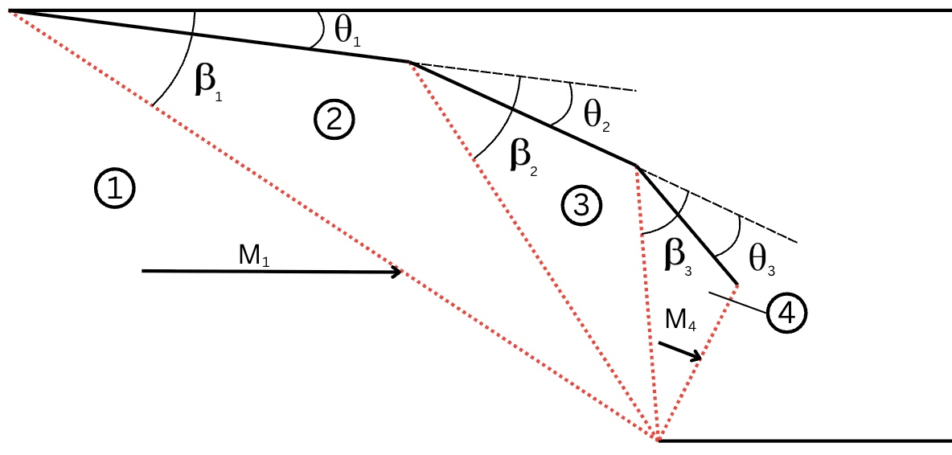
Supersonic Inlet
For the design of the supersonic inlet, an external compression model was selected for the ramp. The shown schematic provides a 2D visual of the model showing key parameters.
Utilizing the flight conditions and requirements, the Oswatitsch principle was used to optimize the inlet.
The Oswatitsch principle states, the pressure recovery in a system (πn) of (n-1) oblique shocks followed by the n^{th} normal shock is maximum when the shocks are of equal strength. When the normal Mach component of each shock is equal.
External Compression Supersonic Inlet

Slide 4
Supersonic Inlet Design
Designed Inlet Parameters
n | Mn | βn | θn | π n
1 | 3.2 | 27.8° | 11.9° | 0.9320
2 | 2.6 | 35.6° | 14.4° | 0.9320
3 | 2.0 | 50° | 17.2° | 0.9320
4 | 1.3 |  |  | 0.9320
The overall pressure recovery ( π d ) was calculated as 0.79
After iterating the flow turning angle (θ1), then solving a series of compressible flow equations (while forcing the Oswatitsch principle each iteration), a maximum overall pressure recovery was found.
The table shows the key inlet parameters found at the iteration with the highest overall pressure recovery (πd):

Slide 5

“Fictional” Supersonic Inlet Rendition
Modelled using the Designed Inlet Parameters

Slide 6
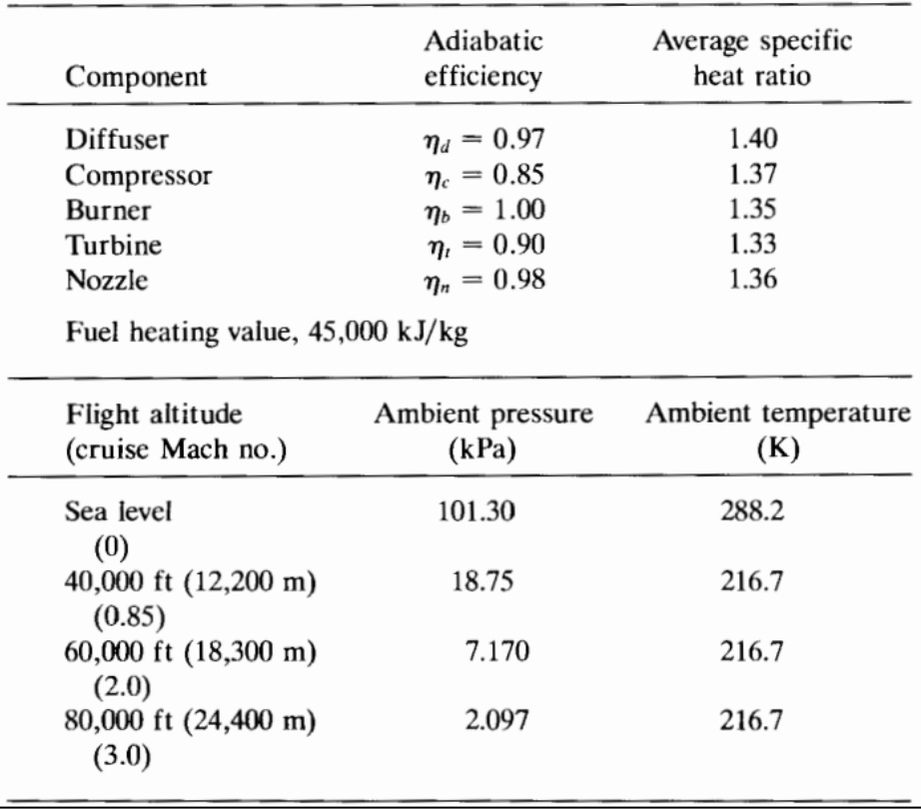
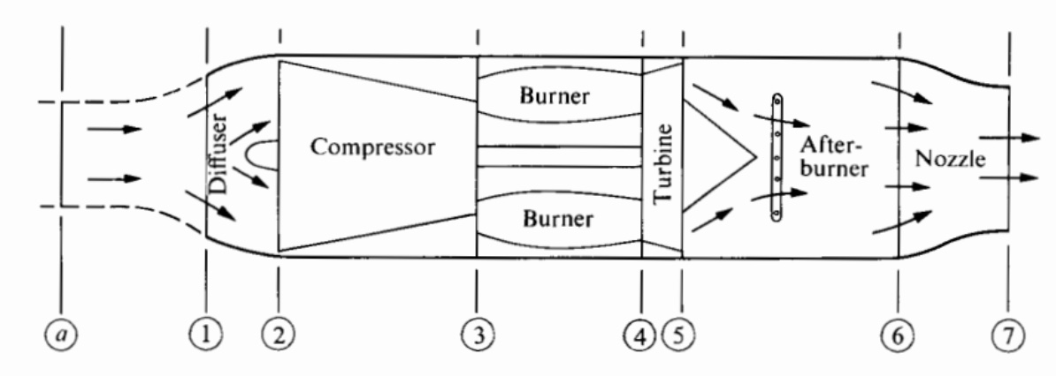
“Fictional” Supersonic Engine
A turbojet was selected as the “Fictional” engine.
Key Turbojet Parameters for Non-Ideal Analysis
Turbojet Engine Schematic

Slide 7

Parametric Cycle Analysis
For the “Fictional Engine”
The parametric cycle analysis of the Fictional Engine was performed with:
3 different maximum combustion temperatures: 1500 K, 1600 K, 1700 K
3 different Mach numbers: 0.85, 2, and 3.2
A program was created to iterate across compressor ratios (from 1 - 100), calculating:
Temperature and Pressure of airflow at each turbojet stage
TSFC and Specific Thrust

Slide 8
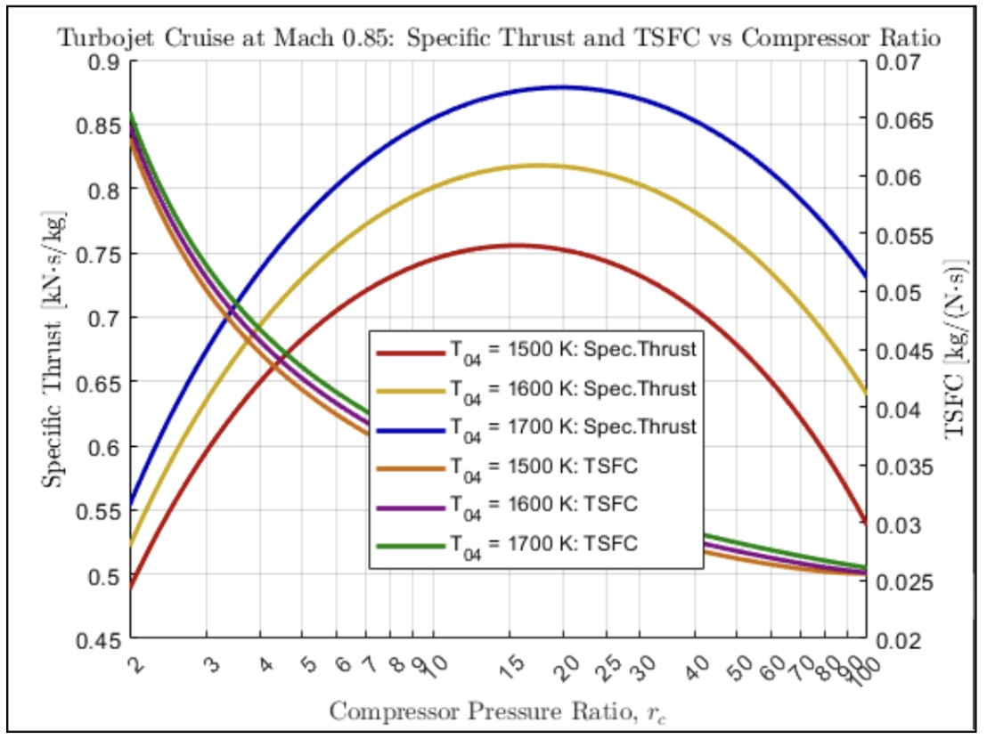
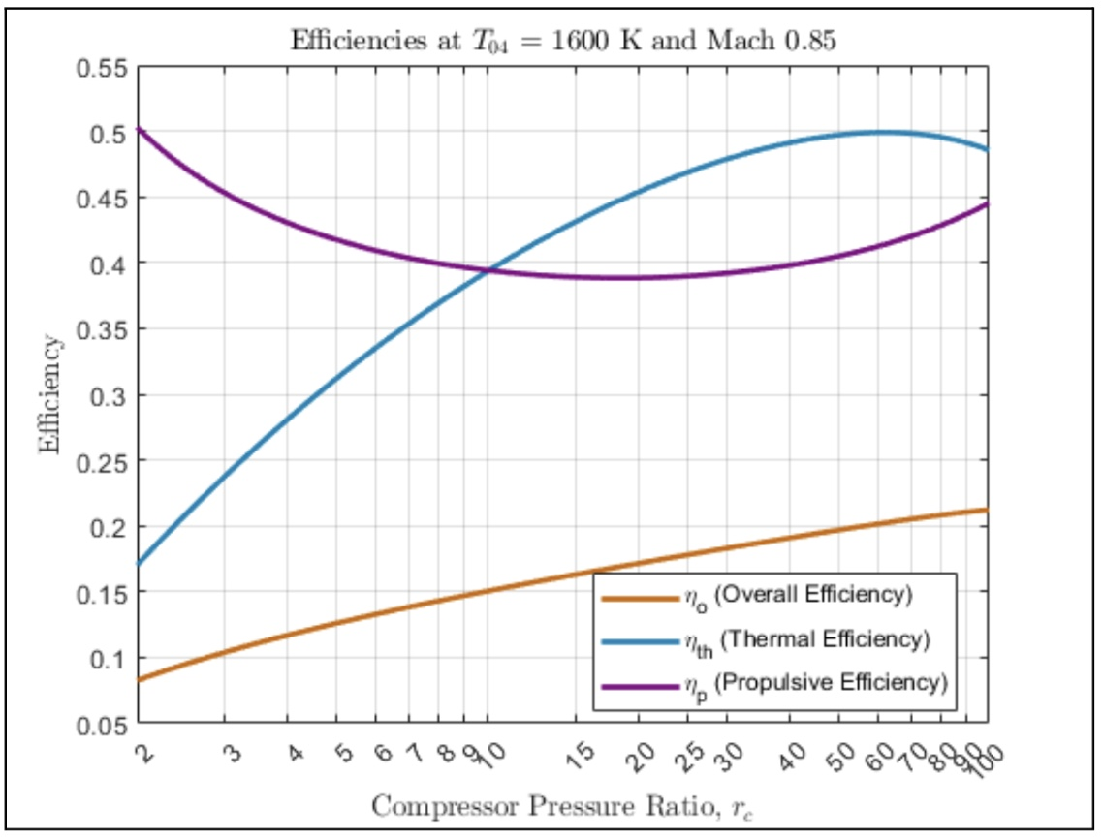
Parametric Cycle Analysis
Mach 0.85 Results

Slide 9
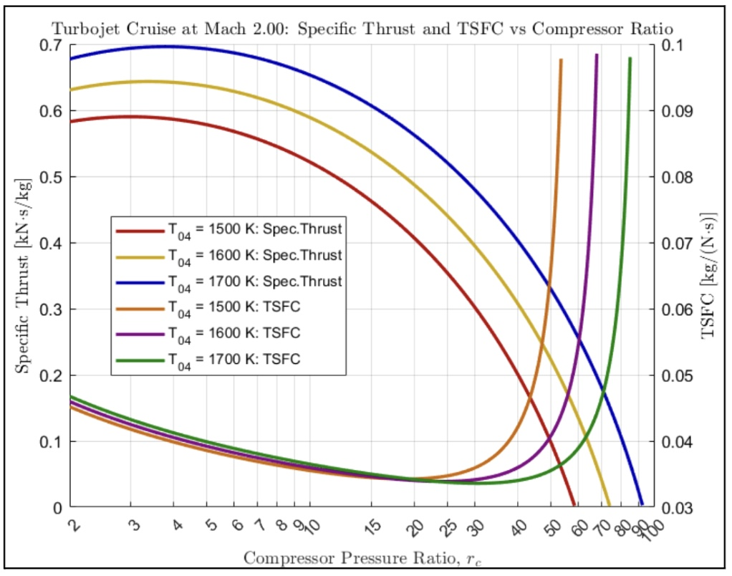
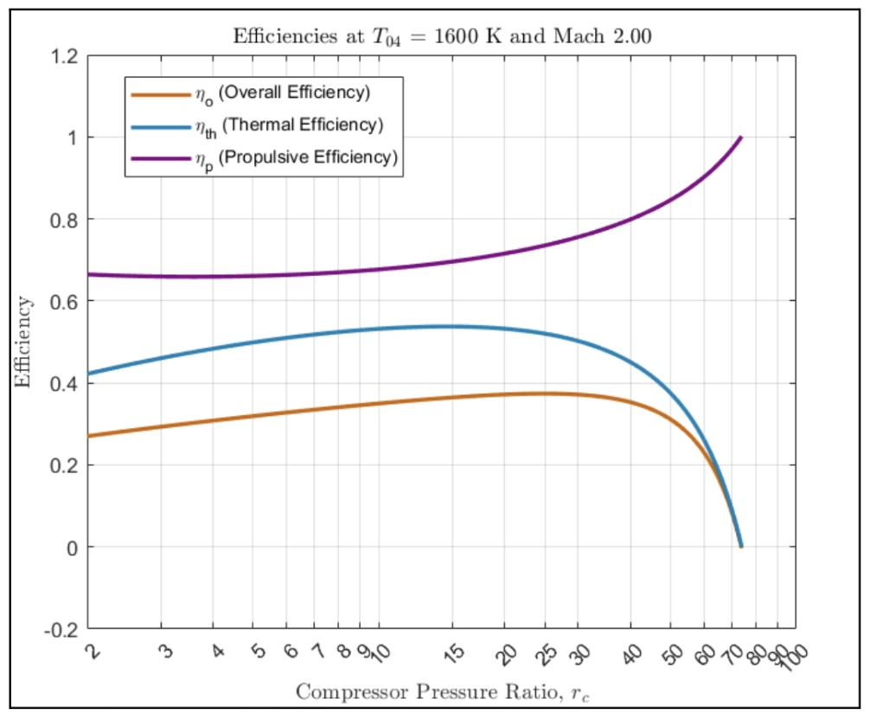
Parametric Cycle Analysis
Mach 2.0 Results

Slide 10
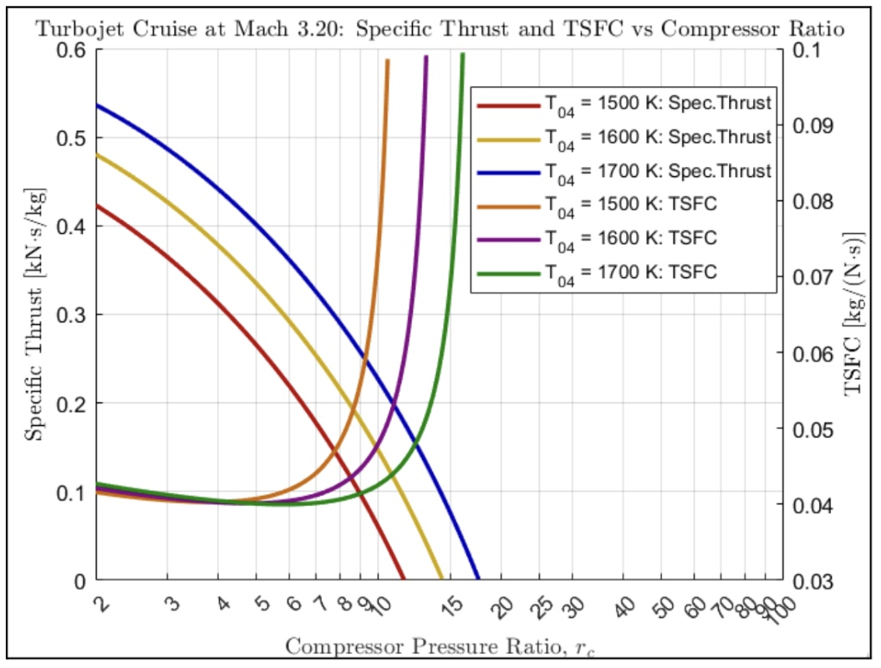
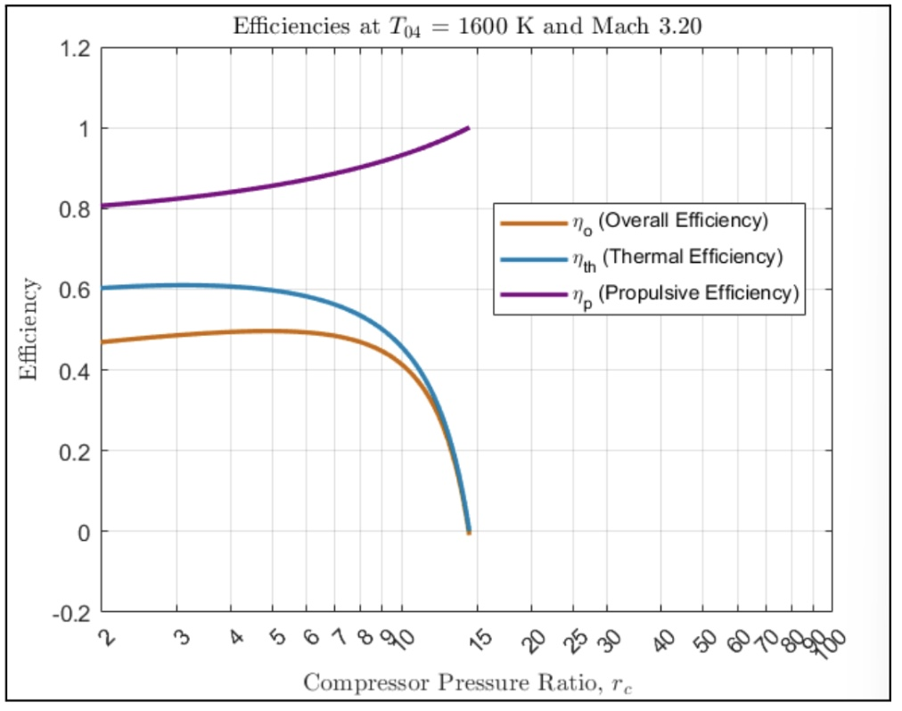
Parametric Cycle Analysis
Mach 3.2 Results

Slide 11
Compressor Pressure Ratio Selection
For a Flight Mach of 3.2 and Maximum Combustion Temperature of 1600 K

Slide 12
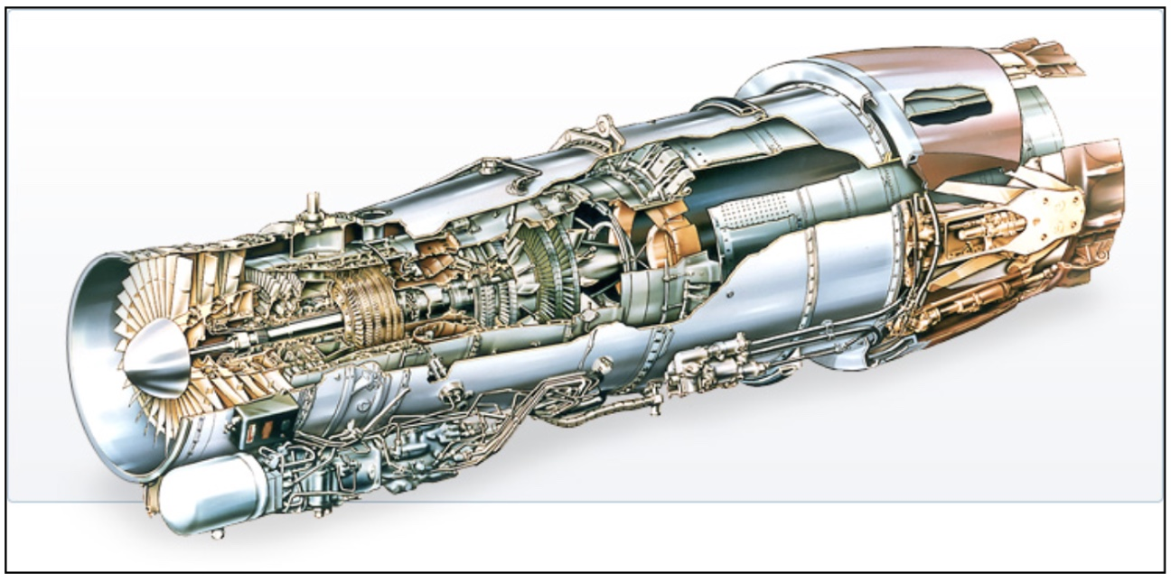
“Off-the-Shelf” Engine
Pratt & Whitney J58 Engine

Slide 13
Engine Comparison
Performance Parameter | PWJ58 Engine | Fictional Engine
Type | Turbojet* | Turbojet
Max Combustion Temp. | 1600 K | 1600 K
Compressor Pressure Ratio | 8.8:1 | 5:1
Thrust to mass flow rate at sea-level (kNs/kg) | 0.708 | 0.770**
TSFC at sea-level (kg/Nh) | 0.075 - 0.11 | 0.037**
*PWJ58 is Turbojet but with Ramjet-like qualities at higher Mach numbers. **Numbers were retrieved from parametric cycle analysis at Mach 0 sea-level, since there is no published data on the performance of the PWJ58 at cruise.
“Fictional” vs “Off-the-Shelf”
Not only does the Fictional engine have a greater Specific Thrust, it also has significantly lower TSFC at takeoff.
These improvements come down to more inefficiencies and variables that exist in the real world - that is simply unaccounted for.

