Slide 1
Group 8 Software Development
Alex, Callum, Elliott, Luke, Shiyan.

Slide 2
Group Dynamics
The first sprint was split into different categories, those being, design, API’s and algorithms. This allowed people to work on their own parts of the project whilst having to rely on the output of others less.
People were assigned jobs based on these areas.
For our first two sprints roles remained mostly the same.
Algorithms – Elliott, Callum, Luke
API’s – Callum
Design – Luke, Alex, Shiyan
These categories were split into smaller tasks that separate people could carry out.

Slide 3
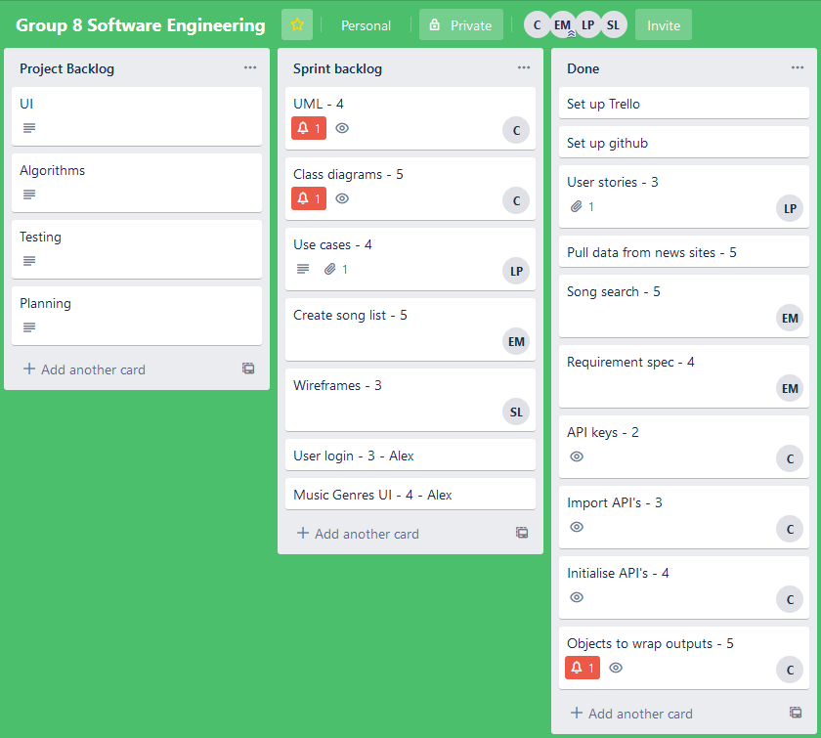
Sprint 1 and 2
Our first sprint was partially successful. Our goal was not achieved as we set the bar too high however a deliverable was still presented. We completed sprint 1 with a basic UI with most of the API section implemented.
For our second sprint we succeeded in completing our sprint goal which was: Develop a deliverable that will show the user the creation of a playlist based on the news with limited customisation options and limited UI.
We Decided what to complete from our sprint backlog based on what seemed the next logical steps in the development of our product and allowed everyone to have something to work on.

Slide 4
Tools used
We have been using three main Tools throughout our development.
We have been using Github to develop our code collaboratively as well as uploading other design documents and logs from sprints.
We have been using Trello to allocate work to everyone in the team. We have been allocating different points to each of the tasks and then have been allocating each task to someone in the group.
For talking about development and discussing what we were working on when a stand up meeting hasn’t ben viable we have been using discord.
All these tools have been very helpful in the development and documentation of our implementation. They have been very useful in collaboration and the allocation of work.

Slide 5
Evaluation
So far scrum is being managed well within our group. Our sprints last for a week and we have sprint retro and planning at the end of the week.
We expect to have our code completed and hopefully ready for deployment within the next sprint.
So far sprint has been working well within our group. The quick paced nature of development is good at motivating the group to complete their work. It is also useful to constantly be up to date with what others in the group are doing.
A disadvantage is that due to the small nature of the project is that the equal allocation of work has been hard as there are some things that are hard to collaborate on such as the implementations of the API’s.

