Slide 1
Introduction to R
Elliott Messeiller

Slide 2
Introduction to R
What is R?
Why use R?
Basic data types

Slide 3
What is R?
R is a programming language designed for statistical computing and graphics.
Developed by Ross Ihaka and Robert Gentleman in the early 1990s at the University of Auckland, New Zealand.
Open Source: Free to use, share, and modify
Comprehensive: Offers a vast collection of techniques
Extensible: Users can easily write their own packages and distribute them
Interactive: Allows for immediate feedback and facilitates exploratory data analysis.
Reproducible: scripts can be written for reproducible research and automation of complex analyses.
Integration: Works well with data from various sources and can be integrated with other languages (e.g., C, C++, Java, Python) and tools (e.g., databases, GIS).

Slide 4
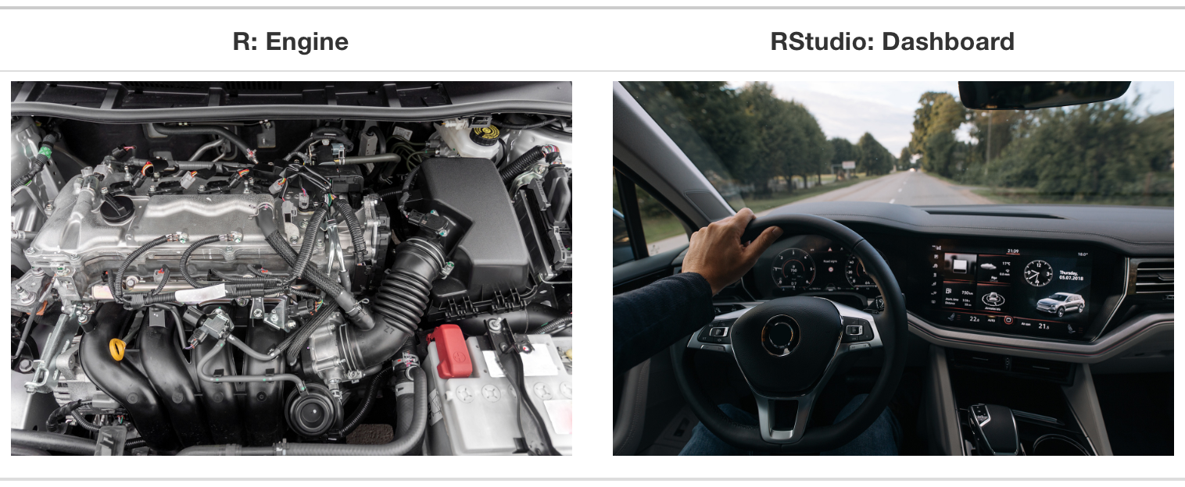
R and RStudio
Simply put, R is the engine and RStudio is the dashboard:
Source: Statistical Inference via Data Science, Modern Dive

Slide 5
Why use R and not excel?
Reproducibility and Automation: from the same input, the same output will always come out. Easier to audit what’s going on under the hood.
Data Visualization: superior graphic generation capabilities
Advanced statistical abilities
Integration with other languages and tools
Free and open source
Large datasets

Slide 6
Why Use R? Comparing R to Python
Feature | R | Python
Focus | Designed specifically for statistical analysis and visualization. | General-purpose programming with strong support for data science.
Ecosystem | Over 16,000 packages on CRAN for various statistical needs. | Rich library ecosystem with a strong focus on both data science and general programming.
Data Visualization | ggplot2 offers superior aesthetics and functionality. | matplotlib and seaborn for powerful visualizations, with a learning curve.
IDE | RStudio: A powerful, dedicated IDE for R. | Various (e.g., PyCharm, Jupyter Notebooks, VS Code), versatile but not specialized.
Community and Support | Deeply rooted in academia and research, with extensive resources for statistical problems. | Broad, with a strong emphasis on general programming and software development.
Ease of Learning | Syntax and data structures designed with statisticians in mind, potentially more intuitive for those with a statistical background. | Praised for readability and simplicity, appealing to a wide range of backgrounds.
Performance | Highly efficient for data analysis tasks, with packages designed for speed. | Might have an edge in performance for general programming tasks, due to optimized libraries like NumPy.
The choice between R and Python often depends on the needs of the project, and ultimately the programmers. Data scientist tend to prefer R, whilst data engineers Python.

Slide 7
Basic Data Types in R
Numeric: Represents decimal values and integers. Example: x <- 2.5, y <- 10
Integer: A subtype of numeric that represents whole numbers. Integers are specified by adding L to the end of a number (or just 25). Example: count <- 25L
Character: Represents strings (text). Example: name <- "John Doe"
Factor: Used for categorical data. Levels provide a way to handle categorical variables. Example: gender <- factor(c("male", "female", "female"))
gender <- factor(c("male", "female", "female")) print(gender)
## [1] male female female ## Levels: female male
Logical: Holds Boolean (TRUE or FALSE), logical, values. Example: is_valid <- TRUE

Slide 8
Collections of data
List: An ordered collection that can contain objects of different types, including numbers, strings, vectors, and even other lists. Example:
my_list <- list(name="Alice", age=25, scores=c(90, 80, 85))
Data Frame: A collection of vectors of equal length, but potentially different types. It’s the most common data structure for datasets. Example:
df <- data.frame( Name = c("Alice", "Bob", "Charlie"), Age = c(25, 32, 28), Gender = factor(c("Female", "Male", "Male")) )
Matrix: similar to data frames but with only one type of data (e.g. only numerical)

Slide 9
R packages
Out of the box R is called “base R”. However, it can be limited in its functionalities, and its use a bit confusing to modern users.
Then come packages. They supplement base R, and can be so useful that the first thing you would typically do is to load one.
Excellent sources of packages include the tidyverse (see below) and ROpenSci.
Packages are installed with:
install.packages("tidyverse")
The package are then loaded for use with the R environment with (note the absence of quotation):
library(tidyverse)

Slide 10
The tidyverse
Reigning supreme over all packages are the tidyverse packages.
They are a collection of packages that offer a similar approach to data. They are well maintained and documented which make them excellent choices:
tidyr: helps to create tidy data: pivot, fill, split, etc.
dplyr: data manipulation: summarise, group, filter, select, slice, join, etc.
readr: read data
ggplot2: plotting data
stringr: string manipulation
forcats: factors manipulation
purrr: functional programming

Slide 11
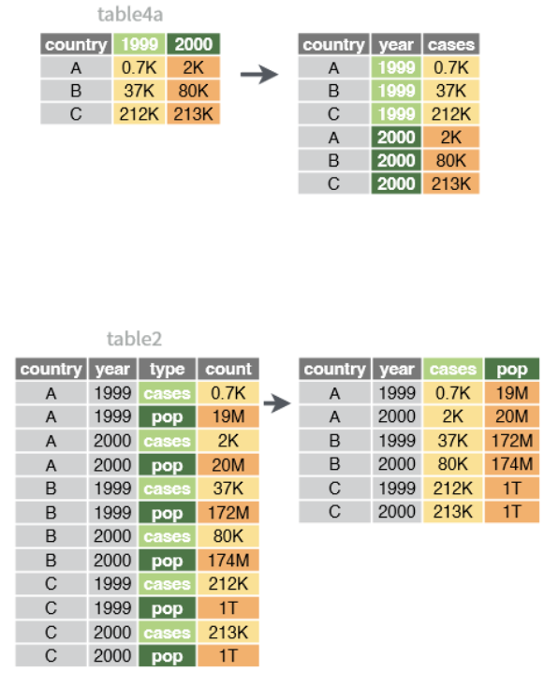
Tidy data
Core to the tidyverse is the concept of tidy data.
Tidy data is data where:
Each variable is a column; each column is a variable.
Each observation is a row; each row is an observation.
Each value is a cell; each cell is a single value.
HeRAMS data is mostly tidy when downloaded from the platform:
each variable is a column (or close to it)
each row is an observation (HSDU)
Each cell is a single value

Slide 12
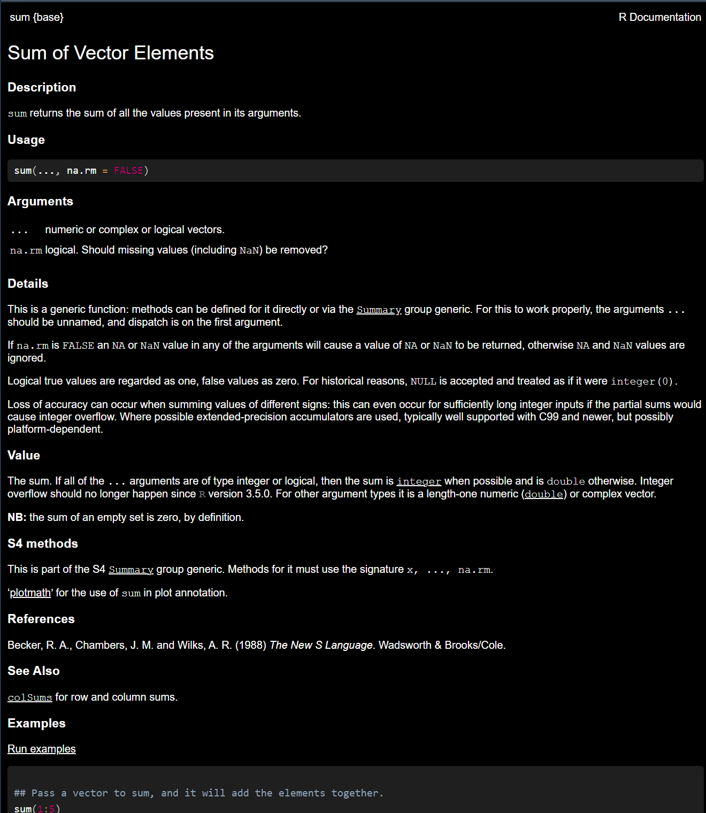
Getting help from R: help pages
Any function coming from an R package should have an help page that can be accessed with:
?sum
It opens something like:

Slide 13
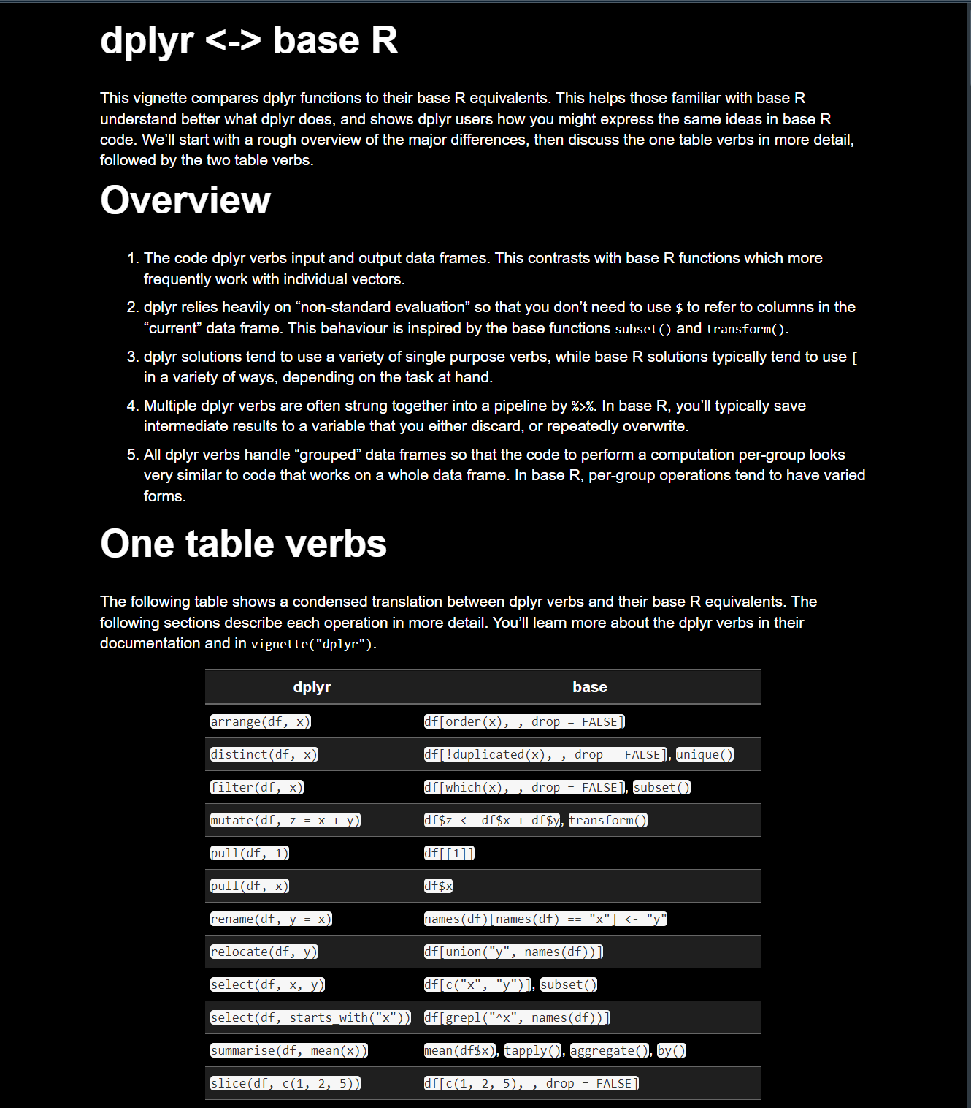
Getting help from R: vignettes
Vignettes are more descriptive help pages. They are written by the package creator to examplify a specific topic.
vignette("base", "dplyr")

Slide 14
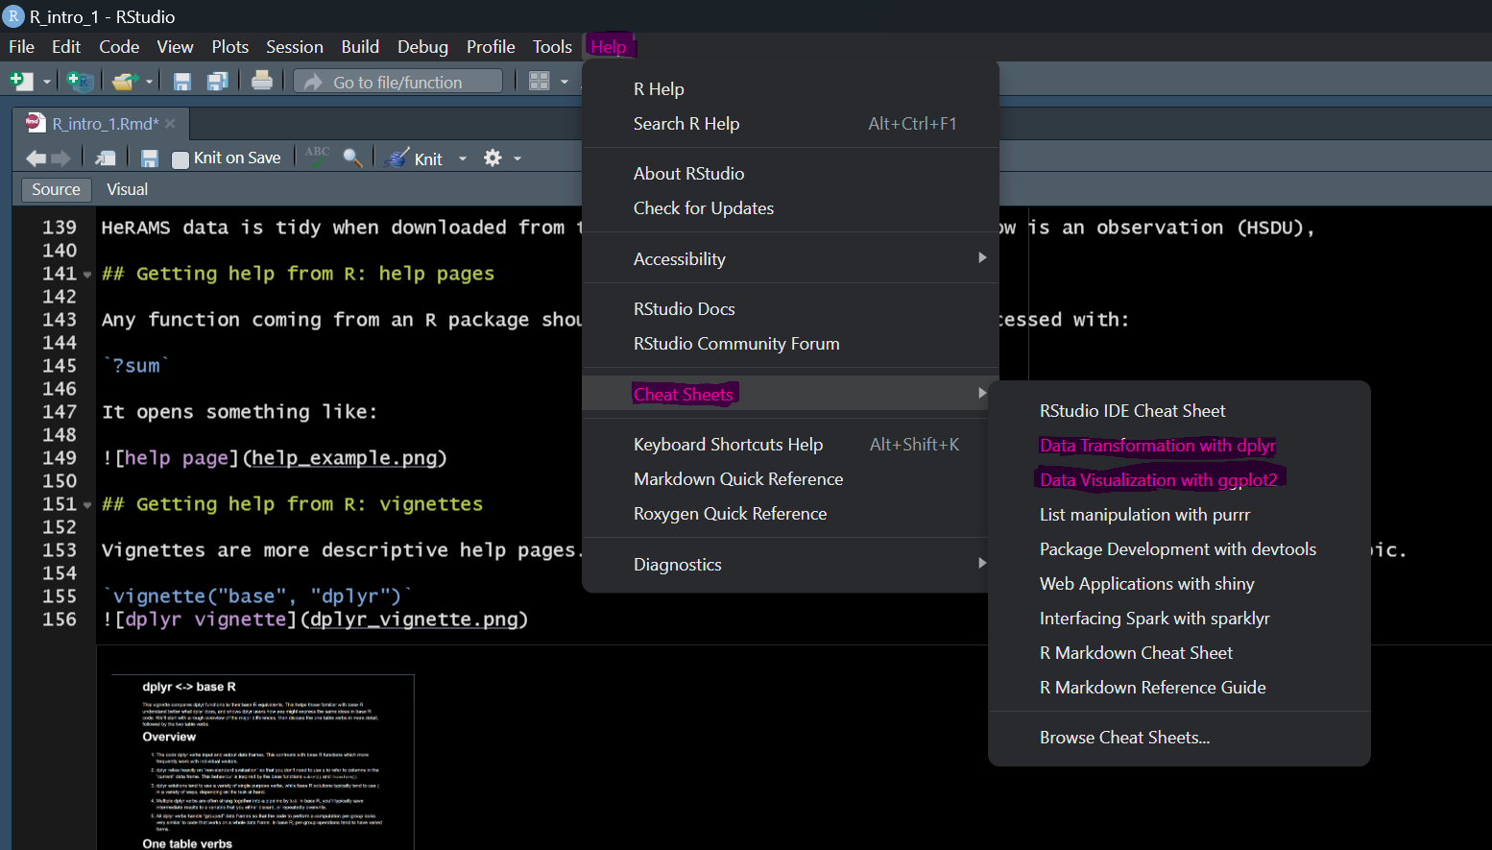
Getting help from R: cheatsheet
Cheatsheets are available for most tidyverse packages directly from RStudio

Slide 15
Go further
datacamp: good starting point for learning
RStudio’s beggininers education
Large language models (chatGPT & co.) can be great coding tutors! (this presentation was done on a ChatGPT skeleton)

