Slide 1
MALTA2 Allpix-Squared
Author: Elliott P Wright

Slide 2
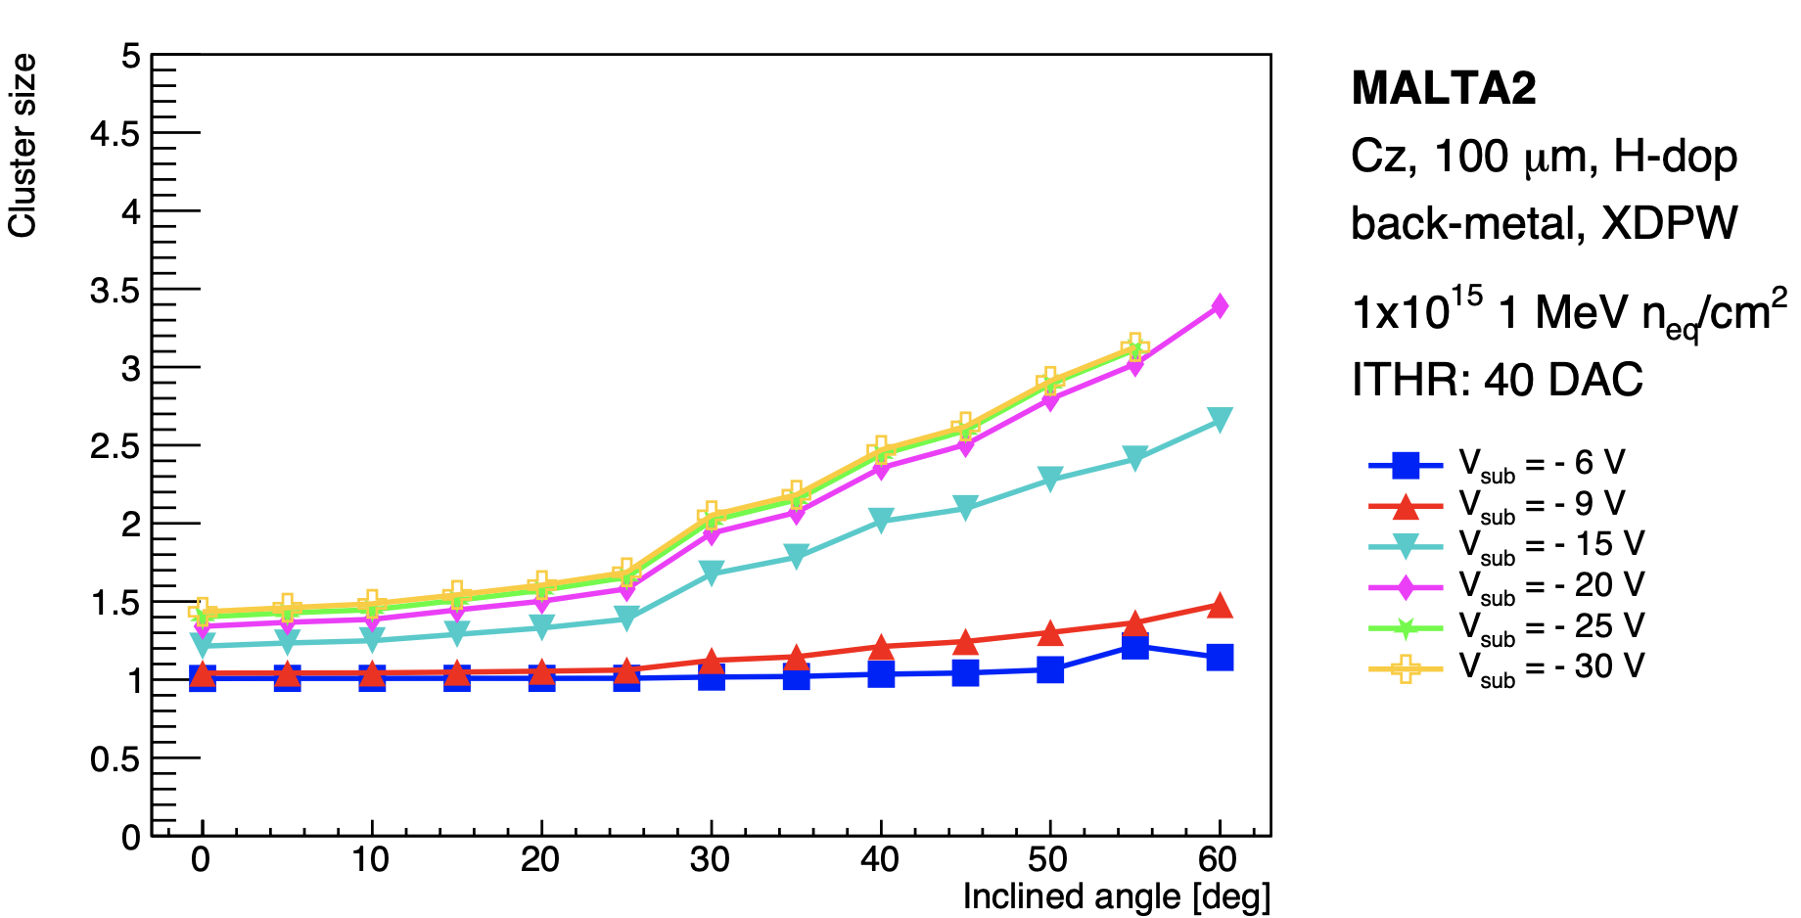
Cluster Size vs Incident Angle

