Slide 1

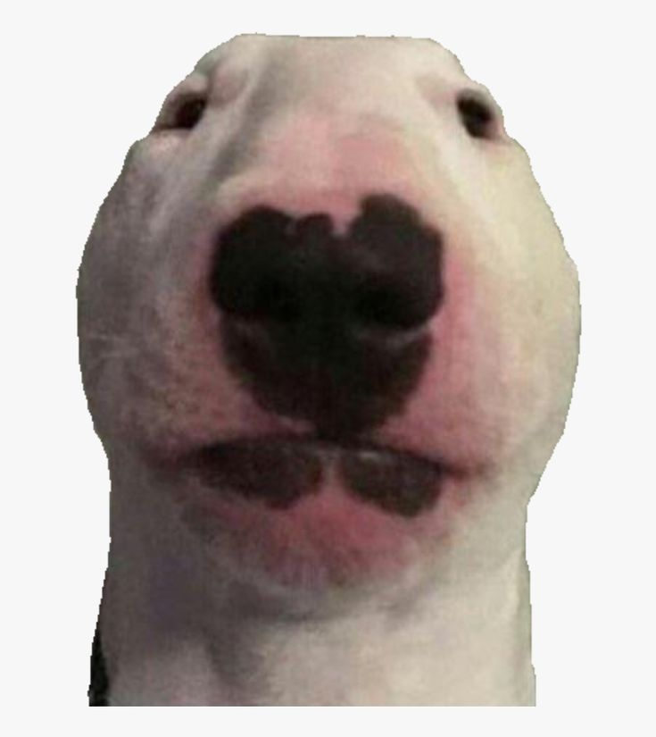

SCI 11

Slide 2
Ellis Dann
The Project Idea
The idea for our project is to develop an AI to accurately identify dog breeds.
The primary milestones for the project include:
Finding an appropriate dataset that we can use to train the AI
Using the appropriate algorithms as well as the dataset we found to train the AI
Creating a simple and easy to understand user interface for our users and finally
Remove bugs and optimise.
To find an appropriate dataset we plan on searching through various websites such as Roboflow and Kaggle until we find a comprehensible dataset with multiple pictures of various dog breeds for us to use. This should be the simplest of all the milestones to achieve.
To train the AI we first need to do research into the potential libraries that we could use for the machine learning such as TensorFlow and then learn how to leverage these libraries to train our own AI.
To develop a user interface, we will use the python library Tkinter. The primary feature that needs to be included in the UI to make it simple to users is an image upload feature.
To ensure accuracy and reliability we will continue testing and training our AI whilst making changes to optimise it. We will also vigorously test the UI to remove any bugs and ensure reliability for our users.

Slide 3
Joseph Kemp

Slide 4
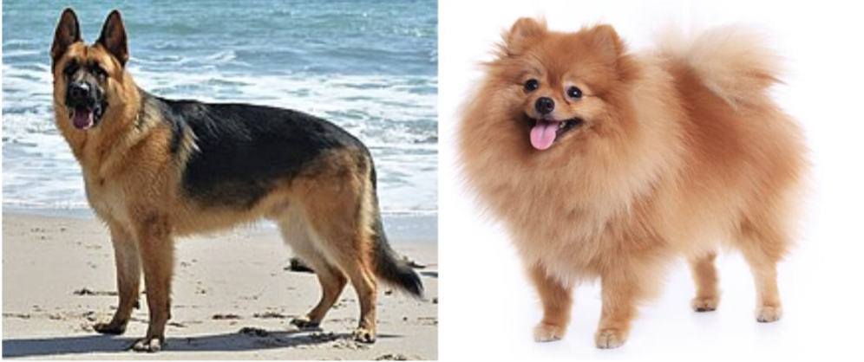
Daniel Arnold
Challenges in dog breed identification
· Finding a large enough dataset
To accurately distinguish breeds you need a large dataset. Lots of dogs are quite similar so without it the program would never get a high certainty
· Most dog breeds are easy to distinguish between E.G:
It is obviously very easy for us to recognize the difference between a German shepherd and a Pomeranian. Very distinct breeds are all easy to recognize by our program.
· The problems only happen when the characteristics of the breeds are very similar E.G a Malamute and a Husky.
Depending on the image this may course the program to not get the correct answer or not too particularly certain about it. To mitigate this problem we have tried to get the largest data set we could to improve the accuracy of the predications. Training it for an increased amount of time may also help but that would be limited by the training data at some point.

