Slide 1
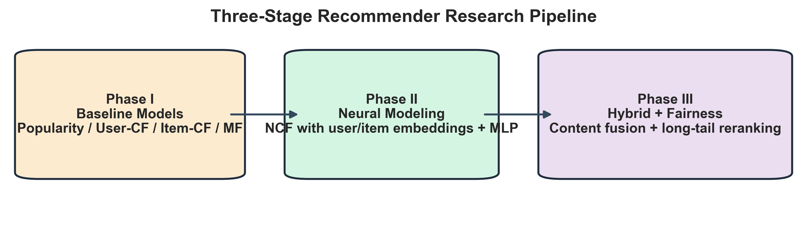
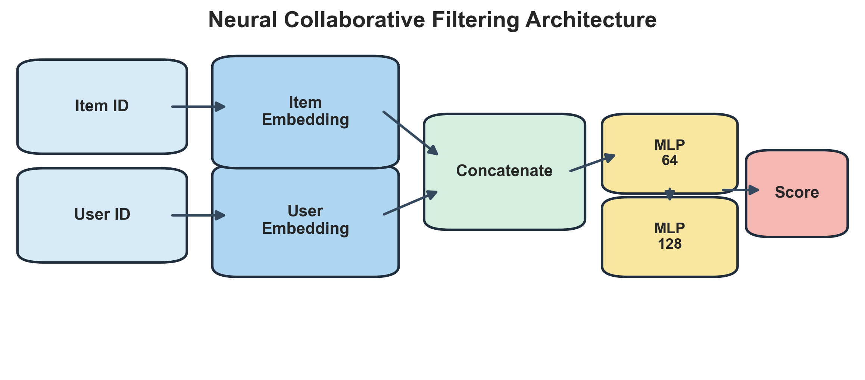
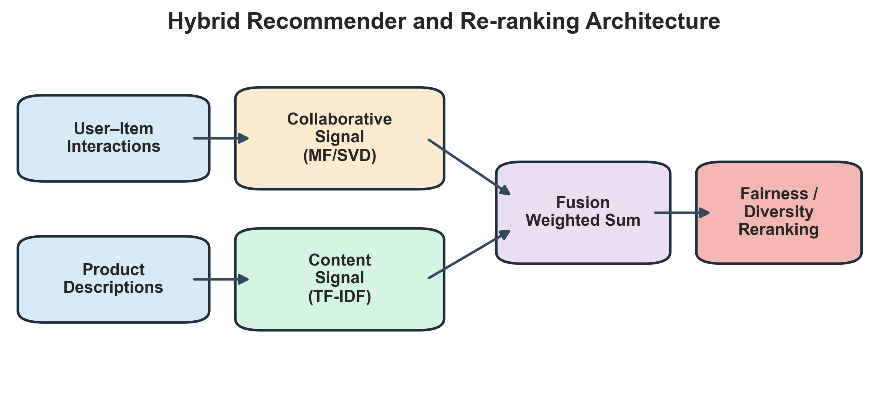
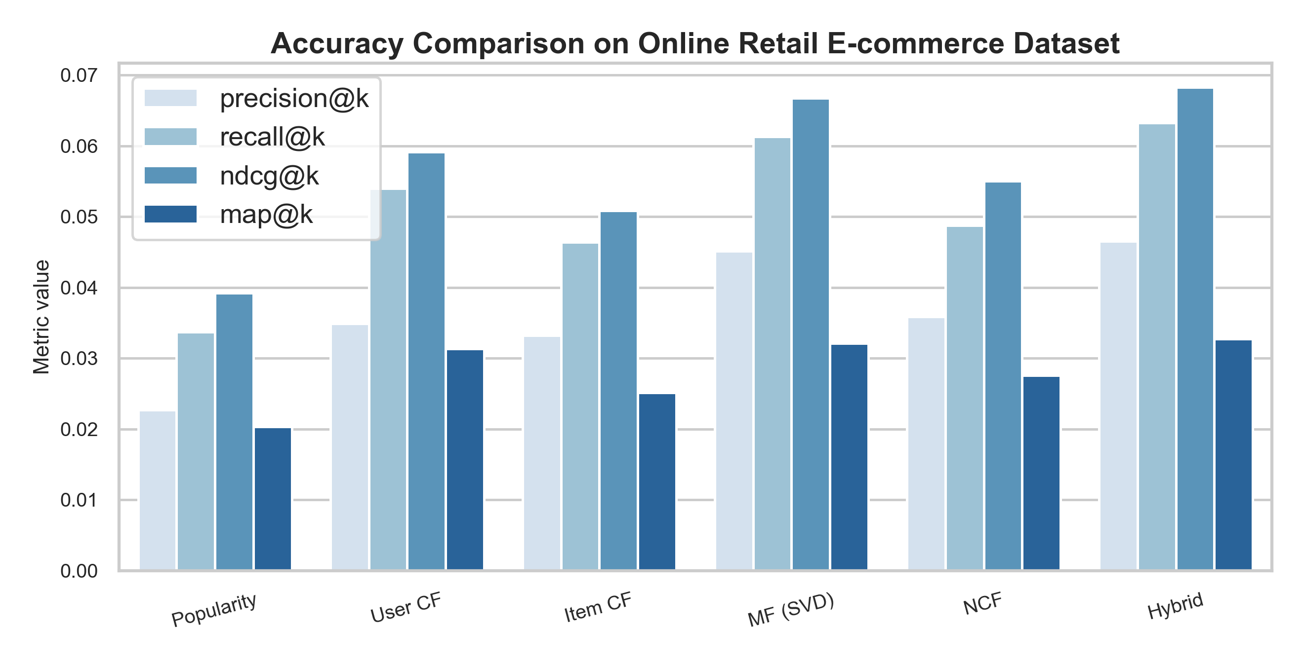
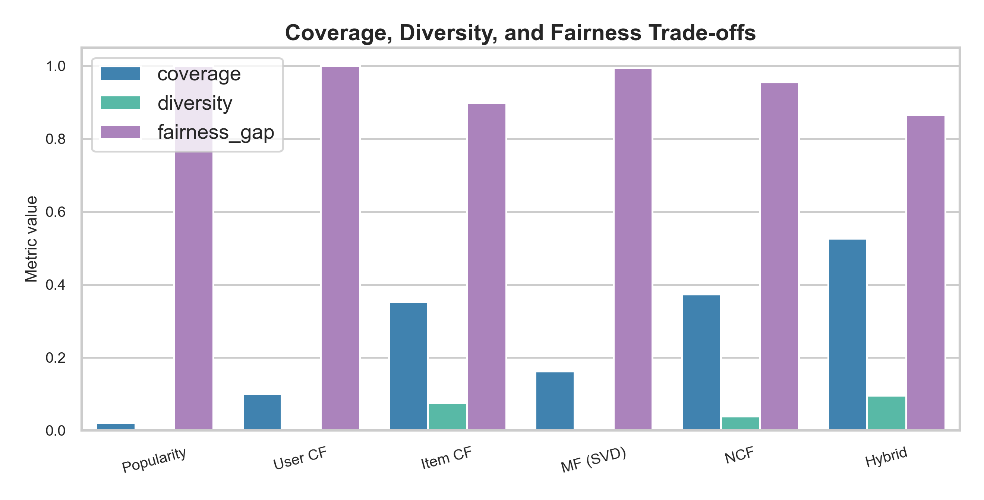
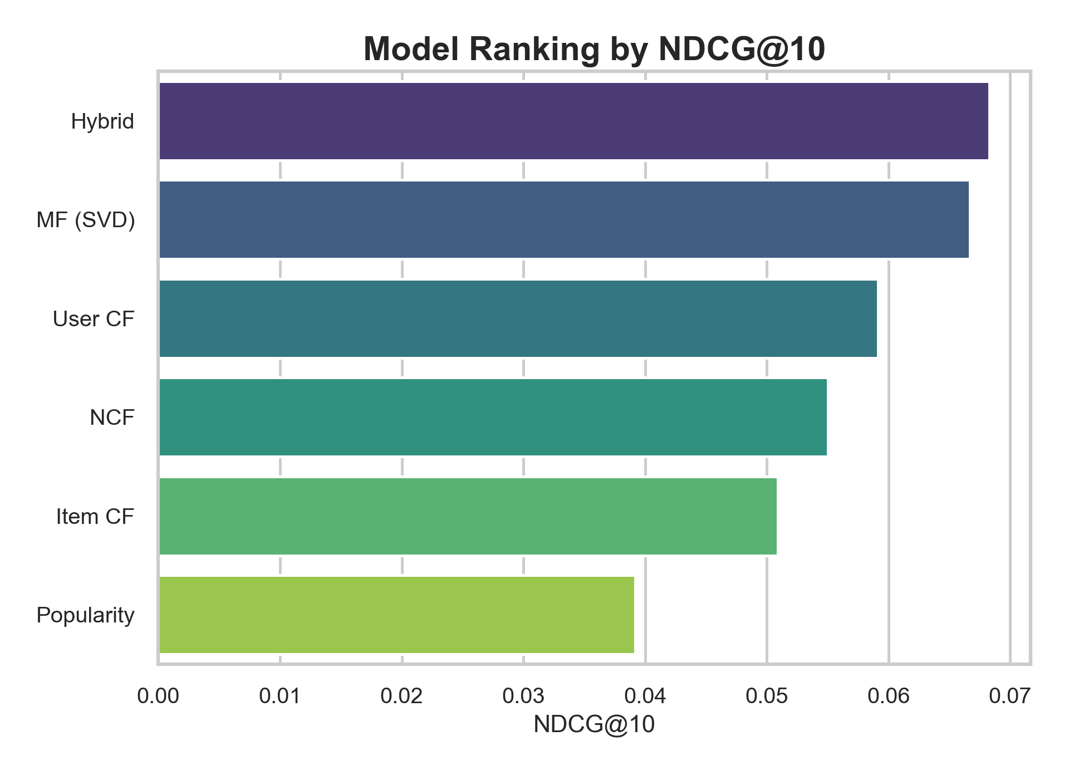
A Systematic Study of Recommendation Algorithms for E-commerce Platforms
Real e-commerce dataset + three-stage recommender benchmark + academic poster redesign
Licheng Guo · DATS5990 Independent Study · University of Pennsylvania
Research Motivation
Dataset and Protocol
Main Contributions
E-commerce platforms require recommenders that balance ranking quality, product coverage, diversity, and fairness.
Purely accuracy-oriented methods often overexpose head products and under-serve the long tail.
This project studies whether hybrid and fairness-aware methods improve practical recommendation quality.
Dataset: UCI Online Retail, a transactional e-commerce dataset with customers, stock codes, timestamps, and product descriptions.
Users with at least 5 interactions and items with at least 5 purchases were retained.
Evaluation uses chronological train/validation/test splitting and Top-K ranking metrics.
Unified pipeline for baseline, neural, and hybrid recommenders.
Switched from movie benchmark to a true product-level e-commerce dataset.
Poster integrates model architectures, empirical results, and deployment-oriented interpretation.
Overall Research Pipeline
Phase I — Classical Baselines
Phase II — Neural Modeling
Phase III — Hybrid + Fairness-aware Optimization
Included Models
Popularity ranking
User-based collaborative filtering
Item-based collaborative filtering
Matrix factorization via truncated SVD
Role: establish interpretable and competitive baselines for offline ranking.
NCF learns nonlinear user–item interactions using embedding layers followed by an MLP scoring network.
Hybrid ranking combines collaborative and content signals, then applies reranking to improve long-tail exposure and recommendation diversity.
Quantitative Results: Accuracy Metrics
Quantitative Results: Trade-off Metrics
Ranking Summary
Key Empirical Findings
Interpretation for E-commerce
Best ranking accuracy: Hybrid (NDCG@10 = 0.068).
Best coverage: Hybrid (Coverage = 0.527).
Best diversity: Hybrid (Diversity = 0.095).
Hybrid recommendation offers the strongest overall balance across ranking quality, catalog coverage, and diversity.
Neighborhood and factorization methods remain strong on sparse transactional data.
Neural models are feasible, but are not automatically superior without richer features or sequence signals.
Hybrid reranking is attractive for deployment because it broadens product exposure while preserving accuracy.
Metric Table
Model | Precision@10 | Recall@10 | NDCG@10 | MAP@10 | Coverage | Diversity | Fairness Gap
Hybrid | 0.047 | 0.063 | 0.068 | 0.033 | 0.527 | 0.095 | 0.867
MF (SVD) | 0.045 | 0.061 | 0.067 | 0.032 | 0.161 | 0.005 | 0.995
User CF | 0.035 | 0.054 | 0.059 | 0.031 | 0.099 | 0.000 | 1.000
NCF | 0.036 | 0.049 | 0.055 | 0.028 | 0.373 | 0.039 | 0.955
Item CF | 0.033 | 0.046 | 0.051 | 0.025 | 0.352 | 0.075 | 0.898
Popularity | 0.023 | 0.034 | 0.039 | 0.020 | 0.019 | 0.000 | 1.000
Conclusion
Future Directions
Using a real e-commerce dataset changes the framing from generic recommendation to product-level retail recommendation.
The hybrid model achieved the best overall balance, especially for catalog coverage and diversity.
This supports the argument that practical recommender systems should optimize more than accuracy alone.
Add sequential models such as GRU4Rec or Transformer recommenders.
Integrate richer product attributes and user history features.
Extend fairness analysis to seller exposure, category fairness, and cold-start product promotion.
Poster regenerated from the updated Online Retail e-commerce experiment pipeline. Layout intentionally styled closer to academic conference posters with architecture diagrams and enlarged typography.

