Slide 1
MUSIC_BAND
Band-name | Band-page
RELEASE
Release-ID | Band-name | Release-title | Release-year | Release-type | Release-rate
SONG
Release-ID | Song-title | Award
MEMBERSHIP
Member-ID | Musician-webpage | Band-name | End-y | Start-y | Band_role
MUSICIAN
Musician-webpage | Musician-name

Slide 2
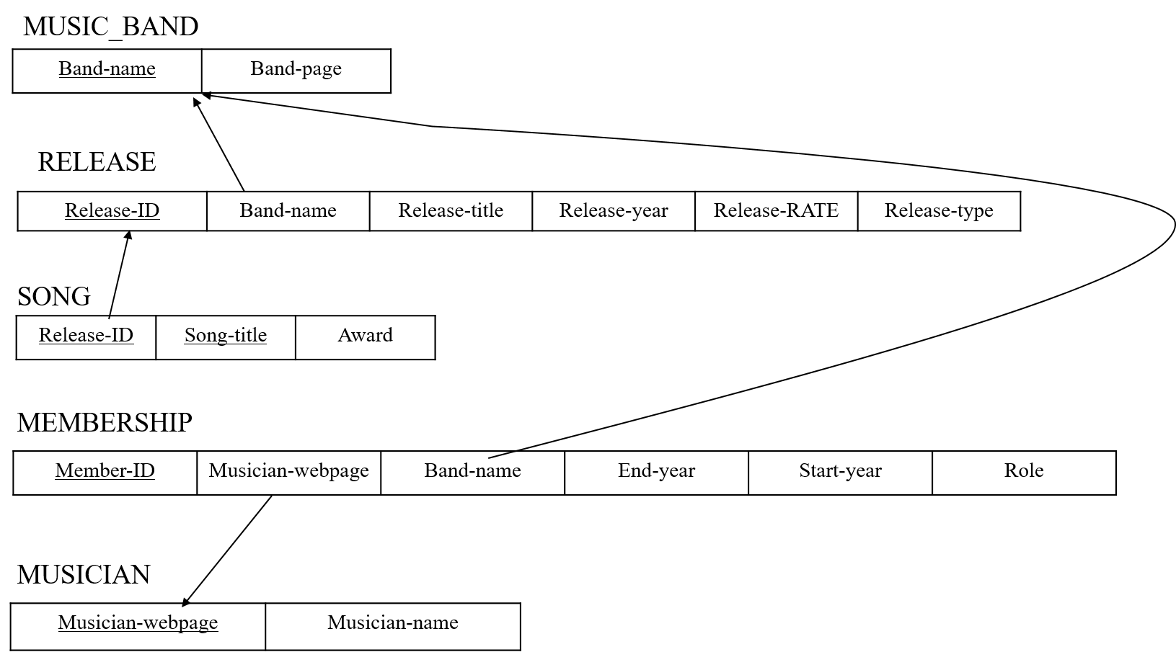

Slide 3



$$π_{musician_name}$$
SQL1
$$σ_{End_y=NULL}$$
$$σ_{Band_name=^{′}The CURE^{′}}$$
$$⋈_{E.musician_webpage=U.musician_webpage}$$
E
U
MEMBERSHIP
MUSICIAN

Slide 4


$$π_{musician−name,band−name}$$
SQL2
$$⋈_{musician−name=band−name}$$
B
U
MUSIC_BAND
MUSICIAN

Slide 5



$$π_{ busician−webpage}$$
SQL3
$$σ_{count(distinct busician−webpage)}$$
$$σ_{Band−role=^{′}bass^{′}}$$
E
MEMBERSHIP

Slide 6


$$π_{release−title,release−year,musician−year}$$
SQL4
$$σ_{release−year≤End−y OR releas−y is null}$$
$$σ_{release−year≥Start−y OR releas−y is null}$$
$$⋈_{E.musician−webpage=U.musician−webpage}$$
$$⋈_{E.band−name=R.band−name}$$
$$σ_{band−role=^{′}drums^{′}}$$
U
E
R
MUSICIAN
MEMBERSHIP
RELEASE_INFO

Slide 7




$$π_{musician_name}$$
OP SQL1
$$⋈_{E.musician_webpage=U.musician_webpage}$$
$$π_{E.musician_webpage}$$
$$π_{U.musician−webpage,U.musician−name}$$
$$σ_{End_y=NULL}$$
$$σ_{Band_name=^{′}The CURE^{′}}$$
U
E
MUSICIAN
MEMBERSHIP

Slide 8




$$π_{musician−name,band−name}$$
OP SQL2
$$⋈_{musician−name=band−name}$$
$$π_{band−name}$$
$$π_{musician−name}$$
B
U
MUSIC_BAND
MUSICIAN

Slide 9




$$σ_{count (busician−webpage)}$$
OP SQL3
$$σ_{distinct busician−webpage}$$
$$π_{ musician−webpage}$$
$$σ_{Band−role=^{′}bass^{′}}$$
E
MEMBERSHIP

Slide 10


$$π_{release−title,release−year,musician−name}$$
$$⋈_{E.musician−webpage=U.musician−webpage}$$
OP SQL4
$$σ_{release−year≤End−y OR releas−y is null}$$
U
$$σ_{release−year≥Start−y OR releas−y is null}$$
$$π_{ start−y, end−y, musician−webpage, release−name, release−title}$$
MUSICIAN
$$⋈_{E.band−name=R.band−name}$$
$$π_{E.musician−webpage, E.Start−y,E.End−y, E.band−name}$$
$$π_{Rrelease−year, R.release−title, R.band−name}$$
$$σ_{band−role=^{′}drums^{′}}$$
R
E
MEMBERSHIP
RELEASE_INFO

