Slide 1
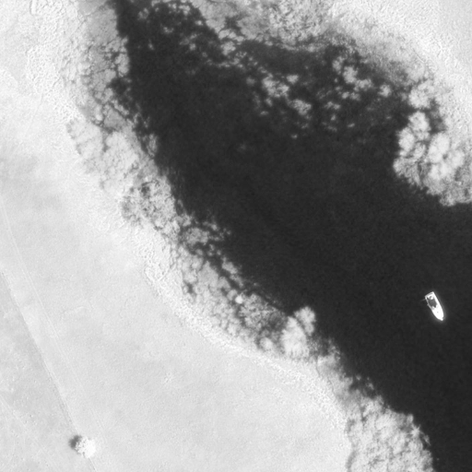
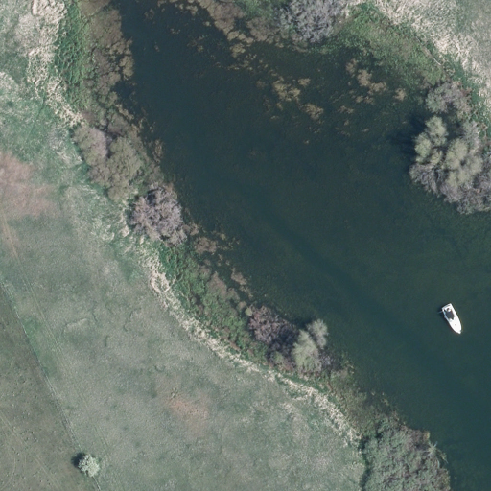
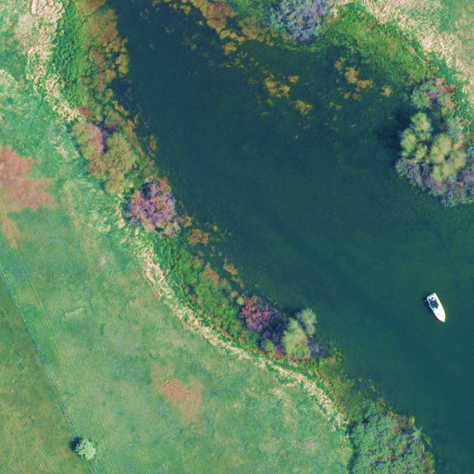
YOLOv11-RGBT: Towards a Comprehensive Single-Stage Multispectral Object Detection Framework
Dahang Wan^{a,b}, Rongsheng Lu^{a,b}*, Yang Fang^{a,b}, Xianli Lang ^{a,b}, Shuangbao Shu^{a,b}, Jingjing Chen^{a,b}, Siyuan Shen^{a,b}, Ting Xu^{a,b}, Zecong Ye^{c}
ªSchool of Instrument Science and Opto-electronics Engineering, Hefei University of Technology, Hefei 230009, China
^{b}Anhui Province Key Laboratory of Measuring Theory and Precision Instrument, Hefei University of Technology, Hefei 230009, China
^{c}School of Information Engineering, Engineering University of PAP, Xi’an 710086, China
Visible images
B,3,640,640
Infrared images
B,1,640,640
Conv
Conv
Bbox Conv2d
Conv
Conv
Add
DWConv
Conv
Cls Conv2d
Conv
DWConv
Decoupled Head
(DC Head)
Bottleneck (BK)
Conv
BK
Conv
C3K
Add
Conv
Backbone
Conv
2 X
… n …
Conv
Split
… n …
C3K
BK
Concat
C3K2
C3K
Conv
Conv
4 X
Conv
MaxPool2d
MaxPool2d
MaxPool2d
Conv = Conv2d + BN + Silu
C3K2 *2
C3K2 *2
SPPF
Concat
Conv
Conv
Conv
8 X
Neck
C3K2 *2
Head
C3K2 *2
Concat
C3K2 *2
P3
DC Head
P3
8 X
Concat
Conv
(4*reg_max+nc)*256*256
Conv
Concat
Conv
16 X
Upsample
Concat
reg_max=16
C3K2 *2
P4
16 X
C3K2 *2
C3K2 *2
C3K2 *2
DC Head
Conv
Concat
Conv
P4
Concat
Conv
(4*reg_max+nc)*192*192
C3K2 *2
C3K2 *2
32 X
SPPF
Upsample
Concat
(4*reg_max+nc)*128*128
C2PSA
P5
C3K2 *2
DC Head
P5
32 X
使用请注明来源：https://github.com/wandahangFY/YOLOv11-RGBT
Dahang Wan, wandahang@mail.hfut.edu.cn

