Slide 1

Nginx K8s LoadBalancer Controller - Overview for <who>
Chris Akker – Solution Architect / Nginx
Steve Wagner – Solution Architect / Nginx

Slide 2
Agenda
Kubernetes Network / Ingress Review
Use case
What is it
Why build it
Business Case – Dell
Rob’s Dell Trip Report Snippet
Alternatives

Slide 3
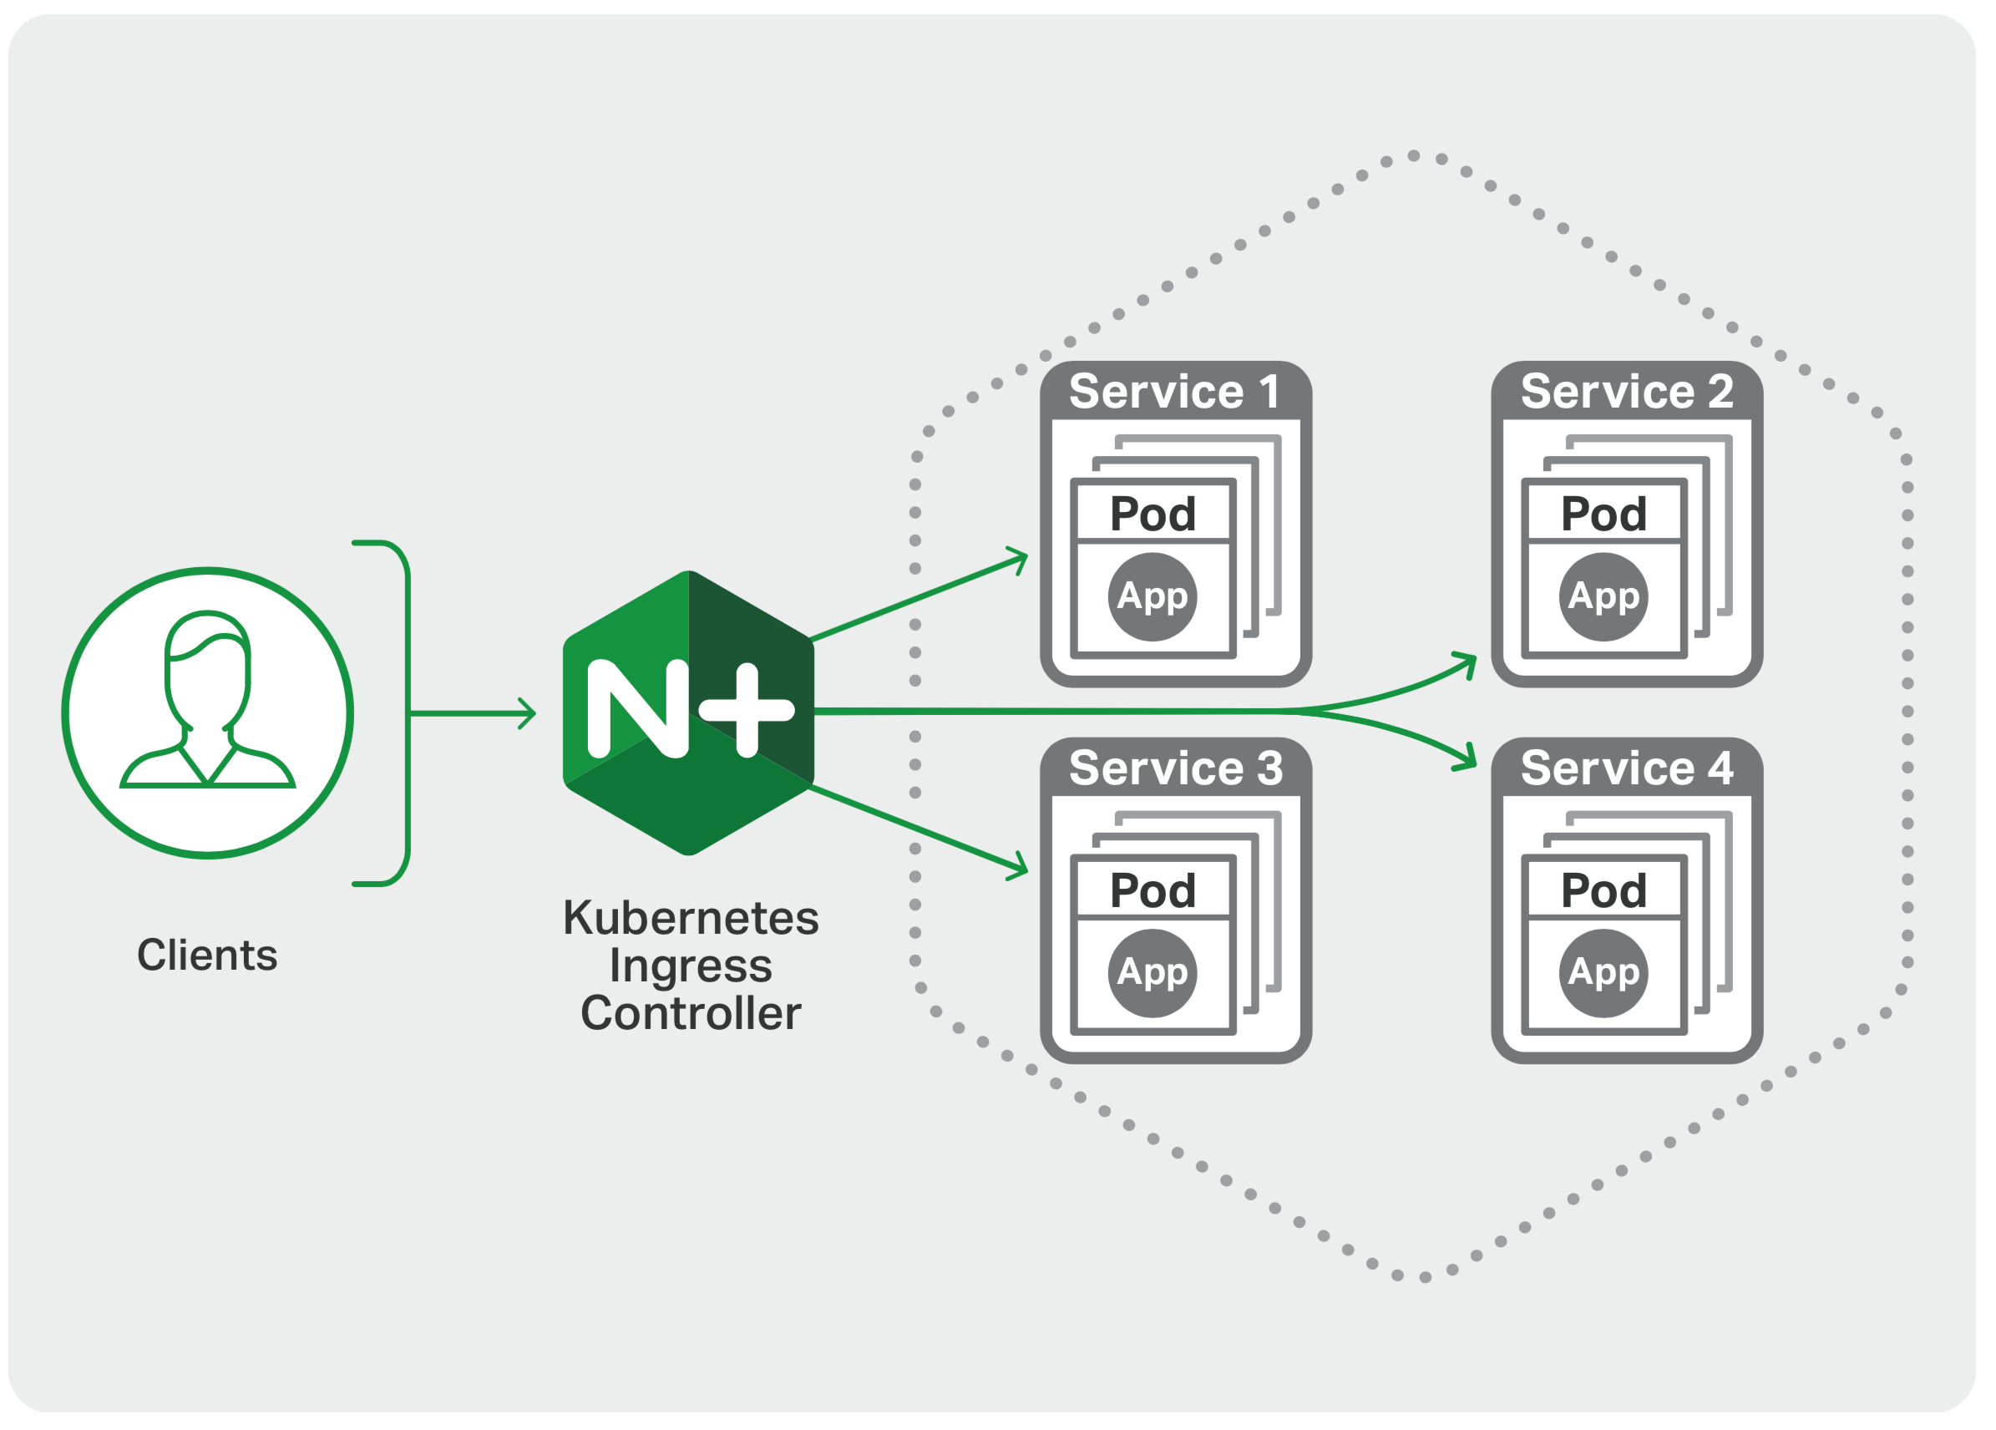
Kubernetes Ingress Controller
An advanced Layer 7 load‑balancing solution for exposing Kubernetes services to the Internet
NGINX commonly used as Ingress Controller
Dynamic reconfiguration of endpoints (no configuration reloading)
Additional metrics, provided by a streamlined Prometheus exporter
Dedicated Helm chart repository
Support for Custom resources to expose more (all) NGINX Plus features as an Ingress
Keep business logic in tact and move it closer to the cluster resources
Notes:
Benefits
Improved system resources utilization for large-scale deployments Every time the number of running containers of an application changes, the Ingress controller updates the configuration of NGINX to reflect those changes. For the open source NGINX software, the configuration file must be changed and the configuration reloaded. For NGINX Plus, the on-the-fly reconfiguration feature is utilized, which allows NGINX Plus to be updated on-the-fly without reloading the configuration. This prevents increase of memory usage during reloads, especially with a high volume of client requests, as well as increased memory usage when load balancing applications with long-lived connections (WebSocket, applications with file uploading/downloading). As a result, NGINX Plus Ingress controller is better suited for production-ready deployments.
Reduced complexity – Standardizing On NGINX Plus for both Kubernetes and non-Kubernetes applications means fewer tools to manage, and that means more reliable applications and lower costs.
Advanced load balancing – Support for session persistence, WebSocket, HTTP/2, and gRPC addresses the needs of complex microservices applications.
Security – SSL/TLS termination with configurable encryption and support for JWT authentication maximizes performance and privacy.
Real-time statistics – Advanced real-time statistics about traffic flow through the cluster provide detailed insights into how NGINX Plus and your applications are performing.
Production ready – Feel confident with a stable, reliable Ingress controller tested by NGINX, Inc. and covered by 24x7 support for NGINX Plus customers.

Slide 4
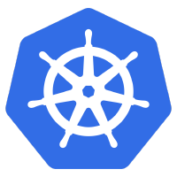

K8s Type: NodePort
Kubernetes will allocate a specific port on each Node to that service, and any request to your cluster on that port gets forwarded to the service. Ports are ephemeral - they will change.
example.com
coffee
service
NodePort
Coffee pods
30000-32767
URL – https://cafe.example.com:30433/coffee
Notes:
In layman's terms, nodePort is the port that a client outside of the cluster will "see".
nodePort is opened on every node in your cluster via kube-proxy and is accessible from outside the cluster by requesting the <NodeIp>:<NodePort>. This is easy, but not robust. You don’t know what port your service is going to be allocated, and the port might get re-allocated at some point.
nodePort is a configuration setting you declare in a service’s YAML and the Node port will be a fixed port for that Service, in the default range of 30000-32767)
------------------------------------------------------------------------------------------------------------
Good Explanation:
https://matthewpalmer.net/kubernetes-app-developer/articles/kubernetes-ingress-guide-nginx-example.html

Slide 5

K8s Type: Ingress
In Kubernetes, an Ingress is an object that allows access to your Kubernetes services from outside the Kubernetes cluster.
Nginx Ingress Controller(s)
coffee
service
/coffee
Coffee pod
Plus/OSS Ingress
NodePort
Service
/tea
tea
service
Tea pod
café.example.com:3xxxx/coffee café.example.com:3xxxx/tea
Notes:
How to expose ingress controller?
On-premises
Exposing the NGINX IC on a subset of cluster nodes
A load balancer in front of NGINX IC
Cloud
Cloud load balancer in front of NGINX IC

Slide 6
K8s Type: LoadBalancer
There needs to be some External load balancer functionality in the cluster, typically implemented by a cloud provider. It assigns a Public IP, DNS A record, and TCP Loadbalancer. Ports are well-known and static.
cafe.example.com
example
service
LoadBalancer
NodePort
pod
80-1024
30000-32767
URL – https://cafe.example.com/coffee
Notes:
You can set a service to be of type loadBalancer the same way you’d set nodePort— specify the type property in the service’s YAML
loadBalancer is typically dependent on the cloud provider. The cloud provider will provision a load balancer for the Service, and map it to its automatically assigned NodePort. This is the most widely used method in production environments in the cloud
For example GKE creates a Network Load Balancer with an IP address that you can use to access your service.
The loadBalancer is the best option for a production environment, with two caveats:
Every service that you deploy as loadBalancer will get its own IP - If you have lots of services, this can get expensive, because
The loadBalancer is usually billed based on the number of exposed services and potentially other metrics like throughput or connections
------------------------------------------------------------------------------------------------------------
Good Explanation:
https://matthewpalmer.net/kubernetes-app-developer/articles/kubernetes-ingress-guide-nginx-example.html

Slide 7
LoadBalancer is missing with On Premises Clusters!
There needs to be some External load balancer functionality On Premises, similar to Cloud Provider.
café.example.com
example
service
LoadBalancer
NodePort
pod
80-1024
30000-32767
Notes:
You can set a service to be of type loadBalancer the same way you’d set nodePort— specify the type property in the service’s YAML
loadBalancer is typically dependent on the cloud provider. The cloud provider will provision a load balancer for the Service, and map it to its automatically assigned NodePort. This is the most widely used method in production environments in the cloud
For example GKE creates a Network Load Balancer with an IP address that you can use to access your service.
The loadBalancer is the best option for a production environment, with two caveats:
Every service that you deploy as loadBalancer will get its own IP - If you have lots of services, this can get expensive, because
The loadBalancer is usually billed based on the number of exposed services and potentially other metrics like throughput or connections
------------------------------------------------------------------------------------------------------------
Good Explanation:
https://matthewpalmer.net/kubernetes-app-developer/articles/kubernetes-ingress-guide-nginx-example.html

Slide 8

Nginx LoadBalancer
Nginx Plus Server, provides TCP Load Balancing.
New Controller manages the Upstreams.
cafe.example.com
example
service
NodePort
pod
80-1024
30000-32767
URL – https://cafe.example.com/coffee
Notes:
You can set a service to be of type loadBalancer the same way you’d set nodePort— specify the type property in the service’s YAML
loadBalancer is typically dependent on the cloud provider. The cloud provider will provision a load balancer for the Service, and map it to its automatically assigned NodePort. This is the most widely used method in production environments in the cloud
For example GKE creates a Network Load Balancer with an IP address that you can use to access your service.
The loadBalancer is the best option for a production environment, with two caveats:
Every service that you deploy as loadBalancer will get its own IP - If you have lots of services, this can get expensive, because
The loadBalancer is usually billed based on the number of exposed services and potentially other metrics like throughput or connections
------------------------------------------------------------------------------------------------------------
Good Explanation:
https://matthewpalmer.net/kubernetes-app-developer/articles/kubernetes-ingress-guide-nginx-example.html

Slide 9

NGINX LB Controller
2
1
k8s
API
1
LB Controller
api v1
service
/v1
pod
Ingress
/v2
Watches for Ingress Service changes from Kubernetes API
Updates NGINX Configuration via API
Updates to upstream (w/Plus Go Client) requires no reloads!
Repeat (back to Step 1.)
api v2
service
pod
Notes:
This is how it works:
The NGINX Ingress Controller for Kubernetes is a daemon that runs alongside NGINX and it is installed in the same container as NGINX Plus and constantly monitors Kubernetes API for changes in the cluster (The daemon monitors Ingress resources and NGINX custom resources). For example, the number of pods of services has scaled up/down .
The IC generates configuration files according to the created Ingress resources and reloads NGINX however, a important feature in NGINX Plus is IF there are simply changes in services scaling up and down, adjustments to the load balancing pool, i.e. add/remove endpoints, does NOT need a NGINX reload because the Ingress controller uses the on‑the‑fly reconfiguration API to update the NGINX configuration with the new upstream
Watch and repeat
The pattern kubernetes Ingress Controller (IC) is common: API -> Ingress Controller (IC) -> Load balancer, is a common implementation:
Ingress Controller (IC) – Software that applies Ingress rules to a particular load balancer
Kubernetes only provides Ingress resource, not a load balancer, Ingress Controller (IC)
Several IC implementations for software/hardware/cloud load balancers. they are written by different groups and vendor for different ingresses (nginx, HAproxy, envoy, etc)
It is common to refer to both a load balancer and the IC software as the IC
---------------------------------------------------------
When a reload is required¶
The next list describes the scenarios when a reload is required:
New Ingress Resource Created.
TLS section is added to existing Ingress.
Change in Ingress annotations that impacts more than just upstream configuration. For instance load-balance annotation does not require a reload.
A path is added/removed from an Ingress.
An Ingress, Service, Secret is removed.
Some missing referenced object from the Ingress is available, like a Service or Secret.
A Secret is updated.
---------------------------------------------------------
How NGINX Community ingress-nginx, open source works: https://kubernetes.github.io/ingress-nginx/how-it-works/

Slide 10
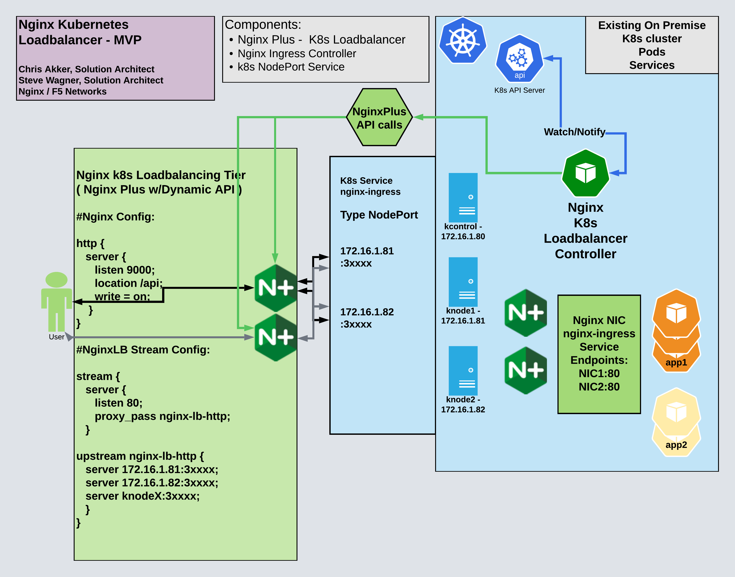
NKL test/demo UDF
3 node cluster
NIC
LB Controller ( new )
Nginx-ingress Service
Type NodePort
Nginx Plus LB Servers
API Enabled
Café Demo

