Slide 1
AES
Advanced Encryption Standard
EL MAJJODI Abdeljalil

Slide 2
Encoding is Not Encrypting
Encryption can be defined as the process of transforming information or data into a code in order to conceal its original content.
Decryption is the process of transforming this encrypted code back to its original state.
For it to be considered encryption and not encoding, a secret key is necessary.

Slide 3
What is AES ?
AES is a symmetric cipher which means, much like our lock from before, the same key used to encrypt data is necessary to decrypt that data.
AES keys are a string of bits (1s and 0s) and can take three different sizes: 128, 192, or 256 bits.

Slide 4
How does it work?
Divided our text into blocks of 128/192/256 bits.
Data
...
Block 1
Block n

Slide 5
Block i
Put a bloc of data and a ket as an input of the AES Algorithm and we get a cipher text in the output
Block Cipher Encryption
⚙
Key
Cipher Text
✔ This Mode of operation call ECB (Electronic CodeBook) Encryption.

Slide 6
Block 1
Block 2
Initialization Vector
+
+
Block Cipher Encryption
⚙
Block Cipher Encryption
⚙
Key
Key
Cipher Text
Cipher Text
✔ This Mode of operation call CBC(Cipher Block Chaining) Encryption.

Slide 7
Encryption what goes on inside AES when it encrypts data?
As we mentioned AES can have keys of three sizes, 128, 192, and 256 bits, and that the longer the key, the stronger the encryption. To understand this we must know that when AES encrypts, if applies the same algorithm encryption algorithm for a certain number of rounds, each round using a different sub-key generated from our initial key in a process called key expansion.

Slide 8
AES Algorithm is composed of 4 operations : Byte Sub, Shift Rows, Mix Columns and Add Round Key. How does it work?
Round Key
128-bit input
Byte Sub
Add round key
Round Key
Shift Row
if i <= 10,12,14
Byte Sub
Add Round Key
else
Add Round Key
Round Key
Shift Row
Mix Columns
128 encrypted block

Slide 9
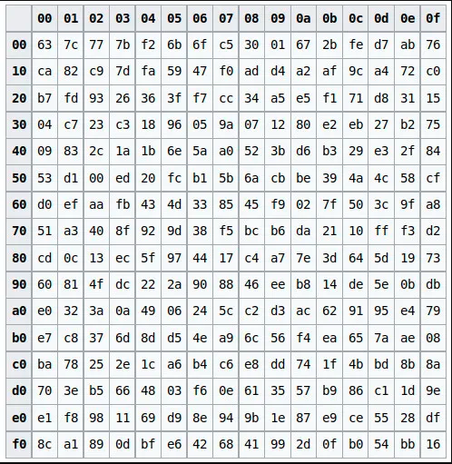
Byte Sub Operation
a02
a03
a00
a01
a02
a03
a00
b00
b01
b02
b03
a10
a11
a12
a13
a01
b10
b11
b12
b13
a20
a21
a22
a23
b20
b21
b22
b23
a30
a31
a32
a33
b30
b31
b32
b33
Substitute each cell of 8 bits with another 8 bits in a predefined look-up table.
The first four bits of each cell will decide the row and the last four the column,

Slide 10
Shift Rows Operation
shift rows as it names suggest, shift each row of our matrix to the left
b00
b01
b02
b03
No shift
b00
b01
b02
b03
b10
b11
b12
b13
1 shift
b11
b12
b13
b10
b20
b21
b22
b23
2 shift
b22
b23
b20
b21
b30
b31
b32
b33
3 shift
b33
b30
b31
b32

Slide 11
Mix Columns Operation
In Mix Columns we will perform a matrix multiplication between our current matrix and a predefined given matrix K. But it’s a slight trickier matrix multiplication, as the sum operation is substituted by xor.
b00
b01
b02
b03
k00
k01
k02
k03
c00
c01
c02
c03
b10
b11
b12
b13
X
k10
k11
k12
k13
=
c10
c11
c12
c13
b20
b21
b22
b23
k20
k21
k22
k23
c20
c21
c22
c23
b30
b31
b32
b33
k30
k31
k32
k33
c30
c31
c32
c33
C00 = b00 X k00 ⊕ b01 X k01 ⊕ b02 X k02 ⊕ b03 X k03

Slide 12
Add Round Key Operation
b00
b01
b02
b03
k00
k01
k02
k03
r00
r01
r02
r03
b10
b11
b12
b13
⊕
k10
k11
k12
k13
=
r10
r11
r12
r13
b20
b21
b22
b23
k20
k21
k22
k23
r20
r21
r22
r23
b30
b31
b32
b33
k30
k31
k32
k33
r30
r31
r32
r33

Slide 13
Decryption: We only need to reverse the encryption procedure to decrypt a text.

Slide 14
Application use AES Several apps employ AES to encrypt user-provided data transmission; the following list includes various VPN (Virtual Private Networks) names:
ExpressVPN
NordVPN
TunnelBear VPN

Slide 15
Implementation Python & Test github.com/Elma-dev/AES_Python

