Slide 1

計算機程式
第一單元 Introduction to Computers,
the Internet and the WWW
授課教師：廖婉君教授
【本著作除另有註明外，採取創用CC「姓名標示－非商業性－相同方式分享」台灣3.0版授權釋出】
本課程指定教材為 C++ How to Program, 7/e, Harvey M. Deitel and Paul J. Deitel, both from Deitel & Associates, Inc. © 2010。 本講義僅引用部分內容，請讀者自行準備。
本作品轉載自Microsoft Office 2007多媒體藝廊，依據Microsoft服務合約及著作權法第46、52、65條合理使用。

Slide 2

本課程指定教材
書名：C++ How to Program, 7/e
作者：Harvey M. Deitel and Paul J. Deitel
出版社：Deitel & Associates
出版日期：2010

Slide 3


Computer:At A Glance (1/3)
Hardware
Central Procesing Unit (CPU)
Arithmetic and Logic Unit (ALU)
Main Memory
Secondary Storage Unit
Input unit
Output unit
Network Interface

Slide 4




Computer:At A Glance (2/3)
Software
System software
e.g.,Operating System (OS)
Application software
e.g.,Powerpoint,MS Word,Skype
Programming language
Machine language
Assembly language
High-level language

Slide 5


Computer:At A Glance (3/3)
Evolution of Computing/computer
Main frame
Personal computer
Networked computer
Thin client and clout computing
Personal computing
Distributed computing
Client/Server computing
Peer-to-peer computing

Slide 6
Basics of a Typical C++ Environment
C++ system
Program development environment
Language itself
C++ standard libraray:
Classes and functions
Software IC
Six phases
Edit,preprocess,compile,link,load,execute
.cpp,.cxx,.cc,.c
xx.cpp,#something,CC xx.cpp,a.out

Slide 7
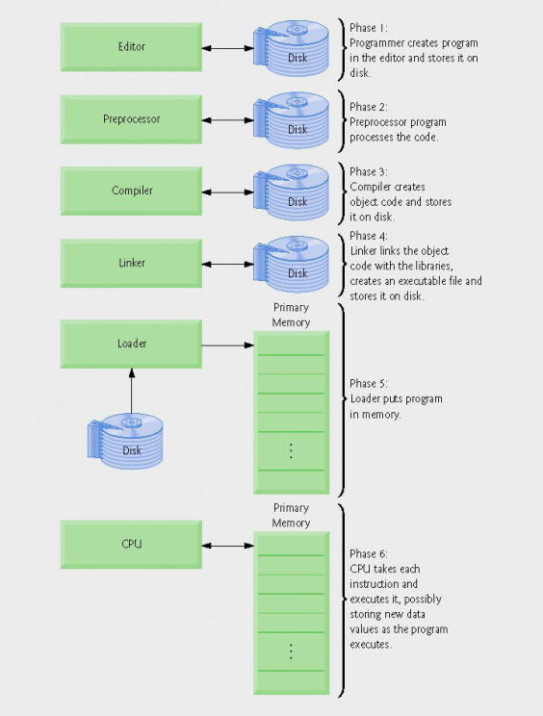
Six Phases in Program Execution

Slide 8
C++ Program Structure
Single-line comment line: //
Preprocessor directives: # something
e.g., #include
Main body
Classes and functions
Must come/start with a function called main(),which is delimited by {}.
Mostly come with I/O

Slide 9
A skeleton Outline of a Simple C++ Program
//
#include <iostream>
int main (){
return 0;
}
preprocessor directive
program goes here!
function name

Slide 10


Examples (1/2)
p.40

Slide 11
Examples (2/2)
p.44-45

Slide 12
Escape Characters
escape sequence | description
\n | Newline. Position the screen cursor to the beginning of the next line.
\t | Horizontal tab. Move the screen cursor to the next tab stop.
\r | Carriage return. Position the screen cursor to the beginning of the current line; do not advance to the next line.
\a | Alert. Sound the system bell.
\\ | Backslash. Used to print a backslash character
\’ | Single quote. Use to print a single quote character.
\” | Double quote. Used to print a double quote character.

Slide 13
Another Example
p. 45

Slide 14
Another Example (cont.)
p. 46-49

Slide 15
C++ Keywords
C++ Keywords
Keywords common to the C and C++ programming languages
auto | break | case | char | const | continue | dafault
do | double | else | enum | extern | float | for
goto | if | int | long | register | return | short
signed | sizeof | static | struct | switch | typedef | union
unsigned | void | volatile | while
C++ only keywords
and | and_eq | asm | bitand | bitor | bool | catch
class | compl | const_cast | delete | dynamic_cast |  | explicit
export | false | friend | inline | mutable | namespace
new | not | not_eq | operator | or | or_eq | private
protected | public | reinterpret_cast |  | static_cast | template | this
throw | true | try | typeid | typename | using | virtual
wchar_t | xor | xor_eq

Slide 16
Built–in Data Types
bool
char
short int
unsigned short int
int
unsigned int
long int
unsigned long int
float
double
long double
bool
char
short int vs . unsigned short int
int vs. unsigned int
long int vs. unsigned long int
float
double
long double

Slide 17
Variables
Memory concept
Declaration
date type variable name
e.g., int a;
Variables have characteristics
name,type,size ,and vale
case sensitive: e.g.,CAT,Cat,cat
declared before used (anywhere)
legal identifier
I/O: destructive vs. non-destructive

Slide 18
More on Operators
associability
Operators | Associativity | Type
() | left to right | parentheses
* / % | left to right | multiplicative
+ - | left to right | additive
<< >> | left to right | stream insertion/extraction
< <= > >= | left to right | relational
== != | left to right | equality
= | right to left | assignment
precedence relation

Slide 19
One More Example
p. 55-56

Slide 20

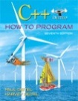




版權聲明
頁碼 | 作品 | 版權圖示 | 來源/作者
1-21 |  |  | 本作品轉載自Microsoft Office 2007多媒體藝廊，依據Microsoft服務合約及著作權法第46、52、65條合理使用。
2 |  |  | C++ How to Program, 7/e，作者：Harvey M. Deitel and Paul J. Deitel， 出版社：Deitel & Associates，出版日期：2010。 本作品轉載自：http://www.deitel.com/Books/C/CHowtoProgram7e/tabid/3472/Default.aspx， 依據著作權法第46、52、65條合理使用。
3 |  |  | Open Clip Art Library，作者：kattekrab，本作品轉載自：http://openclipart.org/detail/20928/computer-workstation-by-kattekrab， 瀏覽日期：2013/1/10。
4 |  |  | Open Clip Art Library，作者：sheikh_tuhin，本作品轉載自：http://openclipart.org/detail/78217/it-word-icon-by-sheikh_tuhin，瀏覽日期：2013/1/10。
4 |  |  | Wikipedia，作者：Microsoft Corporation，本作品轉載自：http://en.wikipedia.org/wiki/File:Skype_logo.svg，瀏覽日期：2013/1/10。 依據著作權法第46、52、65條合理使用。
5 |  |  | Open Clip Art Library，作者：lmproulx，本作品轉載自：http://openclipart.org/detail/3982/computer-by-lmproulx，瀏覽日期：2013/1/10。

Slide 21


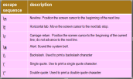

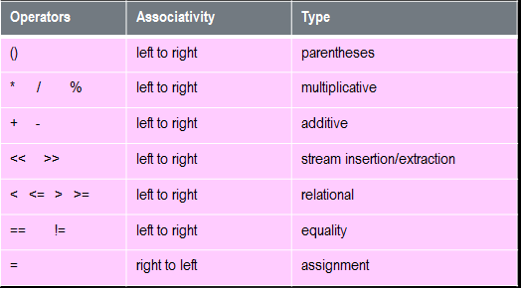
版權聲明
頁碼 | 作品 | 版權圖示 | 來源/作者
7 |  |  | Faculty Web Sites，Typical Java Development Environment(http://faculty.inverhills.mnscu.edu/speng/cs1126/Notes/Chapter01/JavaDE.htm)，瀏覽日期：2012/9/14。依據著作權法第46、52、65條合理使用。
10、11、13、14、19 |  |  | Open Clip Art Library，作者：aritztg，本作品轉載自：http://openclipart.org/detail/3422/mouse-by-aritztg，瀏覽日期：2013/1/10。
12 |  |  | C++ How to Program, 7/e，作者：Harvey M. Deitel and Paul J. Deitel， 出版社：Deitel & Associates，出版日期：2010，P.41。 依據著作權法第46、52、65條合理使用。
15 |  |  | 臺灣大學電機系 廖婉君教授
18 |  |  | C++ How to Program, 7/e，作者：Harvey M. Deitel and Paul J. Deitel， 出版社：Deitel & Associates，出版日期：2010，P.49。 依據著作權法第46、52、65條合理使用。

