Slide 1
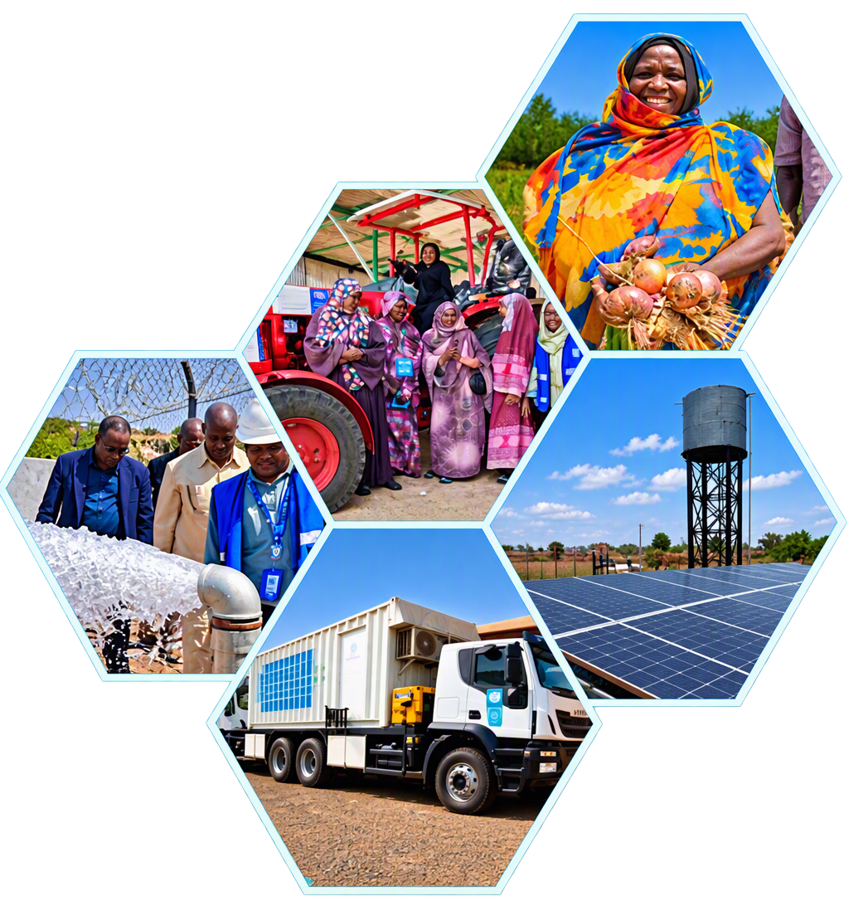
PROGRAMME PROGRESS REPORT
Jan-Sep 2026
Programme Delivery, Beneficiary Reach and Geographic Impact
Notes:
---

Slide 2
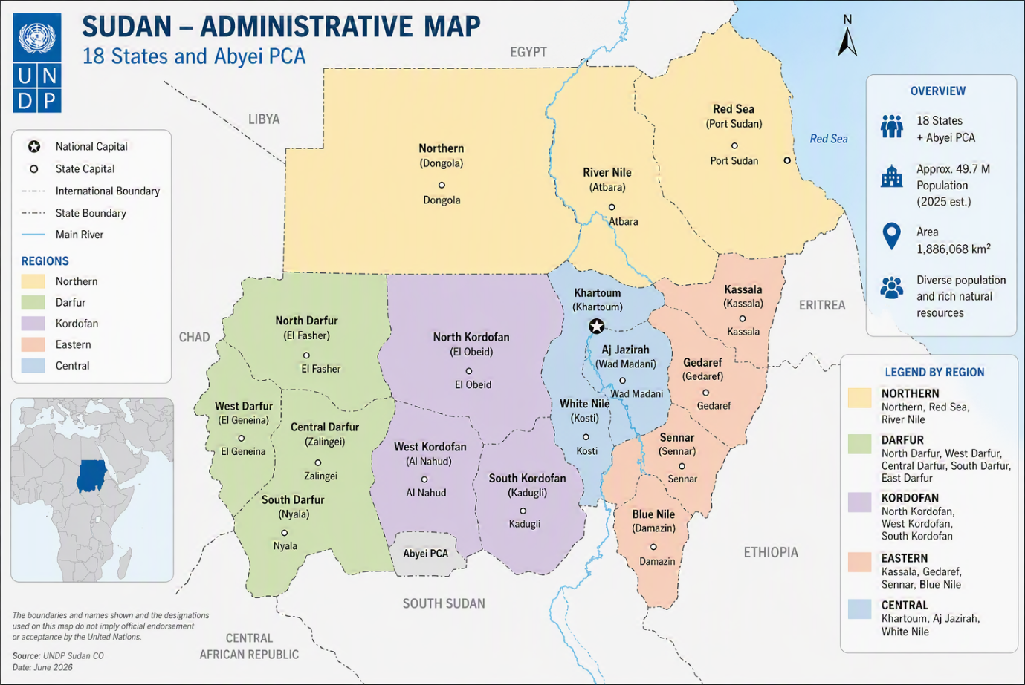
Context, Purpose, and Scope of the Progress Report
Challenging Context
Sudan continues to face conflict, displacement, food insecurity, and economic pressures, placing significant strain on communities and essential services.
Purpose
To present programme results and beneficiary reach against the 2026 planned targets.
Scope
Covers progress across UNDP Sudan’s four programme pillars through key results, analysis, and visual summaries.
Strategic Focus
Supports evidence-based decision-making and prioritization of interventions for the remainder of 2026.
Notes:
This presentation summarizes key findings from the Sudan Country Office Progress Report on beneficiaries reached between January and May 2026. The reporting period took place against an exceptionally challenging backdrop marked by protracted conflict, large-scale displacement, and severe socioeconomic stress. Sudan continues to host more than 8.8 million internally displaced persons, placing extraordinary pressure on essential services, livelihoods, and local coping mechanisms. At the same time, food insecurity remains acute, with famine risk identified in multiple areas of Darfur and Kordofan under worst-case scenarios. Despite these constraints, there are early signs of economic recovery in relatively stable areas, with estimated growth of around 3 percent in 2025, although this recovery remains uneven and fragile due to inflation levels approaching 50 percent and rising costs of fuel and imported goods. The purpose of this presentation is to distill the most relevant programmatic results from the full report into a concise, decision-oriented format suitable for programme and pillar-level discussions. It focuses on who was reached, where interventions were delivered, and how progress aligns with planned targets under the Country Programme Document (CPD) 2026–2028. The scope covers all four programme pillars—Health and Essential Services; Resilience and Recovery; Peacebuilding and Inclusive Governance; and Environment, Energy and Climate Change—using both narrative analysis and visual summaries drawn directly from the report. Particular attention is given to geographic coverage, beneficiary composition by gender and age, and variations in performance across states. By providing a clear overview of achievements and gaps, this slide sets the foundation for informed discussion on strategic adjustments, resource allocation, and prioritization for the remainder of 2026. The presentation is intended to complement, not replace, the full report, offering a shared evidence base to support programme planning, coordination, and accountability across pillars.

Slide 3
Key Results Achieved and Strategic Contribution to Country Programme Outcomes
Table 1: Progress in Beneficiary Reach Against Approved 2026 Integrated Work Plan (IWP) Targets (January-September 2026)
Pillar | Beneficiaries Target | Reached direct+ indirect | % Achieved | % of Women
Health | 8,511,342 | 5,509,874 | 64% | 61%
Livelihoods and Economic Recovery | 1,610,404 | 1,561,005 | 97% | 36%
Peacebuilding and Social Cohesion | 19,079 | 15,943 | 84% | 44%
Climate Resilience and Environment | 163,351 | 116,001 | 71% | 49%
Total | 10,304,176 | 7,202,823 | 79% | 48%

Slide 4
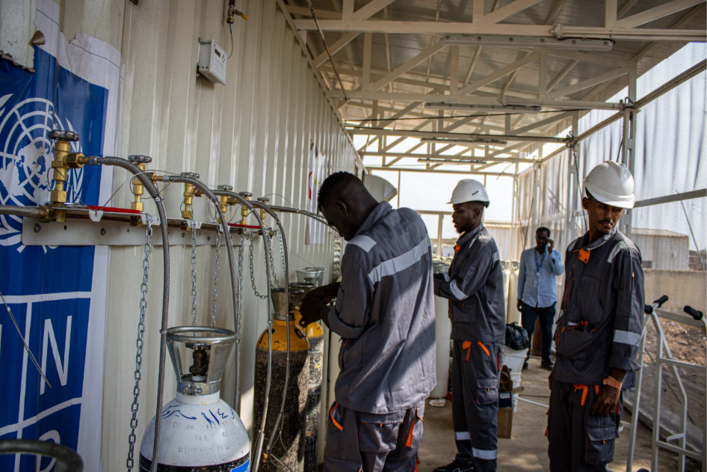
Pillar 1 Results: Health and Essential Services
Key results achieved include: 5,509,874 61% women
4,677,963 people gained access to improved healthcare services through investments in critical health infrastructure and systems, including oxygen supply systems and PSA oxygen plants, healthcare waste management incinerators, solarization of health facilities, and other essential health service delivery interventions.
598,586 people benefited from HIV, Tuberculosis (TB), and Primary Health Care (PHC) services, supporting continued access to life-saving and routine healthcare services.
45,000 people living with diabetes received life-saving insulin and related treatment support, helping to ensure continuity of care for individuals with chronic health conditions.
646 health personnel were trained during 2026 to strengthen the capacity of healthcare institutions and improve service quality. Training focused on:
  Healthcare waste management.
  Incinerator operation and maintenance.
  Oxygen PSA plant operation and maintenance.
  Prevention, Diagnosis, care, and treatment of TB and HIV.
  Awareness raising, Human rights, and stigma reduction.
Collectively, these interventions strengthened access to essential healthcare services, enhanced the resilience of health systems, improved service quality, and built the capacity of health workers to respond effectively to the growing health needs of vulnerable populations across Sudan
Notes:
Under Pillar 1, UNDP-supported health and essential service interventions reached more than 6.1 million people between January and May 2026, with women accounting for approximately 46 percent of beneficiaries. Key results include over 4.1 million people accessing healthcare services through mobile and facility-based primary healthcare, 1.5 million people benefiting from improved access to functional health facilities, and nearly 400,000 individuals receiving HIV, tuberculosis, and related services. Targeted support was also provided to people living with chronic conditions, including 45,000 individuals receiving life-saving insulin and related diabetes care. Beyond service delivery, investments focused on strengthening system resilience through upgrading 50 primary healthcare facilities and building the capacity of 1,500 health workers. Strategic initiatives, such as preparations for the installation of an MRI unit in Kassala State, demonstrate a commitment to expanding access to advanced diagnostic services for an estimated 1.5 million people. Health interventions were closely integrated with water, food security, and climate-resilient activities, recognizing the interdependence of essential services in fragile contexts. This integrated approach has contributed to improved continuity, quality, and sustainability of health services in conflict-affected and hard-to-reach areas, while laying the groundwork for longer-term system recovery.

Slide 5
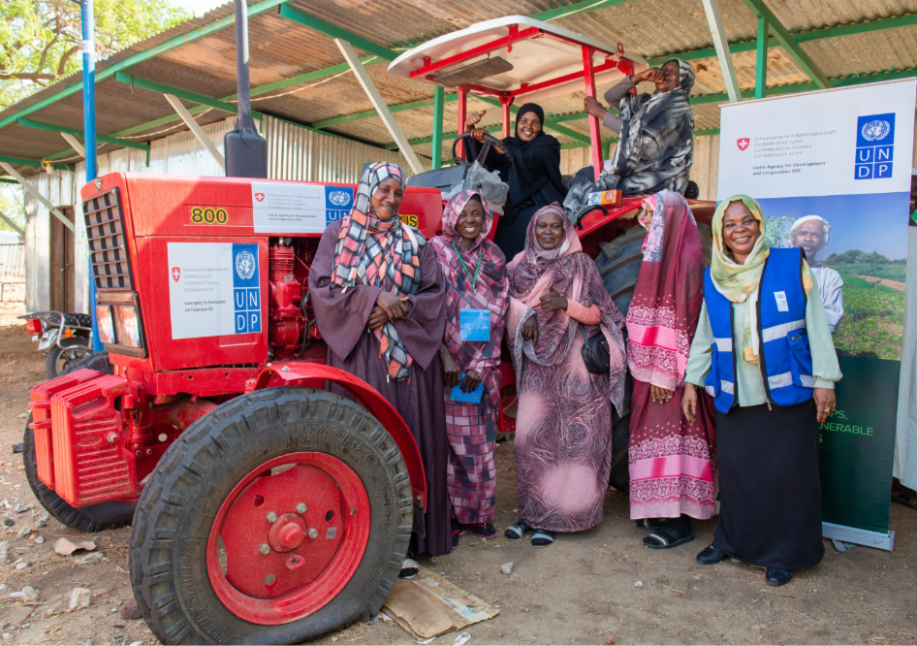
Pillar 2 Results: Resilience and Recovery
1,561,005 individuals (36% women) benefited from integrated livelihood interventions between January and September 2026, contributing to improved food security, sustainable income streams, and essential services powered through renewable energy. Out of which:
111,489 individuals received agricultural inputs, seeds, tools and extension services including agricultural associations that utilized heavy duty tractors to increase their production, benefiting 510,194 community members indirectly.
23,200 people gained access to clean, safe drinking water through established and rehabilitated solarized water yards, benefiting 39,200 community members indirectly. An additional 260,070 farmers gained access to improved water through solarized irrigation schemes and rehabilitated water canals reviving agricultural activity creating multiplier benefits for an extended 11,680 small-holder farmers.
18,440 people received capacity building spanning vocational training, cost recovery systems and community management through Community Management Committees (CMCs) and Water User Associations (WUAs) enabling self-sustained access to critical services reaching 177,450 extended households beyond project lifecycles.
21,995 people received immediate financial resources (cash for work) through temporary employment opportunities provided by cash-for-work schemes, enabling them to support an additional 64,370 community members indirectly through multiplier effects of cleaning campaigns, communal spending and cost-sharing for community infrastructure.
17,229 people received job opportunities through various micro-grants to establish small-scale businesses and create long-term sources of income through self-employment. 39% were women empowered through VSLAs and income-generating groups to launch small-businesses including women who received access to financial services. Altogether, these support an additional 123,788 community members through improved household income covering education, health services and dignified living conditions.
Other interventions geared towards improving community resilience have reached 74,700 people through social cohesion forums, shared infrastructure rehabilitation including health centers, distribution of solar kits and installation of solar streetlights, extending reach to 107,200 community members significantly reducing associated GBV risks.
Notes:
Resilience and Recovery interventions reached approximately 1.52 million people during the reporting period, with women representing 36 percent of direct beneficiaries. Activities focused on restoring livelihoods, strengthening food security, improving water access, and expanding economic opportunities for vulnerable populations. Over 105,000 individuals received agricultural inputs and extension services, indirectly benefiting hundreds of thousands of community members. Solarized water yards and irrigation schemes improved access to safe water for more than 240,000 people and enhanced agricultural productivity for farmers. Cash-for-work programmes and micro-grants provided short-term income support and longer-term self-employment opportunities, particularly for women and youth, while vocational training and capacity-building initiatives strengthened employability and community management systems. These interventions collectively contributed to rebuilding productive capacities, stimulating local economies, and enhancing resilience to economic and climate-related shocks. The scale and diversity of results under this pillar underscore the importance of integrated livelihood and recovery programming in addressing both immediate needs and structural vulnerabilities in crisis-affected contexts.

Slide 6
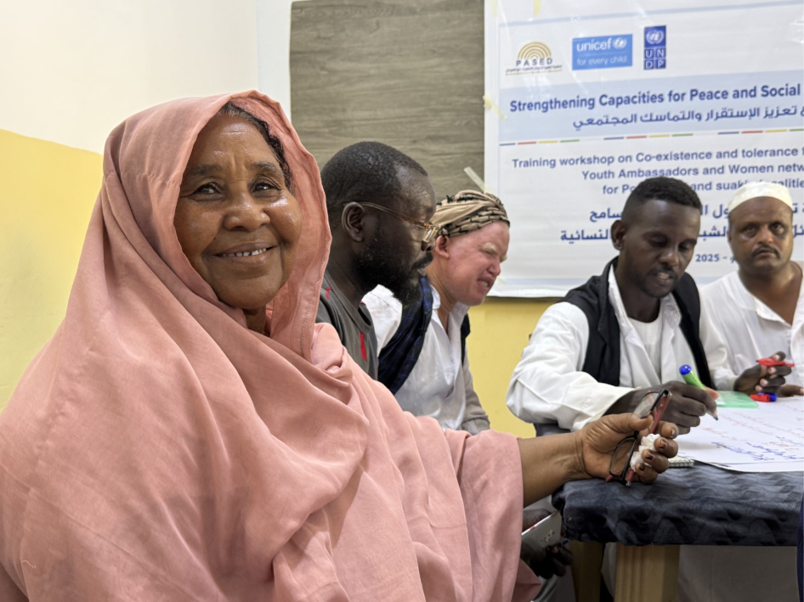
Pillar 3: Peacebuilding & inclusive Governance
Peacebuilding and Inclusive Governance
In total 15,943 people (873 direct and 14,534 indirect/(44%women), were reached through interventions focused on community protection, mediation, peacebuilding, and social cohesion between January and September 2026.
UNDP supports a nationwide network of Academic Peace Centres, providing an impartial platform for conflict analysis, dialogue, locally led peacebuilding initiatives, and the preservation of professional relationships across conflict lines. As part of this effort, UNDP brought together 60 participants representing 22 Academic Peace Centres from all states across the country, strengthening collaboration, knowledge exchange, and coordinated peacebuilding efforts at the national level.
Support was provided through the reactivation and strengthening of community-based protection and peacebuilding mechanisms, enabling local actors to play a greater role in conflict prevention and resolution.
Community members, including women, youth, displaced populations, and other vulnerable groups, participated in initiatives that promoted inclusive dialogue, peaceful coexistence, and community engagement.
Notes:
Peacebuilding and inclusive governance interventions reached nearly 4,918 people between January and May 2026, with women accounting for about 45 percent of participants. These initiatives focused on community protection, mediation, dialogue, and social cohesion, supporting locally led mechanisms to prevent and resolve conflict and strengthen inclusive institutions. Activities included strengthening academic peace centres, reactivating community-based protection structures, and promoting the participation of women and youth in peace processes. Under Pillar 4, environment, energy, and climate change interventions expanded access to clean energy and climate-resilient services. More than 47,000 people were connected to electricity through solar infrastructure, over 239,000 gained access to safe water via solar-powered systems, and nearly 13,000 farmers benefited from solar irrigation, supporting food production for tens of thousands more. Together, these pillars contribute to safer, more resilient communities while advancing sustainable natural resource management and climate action aligned with national and global commitments.

Slide 7
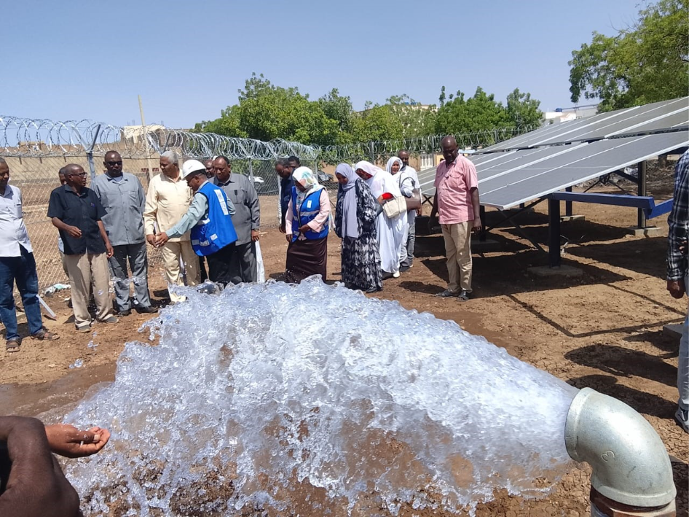
Pillar 4 Results: Environment, Energy Climate Change
Water, Clean Energy and Climate Resilience
A total of 116,001 people (49% women) benefited from interventions in water, clean energy, and climate resilience. This included 47,380 people gaining access to electricity through the installation of new solar energy infrastructure, including solar streetlights and solar 3-in-1 kits. In addition, communities benefited from improved access to safe water through the establishment and rehabilitation of solar-powered water systems and water yards. Furthermore, 12,980 farmers received solar-powered irrigation systems, contributing to enhanced agricultural productivity and supporting increased food production for an estimated 20,980 people.

Slide 8
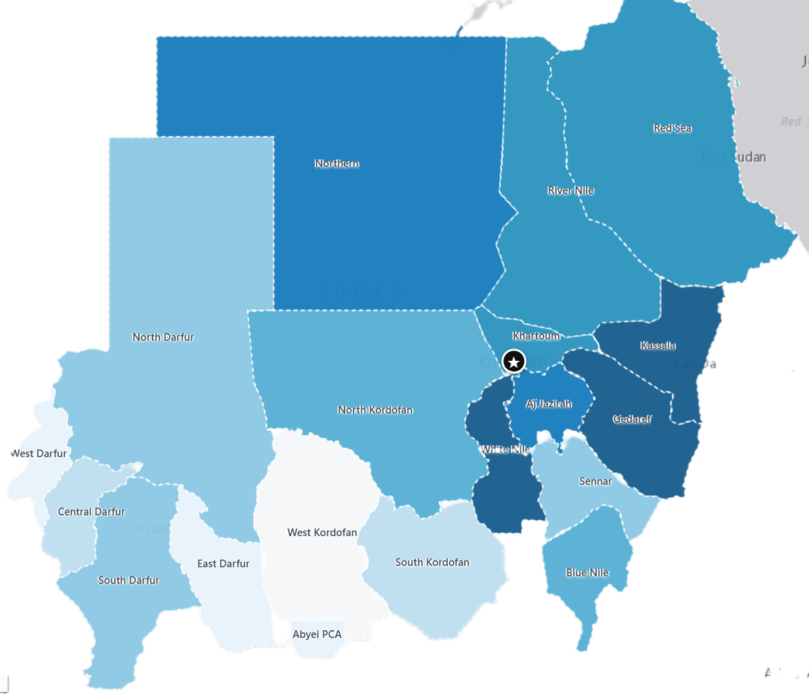
Overview
State-Level Performance Variation
Sudan’s states show substantial variation in beneficiary reach against planned targets. Direct achievement ranges from below 30% in some states to more than 190% in others.
High-Performing States
North Kordofan, Central Darfur, Red Sea, Aj Jazirah, and North Darfur met or exceeded their direct beneficiary targets, reaching approximately 104%–193% of planned targets.
Lower-Reach States
Kassala, Sennar, Abyei PCA, East Darfur, Northern, White Nile, Gedaref, and South Kordofan achieved less than 50% of their direct beneficiary targets.
Multi-Pillar Presence and Gaps
Red Sea, Kassala, and Gedaref have activities across all four pillars. Aj Jazirah, Blue Nile, River Nile, and Sennar show three-pillar coverage, while West Kordofan has no recorded programme presence in the current dataset.
Notes:
Geographic analysis of beneficiary data reveals significant variation in programme reach and performance across Sudan’s states, shaped by differences in access, security conditions, partner presence, and operational capacity. States such as Northern, Red Sea, Kassala, Aj Jazirah, Gedaref, and North Kordofan have largely met or exceeded their planned beneficiary targets, reflecting relatively stable operating environments and strong multi-pillar engagement. In contrast, South Kordofan, Blue Nile, Sennar, and White Nile recorded lower reach compared to targets, highlighting persistent access constraints, insecurity, and logistical challenges that have slowed implementation. Darfur states show mixed performance, with moderate progress overall but notable disparities between locations, underscoring the need for more nuanced, area-based planning. Mapping of pillar presence also indicates that Red Sea, Kassala, and Gedaref benefit from the strongest multi-pillar overlap, while some areas—such as West Kordofan—currently show limited or no programme presence. These spatial patterns are critical for understanding not only where beneficiaries are being reached, but also where service gaps remain. The maps included in the report provide a visual synthesis of these trends, enabling clearer identification of opportunities for scale-up, rebalancing, or targeted support. Strengthening the clarity of map legends and keys, as noted in feedback, will further enhance their usefulness for programme decision-making and coordination.

Slide 9
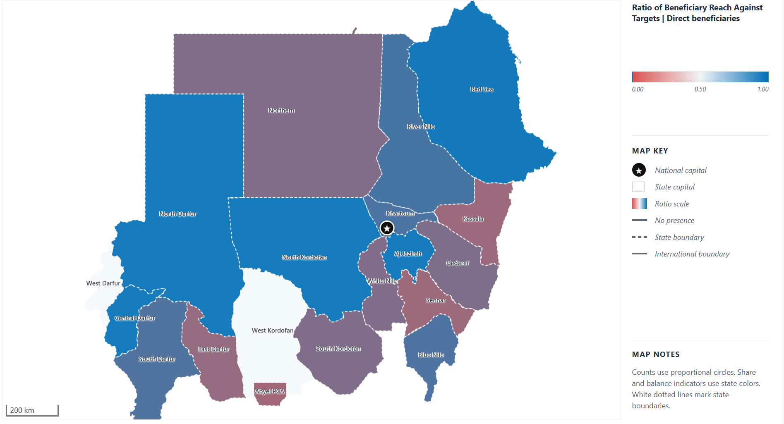
Raito of Beneficiary Reach Against Targets
Key Insights:
Strong Reach: North Kordofan, Central Darfur, Red Sea, Aj Jazirah, and North Darfur met or exceeded their direct beneficiary targets.
Moderate Reach: River Nile, Khartoum, Blue Nile, and South Darfur achieved approximately 69%–75% of their planned targets.
Lower Reach: Gedaref, South Kordofan, White Nile, Northern, East Darfur, Kassala, Sennar, and Abyei PCA remained below 50% of target achievement.
Highest Shortfalls: Kassala and Sennar show particularly low reach ratios despite substantial planned targets. Kassala reached approximately 31% of its target.
Mixed Darfur Performance: North Darfur and Central Darfur exceeded their targets, while South Darfur and East Darfur achieved partial progress. West Darfur has no valid target or actual values for comparison.
Potential Scale-Up: River Nile, Khartoum, Blue Nile, and South Darfur show moderate progress with scope for further implementation gains.
Large-Scale Priority: Gedaref and White Nile have substantial planned beneficiary volumes but reached less than half of their targets, making them important areas for operational review.
Geographic Variation: Achievement differs considerably across states, reflecting varying implementation conditions, access constraints, programme scale, and reporting completeness. These ratios indicate target achievement, not population coverage or unmet need.

Slide 10
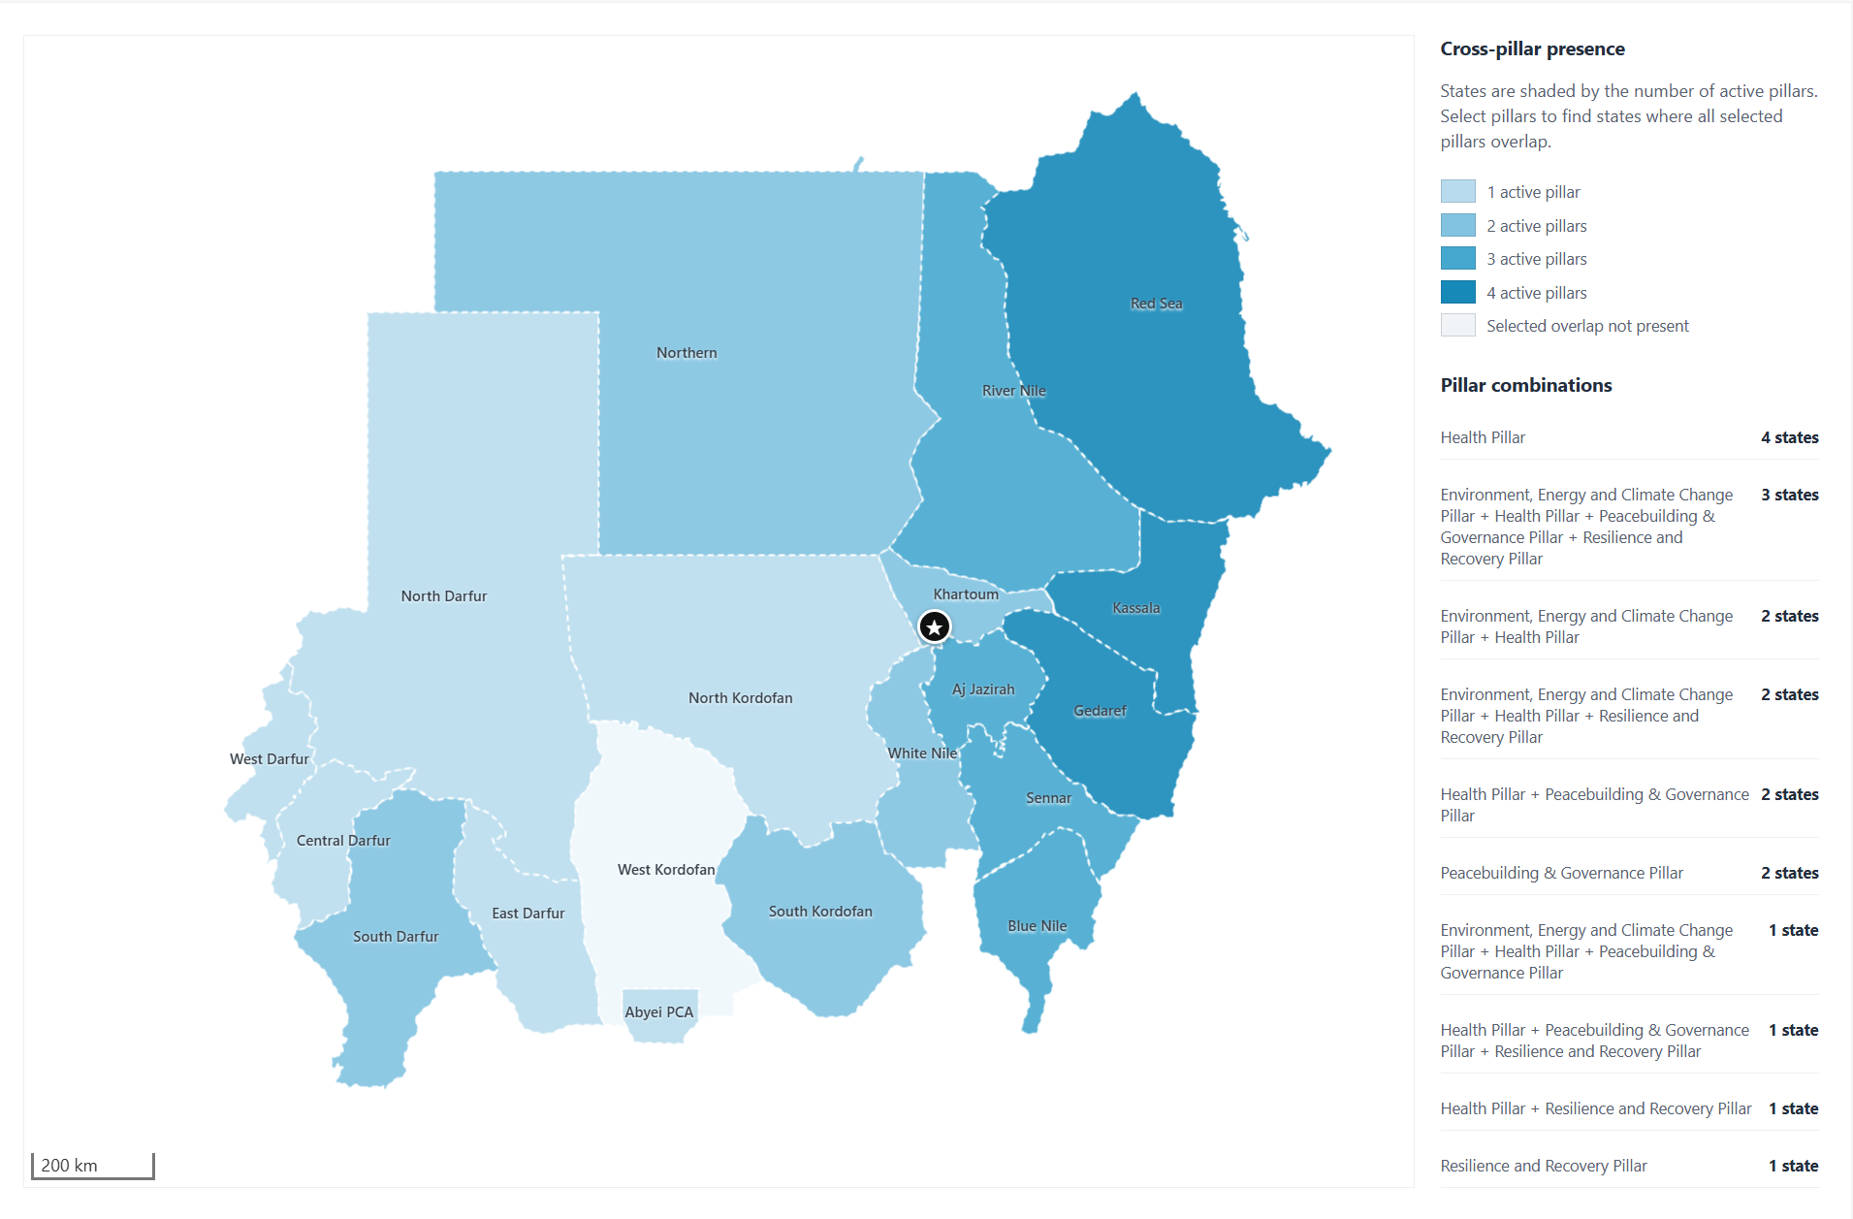
UNDP Sudan Geographical Coverage and Pillar Presence and Overlapping
Key Insights:
Strongest Multi-Pillar Presence: Red Sea, Kassala, and Gedaref have activities across all four pillars: Health, Environment/Energy/Climate Change, Peacebuilding & Governance, and Resilience & Recovery.
Broad Three-Pillar Coverage: Aj Jazirah, Blue Nile, River Nile, and Sennar each show activity across three pillars, indicating relatively broad programme integration.
Health as the Most Widespread Pillar: Health activities appear across the largest number of states and form the primary programme presence in several locations.
Peacebuilding Concentration: Peacebuilding and Governance is present in Red Sea, Kassala, Gedaref, Aj Jazirah, Blue Nile, Sennar, South Darfur, South Kordofan, Abyei PCA, and North Darfur. In Darfur, it is strongest in North Darfur and South Darfur.
Limited Pillar Coverage in Darfur: South Darfur has two active pillars, while North Darfur, Central Darfur, East Darfur, and West Darfur each show activity from only one pillar. This indicates more limited cross-pillar integration across much of Darfur.
Single-Pillar States: Abyei PCA, Central Darfur, East Darfur, North Darfur, North Kordofan, and West Darfur currently show activity from only one pillar.
Geographic Gap: West Kordofan shows no recorded programme presence in the current master data.
Uneven Cross-Pillar Coverage: UNDP activities extend across most mapped states, but the depth of collaboration varies substantially, from single-pillar presence to four-pillar coverage.

Slide 11
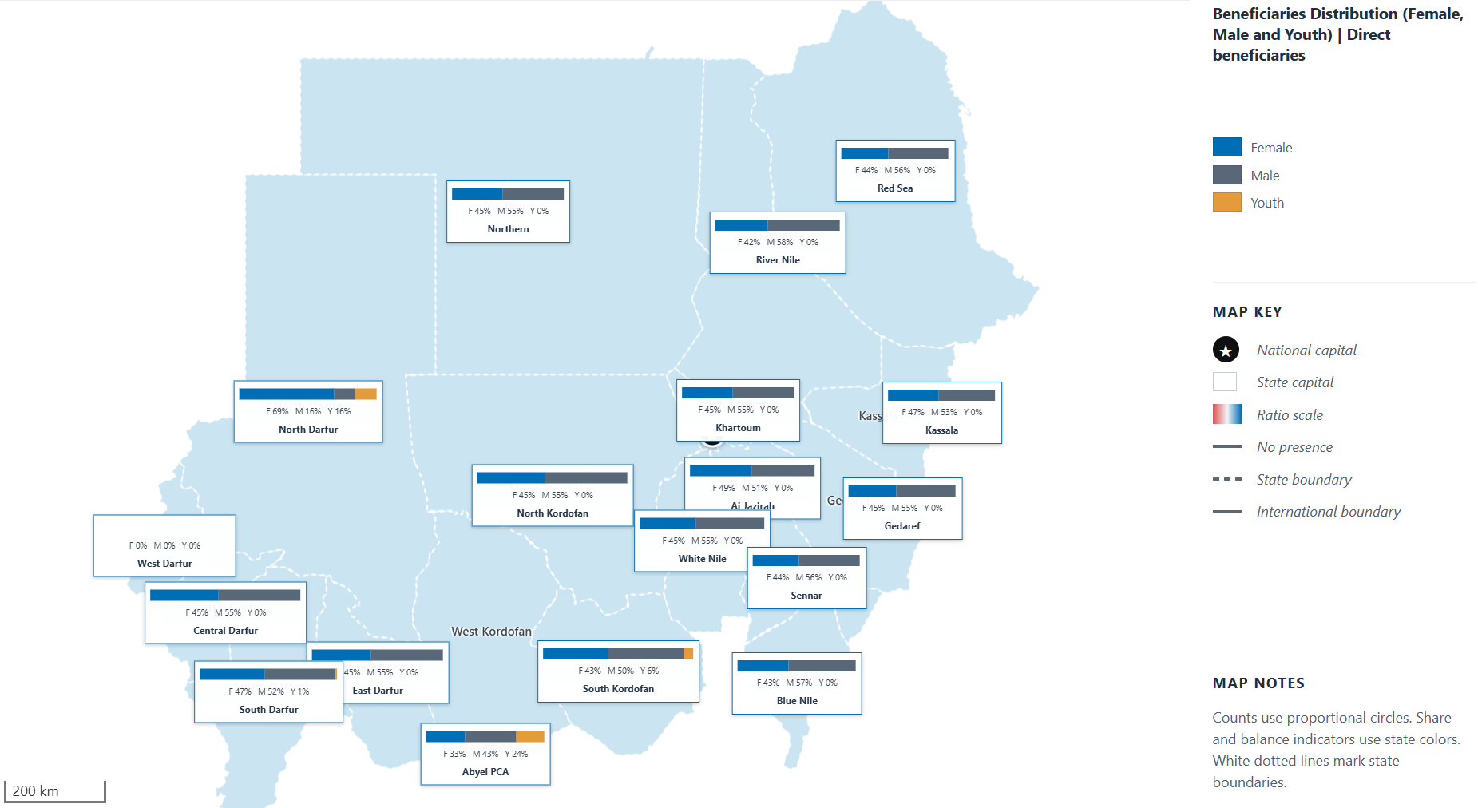
Beneficiaries Distribution (Female, Male and Youth)
Key Insights:
Male-Dominant Distribution: Male beneficiaries represent the largest share in most states, including Red Sea, River Nile, Blue Nile, Gedaref, Khartoum, Kassala, and White Nile.
Female-Dominant Exception: North Darfur shows a clearly female-dominant distribution, with female beneficiaries accounting for approximately 69% of the reported total.
More Balanced States: Aj Jazirah and Kassala show relatively balanced Female/Male distributions, although male beneficiaries remain slightly higher.
Youth Representation: Youth beneficiaries account for a smaller share in most states. The highest reported youth representation appears in Abyei PCA and North Darfur, followed by South Kordofan and South Darfur.
Regional Variation: Female participation is comparatively stronger in parts of Darfur, while most eastern, central, and northern states show a clearer male majority.
Data Interpretation: Youth is reported as a separate category and may overlap with Female or Male beneficiaries. Therefore, Female, Male, and Youth percentages should be interpreted as reported demographic shares rather than mutually exclusive groups.

Slide 12
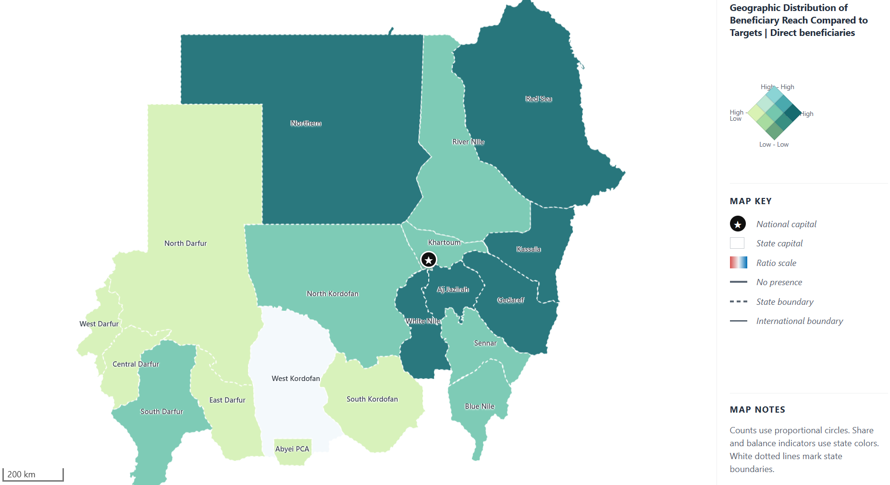
Geographic Distribution of Beneficiary Reach Compared to Targets/Coverage
Key Insights
Strong Progress Against Targets:
Aj Jazirah and Red Sea combine relatively substantial targets with actual reach at or above target. North Kordofan and Central Darfur also exceed their targets, although their overall target volumes are comparatively small.
High Targets with Scope to Improve Delivery:
Kassala, White Nile, Gedaref, and Northern carry some of the largest beneficiary targets but remain below 50% achievement. These states should be prioritized for implementation review, operational strengthening, or target reassessment.
Moderate Progress:
River Nile, Khartoum, Blue Nile, and South Darfur show intermediate achievement levels, reaching approximately 69%–75% of their targets.
Lower Reach and Potential Constraints:
Sennar, Abyei PCA, East Darfur, and South Kordofan show lower target achievement. Their results may reflect implementation, access, reporting, or operational constraints.
Limited or Missing Coverage:
West Darfur has no valid target or actual value for comparison, while West Kordofan shows no recorded programme presence in the current dataset. These should be treated as data or coverage gaps rather than confirmed low performance.

Slide 13

Key Challenges, Lessons Learned, and Way Forward -NH
Lessons Learned
Future Priorities
  Digitalizing data, quarterly beneficiary mapping, and GIS analysis will enhance decision-making and program effectiveness.
Key Recommendation: Sustaining Progress/SIMS
Notes:
Implementation during the first half of 2026 was constrained by continued conflict and insecurity, large-scale displacement, high inflation, fuel shortages, and limited institutional capacity in many areas. These challenges affected access, increased operational costs, and slowed delivery in several states. Despite these constraints, key lessons have emerged. Integrated, area-based programming under the Humanitarian–Development–Peace Nexus has proven effective in generating more sustainable outcomes by addressing immediate needs and underlying drivers of vulnerability simultaneously. Strong partnerships with national institutions, local organizations, and communities have enhanced ownership and responsiveness, while gender-responsive approaches have increased women’s participation across pillars. Looking forward, priorities include accelerating the digitalization of beneficiary data systems, institutionalizing quarterly beneficiary mapping, and strengthening GIS-supported analysis and visualization to improve decision-making. Continued investment in adaptive programming, local systems strengthening, and risk-informed planning will be essential to sustaining progress, expanding reach in underserved areas, and supporting Sudan’s transition toward recovery, resilience, and sustainable development.

