Slide 1


Slide 2


The world is changing so fast…
…we won’t recognize 2030.
Notes:
The world is changing so fast that you won’t even recognize the year 2030.
These words didn’t come from me. This is what technology experts around the world are saying today.
By that year, driverless cars will be everywhere.
There will be flying cars in the sky.
We will be talking to sentient robots – robots that are intelligent enough to think that they are alive.

Slide 3

Gen Alpha (α):
born between 2010 and 2024
the most technologically savvy generation ever
plays, learns, interacts, and lives through screens

Slide 4

Education of Gen α:
1) relies on technology, visual learning, independent study habits, and engaging, interactive methods
2) anchored on constant digital connectivity
3) demands personalized learning experiences

Slide 5
Key Points About Gen Alpha Education
1. Tech-Immersed Learning
- Use of digital tools and ready/instant access to information
2. Visual Learning Style
- Learning through videos, images, animations, and interactive graphics rather than lengthy text-based materials
3. Fast-paced
- Incorporates frequent changes in activity and engaging elements to address shorter attention spans
4. Personalized Learning
- Learning experiences tailored to individual needs and learning styles

Slide 6




Many parents find teaching
Gen α kids at home difficult.
books, VHS Videos, simple CD-Rom apps
books, e-books, websites and social media, digital videos, PC apps, Android/IOS apps, cloud computing, AI tools etc.
Learning Tools of Gen α Kids’ Parents
Learning Tools of Gen α Kids
Generation gap is just one problem.

Slide 7


Parents Wrestle with Traffic 2X a Day
AM
PM
must leave at 6 AM to reach the office by 8 AM
must wake up at 4:30 AM every morning
after a hard day’s work, another two hours in traffic
4 hours lost in traffic each day

Slide 8
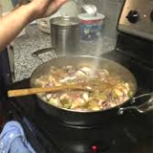




More Work at Home for Parents
cook dinner
do the dishes
teach the kids
help them wash up
say ‘good night’

Slide 9

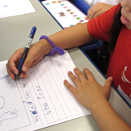

Helping Kids Study Well at
Home is Hard!
make exercises
ask the kids to work on them
check their answers
And reteach them if necessary!

Slide 10




Why Most Parents Could Not Help
their Children Study at Home
lack of time
lack of energy
lack of knowledge
stress

Slide 11


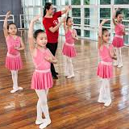

Parents Must Give their Kids Unique Learning Experiences
sports
gamified online academic programs
performing arts
provides a unique but affordable learning experience to kids.

Slide 12

: the best online
learning system for Gen Alpha
It is very comprehensive, providing the strong
academic foundation needed for critical thinking
in the age of AI.
2. It is technology-driven, allowing for high
interactivity and real-time updating.
3. It is visual, dynamic, and personalized.

Slide 13









a complete academic excellence system on the internet that can be used anywhere, anytime for 8 major subjects.
Math
Science
English
AP
Filipino
MAPEH
TLE
Mandarin
Notes:
KPluz is the country’s most comprehensive online learning system. Because it is web-based, it can be used anywhere and anytime. It covers 8 major subjects: math, science, English. AP, Filipino, MAPEH, TLE, and Mandarin. We are also working already on additional subjects: Values Education and Mother Tongue.

Slide 14
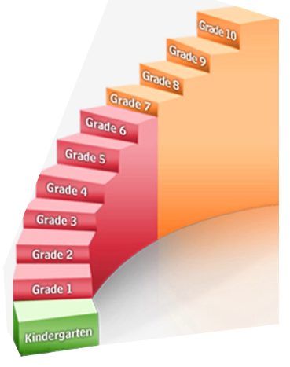
covers Prep to Grade 10
completely mapped to Matatag requirements
promotes subject mastery by providing endless examples and exercises
Notes:
KPluz covers Prep to Grade 10 and is completely mapped to the MELCS requirements. It promotes subject mastery by providing endless examples and exercises to students.

Slide 15
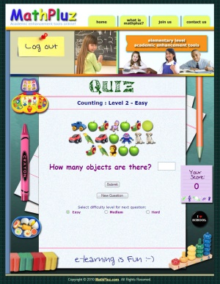
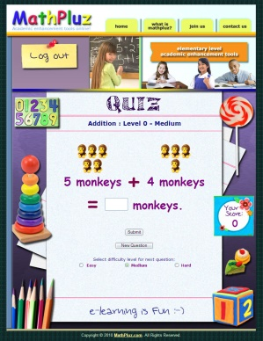
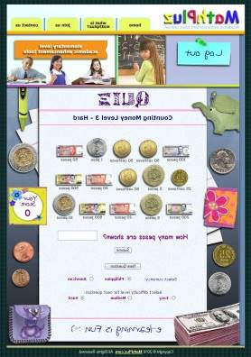
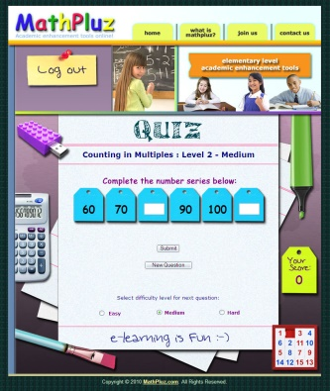
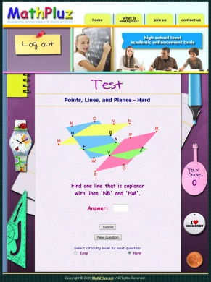
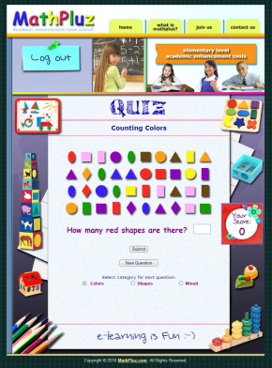
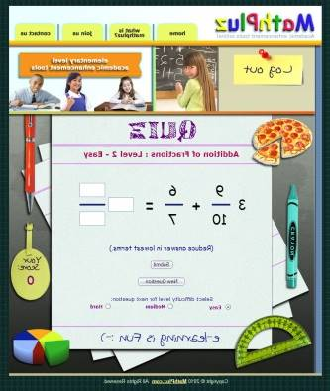
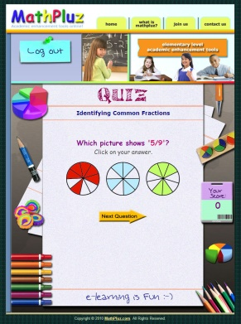
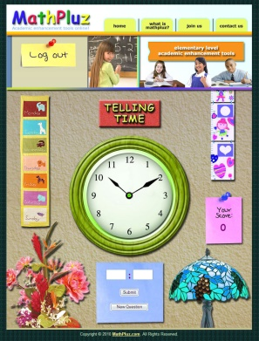
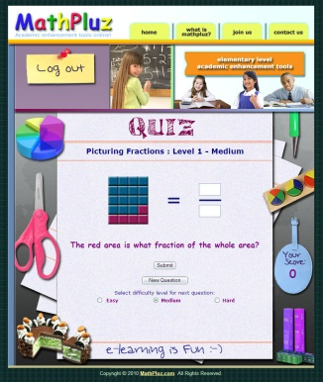
Students are always excited
to work on KPluz modules:
visually appealing, fun-filled, and easy to use!
Notes:
Students are always excited to work on KPluz modules because all KPuz modules are visually appealing, fun-filled, and easy to use. As such, teachers no longer need to convince them to work on their assignments – they do them on their own. With KPluz, students quickly master their lessons because they practice not because they are told to, but because they really want to.

Slide 16
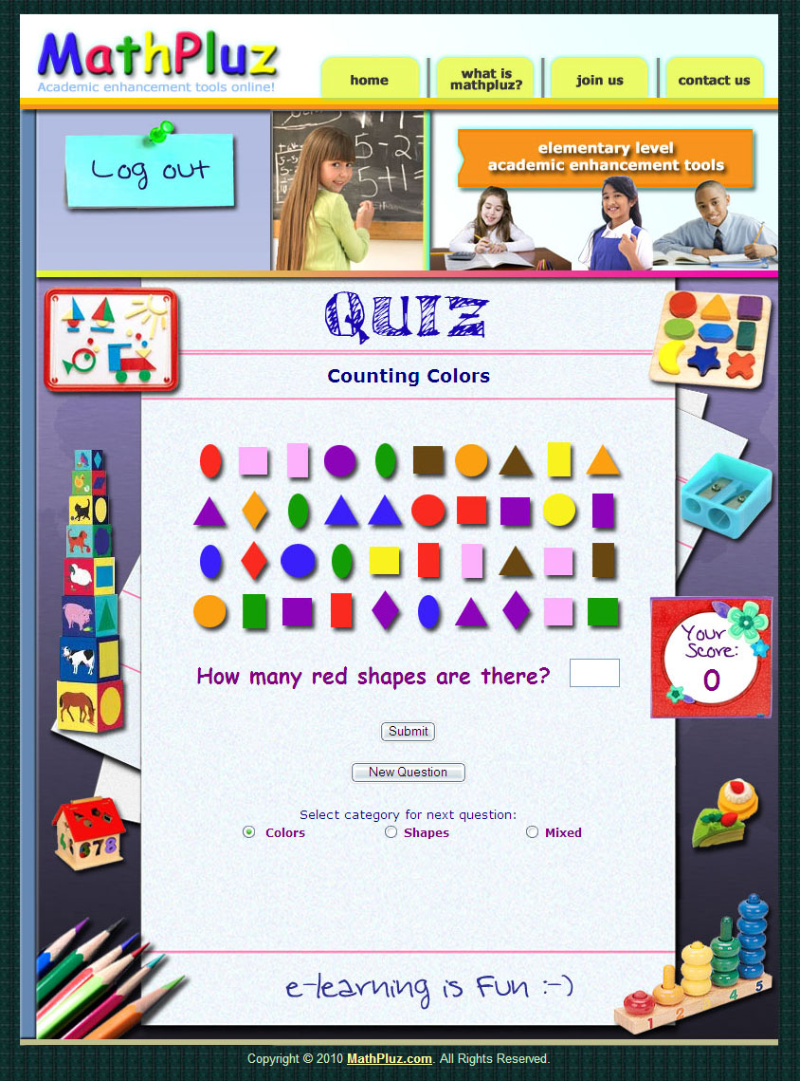
saves time:
mastery takes only a few minutes a day!
- fully automated system
- one question at a time with instructions to follow
- very convenient submission of answers through input boxes and click-on buttons
quick access to different levels of difficulty
immediate feedback if answer is correct or not
the correct answer is always provided
real-time recording of scores in the database
unlimited practice!
Notes:
KPluz is so easy to use and so effective that subject mastery takes only a few minutes each day, saving both students and teachers a lot of time.
KPluz is a fully automated system that serves questions and instructions that are very easy to follow.
The input boxes and click-on buttons with which students submit answers are very convenient to use.
KPluz immediately tells the student if the answer is correct or not, and always gives the correct answer.
All scores are instantly recorded in the report card.
KPluz users can use KPluz all they want with no limit.
For the reasons stated above, a student can master a lesson in less than 5 minutes!

Slide 17
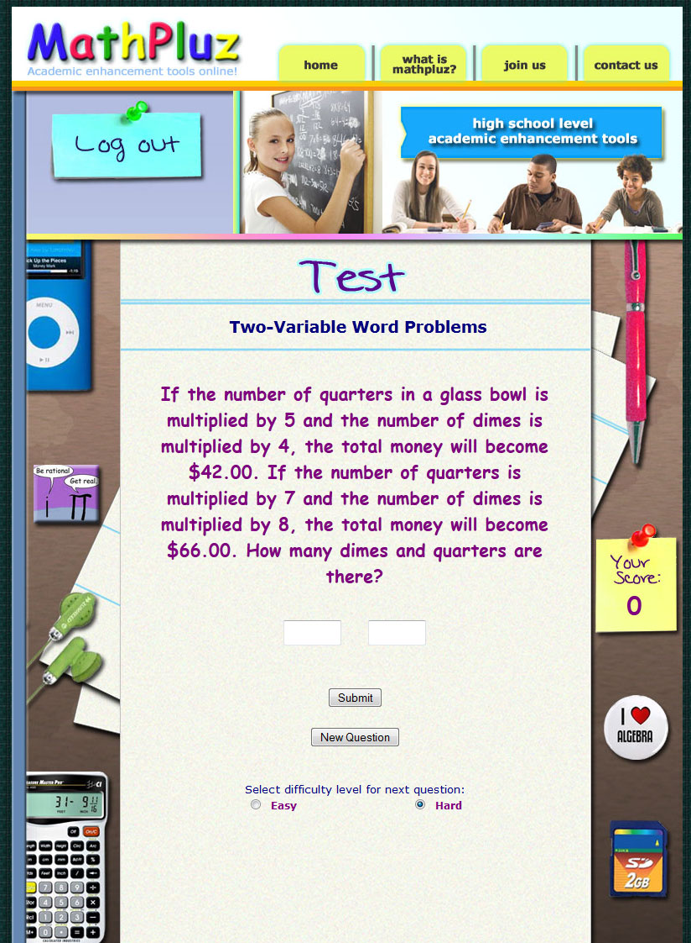
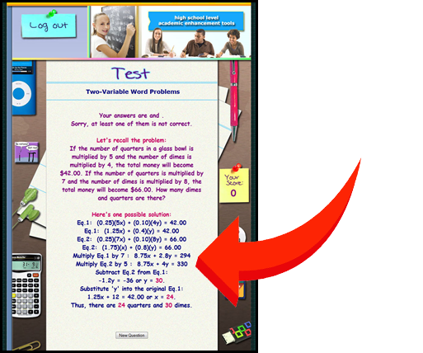
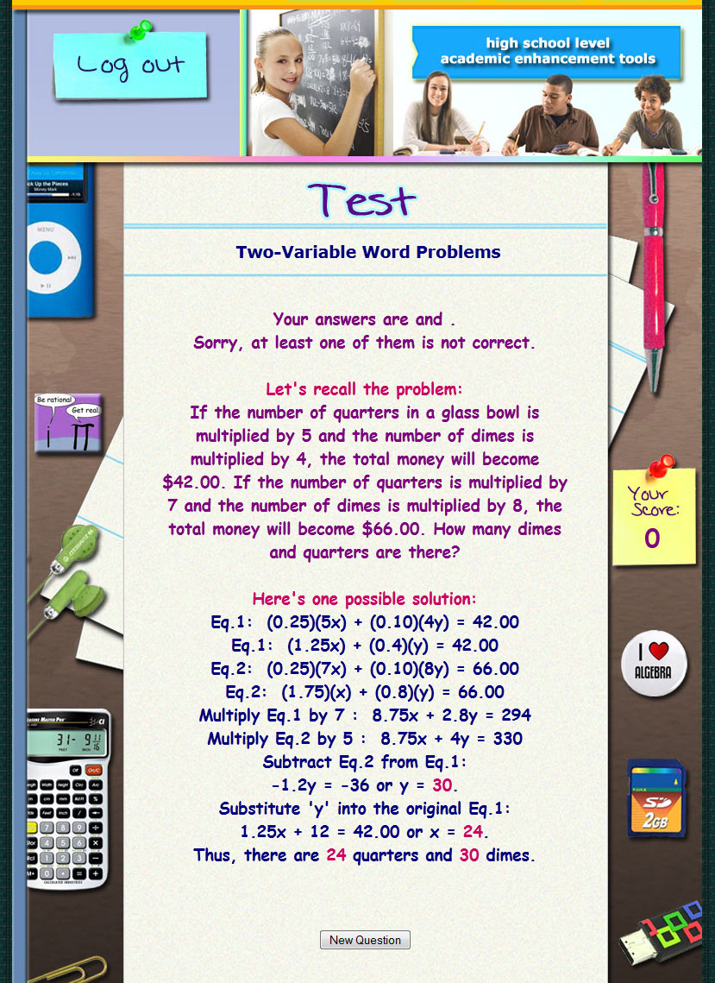
High school students quickly master
advanced math word problems!
step-
by-
step solution
Notes:
With KPluz, even high school students who hate math are able to quickly master solving word problems in algebra because KPluz provides a step-by-step solution for all math word problems.
For this reason, a student who makes a mistake could easily spot the error in his or her solution.
This is not possible with printed books, which never give step-by-step solutions for any of its word problem exercises.

Slide 18
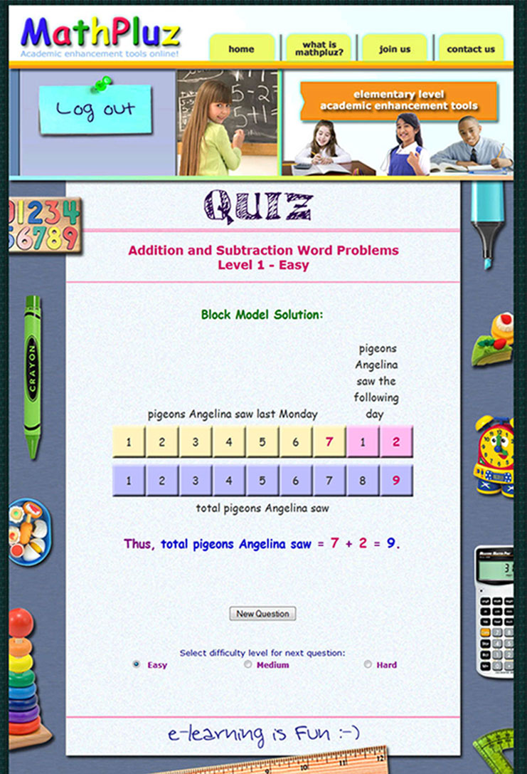
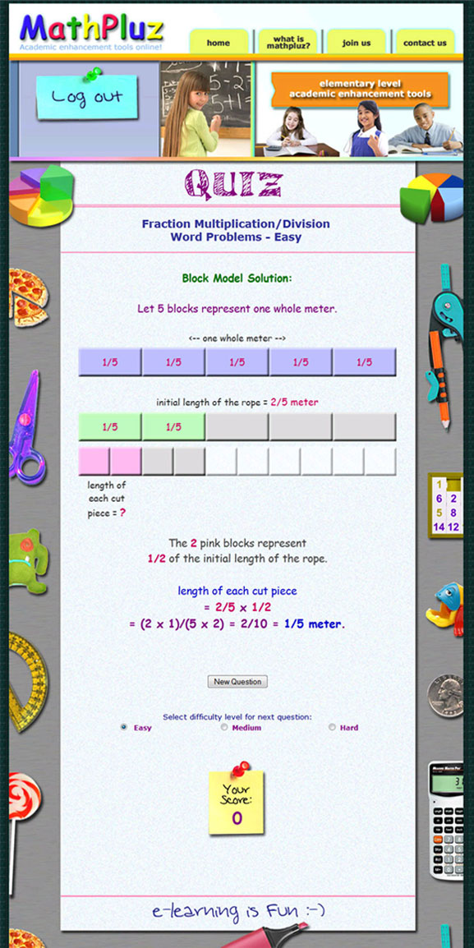
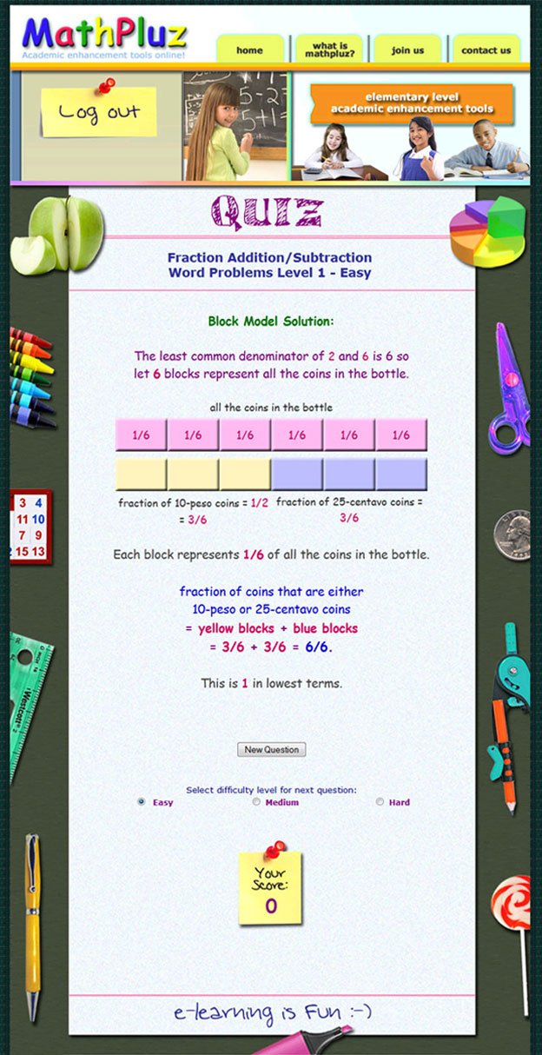
Block Modeling à la Singapore Math
helps young pupils visualize word problems!
Notes:
KPluz even provides automated block modeling ala Singapore Math for many word problems in grade school.
Block modeling allows young students to visualize word problems better.
KPluz is so advanced that it started offering online block modeling long before Singapore Math did the same.

Slide 19
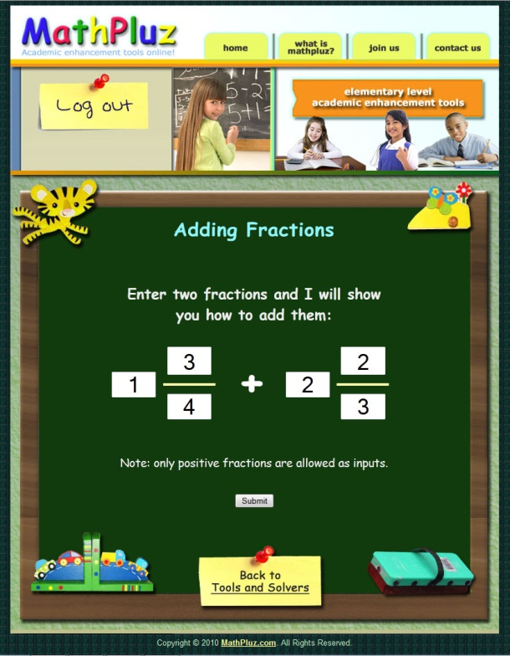
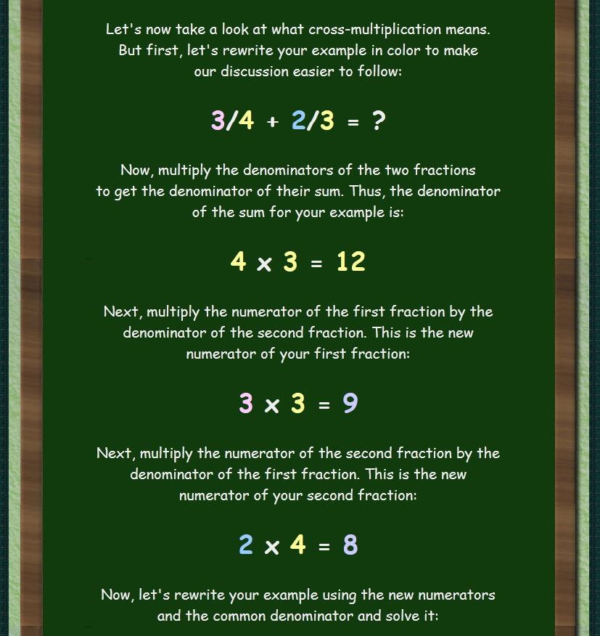
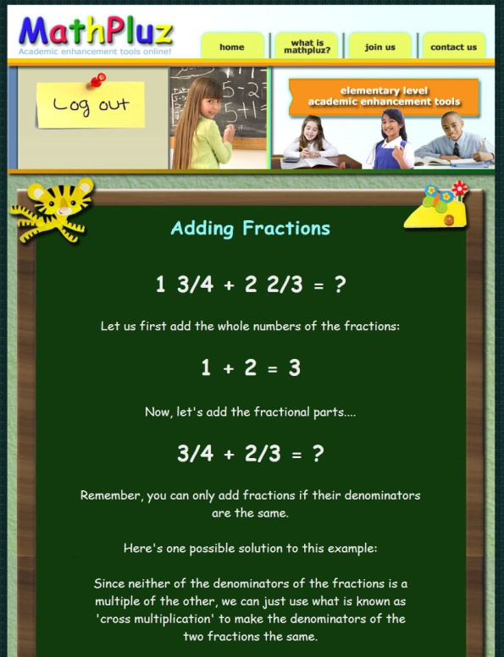
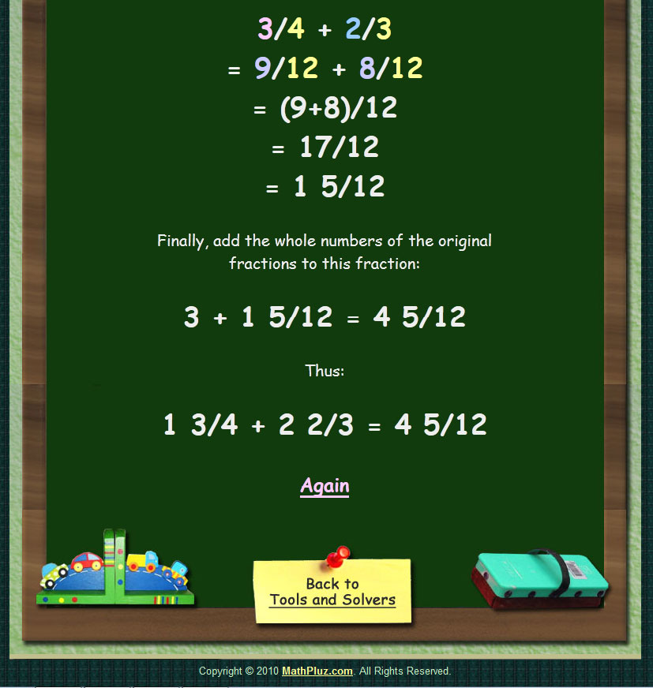
solvers are like home tutors:
they give solutions in plain English!
Notes:
For some lessons, having KPluz is like having a tutor at home.
KPluz has math solvers that students, or even parents, can ask.
These solvers explain the solution to the question step by step in plain English.
Students can use these solvers again and again until they master the operations they want to understand.
You won’t find this unique and outstanding feature in other online learning systems.

Slide 20
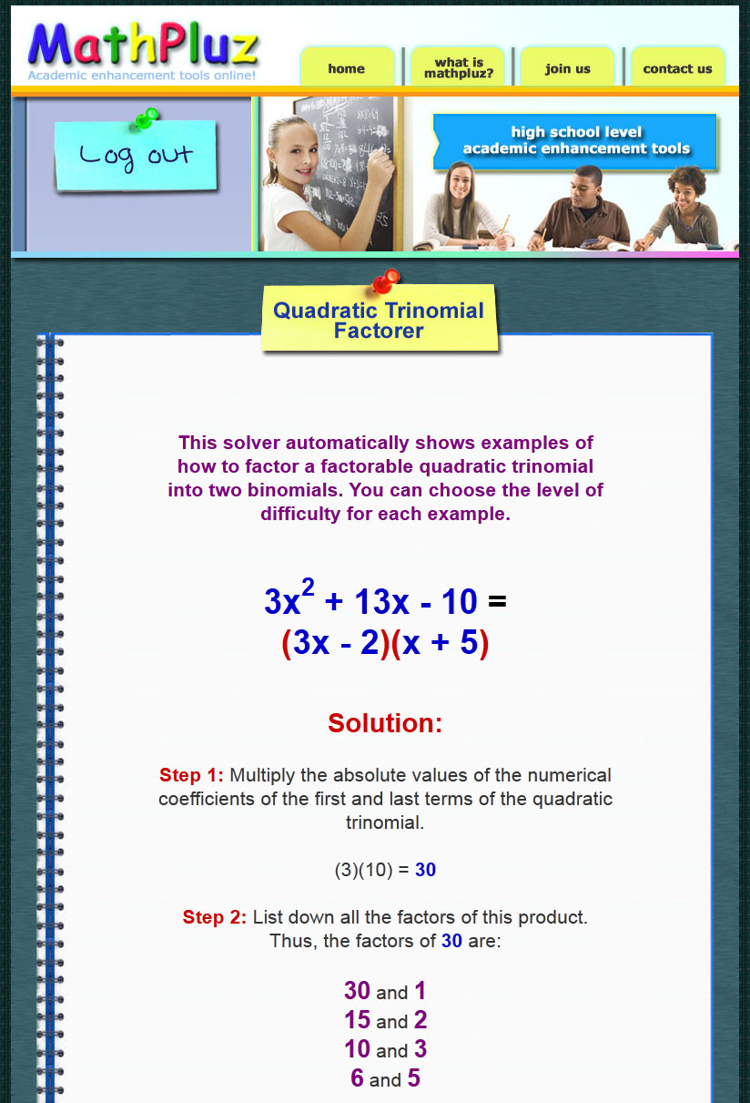
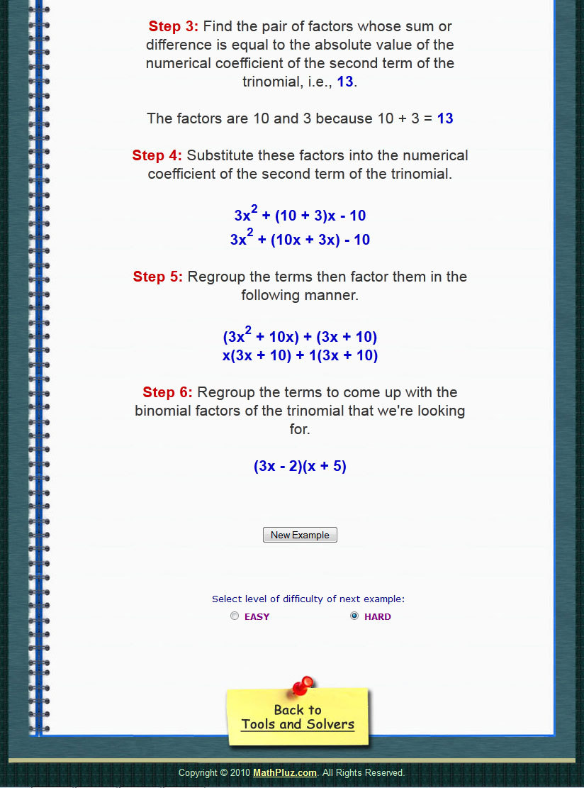
Need hundreds of examples?
No problem with KPluz solvers!
Notes:
Some math problem-solving techniques are so complex that students need many examples in order to master them.
Quadratic trinomial factoring is one such example.
Printed books seldom include more than two examples for each lesson.
KPluz solvers, on the other hand, provide as many examples as needed for the student to understand the technique.
With KPluz, learning is a cinch!

Slide 21

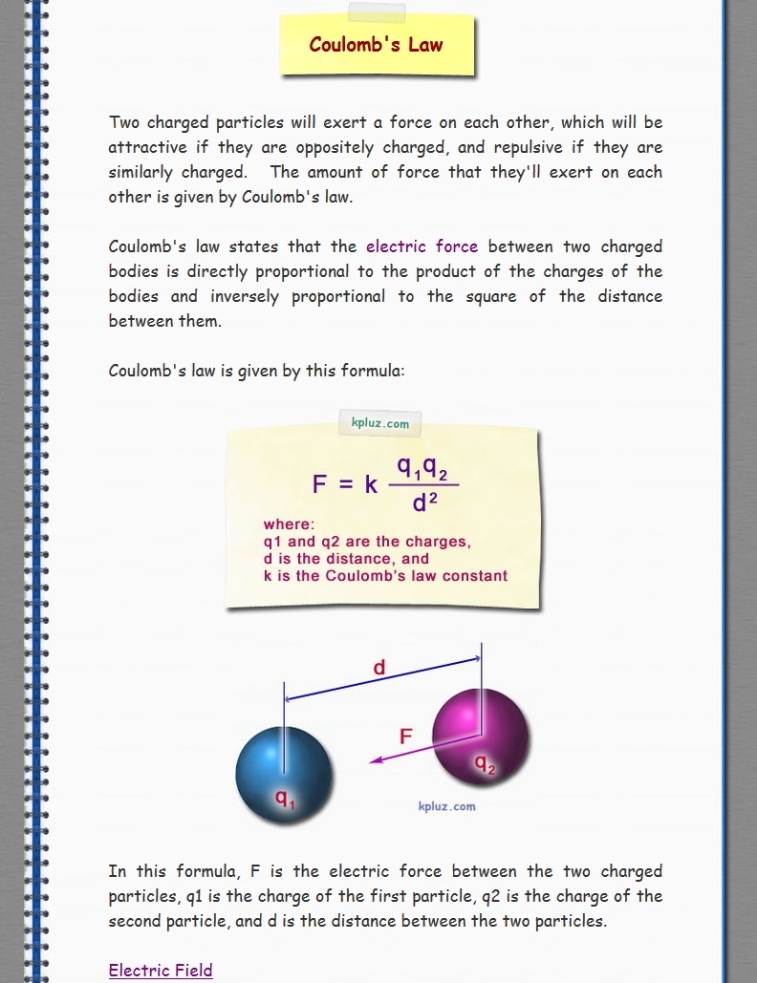

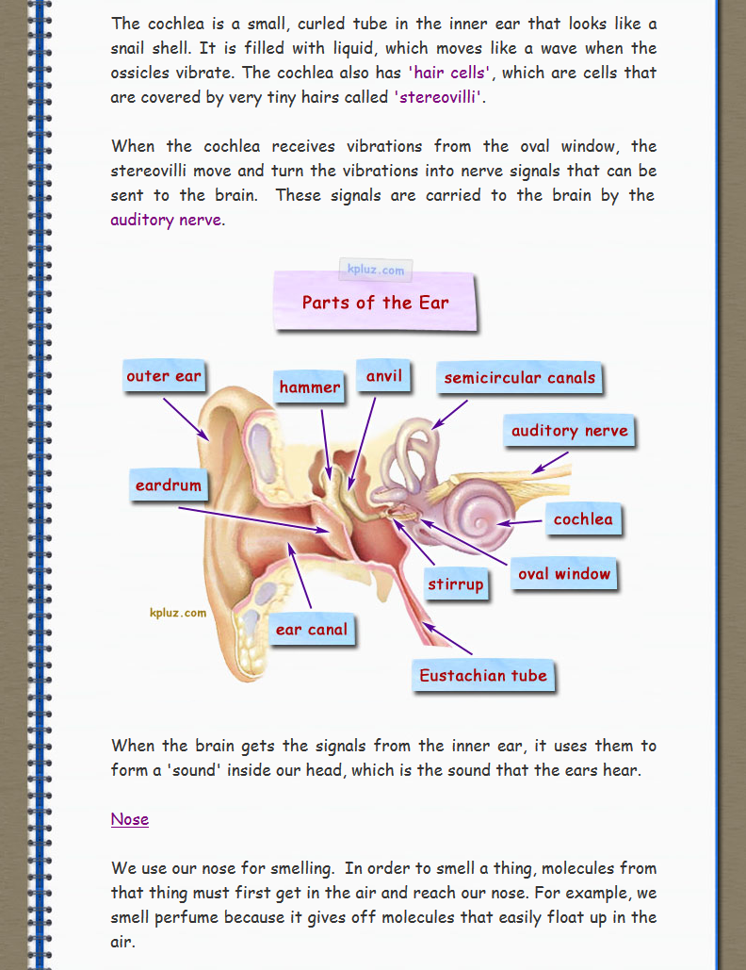
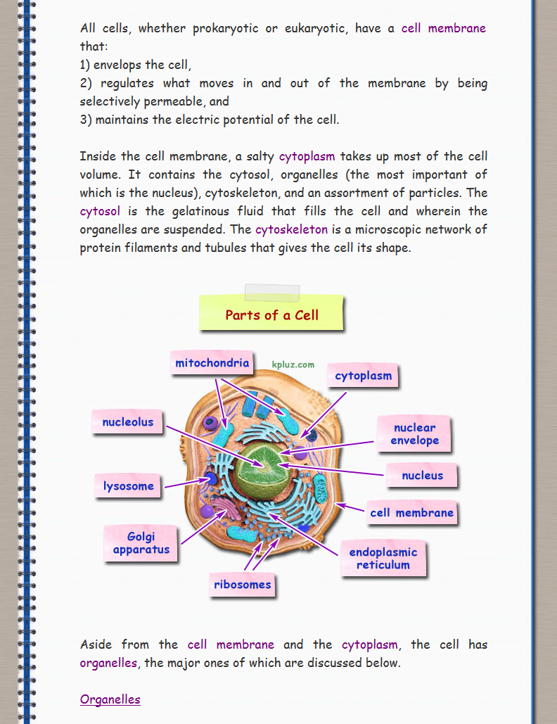
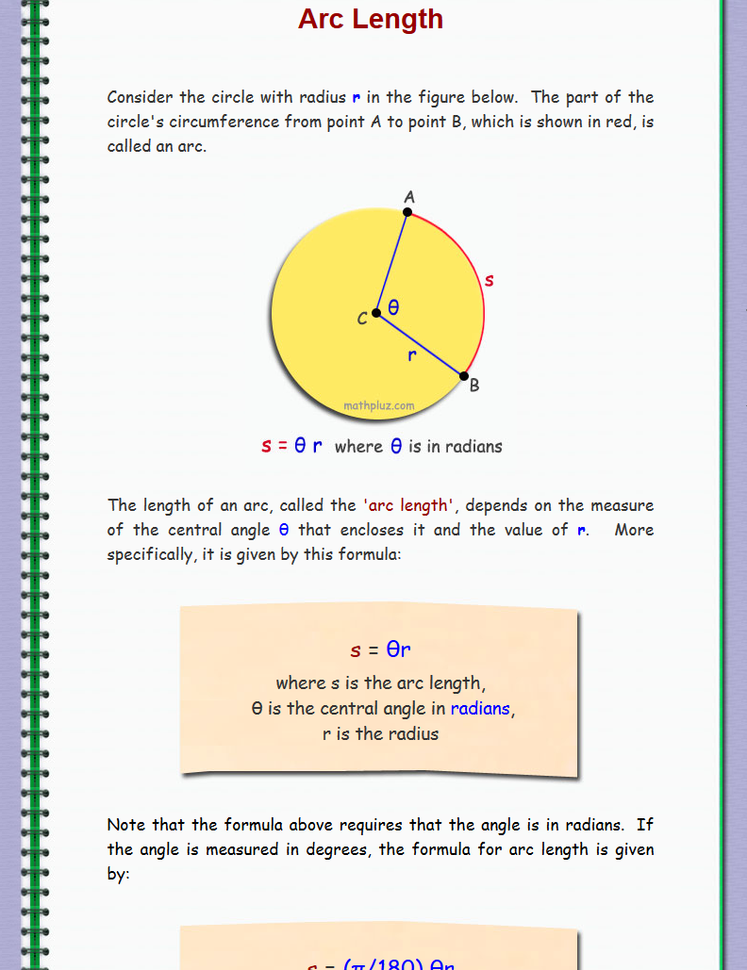
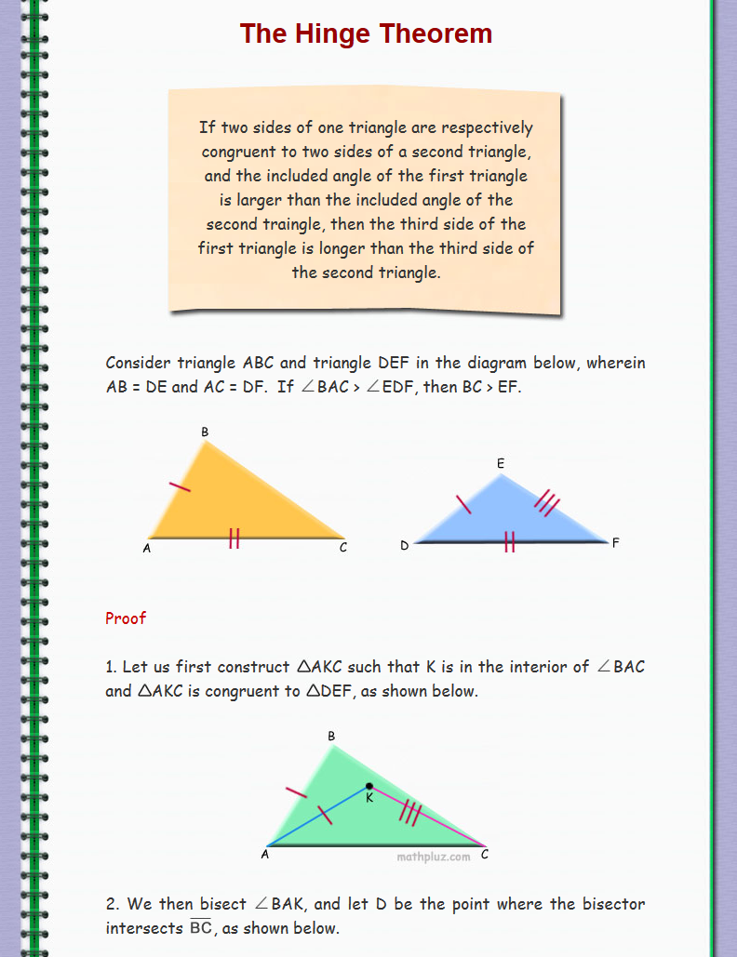
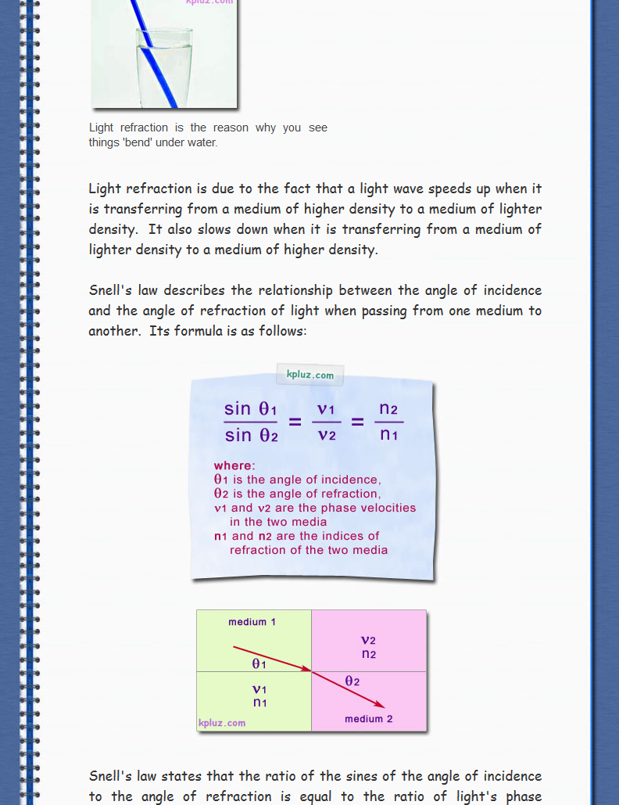
Students get world-class education
from advanced readings in KPluz tutorials.
exceeds DepEd requirements
Notes:
We want KPluz users to have world-class education, so we included tutorials for their advanced readings.
These readings are on top of the KPluz schoolbooks that satisfy DepEd’s curriculum requirements.
KPluz tutorials are a surefire way to satisfy any student’s voracious appetite for new knowledge!

Slide 22
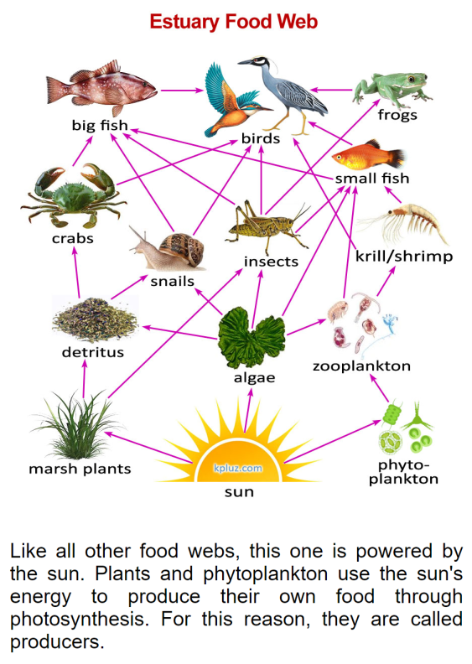
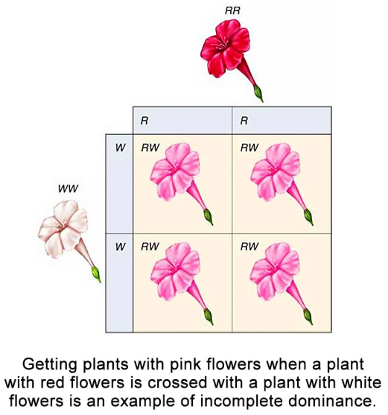
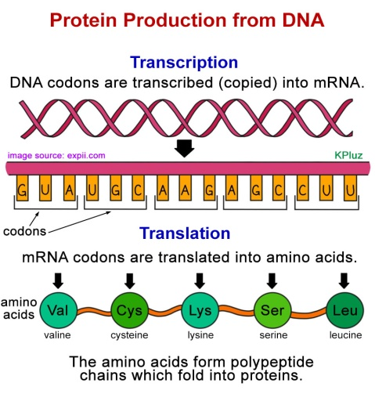
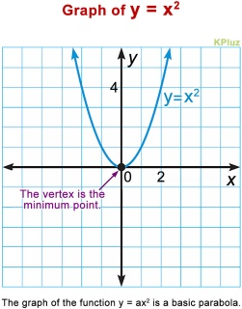
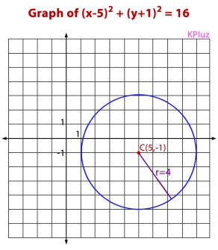

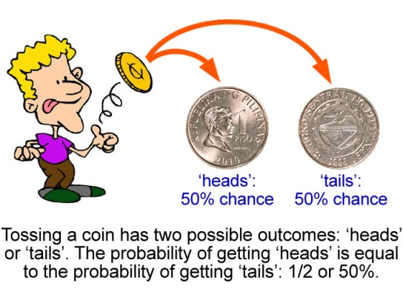

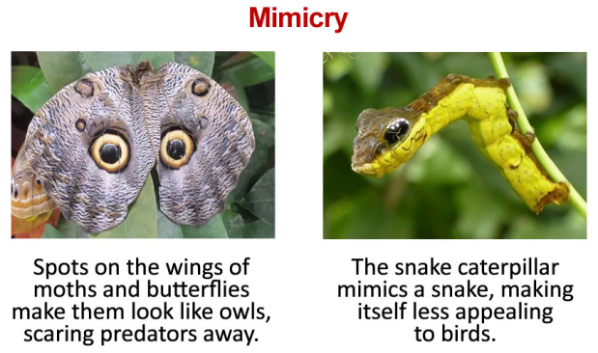
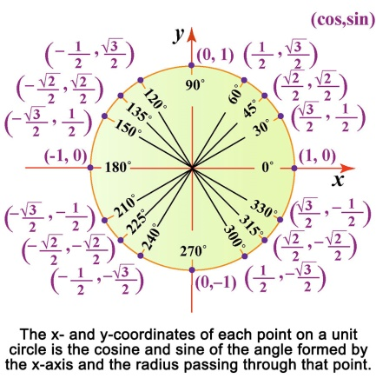

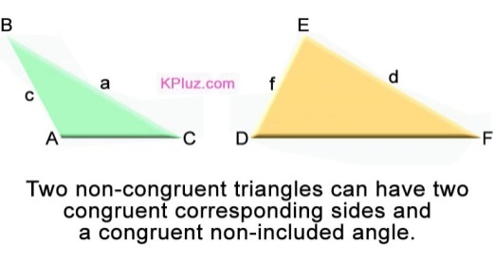
Learning is FUN with KPluz books!
Informative. Easy to read. Visually appealing.
Notes:
We’ve mentioned that KPluz has free schoolbooks that can replace the bulky and expensive printed books that schools traditionally use.
Here are examples of what you’ll find in KPluz books.
It is easy to see why students prefer readings them: they are very informative, easy to read, and so exciting to look at!

Slide 23

Students prefer reading KPluz books!
They seldom open their printed books.
FREE!
Notes:
Let us now look at the reasons why students prefer KPluz books to printed books.
KPluz books are very comprehensive and informative, yet really easy to read. Printed books have too much verbiage and use very scholarly words, which is why students do not enjoy reading them.
KPluz books have dynamic content. In fact, many pages in our math schoolbooks change their examples every time they are refreshed! This means that students get unlimited examples from them.
Printed books have static content. Sadly, they also contain many errors that can not be corrected and will be there forever.
KPluz books have crisp and colorful illustrations while the images in printed books are bland and dull.
KPluz books are convenient to use, unlike printed books which are very bulky – something that gadget-savvy students do not like.
Lastly, printed books are very expensive. KPluz books, on the other hand, are free, and can drastically bring down the cost of your education.

Slide 24



Track Students’ strengths/weaknesses
in real time with NO effort!
- score of each student for every module recorded in real time
- blue bars of each student auto-matically counted and tabulated
- parents and teachers can quickly
check report cards anytime
Notes:
All students are different, so their education should not be one-size fits all.
One of the keys to having a superior education system is being able to monitor the individual strengths and weaknesses of your students so that your teachers can teach them based on what they actually need.
This is exactly what KPluz gives you – the power to effortlessly know where each of your students need help, so your teachers can come to their rescue.
KPluz has one of the best academic performance monitoring systems, recording student scores for all competencies in real time. Completed modules, called blue bars, are automatically counted and tabulated for each student. Just a single click by parents and teachers can let them see a student’s KPluz report cards, so keeping an eye on any student’s academic performance is very convenient with KPluz.

Slide 25
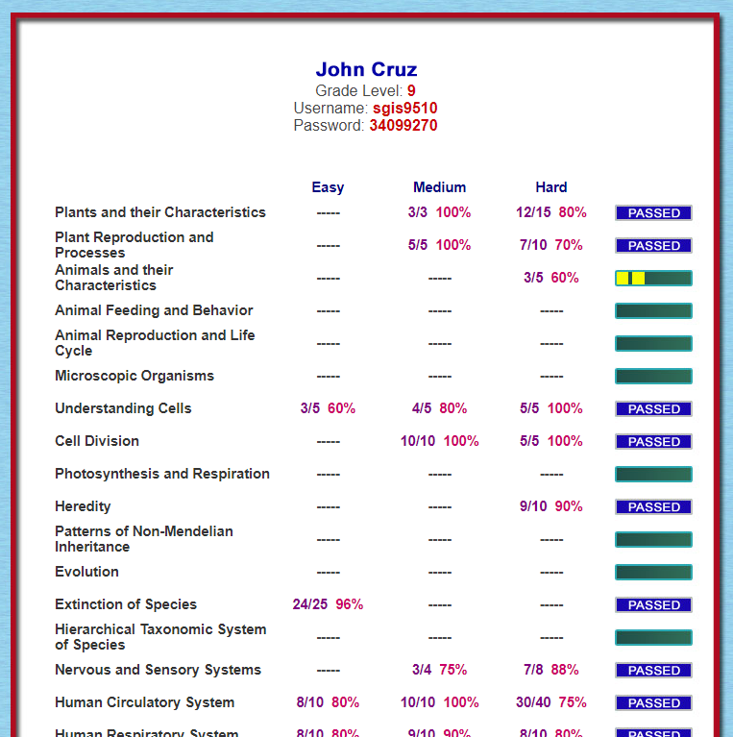
report cards will amaze you!
They make checking of student performance
fast, easy, thorough, and convenient!
- shows the correct answers over the number of questions answered for each level of each topic
- shows the percentage of the correct answers for each level of each topic
has a progress bar that shows how far the child is from passing a topic
shows a blue bar if the child has already passed a topic
Notes:
Here is an example of a KPluz report card. You will be amazed at how it can be both very informative yet quite simple to analyze.
It shows the student’s raw scores and percentage scores for each competency in the curriculum.
It also has progress bars that allow you to instantly have an idea of how many modules have already been completed by the student.
A progress bar starts as a green bar and accumulates yellow squares inside it as the student collects correct answers.
Once the student has attained a minimum number of questions answered and minimum percentage score, the bar will become blue with the word ‘PASSED’ written inside it.
This is what we call a blue bar, which tells us that the student has completed the module it stands for.
The goal of each student, therefore, is to accumulate as many blue bars as possible for each subject.
A single glance at how ‘blue’ a report card is immediately tells the teacher if a student is performing well or not in the subject.
This fast, easy, thorough, and convenient system for checking student performance is one of the things that will give your school superiority over other schools.

Slide 26
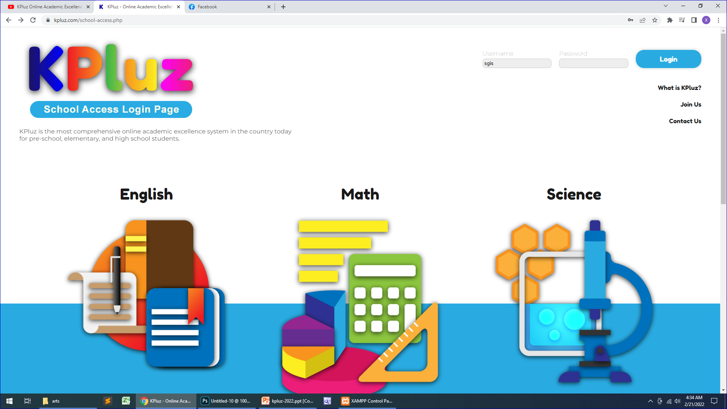
With , you see everything!
You have administrative access to all KPluz data.
Notes:
We will give your school administrative access to all KPluz data concerning your school.
This school access will let you see everything that’s happening in your students’ education in real time.
Once you’ve partnered with us, we will train your teachers on how to use this school access system so that they can maximize the use of KPluz in your school.
It won’t take long for your school to reap all the benefits of having Kpluz: lower operational costs, superior quality of education, higher enrollment, and greater profitability.

Slide 27
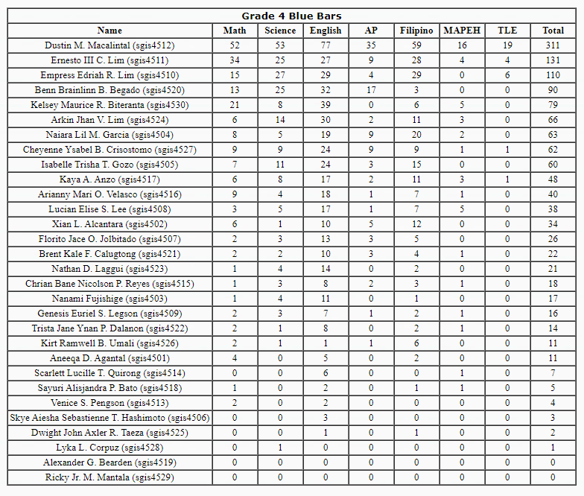
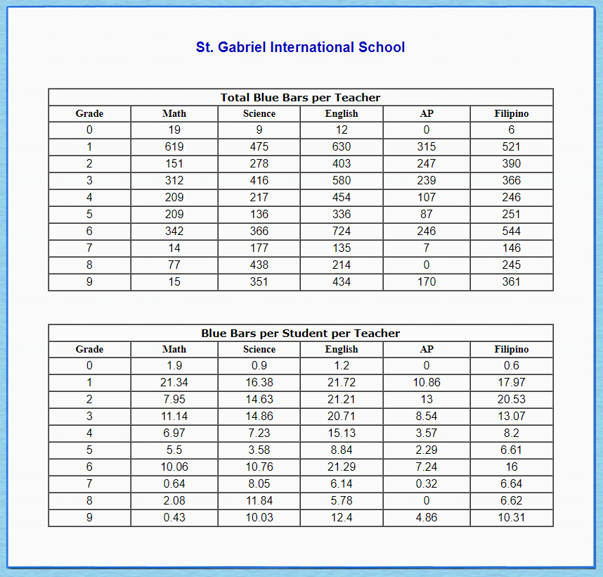
Analyze your school like never before:
Compare students, sections, grade levels,
teachers, and branches!
Notes:
With KPluz, you can analyze your school like never before. You can do it at different levels and from many angles.
Imagine being able to compare students, sections, grade levels, teachers, and even branches if you have several of them.
This ability to compare performances at different levels will help you identify which strategies, tactics, and systems work best, and apply all of them across the board.
Identifying and addressing areas for improvement within your school system can never be easier than this.

Slide 28

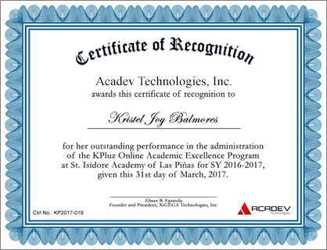
KPluz awards gold medals and certificates to students and teachers.
motivates!
Notes:
At the end of each school year, KPluz awards medals and certificates to deserving students and teachers.
KPluz medals and certificates are excellent motivators, bringing out the best in students and teachers alike year after year.

Slide 29

The KPluz Affiliate Marketing Program is an ideal income-
generating opportunity for parents and teachers looking for
a flexible and rewarding way to earn from home.
With a 5-level commission system, you can generate both
active and passive income - perfect for those balancing
family time or working around a busy schedule.
Notes:
The world is changing so fast that you won’t even recognize the year 2030.
These words didn’t come from me. This is what technology experts around the world are saying today.
By that year, driverless cars will be everywhere.
There will be flying cars in the sky.
We will be talking to sentient robots – robots that are intelligent enough to think that they are alive.

Slide 30
BENEFITS of Being a KPluz Affiliate Marketer
1) Great product with high demand
KPluz is a proven educational product that is easy to sell to parents who believe in the power of education.
2) No competitors
As far as we know, KPluz is the first and only online academic excellence system that has an internal affiliate marketing. Thus, as an affiliate marketer, you’ll have no competitors in this field.

Slide 31
BENEFITS of Being a KPluz Affiliate Marketer
3) Passive Income Opportunity
Once you've built your referral network, you can continue to earn commissions even when you're not actively selling.
4) 5-level Earning Potential
Since you earn from three levels of referral, your earning potential grows as your network expands.

Slide 32
BENEFITS of Being a KPluz Affiliate Marketer
5) Easy Tracking & Payout System
You don’t have to worry about complicated tracking or missing out on commissions. The commission tracking system is smooth, transparent, and reliable.
Commissions are calculated in real time and paid as quickly as possible, typically within two hours.

Slide 33
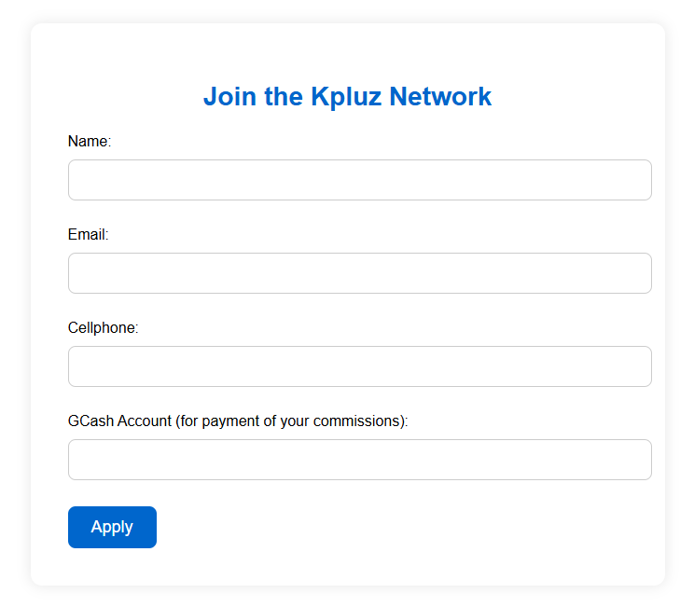
How to Participate
Sign up through a valid referral code link to get your own referral code link and network password. Here’s an example of a referral code link:
https://kpluz.com/join.php?ref=ElmNim!416

Slide 34
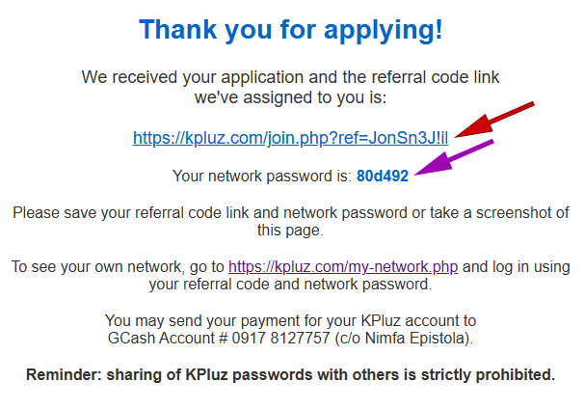
How to Participate
2. Copy the referral code link and network password assigned to you by the system and/or take a screenshot of the page shown.

Slide 35
How to Participate
3. Send your payment of Php 1950.00 for one (1) KPluz account to our official Gcash account:
0917 812 7757 (c/o Nimfa Epistola)
In the comment section of the Gcash payment interface, indicate your own referral code and what grade level your purchased KPluz account is for like this:
ElmNim!416 – Grade 3
4. Grow your network by referring/selling KPluz accounts in person or via social media using your referral code link.

Slide 36
How to Participate
5. Earn commissions: get paid based on the sales made within your 5-level sales network. Commissions are calculated in real time and paid as quickly as possible, typically within two hours.
6. Use our online app to check your sales and commissions.
Go to https://kpluz.com/my-network.php and log in using your own referral code and network password.

Slide 37
Level Commissions (per KPluz Account Sold at ₱1,950)
Direct Seller (DS):
Earn ₱500 for every direct sale.
Sub-affiliate 1 (SA1: Customer of DS):
Earn ₱200 when your SA1 makes a sale.
Sub-affiliate 2 (SA2: Customer of SA1):
Earn ₱150 when your SA2 makes a sale.

Slide 38
Level Commissions (per KPluz Account Sold at ₱1,950)
Sub-affiliate 3 (SA3: Customer of SA2):
Earn ₱100 when your SA1 makes a sale.
Sub-affiliate 4 (SA4: Customer of SA3):
Earn ₱50 when your SA2 makes a sale.

Slide 39
Example Scenario # 1
👉 You (DS) directly sell 5 KPluz accounts to Anna
    Your earnings: ₱500 x 5 = ₱2,500
👉 Anna (SA1) then sells 3 KPluz accounts to Ben (SA2)
    Anna’s earnings: ₱500 x 3 = ₱1,500
    Your earnings from Anna’s sales: ₱200 x 3 = ₱600

Slide 40
Example Scenario # 1 (Cont.)
Ben (SA2) then sells 4 KPluz accounts to Claude
    Ben’s earnings: ₱500 x 4 = ₱2,000
    Anna’s earnings from Ben’s sales: ₱200 x 4 = ₱800
    Your earnings from Ben’s sales: ₱150 x 4 = ₱600
Your total earnings = ₱2,500 + ₱600 + ₱600 = ₱3700
Anna’s total earnings = ₱ 1,500 + ₱800 = ₱2300

Slide 41
Example Scenario # 2
👉 You (DS) sold 1 KPluz account to 2 SA1’s every month, and all your SA1’s, SA2’s, SA3’s, and SA4’s only sold 1 KPluz account every 2 months (6 in one year: very conservative)
    Your earnings per level for 1 year:
      ₱500 x 24 = ₱12,000
      ₱200 x 24 x 6 = ₱28,800
      ₱150 x 24 x 6 x 6 = ₱129,600
      ₱100 x 24 x 6 x 6 x 6 = ₱518,400
      ₱50 x 24 x 6 x 6 x 6 x 6 = ₱1,555,200
    Your total earnings for 1 year:
      = ₱12,000 + ₱28,800 + ₱129,600 + ₱518,400 + ₱1,555,200 = ₱2,244,000

Slide 42
Moving Forward
1) Continuously bring leads to our weekly webinar and convince your SA1’s to do the same.
Continuously bringing your target SA1’s and SA2’s to our weekly webinar will allow us to help you close sales and grow your network.
2) Target organizations.
You should target not just parents but also organizations such as school PTA’s and employee cooperatives of big companies. Putting just one big organization under your network can earn you millions per year.

Slide 43
Moving Forward
3) Earn nonmonetary rewards from KPluz.
By excelling in your sales performance, you can earn nonmonetary rewards from KPluz such as free trips abroad and brand new smartphones or laptops. Details will be announced soon.
4) Use social media.
Promote KPluz on your own social media accounts. For example, you can create Youtube and Tiktok videos and put your KPluz referral code link in their descriptions.

