Slide 1

COMPANY PROFILE

Slide 2

Acadev Technologies at a Glance
Company Name: Acadev Technologies Inc.
Business Address: 3rd Flr. Triple M Commercial Bldg. Dona Soledad Ave., Don Bosco 1700, Paranaque City
Contact Details:
Landline #: 824-1064
Mobile #’s: 0917-812-7757/0917-164-4119/0917-1374784
Email: acadevtech@gmail.com Founder and President: Elmer B. Epistola

Slide 3
Company Description
Acadev Technologies Inc. (ATI) is a tech company based in Paranaque and incorporated on November 25, 2021. ATI is led by its founder and has 8 full-time and 3 part-time employees as well as several freelance developers and marketers.
The company develops:
- hardware/software systems controlled via mobile or PC,
- subscription-based online services,
- AR/VR projects, and
- local generative AI systems
- projects involving IoT, animatronics, and robotics

Slide 4
Our Products and Services
KPluz™
KPluz is an online academic excellence system for Filipino students from Prep to Grade 12 that covers nine (9) major subjects: Math, English, Science, Filipino, Araling Panlipunan, MAPEH, TLE, Mandarin, and GMRC. KPluz has been and is being used by many private schools in the Philippines since 2013.
Epistola Extended Reality (XR) Museum™
The Epistola Extended Reality (XR) Museum is a roving augmented and virtual reality (AR and VR) museum that we bring to and exhibit in schools, featuring attractions such as animated 3D dinosaurs/animals, NASA spacecraft, WWII planes and ships, prehistoric humans, and many more.

Slide 5

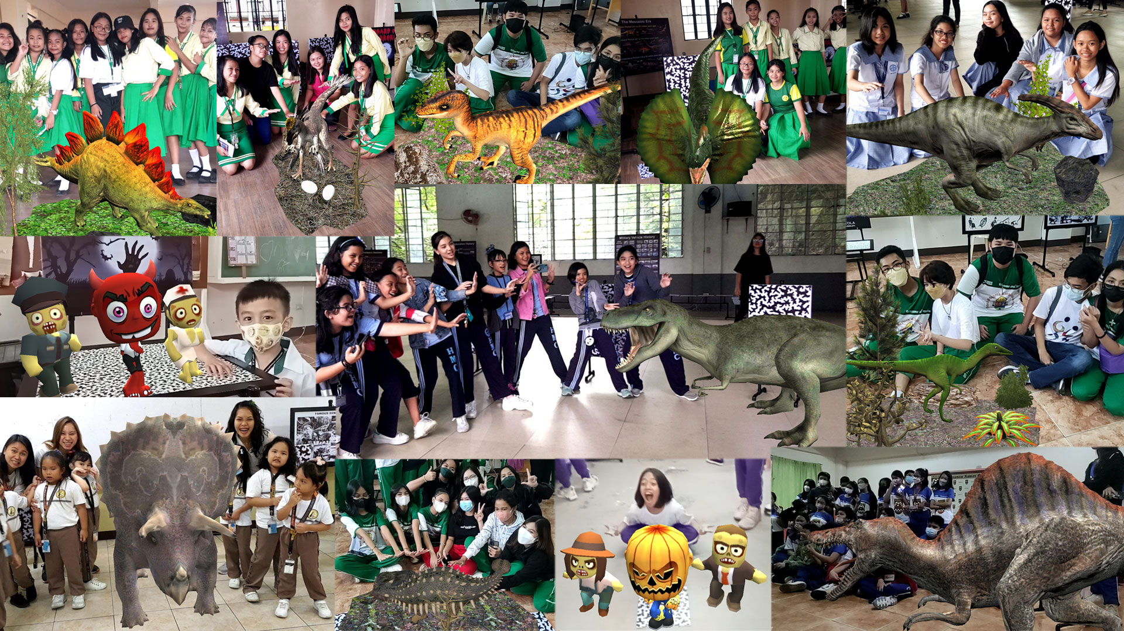

Slide 6
Our Products and Services
3) VR Adventures™
VR Adventures is an online virtual field trip package that allows subscribers to go on any of the following tour-guided 3D fantasy escapades:
3.1. Raptor Island, a virtual world where dinosaurs live ala ‘Jurassic Park’
3.2. ‘African Safari’, a virtual island where African animals roam, and
3.3. ‘Under the Sea’, a virtual world deep under the ocean.

Slide 7
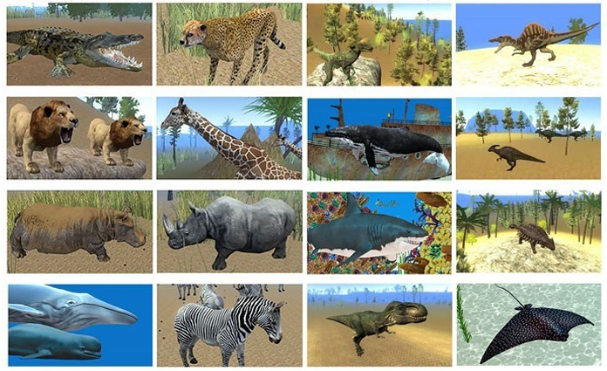
Screenshots from VR Adventures

Slide 8
Our Products and Services
4) Augmented Reality (AR) Services
We are among the pioneers of augmented reality (AR) in the Philippines, with numerous AR projects in education, marketing, amusement, and tourism.
In education and training, we enhance books, magazines, models, props, and other learning materials with AR features.
For marketing, we create AR apps that animate posters, brochures, tarpaulins, and even items like shirts, pet apparel, paintings, and books.
We can also set up AR attractions to spice up corporate parties or events.

Slide 9
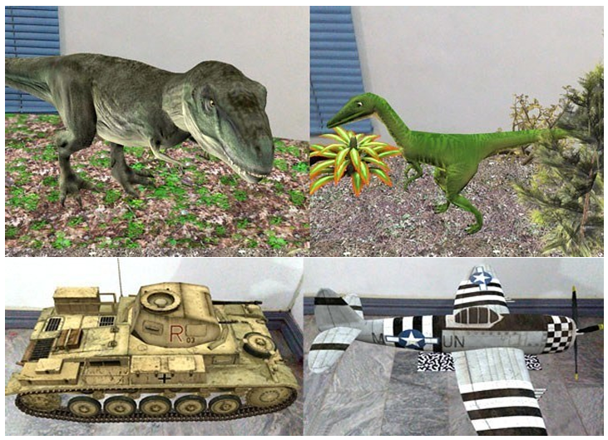
Samples of AR attractions developed by Acadev Technologies

Slide 10
Our Products and Services
Virtual Reality (AR) Services
We are one of the pioneers in the application of real virtual reality (VR) technology in the Philippines. We can develop VR applications in the fields of education, marketing, amusement, and tourism.
In the field of education, we have developed three different VR worlds that let students explore dinosaurs, African animals, or ocean creatures in a fun and immersive way.
For marketing purposes, we can develop VR worlds for companies so that their customers can have fun while learning about their products.

Slide 11
Our Products and Services
Training and Education
Using our proprietary online education system, we can set up various online training and testing programs for companies. We can also develop customized online learning systems for schools.
We offer various corporate training programs to companies. We can also assist in the development of special courses or tools for their internal training and development programs.

Slide 12
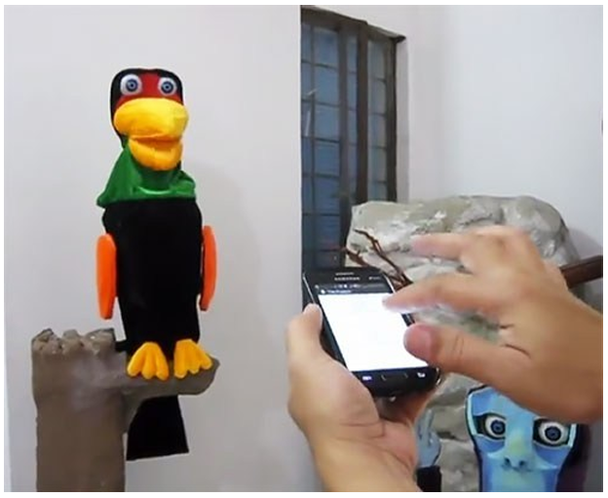
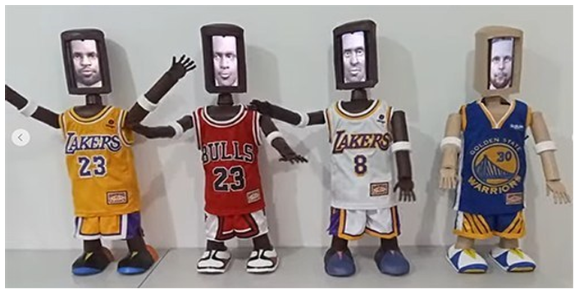
Our Products and Services
7) Robotics and Electromechanical System Design
We can design and build custom robots or electromechanical systems that may be controlled through Windows- or Android-based devices or equipped with generative AI capabilities in the future.
Our AI-ready speaking humanoid robots
Our smartphone-controlled
robotic bird

Slide 13
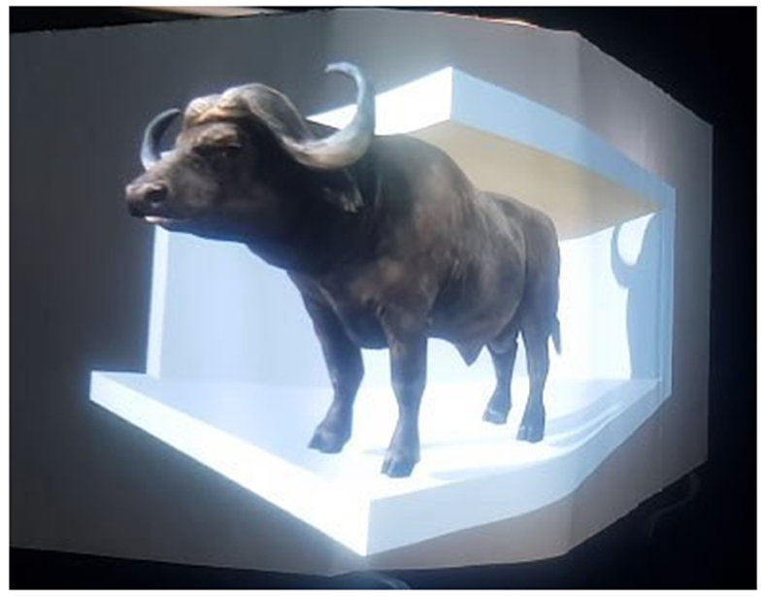
Our Products and Services
3D Imaging and Projection
We can develop content and/or set up a display/projection system for your 3D imaging/projection needs.
Our 3D billboard prototype

Slide 14
Our Products and Services
Artificial Intelligence (AI) Services
We can develop and implement local or offline generative AI apps for schools and companies. Right now, we are using Ollama to develop an AI-driven, voice-controlled TV that can automatically display lessons to students inside the classroom.
Imagine a teacher simply saying, ‘Explain how plants make their own food,’ and the TV automatically displays a lesson on photosynthesis, complete with images for students to read and understand. This kind of ‘magic whiteboard’ could truly revolutionize classroom teaching.

