Slide 1
Satisfying 1NF
Initial Table
DR_NO | Date Rptd | DATE OCC | TIME OCC | Area | AREA NAME | Rpt Dist No | Part | Crm Cd | Crm Cd Desc | Mocodes | Vict Age | Vict Sex | Vict Descent | Premis Cd | Premis Desc | Weapon Used Cd | Weapon Desc | Status | Status Desc | Crm Cd 1 | Crm Cd 2 | Crm Cd 3 | Crm Cd 4 | Location | Cross Street | Lat | Lon
Remove Multivalued Columns
Mocode
Crime_code
DR_NO | Mocodes | Description
DR_NO | Crm_Cd | Crm_Level | Crm Cd Desec
incident
DR_NO | Date Rptd | DATE OCC | TIME OCC | Area | AREA NAME | Rpt Dist No | Part | Vict Age | Vict Sex | Vict Descent | Premis Cd | Premis Desc | Weapon Used Cd | Weapon Desc | Status | Status Desc | Location | Cross Street | Lat | Lon

Slide 2
Satisfying 2NF
Mocode
Crime_code
DR_NO | Mocodes | Description
DR_NO | Crm_Cd | Crm_Level | Crm Cd Desec
FD1
FD1
FD2
FD2
Remove the Partial Dependencies
Mocode
Mocode_description
Crime_code
crime_code_description
DR_NO | Mocodes
Mocodes | Description
DR_NO | Crm_Cd | Crm_Level
Crm_Cd | Description
incident
DR_NO | Date Rptd | DATE OCC | TIME OCC | Area | AREA NAME | Rpt Dist No | Part | Vict Age | Vict Sex | Vict Descent | Premis Cd | Premis Desc | Weapon Used Cd | Weapon Desc | Status | Status Desc | Location | Cross Street | Lat | Lon
FD1

Slide 3
Satisfying 3NF
incident
DR_NO | Date Rptd | DATE OCC | TIME OCC | Area | AREA NAME | Rpt Dist No | Part | Vict Age | Vict Sex | Vict Descent | Premis Cd | Premis Desc | Weapon Used Cd | Weapon Desc | Status | Status Desc | Location | Cross Street | Lat | Lon
FD1
FD2 - 5
Keep Full Dependencies
incident
DR_NO | Date Rptd | Date OCC | Time OCC | Area | RPT_Dist_No | Part | Vict Age | Vict Sex | Vict Descent | Premis Cd | Weapon Used Cd | Status | Location_Id
Decompose Transitive Dependencies
area
premise
weapon
status
Area | Area Name
Premise Cd | Premis Desc
Weapon Used Cd | Weapon Desc
Status | Status Desc
location
Location_Id | Location | Cross Street | Lat | Lon
Surrogate key created for location for a unique identifier

Slide 4
Data Base Schema
incident
DR_NO | Date Rptd | Date OCC | Time OCC | Area | Rpt_Dist_No | Part | Vict_Age | Vict_Sex | Vict Descent | Premis Cd | Weapon Used Cd | Status | Location_Id
Mocode
premise
DR_NO | Mocodes
Premise Cd | Premis Desc
Mocode_description
weapon
Mocodes | Description
Weapon Used Cd | Weapon Desc
status
Status | Status Desc
area
Area | Area Name
location
Location_Id | Cross Street | Lat | Lon
Crime_code
DR_NO | Crm_Cd | Crm_Level
crime_code_description
Crm_Cd | description

Slide 5
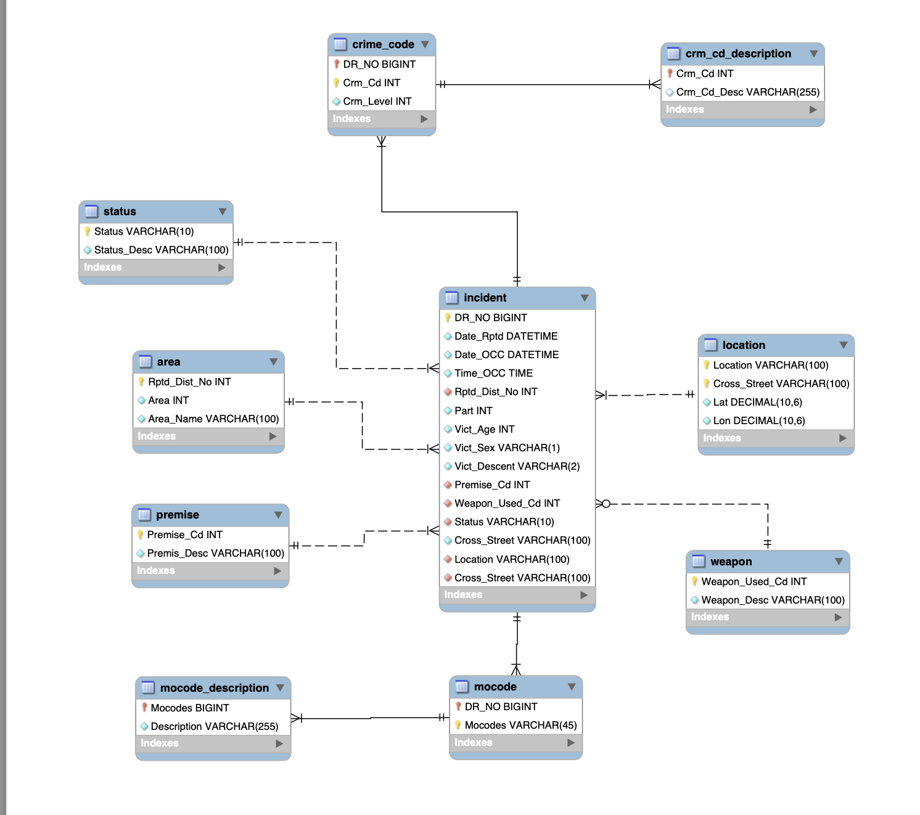

Slide 6
Assumptions Listed
Assuming that area is a georgical area and Rptd_Dist_No is a sub area withing the area then we can use this as a PK since it is more specific.
A crime can happen without a weapon since some of the values for weapon are null
For location I am assuming that if you have the location and the cross street as a composite key this can be primary key since it is unique enough and this can be confirmed by the latitude and longitude
Crime code can have no description, it can be null

Slide 7
6 Queries Planned
Most Frequent Crimes (Join) This query will find the top 5 most commonly reported crime types across all incidents. The tables that will be used are incident, crime_code, and crime_code_description. I plan to do a join on the incident and crime_code table on the column DR_NO. Then with that result do another join with crime_code_description to get the description of the crime. I will then count the frequency of each crime code then sort and display the top 5.
All Areas with or without Incidents (Outer Join) List all LAPD divisions and the number of incidents, including those that reported non incidents. I plan to do a left join from the area table to and the incident table using AREA. Then I plan the group by AREA to count incidents. I plan to display even the areas that have 0 incidents.
Crime Codes never used in any incident (Set Theory) This query will identify and display all crime codes that were never used in any reported incident. The tables used will crime_code_description and crime_code. I will do a set different where I want all of the crime codes in crime_code_description that are not in crime_codes (crime_code_description MINUS crime_code). I plan to select all of the Crm_Cd from crime_code_description then subtract the set of Crm_Cd that appear in the crime_code table and then return the remaining crime codes with there descriptions.
Annual crime trends (Aggregations) This query will count how many incidents were reported in each year. The table that will be used is the incident table. The column that will be used is the Date_OCC and we will have to extract the year from that column. The we will use the count method and the the group by method to count the total number of incidents per year and we will group by the year property that was extracted from the Date_OCC.
Firearm related incidents This query will show all of the incidents involving a firearm. The tables that will be used will be incident and weapon. I plan to do a join on incident and weapon using Weapon_Used_Cd. I then will then filter the results for descriptions that include firearm related words (HANDGUN, RIFLE, OTHER FIREARM, . . .).
Firearm incidents involving femal victims over time This query will show incidents that involved firearms and females' victims and it will group them by year to show how many of those incidents were reported in that specific year. The tables that will be used are incident and weapon. I plan to do a join with the incident and weapon table on Weapon_Used_Cd. From there I plan to filter the results to include only those incidents where Vict_Sex = ‘F’ and where the Weapon_Desc includes firearm related words. After that I will need to extract the year from Date_OCC and then group by that extracted year and count the number of those incidents per year.

