Slide 1
Satisfying 1NF
Initial Table
DR_NO | Date Rptd | DATE OCC | TIME OCC | Area | AREA NAME | Rpt Dist No | Part | Crm Cd | Crm Cd Desc | Mocodes | Vict Age | Vict Sex | Vict Descent | Premis Cd | Premis Desc | Weapon Used Cd | Weapon Desc | Status | Status Desc | Crm Cd 1 | Crm Cd 2 | Crm Cd 3 | Crm Cd 4 | Location | Cross Street | Lat | Lon
Remove Multivalued Columns
Mocode
Crime_code
DR_NO | Mocodes | Description
DR_NO | Crm_Cd | Crm_Level | Crm Cd Desec
incident
DR_NO | Date Rptd | DATE OCC | TIME OCC | Area | AREA NAME | Rpt Dist No | Part | Vict Age | Vict Sex | Vict Descent | Premis Cd | Premis Desc | Weapon Used Cd | Weapon Desc | Status | Status Desc | Location | Cross Street | Lat | Lon

Slide 2
Satisfying 2NF
Mocode
Crime_code
DR_NO | Mocodes | Description
DR_NO | Crm_Cd | Crm_Level | Crm Cd Desec
FD1
FD1
FD2
FD2
Remove the Partial Dependencies
Mocode
Mocode_description
Crime_code
crime_code_description
DR_NO | Mocodes
Mocodes | Description
DR_NO | Crm_Cd | Crm_Level
Crm_Cd | Description
incident
DR_NO | Date Rptd | DATE OCC | TIME OCC | Area | AREA NAME | Rpt Dist No | Part | Vict Age | Vict Sex | Vict Descent | Premis Cd | Premis Desc | Weapon Used Cd | Weapon Desc | Status | Status Desc | Location | Cross Street | Lat | Lon
FD1

Slide 3
Satisfying 3NF
incident
DR_NO | Date Rptd | DATE OCC | TIME OCC | Area | AREA NAME | Rpt Dist No | Part | Vict Age | Vict Sex | Vict Descent | Premis Cd | Premis Desc | Weapon Used Cd | Weapon Desc | Status | Status Desc | Location | Cross Street | Lat | Lon
FD1
FD2 - 5
Keep Full Dependencies
incident
DR_NO | Date Rptd | Date OCC | Time OCC | Area | RPT_Dist_No | Part | Vict Age | Vict Sex | Vict Descent | Premis Cd | Weapon Used Cd | Status | Location_Id
Decompose Transitive Dependencies
area
premise
weapon
status
Area | Area Name
Premise Cd | Premis Desc
Weapon Used Cd | Weapon Desc
Status | Status Desc
location
Location_Id | Location | Cross Street | Lat | Lon
Surrogate key created for location for a unique identifier

Slide 4
Data Base Schema
incident
DR_NO | Date Rptd | Date OCC | Time OCC | Area | Rpt_Dist_No | Part | Vict_Age | Vict_Sex | Vict Descent | Premis Cd | Weapon Used Cd | Status | Location_Id
Mocode
premise
DR_NO | Mocodes
Premise Cd | Premis Desc
Mocode_description
weapon
Mocodes | Description
Weapon Used Cd | Weapon Desc
status
Status | Status Desc
area
Area | Area Name
location
Location_Id | Cross Street | Lat | Lon
Crime_code
DR_NO | Crm_Cd | Crm_Level
crime_code_description
Crm_Cd | description

Slide 5
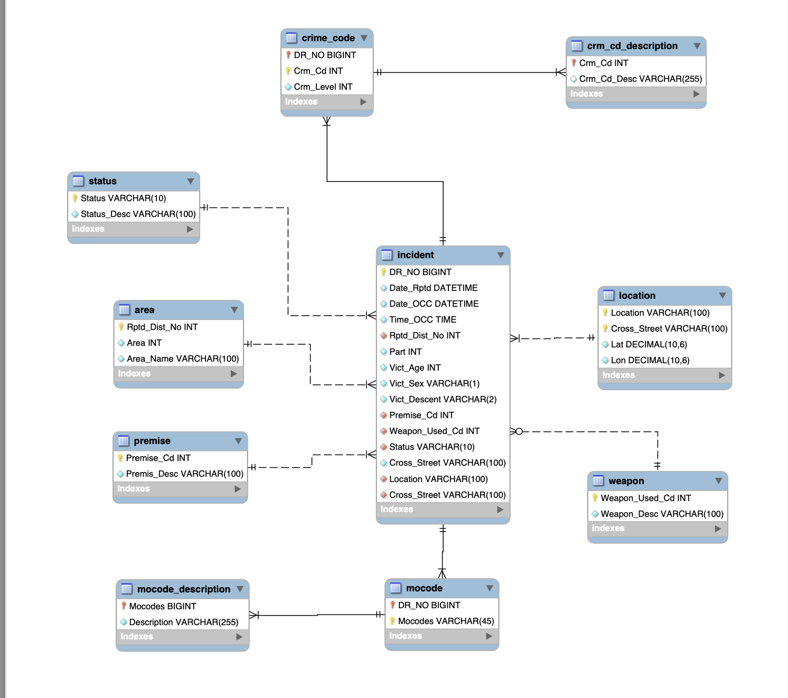

Slide 6
Assumptions Listed
Assuming that area is a georgical area and Rptd_Dist_No is a sub area withing the area then we can use this as a PK since it is more specific.
A crime can happen without a weapon since some of the values for weapon are null
For location I am assuming that if you have the location and the cross street as a composite key this can be primary key since it is unique enough and this can be confirmed by the latitude and longitude
Crime code can have no description, it can be null

Slide 7
6 Queries Planned
Most Frequent Crimes (Join) This query identifies the top 5 most commonly reported crime types across all incidents. The tables used are incident, crime_code, and crime_code_description. I will join the incident and crime_code tables on the DR_NO column. Then, I will join the result with crime_code_description to retrieve the crime descriptions. Finally, I will count the frequency of each crime description, sort them in descending order, and display the top 5 results.
All Areas with or without Incidents (Outer Join) This query lists all LAPD divisions along with the number of incidents reported in each, including divisions with zero incidents. I will perform a LEFT JOIN from the area table to the incident table using the AREA column. Then, I will group the results by AREA and count the number of incidents per division, ensuring all areas are displayed even if they had no incidents.
Mo_Codes never used in any incident (Set Theory) This query identifies and displays all Modus Operandi (MO) codes that are defined in the mocode_description table but have never been used in any reported incident. This is a set difference operation: selecting all MO codes from mocode_description and subtracting those that appear in the mocode table. The result is a list of unused MO codes along with their descriptions.
Monthly Crime Counts per Reporting District (Aggregation with Join) This query displays the number of incidents reported in each reporting district per month. The tables used are rpt_no and incident. I will join the incident table with the rpt_no table using the RPT_DIST_NO column, extract the month from DATE_OCC, and group the results by both reporting district and month.
Firearm related incidents This query shows all incidents involving a firearm. The tables used are incident and weapon. I will join the incidentand weapon tables on the Weapon_Used_Cd column, then filter the results to include only those with firearm-related weapon descriptions such as "HANDGUN", "RIFLE", "OTHER FIREARM", and similar.
Firearm incidents involving female victims This query shows all firearm-related incidents involving female victims, grouped by month. The tables used are incidentand weapon. I will join these tables on the Weapon_Used_Cd column and filter for records where Vict_Sex = 'F' and the weapon description includes firearm-related terms. Then, I will extract the month from DATE_OCC and group the results to count the number of such incidents per month.

