Slide 1

MOBILE TESTING
by Team 3

Slide 2
TEAM MEMBERS OF TEAM 3
👧
NOÉMI SCRUM MASTER
Student, listener. A lost tester in another dimension.
👨
DONÁT Tester for login, log off functions.
Casual test case enjoyer.
👦
MARCELL Watcher of the Watchlists, Test Cases are the Best Cases
👦
ALEX Story-teller, Visszaeső teszt case-ítő, Functions for View a Movie, Rate a Movie, Watch a Movie Trailer
👩
DORINA Basic search, Advanced search function Reports, Slides

Slide 3
THE PROJECT
Planning, assigning tasks
Creating test cases, Implementation
Sprint 2.: Executing test cases for IMDb v8.5.1.
1
3
5
2
4
6
Creating Project, Epic, User Stories, Tasks in Jira
Sprint 1.: Executing test cases for IMDb v8.4.8.
Summarizing : creating charts, making slides

Slide 4

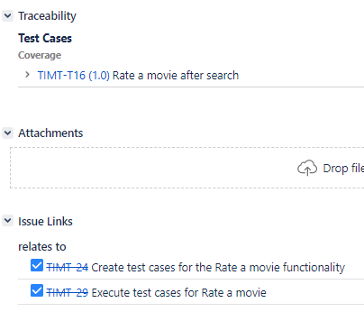
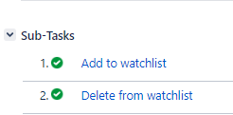
IMDB Mobile Application Testing
Login
Log out
Advanced search
Create a watchlist
Basic search
Edit the watchlist
View movie
Rate movie
Watch a trailer of a movie

Slide 5
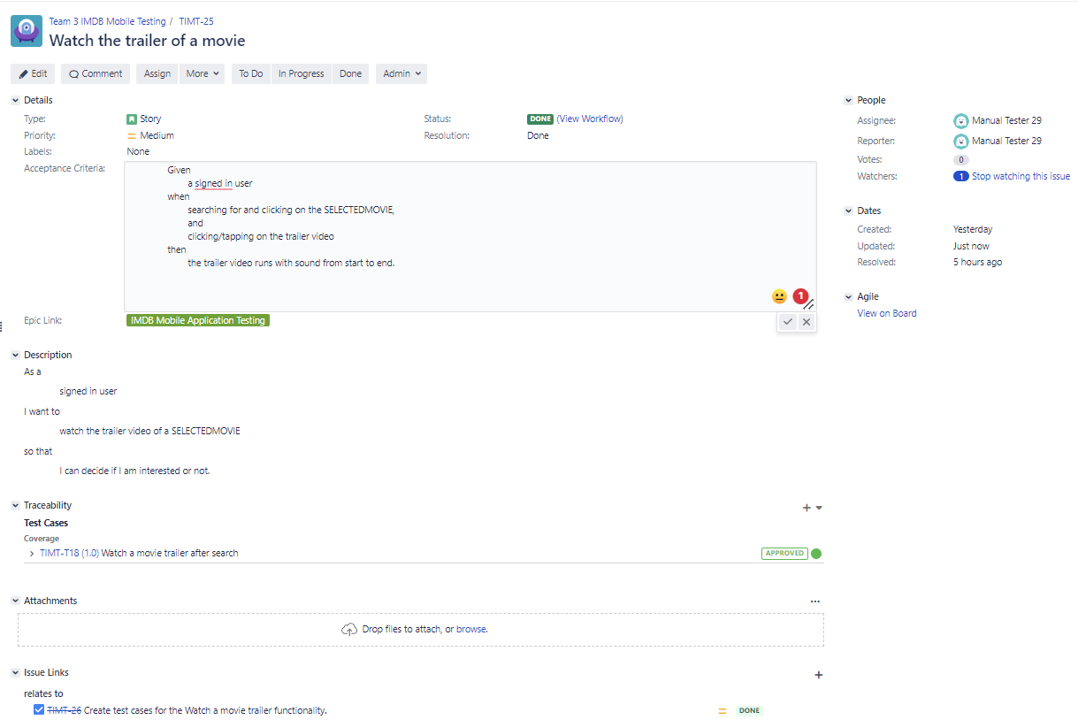
One of our User Stories

Slide 6
TIMT Sprint 1.
IMDb v8.4.8.

Slide 7
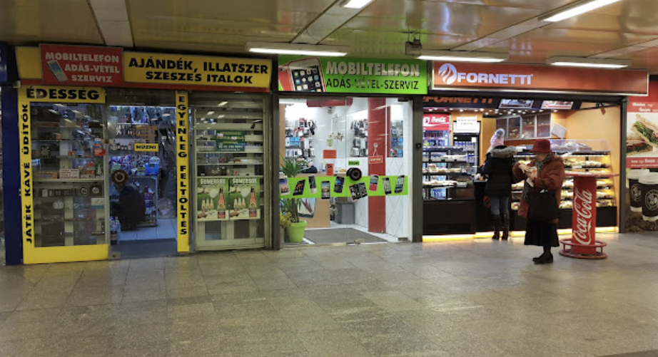
TIMT Sprint 1. : IMDb v8.4.8.
One Test Cycle (TIMT-C1)
Environment: Bluestacks 5, Android
Phone types used for testing:
Samsung Galaxy A90 5g
Samsung Galaxy S21
Xperia XZ
Samsung Galaxy S8+

Slide 8
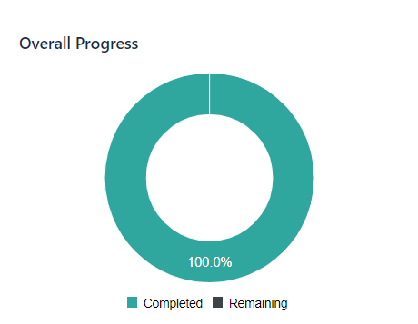
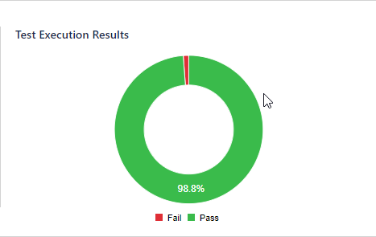
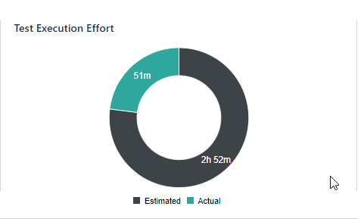
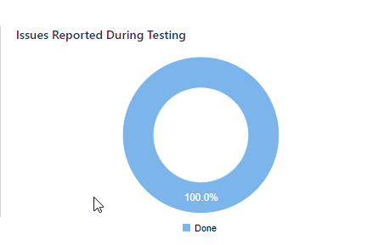
TIMT-C1 Test cycle test execution results

Slide 9
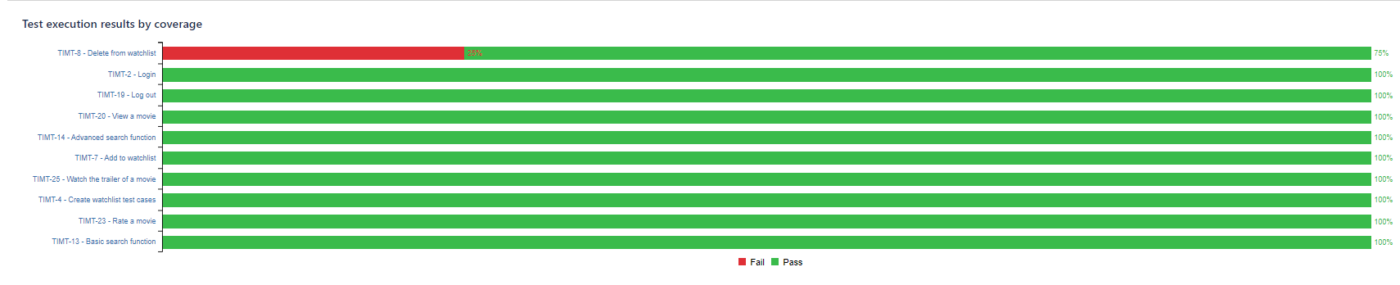
TIMT-C1 Test cycle test execution results

Slide 10
TIMT Sprint 2.
IMDb v8.5.1.

Slide 11
TIMT Sprint 2. : IMDb v8.5.1.
One Test Cycle (TIMT-C2)
Environment: Nox
Phone types used for testing:
Samsung Galaxy 8+
Samsung Galaxy Note 10+
Asus ROG 2
Samsung Galaxy S20 ultra

Slide 12
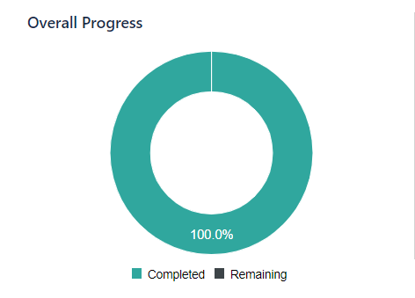
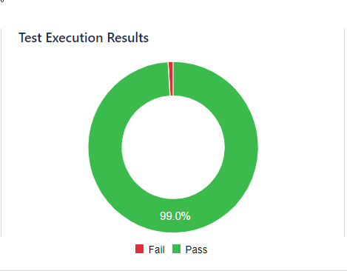
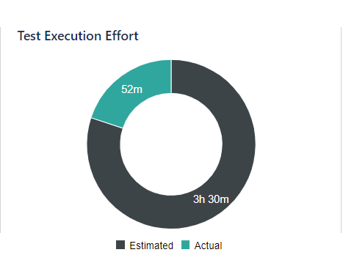
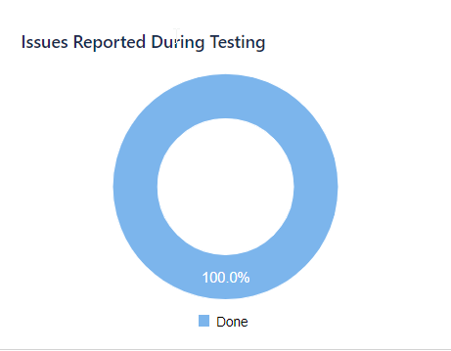
TIMT-C2 Test cycle test execution results

Slide 13
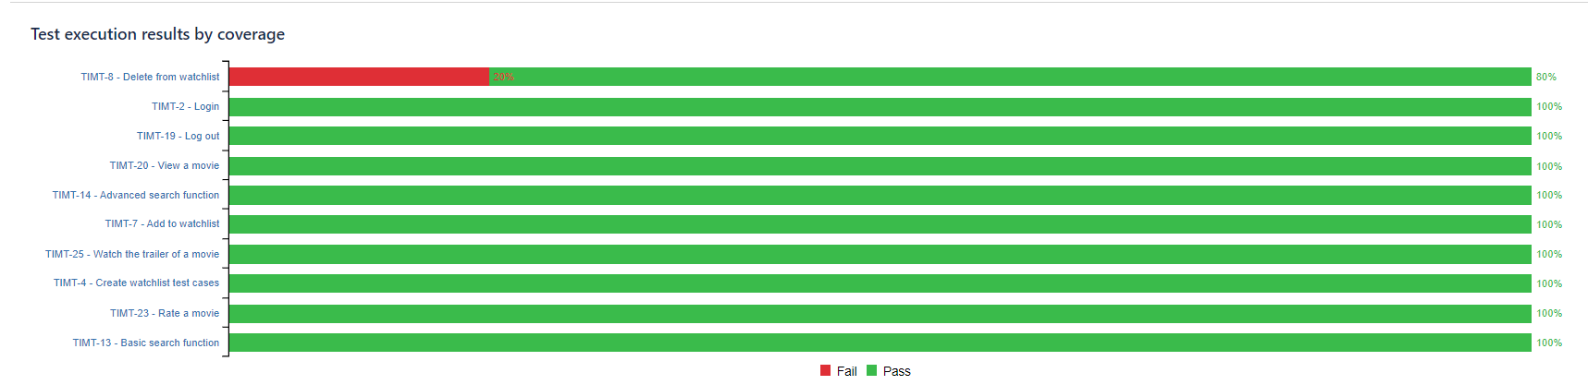
TIMT-C2 Test cycle test execution results

Slide 14
Summary

Slide 15
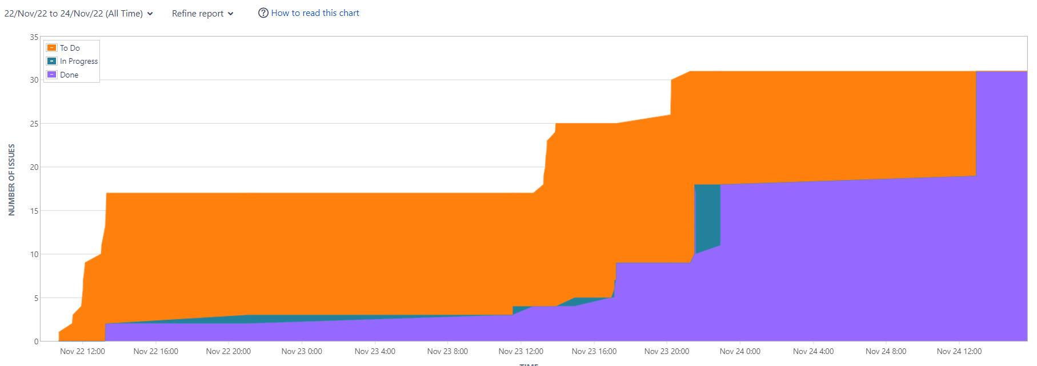
Cumulative Flow Diagram (Issues)

Slide 16
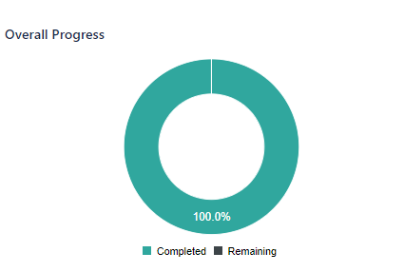
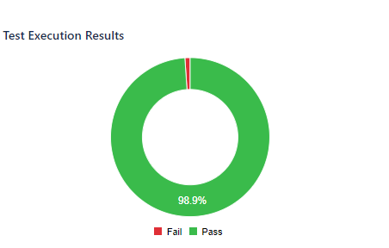
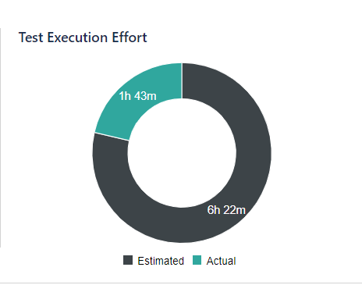
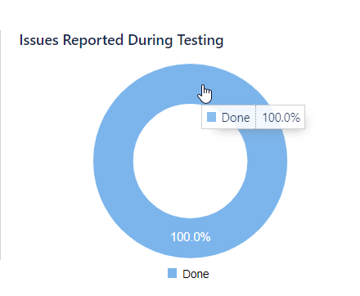
Test execution results

Slide 17
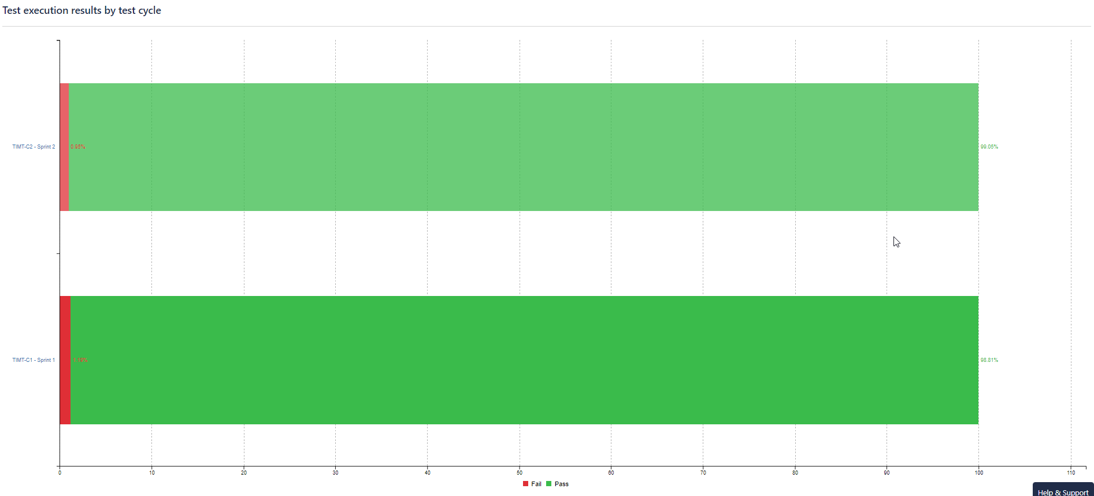
Test execution results by test cycle

Slide 18
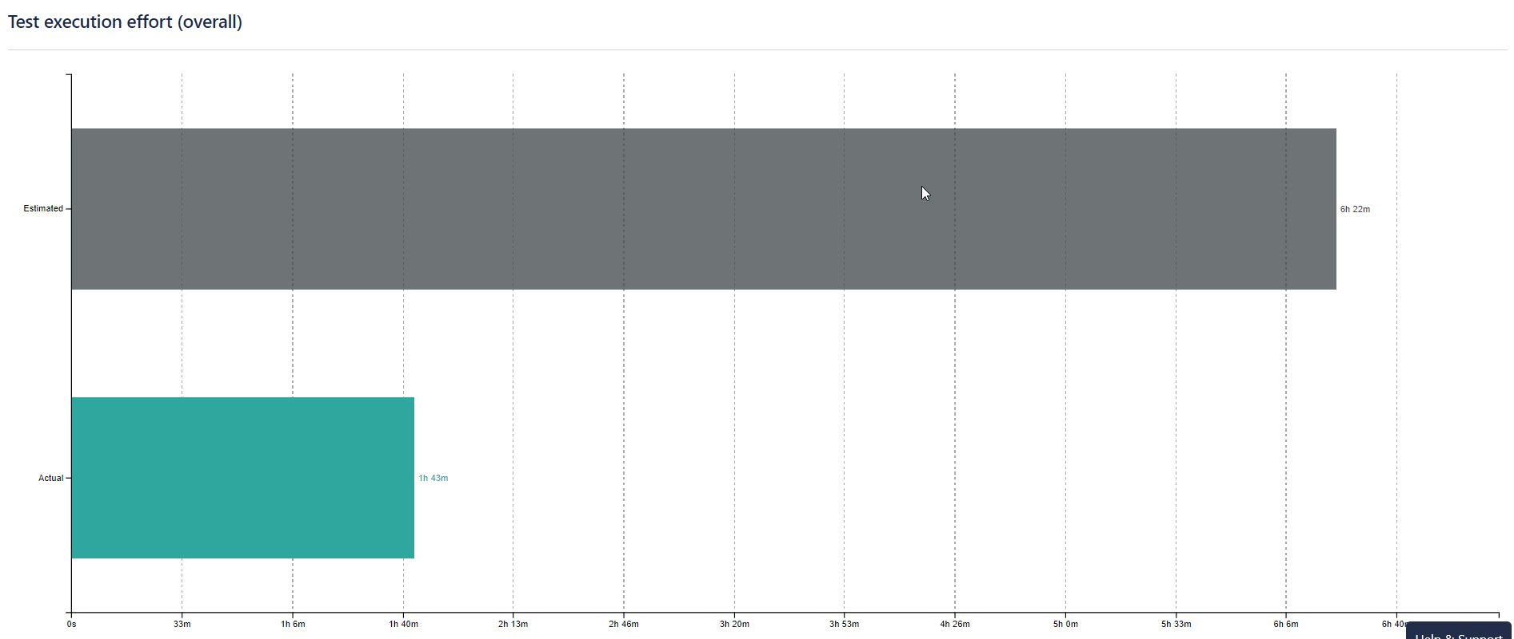

Slide 19

THANK YOU FOR YOUR ATTENTION!

