Slide 1
EC2 Basics
Servers On The Cloud!!

Slide 2

Amazon EC2
• EC2 is one of the most popular of AWS’ offering
• EC2 = Elastic Compute Cloud = Infrastructure as a Service
• It mainly consists in the capability of :
• Renting virtual machines (EC2)
• Storing data on virtual drives (EBS)
• Distributing load across machines (ELB)
• Scaling the services using an auto-scaling group (ASG)
• Knowing EC2 is fundamental to understand how the Cloud works

Slide 3
EC2 Sizing and Config Options
• Operating System (OS): Linux, Windows or Mac OS
• How much compute power & cores (CPU)
• How much random-access memory (RAM)
• How much storage space:
- Network-attached (EBS & EFS)
- hardware (EC2 Instance Store)
• Network card: speed of the card, Public IP address
• Firewall rules: security group
• Bootstrap script (configure at first launch): EC2 User Data

Slide 4
EC2 User Data
• It is possible to bootstrap our instances using an EC2 User data script.
• bootstrapping means launching commands when a machine starts
• That script is only run once at the instance first start
• EC2 user data is used to automate boot tasks such as:
• - Installing updates
• - Installing software
• - Downloading common files from the internet
• - Anything you can think of
• The EC2 User Data Script runs with the root user

Slide 5
Lab - EC2
Let's get our hands dirty

Slide 6
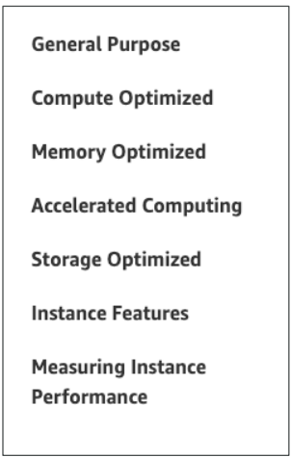
EC2 Instance Types
• You can use different types of EC2 instances that are optimised for
different use cases (https://aws.amazon.com/ec2/instance-types/)
• AWS has the following naming convention:
- m5.2xlarge
• m: instance class
• 5: generation (AWS improves them over time)
• 2xlarge: size within the instance class

Slide 7
EC2 Instance Types - General Purpose
• Great for a diversity of workloads such as web servers or code repositories
• Balance between:
• - Compute
• - Memory
• - Networking
• In the course, we will be using the t2.micro which is a General Purpose EC2
instance

Slide 8
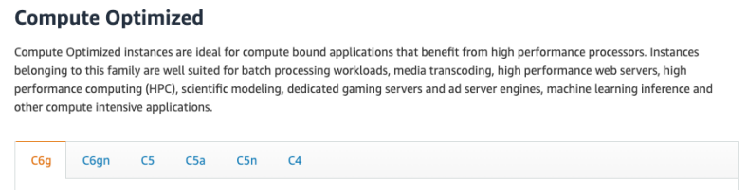
EC2 Instance Types – Compute Optimized
• Great for compute-intensive tasks that require high performance
processors:
• Batch processing workloads
• Media transcoding
• High performance web servers
• High performance computing (HPC)
• Scientific modeling & machine learning
• Dedicated gaming servers

Slide 9
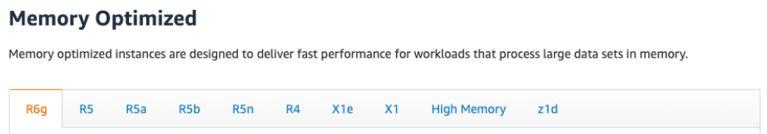
EC2 Instance Types – Memory Optimized
• Fast performance for workloads that process large data sets in memory
• Use cases:
• High performance, relational/non-relational databases
• Distributed web scale cache stores
• In-memory databases optimized for BI (business intelligence)
• Applications performing real-time processing of big unstructured data

Slide 10
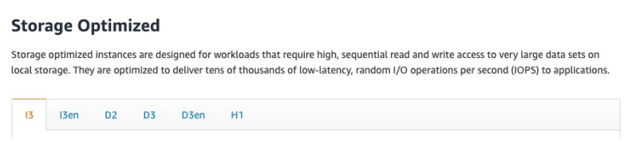
EC2 Instance Types – Storage Optimized
• Great for storage-intensive tasks that require high, sequential read and write access to large data sets on local storage
• Use cases:
• High frequency online transaction processing (OLTP) systems
• Relational & NoSQL databases
• Cache for in-memory databases (for example, Redis)
• Data warehousing applications
• Distributed file systems

Slide 11
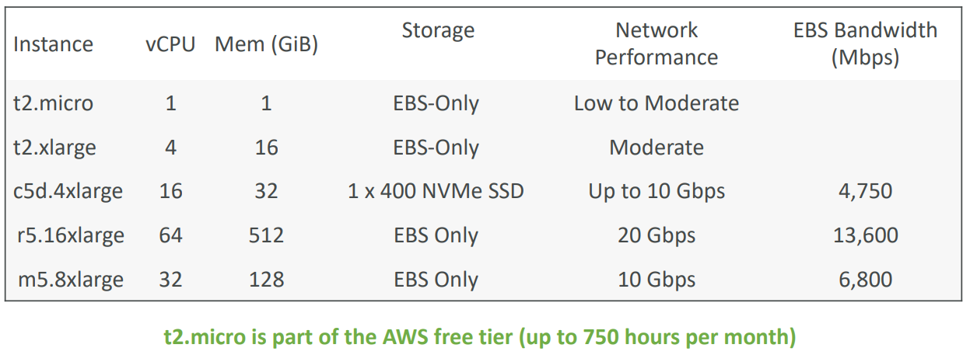
Instance Types : Example

Slide 12
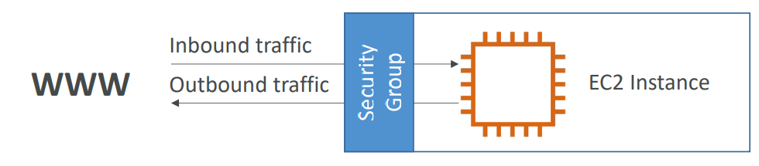
Security Groups
• Security Groups are the fundamental of network security in AWS
• They control how traffic is allowed into or out of our EC2 Instances.
• Security groups only contain rules
• Security groups rules can reference by IP or by security group

Slide 13
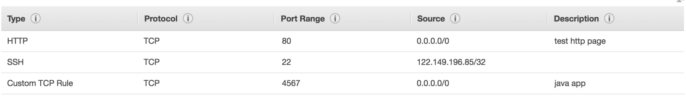
A deeper dive : Security Groups
• Security groups are acting as a “firewall” on EC2 instances
• They regulate:
• Access to Ports
• Authorised IP ranges – IPv4 and IPv6
• Control of inbound network (from other to the instance)
• Control of outbound network (from the instance to other)

Slide 14
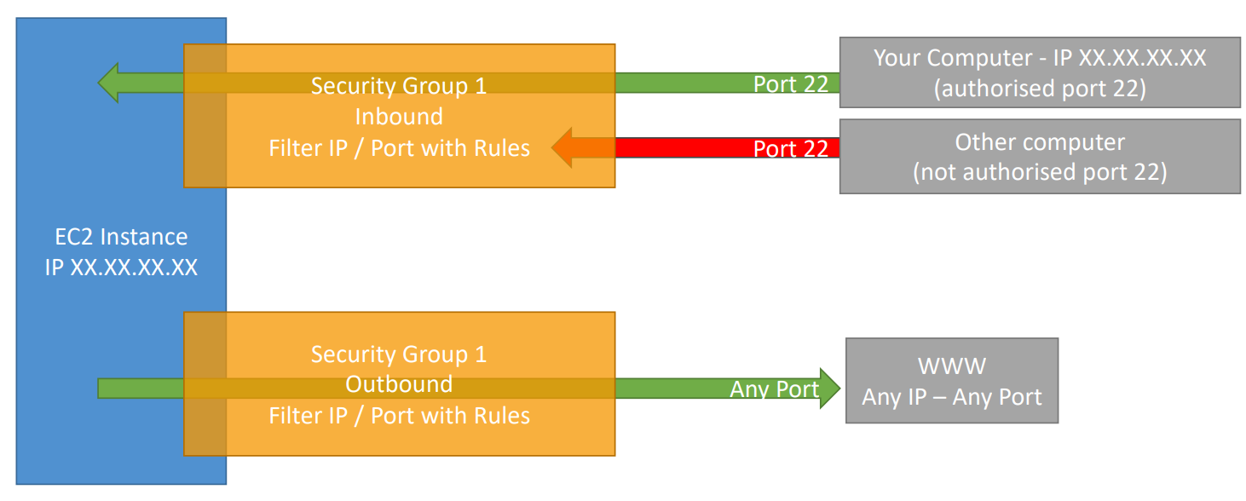
SG – Understand Visually

Slide 15

SG – Important Points
• Can be attached to multiple instances
• Locked down to a region / VPC combination
• Does live “outside” the EC2 – if traffic is blocked the EC2 instance won’t see it
• It’s good to maintain one separate security group for SSH access
• It’s good to maintain one separate security group for SSH access
• If your application gives a “connection refused“ error, then it’s an application error or it’s not launched
• All inbound traffic is blocked by default
• All outbound traffic is authorised by default

Slide 16
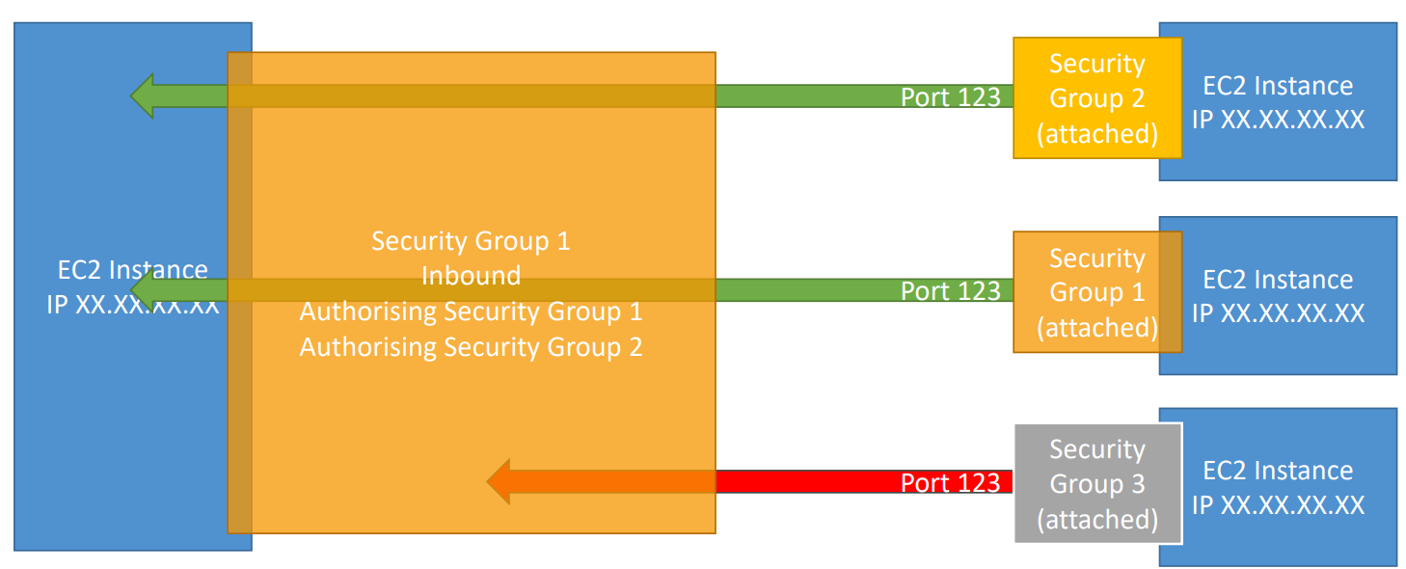
Allowing/Denying other Security Groups

Slide 17

Common Ports to Remember
• 22 = SSH (Secure Shell) - log into a Linux instance
• 21 = FTP (File Transfer Protocol) – upload files into a file share
• 22 = SFTP (Secure File Transfer Protocol) – upload files using SSH
• 80 = HTTP – access unsecured websites
• 443 = HTTPS – access secured websites
• 3389 = RDP (Remote Desktop Protocol) – log into a Windows instance

Slide 18
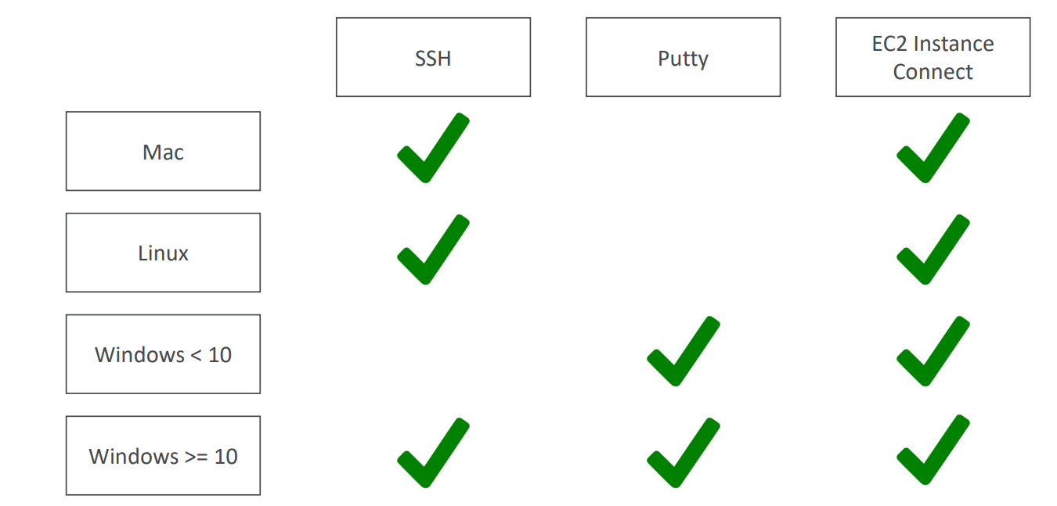
SSH Connections Table

Slide 19

SSH Troubleshooting
• Students have the most problems with SSH
• If things don’t work…
1. Re-watch the lecture. You may have missed something
2. Read the troubleshooting guide
3. Try EC2 Instance Connect
• If one method works (SSH, Putty or EC2 Instance Connect) you’re good

Slide 20
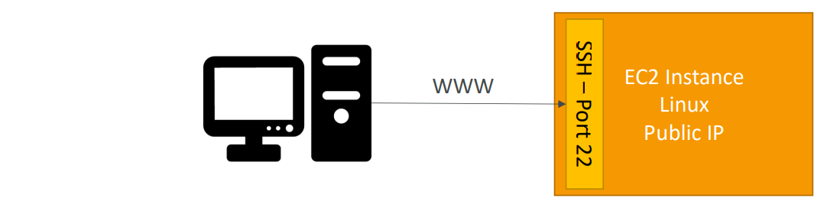
How to SSH into your EC2 Instance Windows
• We’ll learn how to SSH into your EC2 instance using Windows
• SSH is one of the most important function. It allows you to control a remote machine, all using the command line.
• We will configure all the required parameters necessary for doing SSH on Windows using the free tool Putty

Slide 21
EC2 Instance Connect
• Connect to your EC2 instance within your browser
• No need to use your key file that was downloaded
• The “magic” is that a temporary key is uploaded onto EC2 by AWS
• Works only out-of-the-box with Amazon Linux 2
• Need to make sure the port 22 is still opened!

Slide 22
EC2 Instances Purchasing Options
• On-Demand Instances – short workload, predictable pricing, pay by second
• Reserved (1 & 3 years)
• Reserved Instances – long workloads
• Convertible Reserved Instances – long workloads with flexible instances
• Savings Plans (1 & 3 years) –commitment to an amount of usage, long workload
• Spot Instances – short workloads, cheap, can lose instances (less reliable)
• Dedicated Hosts – book an entire physical server, control instance placement
• Dedicated Instances – no other customers will share your hardware
• Capacity Reservations – reserve capacity in a specific AZ for any duration

Slide 23

EC2 On Demand
• Pay for what you use:
• Linux or Windows - billing per second, after the first minute
• All other operating systems - billing per hour
• Has the highest cost but no upfront payment
• No long-term commitment
• Recommended for short-term and un-interrupted workloads, where
you can't predict how the application will behave

Slide 24
EC2 Reserved Instances
• Up to 72% discount compared to On-demand
• You reserve a specific instance attributes (Instance Type, Region, Tenancy, OS)
• Reservation Period – 1 year (+discount) or 3 years (+++discount)
• Payment Options – No Upfront (+), Partial Upfront (++), All Upfront (+++)
• Reserved Instance’s Scope – Regional or Zonal (reserve capacity in an AZ)
• Recommended for steady-state usage applications (think database)
• You can buy and sell in the Reserved Instance Marketplace
• Convertible Reserved Instance
• Can change the EC2 instance type, instance family, OS, scope and tenancy
• Up to 66% discount

Slide 25
EC2 Savings Plans
• Get a discount based on long-term usage (up to 72% - same as RIs)
• Commit to a certain type of usage ($10/hour for 1 or 3 years)
• Usage beyond EC2 Savings Plans is billed at the On-Demand price
• Locked to a specific instance family & AWS region (e.g., M5 in us-east-1)
• Flexible across:
• Instance Size (e.g., m5.xlarge, m5.2xlarge)
• OS (e.g., Linux, Windows)
• Tenancy (Host, Dedicated, Default)

Slide 26
EC2 Spot Instances
• Can get a discount of up to 90% compared to On-demand
• Instances that you can “lose” at any point of time if your max price is less than the current spot price
• The MOST cost-efficient instances in AWS
• Useful for workloads that are resilient to failure
• Batch jobs
• Data analysis
• Image processing
• Any distributed workloads
• Workloads with a flexible start and end time
• Not suitable for critical jobs or databases

Slide 27
EC2 Dedicated Hosts
• A physical server with EC2 instance capacity fully dedicated to your use
• Allows you address compliance requirements and use your existing server- bound software licenses (per-socket, per-core, pe—VM software licenses)
• Purchasing Options:
• On-demand – pay per second for active Dedicated Host
• Reserved - 1 or 3 years (No Upfront, Partial Upfront, All Upfront)
• The most expensive option
• Useful for software that have complicated licensing model (BYOL – Bring Your Own License)
• Or for companies that have strong regulatory or compliance needs

Slide 28
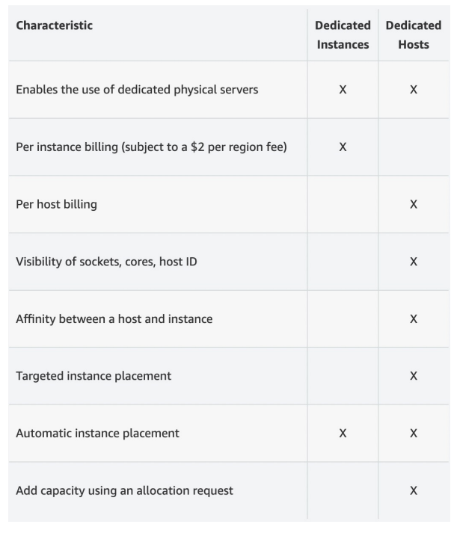
EC2 Dedicated Instances
• Instances run on hardware that’s
dedicated to you
• May share hardware with other
instances in same account
• No control over instance placement
(can move hardware after Stop / Start)

Slide 29

EC2 Capacity Reservations
• Reserve On-Demand instances capacity in a specific AZ for any duration
• You always have access to EC2 capacity when you need it
• No time commitment (create/cancel anytime), no billing discounts
• Combine with Regional Reserved Instances and Savings Plans to benefit
from billing discounts
• You’re charged at On-Demand rate whether you run instances or not
• Suitable for short-term, uninterrupted workloads that needs to be in a
specific AZ

Slide 30

How to choose Purchasing Option?
• On demand: coming and staying in resort whenever we like, we pay the full price
• Reserved: like planning ahead and if we plan to stay for a long time, we may get a good discount.
• Savings Plans: pay a certain amount per hour for certain period and stay in any room type (e.g.,
King, Suite, Sea View, …)
• Spot instances: the hotel allows people to bid for the empty rooms and the highest bidder keeps the
rooms. You can get kicked out at any time
• Dedicated Hosts: We book an entire building of the resort
• Capacity Reservations: you book a room for a period with full price even you don’t stay i

Slide 31
EC2 Spot Instance Requests
• Can get a discount of up to 90% compared to On-demand
• Define max spot price and get the instance while current spot price < max
• The hourly spot price varies based on offer and capacity
• If the current spot price > your max price you can choose to stop or terminate your instance with a 2 minutes grace period.
• Other strategy: Spot Block
• “block” spot instance during a specified time frame (1 to 6 hours) without interruptions
• In rare situations, the instance may be reclaimed
• Used for batch jobs, data analysis, or workloads that are resilient to failures.
• Not great for critical jobs or databases

Slide 32
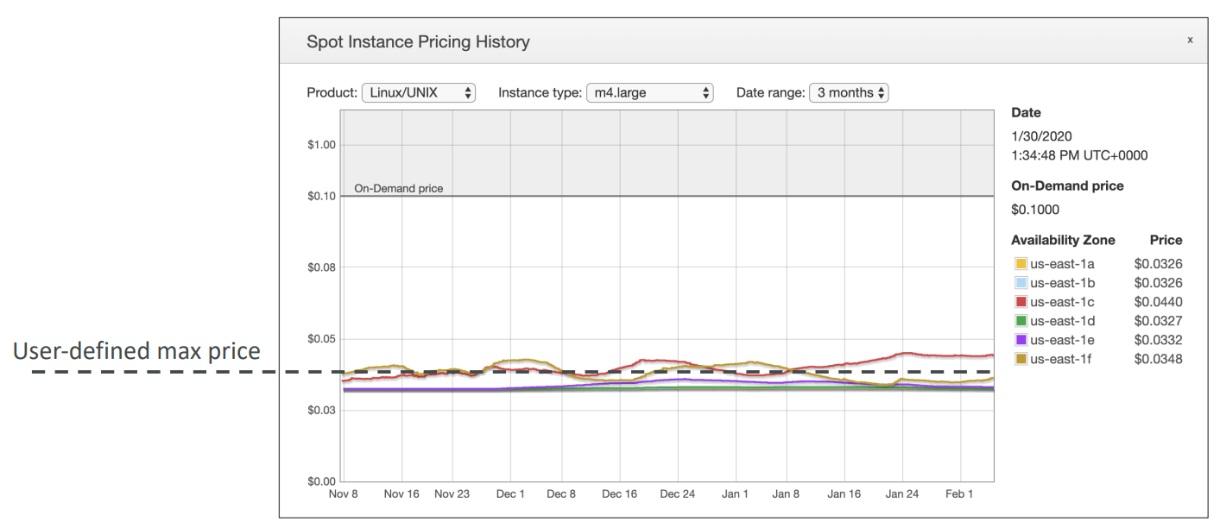
EC2 Spot Pricing

Slide 33
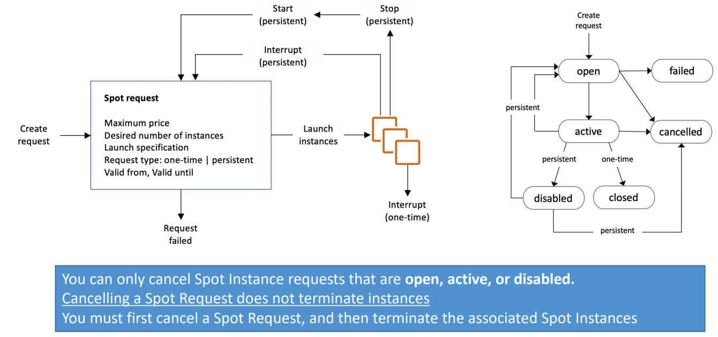
Terminating Spot Instances

Slide 34
Spot Fleets
• Spot Fleets = set of Spot Instances + (optional) On-Demand Instances
• The Spot Fleet will try to meet the target capacity with price constraints
• Define possible launch pools: instance type (m5.large), OS, Availability Zone
• Can have multiple launch pools, so that the fleet can choose
• Spot Fleet stops launching instances when reaching capacity or max cost
• Strategies to allocate Spot Instances:
• lowestPrice: from the pool with the lowest price (cost optimization, short workload)
• diversified: distributed across all pools (great for availability, long workloads)
• capacityOptimized: pool with the optimal capacity for the number of instances
• Spot Fleets allow us to automatically request Spot Instances with the lowest price

Slide 35
EC2 - Summary
• EC2 Instance: AMI (OS) + Instance Size (CPU + RAM) + Storage +
security groups + EC2 User Data
• Security Groups: Firewall attached to the EC2 instance
• EC2 User Data: Script launched at the first start of an instance
• SSH: start a terminal into our EC2 Instances (port 22)
• EC2 Instance Role: link to IAM roles
• Purchasing Options: On-Demand, Spot, Reserved (Standard + Convertible + Scheduled), Dedicated Host, Dedicated Instance

Slide 36
EC2 – Deeper Dive

Slide 37
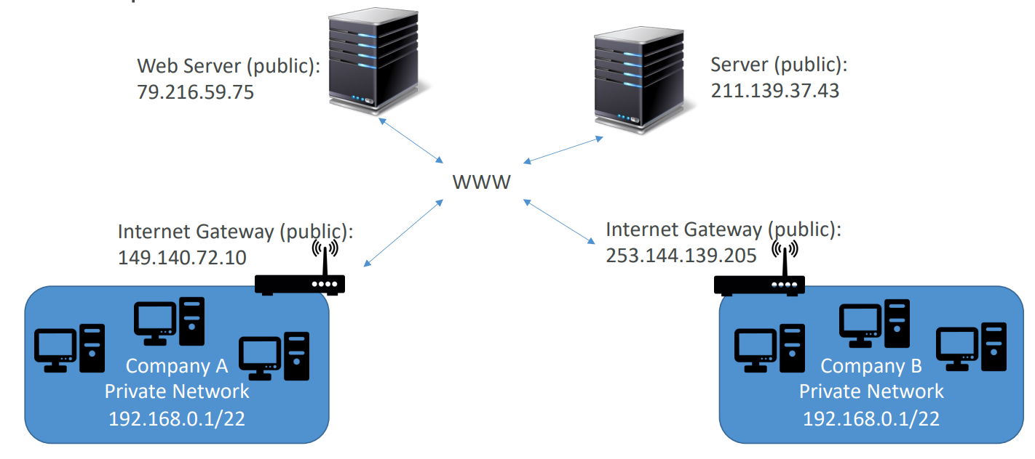
Private VS Public IP

Slide 38
Private and Public IP - Differences
• Public IP:
• Public IP means the machine can be identified on the internet (WWW)
• Must be unique across the whole web (not two machines can have the same public IP).
• Can be geo-located easily
• Private IP:
• Private IP means the machine can only be identified on a private network only
• The IP must be unique across the private network
• BUT two different private networks (two companies) can have the same IPs.
• Machines connect to WWW using a NAT + internet gateway (a proxy)
• Only a specified range of IPs can be used as private IP

Slide 39
Elastic Ip's
• When you stop and then start an EC2 instance, it can change its public
IP.
• If you need to have a fixed public IP for your instance, you need an
Elastic IP
• An Elastic IP is a public IPv4 IP you own as long as you don’t delete it
• You can attach it to one instance at a time

Slide 40
Elastic Ip's
• With an Elastic IP address, you can mask the failure of an instance or software
by rapidly remapping the address to another instance in your account.
• You can only have 5 Elastic IP in your account (you can ask AWS to increase
that).
• Overall, try to avoid using Elastic IP:
• They often reflect poor architectural decisions
• Instead, use a random public IP and register a DNS name to it
• Or, as we’ll see later, use a Load Balancer and don’t use a public IP

Slide 41
Elastic Ip's
• With an Elastic IP address, you can mask the failure of an instance or software
by rapidly remapping the address to another instance in your account.
• You can only have 5 Elastic IP in your account (you can ask AWS to increase
that).
• Overall, try to avoid using Elastic IP:
• They often reflect poor architectural decisions
• Instead, use a random public IP and register a DNS name to it
• Or, as we’ll see later, use a Load Balancer and don’t use a public IP

Slide 42
Hands On!!

Slide 43
Placement Groups
• Sometimes you want control over the EC2 Instance placement strategy
• That strategy can be defined using placement groups
• When you create a placement group, you specify one of the following
strategies for the group:
• Cluster—clusters instances into a low-latency group in a single Availability Zone
• Spread—spreads instances across underlying hardware (max 7 instances per
group per AZ)
• Partition—spreads instances across many different partitions (which rely on
different sets of racks) within an AZ. Scales to 100s of EC2 instances per group
(Hadoop, Cassandra, Kafka)

Slide 44
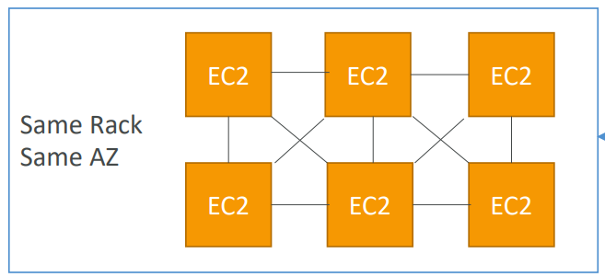
Cluster Placement Group
• Pros: Great network (10 Gbps bandwidth between instances with Enhanced
Networking enabled - recommended)
• Cons: If the rack fails, all instances fails at the same time
• Use case:
• Big Data job that needs to complete fast
• Application that needs extremely low latency and high network throughput

Slide 45
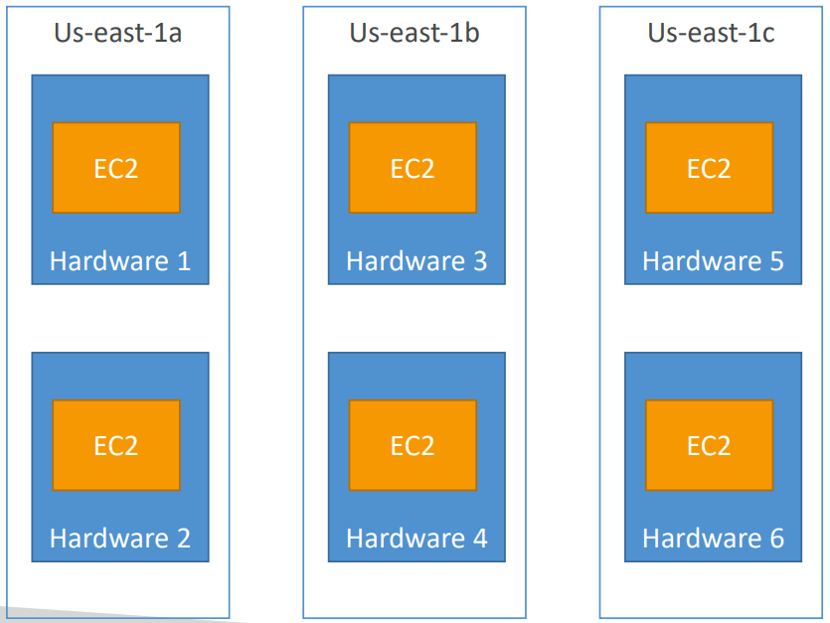
Spread Placement Groups
• Pros:
• Can span across Availability
Zones (AZ)
• Reduced risk is simultaneous
failure
• EC2 Instances are on different
physical hardware
• Cons:
• Limited to 7 instances per AZ
per placement group
• Use case:
• Application that needs to
maximize high availability
• Critical Applications where
each instance must be isolated
from failure from each other

Slide 46
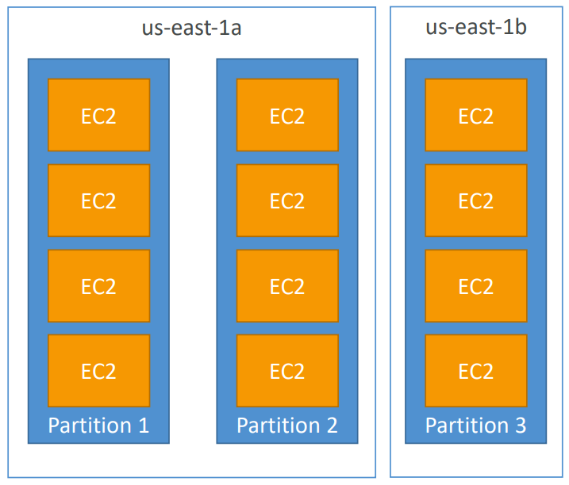
Partition Placement Groups
• Up to 7 partitions per AZ
• Can span across multiple AZs in the
same region
• Up to 100s of EC2 instances
• The instances in a partition do not
share racks with the instances in the
other partitions
• A partition failure can affect many
EC2 but won’t affect other partitions
• EC2 instances get access to the
partition information as metadata
• Use cases: HDFS, HBase, Cassandra,
Kafka

Slide 47
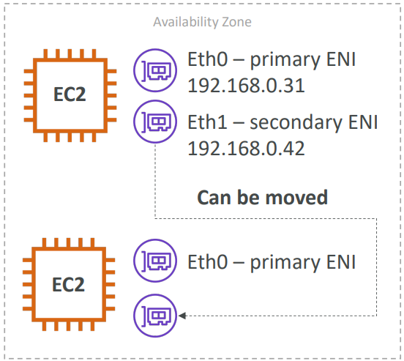
Elastic Network Interface(ENI)
• Logical component in a VPC that represents a
virtual network card
• The ENI can have the following attributes:
• Primary private IPv4, one or more secondary IPv4
• One Elastic IP (IPv4) per private IPv4
• One Public IPv4
• One or more security groups
• A MAC address
• You can create ENI independently and attach
them on the fly (move them) on EC2 instances
for failover
• Bound to a specific availability zone (AZ)

Slide 48
Hibernation in EC2
• We know we can stop, terminate instances
• Stop – the data on disk (EBS) is kept intact in the next start
• Terminate – any EBS volumes (root) also set-up to be destroyed is lost
• On start, the following happens:
• First start: the OS boots & the EC2 User Data script is run
• Following starts: the OS boots up
• Then your application starts, caches get warmed up, and that can take time!

Slide 49
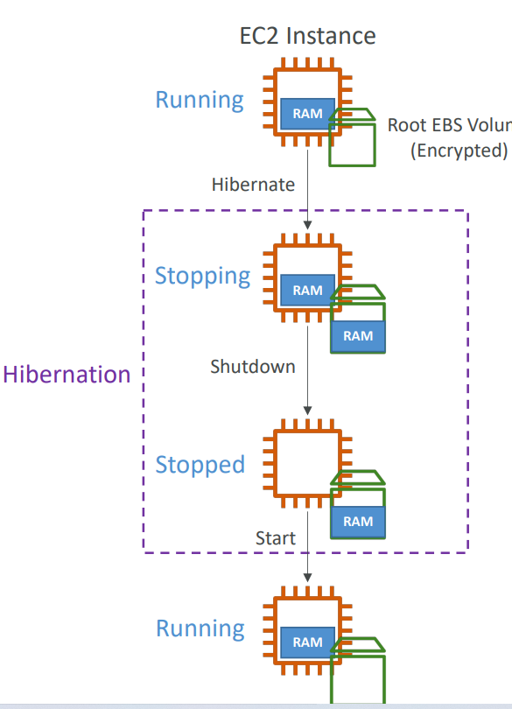
Hibernation in EC2
• Introducing EC2 Hibernate:
• The in-memory (RAM) state is preserved
• The instance boot is much faster!
(the OS is not stopped / restarted)
• Under the hood: the RAM state is written
to a file in the root EBS volume
• The root EBS volume must be encrypted
• Use cases:
• Long-running processing
• Saving the RAM state
• Services that take time to initialize

Slide 50
Hibernation in EC2 – Good to Know
• Supported Instance Families – C3, C4, C5, I3, M3, M4, R3, R4, T2, T3, …
• Instance RAM Size – must be less than 150 GB.
• Instance Size – not supported for bare metal instances.
• AMI – Amazon Linux 2, Linux AMI, Ubuntu, RHEL, CentOS & Windows…
• Root Volume – must be EBS, encrypted, not instance store, and large
• Available for On-Demand, Reserved and Spot Instances
• An instance can NOT be hibernated more than 60 days

