Slide 1
CNN-LSTM Sign Language Recognition
Goal: classify sign language gestures from temporal hand-landmark sequences.
Input per sample: (64 timesteps, 63 features = 21 landmarks x 3 coordinates).
Classes (8): Hello, Thanks, Yes, No, I Love You, Please, Sorry, Help.
Data source: custom NPZ (data/sign_sequences.npz) with fallback synthetic generator.
This project adapts a HAR-style deep model to sign language recognition.

Slide 2
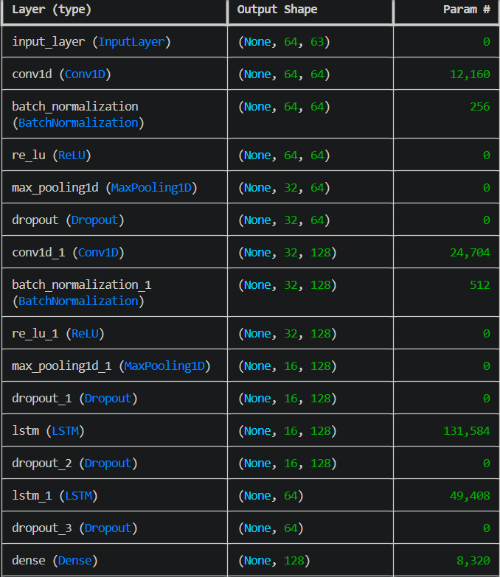
Architecture and Training Pipeline
Model flow: Conv1D(64) -> BN -> ReLU -> MaxPool -> Dropout.
Second block: Conv1D(128) -> BN -> ReLU -> MaxPool -> Dropout.
Temporal modeling: LSTM(128, return_sequences=True) -> LSTM(64).
Classifier: Dense(128, ReLU) -> Dropout -> Dense(8, Softmax).
Split strategy: train/validation/test with stratification and normalization.
Optimization: Adam(lr=1e-3), categorical crossentropy, early stopping, checkpointing, ReduceLROnPlateau.

Slide 3
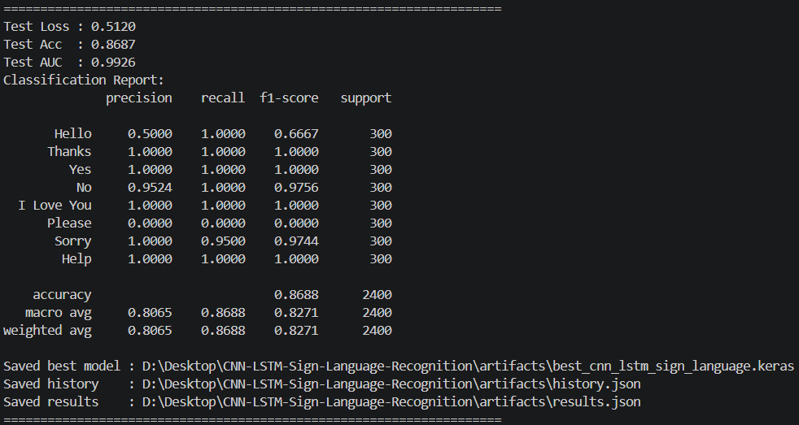
Results, Artifacts, and Conclusion
Test Accuracy: 86.87% | Test AUC: 0.9926 | Test Loss: 0.5120
Validation Accuracy: 86.92% | Validation AUC: 0.9923
Observed confusion: class "Please" is mostly misclassified as "Hello" (data balancing/feature overlap risk).
Saved outputs in artifacts/: best model, final model, history.json, results.json.
Conclusion: CNN extracts local motion signatures while LSTM captures sequence context, giving strong baseline performance for SLR.
Presentation generated on 2026-04-01 for project reporting.

