Slide 1

INSTITUT SUPÉRIEUR D’ÉLECTRONIQUE
DE PARIS (ISEP)
DETECTING SYN FLOODING ATTACKS USING THE SLIDING WINDOWS TECHNIQUE AND ONE-CLASS SUPPORT VECTOR MACHINE(OC-SVM) ALGORITHM
BY
ABUBAKAR UMAR ELNAFATY (62717)

Slide 2
Introduction to Network Security
In the field of network security, the detection of complex threats such as SYN flooding attacks requires advanced analytical techniques. One-Class Support Vector Machine (OC-SVM) has emerged as a potent method in this regard. OC-SVM's capability to effectively distinguish between normal and anomalous network traffic makes it particularly valuable for identifying such cybersecurity threats. As explored in [1], OC-SVM is adept at handling the asymmetric nature of network security data, where normal traffic significantly outnumbers attack patterns. Furthermore, [2] demonstrates the application of OC-SVM in real-time network monitoring, highlighting its effectiveness in identifying SYN flooding attacks amidst vast volumes of legitimate traffic. Additionally, [3] discusses the integration of OC-SVM with other machine learning techniques to enhance the accuracy and efficiency of anomaly detection in network security.

Slide 3
The Challenge in Anomaly Detection
The challenge in anomaly detection within network traffic lies in identifying patterns that deviate from expected behavior. This task is complicated by the vast volumes of data and the subtle nature of anomalies that often blend into normal traffic. Traditional threshold-based methods often prove insufficient for such complex detection tasks due to their lack of adaptability and tendency to generate false positives. As outlined in [1], the need for intelligent, adaptive approaches in anomaly detection is paramount. In this context, One-Class SVM (OC-SVM) has been recognized for its effectiveness. The work presented in [2] demonstrates the application of OC-SVM in network anomaly detection, highlighting its superiority over traditional methods in identifying subtle and complex anomalies. Furthermore, [3] explores the integration of OC-SVM with other machine learning techniques to further enhance its ability to discern anomalous patterns in large-scale network data

Slide 4
Methodology
Methodology Overview
This study employs a data-driven approach to detect anomalies in network traffic, particularly focusing on SYN flooding attacks. The methodology encompasses data preprocessing, feature engineering, anomaly detection using One-Class Support Vector Machine (SVM), and extensive data analysis and visualization. The aim is to identify potential malicious activities within network traffic data.

Slide 5
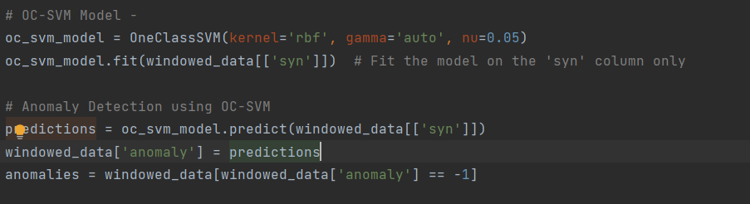
One-Class SVM for Anomaly Detection
One-Class SVM is an unsupervised learning algorithm for anomaly detection. Key parameters include:
Kernel='rbf': Transforms data into a higher-dimensional space.
Gamma='auto': Automatically determines the best parameter for the RBF kernel.
Nu=0.0026: Controls the fraction of outliers in the data.
The model is trained to understand the “normal” data distribution, enabling it to identify deviations as anomalies.
Model Training: The One-Class SVM model is trained on the 'syn' values. This model will learn what 'normal' SYN traffic looks like.
Anomaly Prediction: After training, the model tries to predict which data points are anomalies

Slide 6
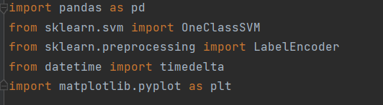
Libraries
pandas: Used for data manipulation and analysis.
sklearn.svm.OneClassSVM: A machine learning model used for anomaly detection.
sklearn.preprocessing.LabelEncoder: Converts categorical text data into a model-understandable numerical form.
datetime.timedelta: Used for manipulating dates and times.
matplotlib.pyplot: A plotting library for creating static, animated, and interactive visualizations.

Slide 7
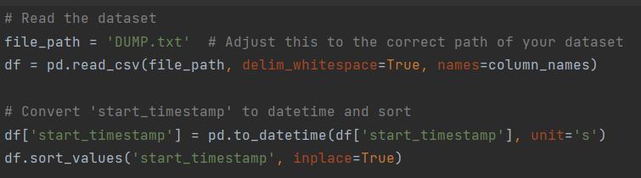
Reading and Preparing the Dataset
Reads data from a text file, assuming it's delimited by whitespace.
I use network traffic data comprising various features like IP addresses, ports, and timestamps. Preprocessing steps include:
Timestamp conversion: Essential for time-series analysis.
Data sorting: Maintaining chronological order for sequential analysis.
IP address encoding: Transforming categorical data into a numerical format for machine learning algorithms.

Slide 8
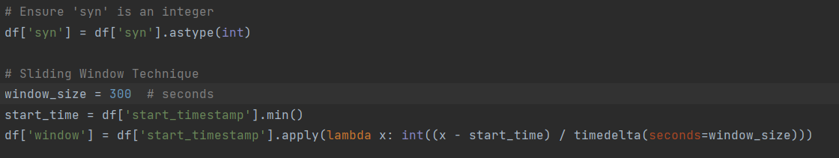
Preparing for Anomaly Detection
Converts 'syn' to integer for numerical analysis.
Implements a sliding window technique. The Sliding Window Technique divides data into time-based segments, facilitating the analysis of data in sequential and manageable chunks. This is vital for spotting anomalies over time. The data is divided into windows of 300 seconds each.
Groups the data by these windows and sums the 'syn' values in each window.

Slide 9
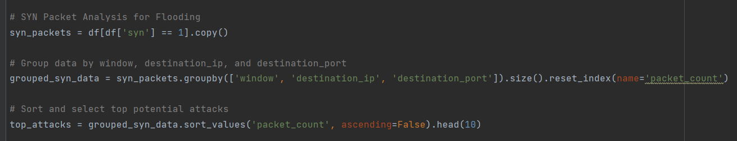
SYN Packet Analysis for Flooding
Filters out SYN packets.
Groups data by 'window', 'destination_ip', 'destination_port', and counts the packets in each group.
Sorts these groups to identify potential top SYN flooding attacks.
Filtering SYN Packets: Only SYN packets are considered (where 'syn' column is 1) for detecting SYN flood attacks.
Grouping by Key Features: The data is grouped by 'window', 'destination_ip', and 'destination_port', and the size of each group is calculated. Large groups might indicate a flooding attack targeting specific IPs and ports.

Slide 10
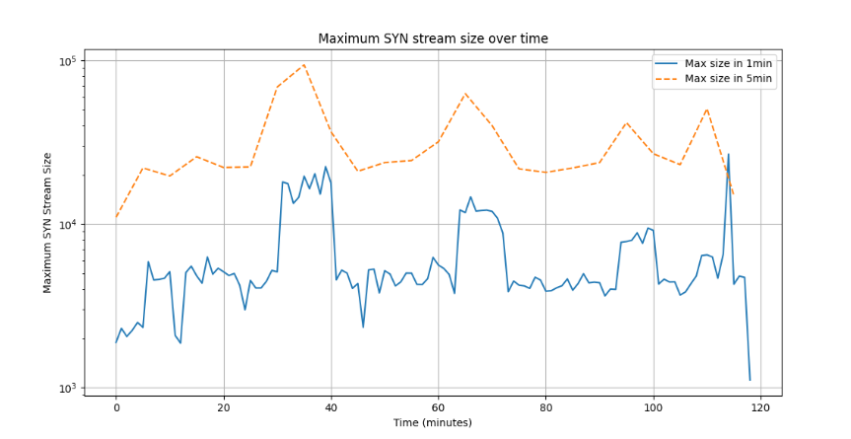
SYN Packet Analysis for Flooding
Finally, I plot a graph showing the number of SYN packets over time (in one-minute and five-minute intervals). The graph presents a time series analysis of maximum SYN stream sizes over a period of 120 minutes, using a logarithmic scale to accommodate a wide range of values. It depicts two sets of data: the maximum SYN size measured in 1-minute intervals (solid blue line), which shows higher variability, and the maximum SYN size measured in 5-minute intervals (dashed orange line), which demonstrates a smoother trend due to the longer aggregation period.

Slide 11
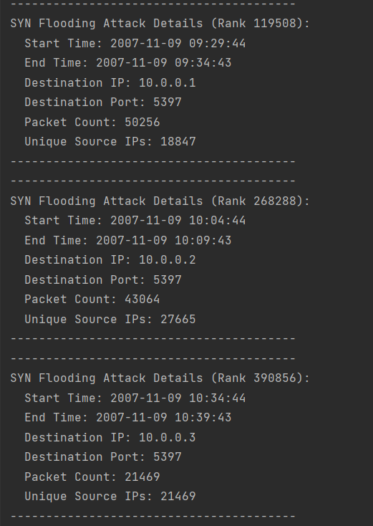
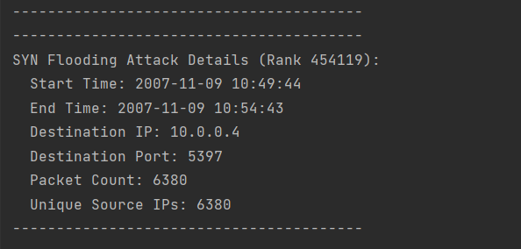
Identifying Potential Attacks
Highly Targeted Attacks:
IP 10.0.0.1: Experienced the most intense attack with 77,290 SYN requests.
IP 10.0.0.2: Subjected to an attack with 43,064 SYN requests.
IP 10.0.0.3: Faced an attack involving 21,469 SYN requests.
Other IPs like 10.0.0.4 also targeted, although with fewer SYN requests.

Slide 12
Conclusion
After conducting a thorough analysis of the network traffic data for potential SYN flooding attacks, we have observed several significant findings that warrant attention:
High Volume of SYN Requests: The most significant attack involved 77,290 SYN requests to a single destination IP within a short time frame, indicating a high potential for network disruption.
Repeated Targeting of Specific IPs and Ports: Certain IPs and ports were consistently targeted, suggesting a focused attack strategy on specific network resources.
Variability in Attack Intensity: The attacks varied in intensity and source IP numbers, indicating diverse attack strategies or multiple attackers.
Temporal Clustering of Attacks: The attacks were concentrated in specific time periods, suggesting coordinated efforts.
Implications: These findings highlight the urgent need for robust network security measures and real-time monitoring to detect and mitigate such large-scale and sophisticated attacks.

Slide 13
Recommendations
According to recent studies, several enhancements can be made to the One-Class Support Vector Machine (O-SVM) for its application in cybersecurity:
Enhanced Data Preprocessing Techniques: Implementing robust preprocessing techniques like feature selection and normalization can improve the model's accuracy [3].
Optimized Parameter Tuning: Effective tuning of O-SVM parameters, particularly kernel functions and nu, is crucial for better model performance [4].
Incorporation of Ensemble Methods: Combining multiple O-SVM models or integrating them with other machine learning techniques can reduce false positives and improve anomaly detection [3].
Adaptation to Evolving Threats: Regular retraining of the O-SVM model with the latest data ensures relevance and effectiveness against current cyber threats [4].
Hybrid Approaches for Complex Threats: Combining O-SVM with other techniques, like reconstruct error methods, enhances effectiveness in complex cyber threats like DDoS attacks [5].
Leveraging Big Data Analytics: Employing big data analytics alongside O-SVM enhances performance, especially in handling large-scale data [3].
Focus on Real-time Analysis: Optimizing the model for speed and efficiency is essential for supporting real-time analysis in threat detection and response [4].
Enhanced Training with Imbalanced Datasets: Training the O-SVM effectively on imbalanced datasets is important; techniques like oversampling the minority class can aid in this regard [3].
Incorporation of Domain Knowledge: Integrating domain-specific knowledge into the model can improve its effectiveness in the cybersecurity environment [5].

Slide 14
References
[1] A. Lakhina, M. Crovella, and C. Diot. 2004. "Diagnosing Network-Wide Traffic Anomalies." In Proceedings of the ACM SIGCOMM 2004 Conference. This paper discusses the use of machine learning techniques, including OC-SVM, for identifying traffic anomalies in networks.
[2] N. Moustafa and J. Slay. 2016. "The Significant Features of the UNSW-NB15 and the KDD99 Data Sets for Network Intrusion Detection Systems." In Proceedings of the 2015 4th International Workshop on Building Analysis Datasets and Gathering Experience Returns for Security (BADGERS). This study examines the application of OC-SVM in network intrusion detection, with a focus on DDoS attacks like SYN flooding.
[3] J. Shone et al. 2018. "A Deep Learning Approach to Network Intrusion Detection." IEEE Transactions on Emerging Topics in Computational Intelligence. This paper explores the integration of deep learning techniques with traditional methods like OC-SVM for enhanced anomaly detection in network traffic. [4] "An Efficient One-Class SVM for Anomaly Detection in the Cybersecurity Domain", arXiv.
[5] "A Literature Review on One-Class Classification and its Potential Application in Cybersecurity", Journal of Big Data, Springer.
[6] "Detection of Unknown DDoS Attack Using Reconstruct Error and One-Class SVM", MDPI.

Slide 15
Thank You for Listening

