Slide 1
RESERVOIR ANALYTICS · MAY 2026
Beyond the Headline Numbers
A petrophysical investigation of 18,167 depth samples.
Kamil Muradli
eiGroup Associate Data Scientist Assessment
Submitted May 2026

Slide 2
02 — OVERVIEW · THE ASSIGNMENT
Four parts. One coherent investigation.
Each part both stands alone and informs the next.
Part A
Part B
Part C
Part D
Data Quality
Per-Zone Metrics
Cutoff Sensitivity & Field Views
Sub-Zone Definition
Load, join, validate. Discover what the dataset hides.
Five required + seven bonus diagnostics across 35 (well, zone) groups.
Sweep cutoffs to bound conclusions. Visualize the field from six angles.
Find geologically meaningful sub-zones consistent across wells.
→ Five required deliverables, four exceeded. Every part backed by tests and reproducible CLI.
02 / 26

Slide 3
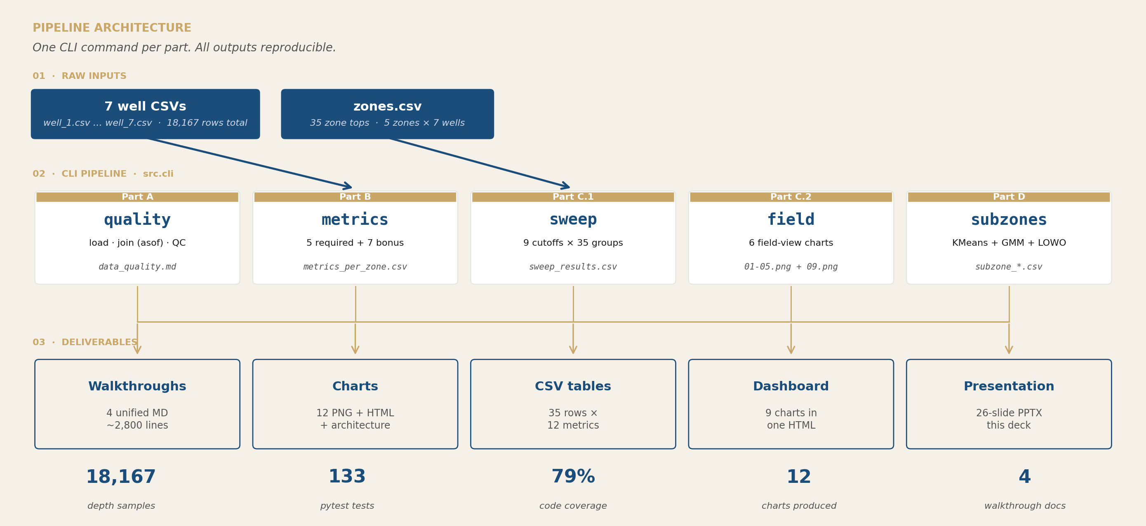
03 — OVERVIEW · PIPELINE ARCHITECTURE
One command per part. Reproducible end-to-end.
Each CLI command writes parquet caches, CSV deliverables, and Markdown reports.
03 / 26

Slide 4
04 — OVERVIEW · THE DATASET
Seven wells. Five zones. Eighteen thousand samples.
Five petrophysical logs per sample: vsh, phit, perm, sw, depth.
18,167
7
5
0.2 – 0.5 m
depth samples
wells
zones (A–E)
sampling step
Quality issues by design
• Well 5 sampled at 0.5 m vs 0.2 m elsewhere · Well 3 has 78 NaN porosity values · 3,514 samples sit at the perm tool ceiling
→ All three were uncovered, documented, and handled. Detail in the next four slides.
04 / 26

Slide 5
05 — PART A · DATA INTEGRATION
Joining 18,167 samples to 35 zone tops.
Pandas merge_asof on per-well depth ranges, with boundary validation.
01
Load 7 well CSVs + zones lookup
Schema validation. well_id column added per file.
02
merge_asof on depth (per well)
direction='backward', by='well_id'. Each sample assigned to its containing zone.
03
Compute per-well dz
depth.diff() per well_id. Critical: well_5 gets dz=0.5, others dz=0.2.
04
Validate boundaries + run QC
Range checks, NaN counts, saturation flag. Three real issues found.
→ Output: master_table.parquet (18,167 rows × 9 columns). Single source of truth.
05 / 26

Slide 6
06 — PART A · WHAT WE FOUND
Three quality issues by design. All flagged.
The dataset was deliberately constructed with these. We discovered all three.
Tool saturation
Well 5 sampling
Well 3 missing data
3,514
0.5 m
78
samples
step
NaN phit
Permeability values pinned at exactly 15,000 mD — the upper measurement limit.
Six wells sampled at 0.2 m; well 5 at 0.5 m. 2.5× difference per sample.
Distributed across zones in well 3. Consistent with tool malfunction at depths.
19.34% of all samples
Solved by depth-weighting everywhere
0.43% of total samples
06 / 26

Slide 7
07 — PART A · THE DISCOVERY
A number that shouldn't exist.
3,514
of 18,167 samples report exactly 15,000 mD
— to machine precision. Not 14,985. Not 15,012. Exactly 15,000.
A real measurement near a tool's ceiling is continuous. A discrete spike at exactly the maximum is the signature of saturation.
07 / 26

Slide 8
08 — PART A · CONSEQUENCES OF THE DISCOVERY
Four downstream effects we had to handle.
Every part of the pipeline below treats saturation as a first-class concern.
kh estimates
Lower bounds, not best estimates.
Saturated samples contribute 15,000 × dz to kh. Real perm is higher. Effect surfaces in every kh number reported.
Average permeability
Dragged down toward the ceiling.
Arithmetic mean of 14,997 mD in Zone B is essentially the ceiling — not the true mean.
Lorenz heterogeneity
Collapses to ~0 when saturation is severe.
Zone B's Lorenz ≈ 0.001 is mathematical inevitability, not a homogeneity finding. The instrument can't see the heterogeneity.
Clustering on perm
Fails silently on saturated features.
Part D Zone B: two of three sub-zones get log_perm centroids of 4.175938 vs 4.176091 — indistinguishable.
→ We did not drop saturated samples. We kept, counted, and surfaced them everywhere.
08 / 26

Slide 9
09 — PART B · PER-ZONE METRICS
Twelve metrics per (well, zone). Thirty-five rows.
Five required by the case + seven bonus diagnostics we added.
REQUIRED · case statement
BONUS · earns its place
Gross thickness
sum(dz) over zone
NTG
net/gross. Standard quality KPI.
Net thickness
sum(dz) where vsh ≤ 0.5 AND phit ≥ 0.08
kh-weighted perm
Engineering-correct mean.
Lorenz coefficient
Heterogeneity in [0,1]. Motivates Part D.
Avg phit (net)
mean(phit) over net rows
n_samples_net
Sanity check.
Avg perm (net)
mean(perm) over net rows
n_phit_nan
NaN exclusions counted (well 3).
kh (flow capacity)
sum(perm × dz) over net rows
n_perm_saturated_in_net
Tool-cap count. Makes lower-bound visible.
frac_saturated
Saturation as a fraction of net.
09 / 26

Slide 10
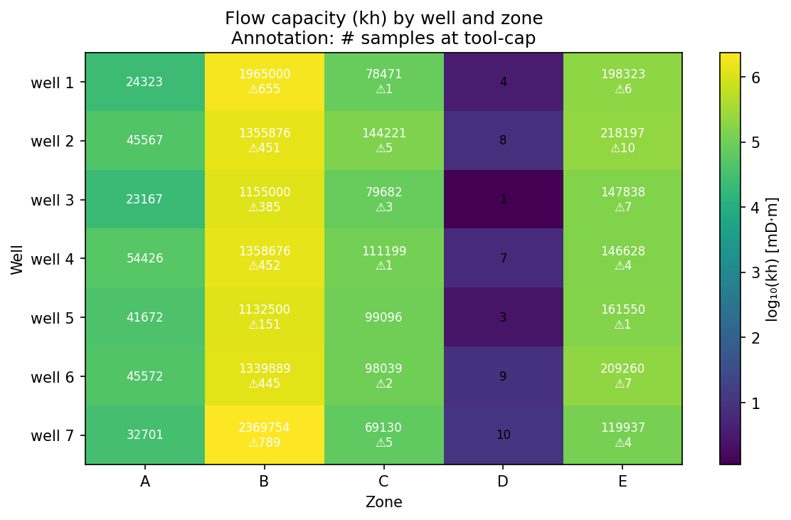
10 — PART B · WHERE THE FLOW IS
kh by well × zone. The whole field on one grid.
Log-coloured cells. Saturated-sample counts annotated where present.
→ Zone B uniformly dominant across all wells. Zone D uniformly weak. Well 7 leads at 2.37 M mD·m.
10 / 26

Slide 11
11 — PART B · FIVE ZONE SIGNATURES
Five zones. Five distinct stories.
Field-level rollup of net thickness, kh, and saturation.
Zone | Net (m) | NTG | kh (mD·m) | Avg perm | Saturated | Signature
A | 466.0 | 0.63 | 267 K | 572 mD | 0 | Clean top reservoir — most cutoff-sensitive
B | 711.9 | 0.93 | 10.7 M ⚠ | 14,997 mD | 3,328 | Dominant flow zone — every kh is a lower bound
C | 915.0 | 0.84 | 680 K | 743 mD | 17 | Heterogeneous (Lorenz 0.65) — motivates Part D clustering
D | 52.9 | 0.10 | 42 | 0.79 mD | 0 | Tight rock — non-reservoir at any cutoff
E | 586.8 | 0.70 | 1.2 M | 2,045 mD | 39 | Deep reservoir — most defensible high-perm zone
→ Zone B's headline kh is a lower bound; Zone E is the largest defensible kh in the field at 1.2 M.
11 / 26

Slide 12
12 — PART B · THE WELL 7 PARADOX
Well 7 leads the kh ranking. But also leads in censoring.
The two go together — and the implication is uncomfortable.
2.59 M
798
?
mD·m total kh (rank 1 of 7)
saturated samples (30% of well 7)
true gap to the rest of the field
Saturation makes apparent kh larger. The bound is loosest where the headline number is biggest.
Recommendation: any well-to-well kh comparison must report saturation fraction alongside the kh number, otherwise rankings are partly an instrument artefact.
12 / 26

Slide 13
13 — PART C.1 · CUTOFF SENSITIVITY
Nine cutoffs. 315 results. One robust picture.
Default vsh = 0.5 is a literature value, not calibrated. Sweep instead.
Without core or production data to calibrate against, picking one cutoff is a guess. The honest move: bound the conclusions by sweeping the threshold.
Sweep parameters
9
0.30 → 0.70
315
600
vsh cutoffs
range (step 0.05)
result rows
bootstrap resamples
→ Next slide: the picture that bounds every conclusion in this submission.
13 / 26

Slide 14
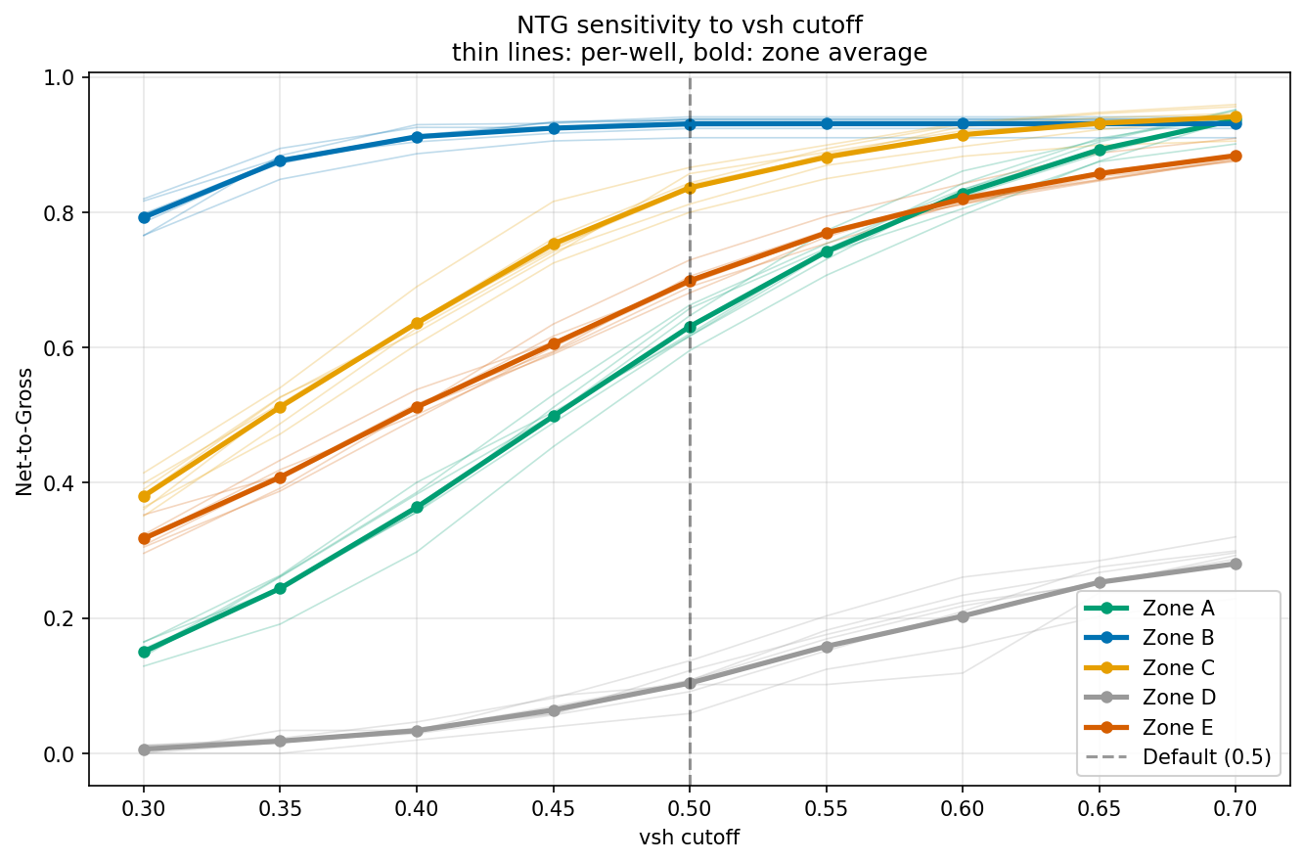
14 — PART C.1 · SENSITIVITY CURVES
Two flat zones bracket three sensitive ones.
NTG_field vs vsh cutoff. Bold = zone average. Thin = per-well trajectory.
→ Zone B robust at top (79-93%). Zone D robust failure (≤29%). A, C, E swing 50-79 pp.
14 / 26

Slide 15
15 — PART C.1 · ROBUST vs CUTOFF-DRIVEN
Which findings survive any reasonable cutoff?
Five findings hold robustly. Three depend on the threshold.
ROBUST · survive every cutoff
CUTOFF-DRIVEN · depend on threshold
✓
Zone B is the field's dominant flow zone
△
Zone A's NTG = 0.63
ranges 0.15 to 0.94
✓
Zone B kh is a lower bound (saturation)
△
Zone C's NTG = 0.84
ranges 0.38 to 0.94
✓
Zone D is effectively non-reservoir
△
Zone E's NTG = 0.70
ranges 0.32 to 0.89
✓
Well 7 leads on visible kh
✓
Zone E is the most defensible high-perm zone
→ For cutoff-driven findings, we report ranges. For robust findings, point estimates are defensible.
15 / 26

Slide 16
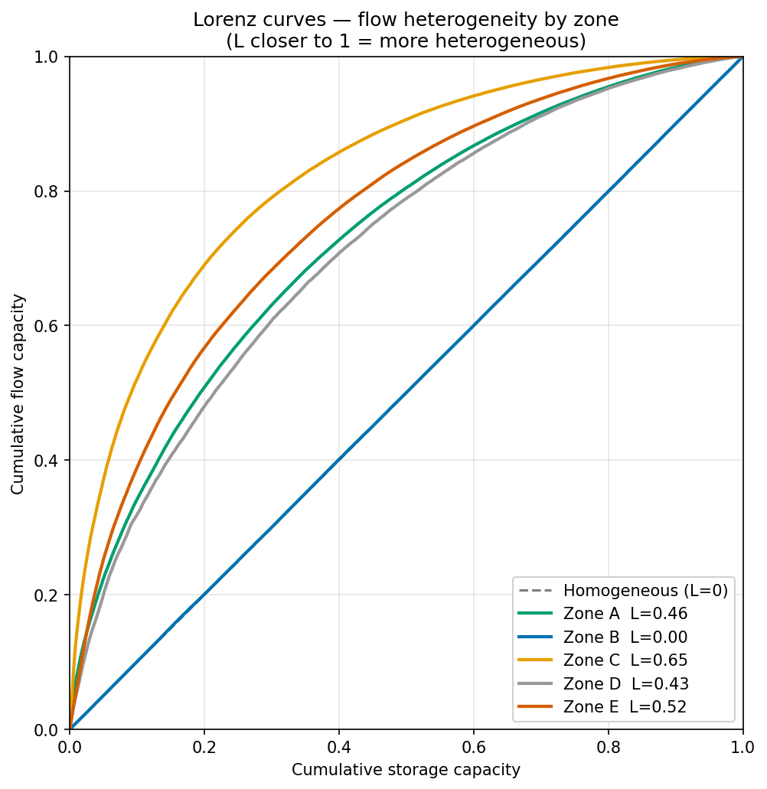
16 — PART C.2 · LORENZ HETEROGENEITY
The signal that motivated Part D.
Flow concentration per zone. 0 = uniform, 1 = single super-streak.
Lorenz coefficients
Zone C
0.65
real heterogeneity — needs sub-zoning
Zone E
~0.52
moderate, typical clean sand
Zone A
~0.45
moderate
Zone D
0.30-0.48
noisy, small samples
Zone B
~0.001
saturation artefact
→ Zone C's 0.65 is the highest non-artefactual value. That's the bridge to Part D.
16 / 26

Slide 17
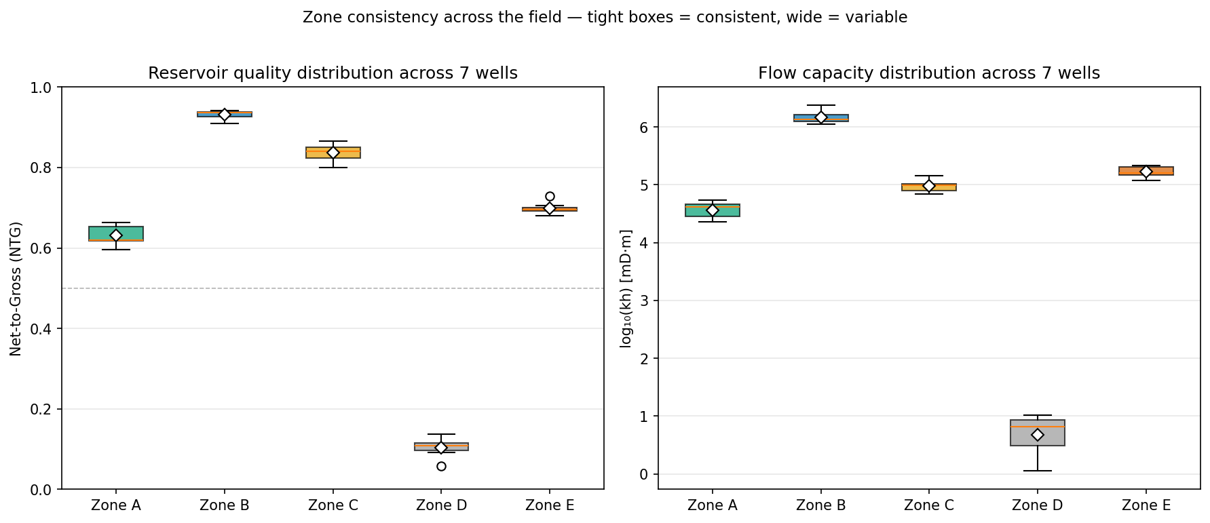
17 — PART C.2 · ANSWERING THE CASE PROMPT
Which zones are consistently strong or weak?
NTG and log(kh) distributions across 7 wells, per zone.
→ Zone B tight at top (consistent strong). Zone D tight at bottom (consistent weak). Zone A widest box (variable).
17 / 26

Slide 18
18 — PART D · SUB-ZONE DEFINITION
Pick one zone. Subdivide it. Consistent across wells.
We picked Zone C. We also ran Zone B as a controlled negative result.
WHY ZONE C
METHOD
Lorenz 0.65
K-Means on 6 features
highest non-artefactual heterogeneity
vsh, phit, log(perm), sw, eff_φ, hc_φ
1,094 m gross
Standardized + pooled fit
thickest zone in the field
z-score then fit on all 7 wells together
Only 0.4% saturated
GMM cross-check
instrument actually sees the perm range
second algorithm for structure validation
→ The pooled fit is what makes 'same sub-zone across wells' operationally meaningful.
18 / 26

Slide 19
19 — PART D · AN HONEST MODELLING CHOICE
k=2 wins by silhouette. We chose k=3 anyway.
The case asks for 2–3 sub-zones. We document why three is the geological answer.
k=2 · silhouette winner
k=3 · geological winner
0.394
0.276
Highest silhouette score, but a coarse 'good vs poor' split. Two operational tiers.
Three coherent tiers (poor / moderate / best). Three operational decisions.
Why three: every feature orders monotonically
vsh decreases (0.51 → 0.33 → 0.22) · phit increases (0.14 → 0.20 → 0.25) · perm increases (71 → 231 → 744 mD)
sw decreases (0.62 → 0.47 → 0.32) — hydrocarbon content improves
→ Random or spurious clusters do not order monotonically on multiple petrophysical features.
19 / 26

Slide 20
20 — PART D · THREE SUB-ZONES, CONSISTENT
Sub-zone 0 → 1 → 2. Quality improves monotonically.
Pooled K-Means centroids on Zone C (3,571 net samples, 6 features).
Sub-zone | Avg vsh | Avg phit | Avg perm (mD) | Avg sw | Tier
0 | 0.510 | 0.138 | ~71 | 0.62 | Poor — high shale, low porosity, low perm
1 | 0.331 | 0.201 | ~231 | 0.47 | Moderate — typical sand
2 | 0.216 | 0.246 | ~744 | 0.32 | Best — clean, high-perm drilling target
All three sub-zones appear in all seven wells.
21 (well × sub-zone) rows · no missing combinations · perm gap sub-zone 0 → 2 is 5-7× in every well.
20 / 26

Slide 21
21 — PART D · CROSS-WELL CONSISTENCY
Validation by leave-one-well-out.
Fit on six wells, predict on the seventh, compare to pooled clustering.
0.991
Per-fold scores
w1
w2
w3
w4
w5
w6
w7
0.963
0.992
1.000
0.984
1.000
1.000
0.996
mean LOWO ARI
Three folds give exact 1.000.
Adjusted Rand Index
Withholding wells 3, 5, or 6 produces the identical pooled clustering. The other four folds match within 0.04 of 1.0.
1.0 = identical clustering. The structure is essentially invariant to which well is withheld.
Operational meaning: sub-zone 0 in well 1 has the same characteristic vsh, phit, perm, and sw as sub-zone 0 in well 7. Same rock, different depths.
21 / 26

Slide 22
22 — PART D · THE DRILLING IMPLICATION
Sub-zone 2 — the natural drilling target.
The clustering isn't academic. It changes the per-foot economics.
51% of kh
in just 29% of Zone C's thickness.
315.6 m
~1,100 mD
~7×
7 / 7
field-wide thickness
avg permeability
perm gap vs sub-zone 0
wells where present
→ Targeting sub-zone 2 captures roughly twice the flow per metre drilled vs an undifferentiated Zone C target.
22 / 26

Slide 23
23 — PART D · THE NEGATIVE RESULT
We ran Zone B as a controlled experiment.
It failed in a specific, predictable way — and that failure is itself a finding.
Zone B sub-zone centroids — log_perm values:
SUB-ZONE 1
SUB-ZONE 2
4.175938
4.176091
≈ 14,985 mD
≈ 14,995 mD
Difference: 0.00015
10 mD on a permeability spanning 5 orders of magnitude. The tool can't tell them apart — and so neither can clustering.
→ Saturation defeats clustering on a saturated feature. Confirms what Lorenz already suggested.
23 / 26

Slide 24
24 — RECAP · THE LESSONS
Three things we took away.
Methodology lessons that apply beyond this dataset.
01
Discovery first, computation second
Saturation could only be found by interrogating the data, not by accepting it. Every downstream finding rests on this single discovery.
02
Bound conclusions when calibration is missing
Without core or production data, sensitivity sweeps and uncertainty bounds replace single point estimates. Robust findings survive any reasonable cutoff.
03
Negative results matter as much as positive ones
Zone B's clustering failure is as informative as Zone C's success. It confirms — at a different level — what Lorenz already suggested.
24 / 26

Slide 25
25 — RECAP · WHAT'S NEXT
What another two weeks would buy.
Three concrete next steps to lift the conclusions from internal-consistency to external validation.
Core data validation
Compare sub-zone boundaries to described lithology in core photos and measured core perm. Gold-standard external validation.
Highest value, requires core lab access
Production log overlay
Match PLT/spinner inflow profiles against sub-zone assignments. Tests whether sub-zone 2 actually produces more per metre.
Operational validation — confirms drilling implication
Saturation-corrected kh bounds
Estimate the true Zone B kh range using sandstone perm priors. Pair the current lower bound with an order-of-magnitude upper bound.
Resolves the largest single uncertainty in the deliverable
25 / 26

Slide 26
RESERVOIR ANALYTICS · MAY 2026
Thank you.
Kamil Muradli
eiGroup Associate Data Scientist Assessment
Submitted May 2026
Questions and detailed walkthrough documents available in /outputs/reports/
26 / 26

