Slide 1
Chinook Company
Performance Analysis

Slide 2
Performance Overview
The key variables that determine the business profitability:
• Revenue, sales amount and income
• Customers in terms of loyalty, growth in the number of users and customer retention
• Products (Tracks)
• Suppliers (Artists, Albums producers)

Slide 3
Revenue
Sales overview over years
Year | Total Track Sold | Total Sales | Growth Rate
2021 | 454 | 449.46 | -
2022 | 455 | 481.45 | 0.071
2023 | 442 | 469.58 | -0.025
2024 | 447 | 477.53 | 0.017
2025 | 442 | 450.58 | -0.056

Slide 4
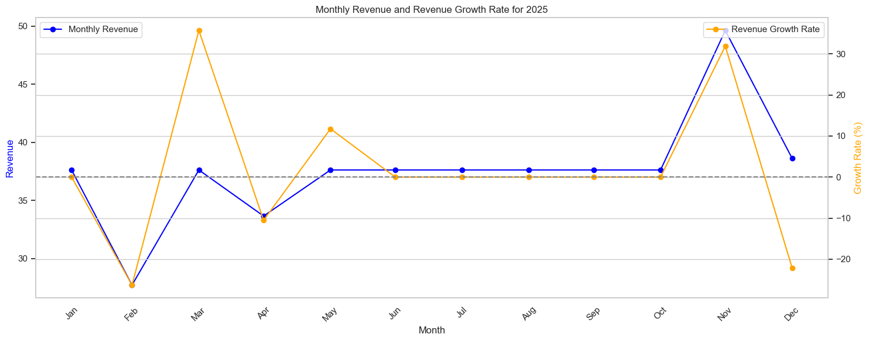
Company's Profitability in 2025

Slide 6
Title

