Slide 1
Deep learning for Time Series Classification
Elnur Maharramov
University of French-Azerbaijan (UFAZ)
Data Science and Artificial Intelligence
07.03.2024

Slide 2
Outline
Education
Work Experiences
Motivation
Literature review
Implementation
Filter analysis
Future works
Conclusion
Reference

Slide 3


Education
ASOIU - Bachelor degree
Electronics, Telecommunication and Radiotechnics engineering
(2018 – 2022)
UFAZ - Master degree
Data Science and Artificial Intelligence
(2018 – 2022)
ASOIU logo - http://asoiu.edu.az/
UFAZ logo - https://fr.m.wikipedia.org/wiki/Fichier:Ufaz_logo.png

Slide 4

Work experiences
Electronics Engineer Intern (02.2022 - 06.2022)
Web Developer (07.2022 - 01.2024)
RPA Engineer (07.2023 - 01.2024)
Picture - https://samoaglobalnews.com/

Slide 5
Motivation
Deep Learning Magic: Think of deep learning as a powerful tool. It can help us make sense of complex time-based data patterns.
Real-life Challenges: From predicting stock market trends to monitoring health conditions, time series classification tackles real-life puzzles we encounter every day.
Time series data holds the key to unlocking valuable insights and predicting future trends, driving decision-making across various industries.

Slide 6

Literature review
Deep learning for time series classification: a review
InceptionTime: Finding AlexNet for Time Series Classification
The UCR Time Series Archive
Time Series Classification from Scratch with Deep Neural Networks: A Strong Baseline
ROCKET: Exceptionally fast and accurate time series classification using random convolutional kernels
LITE: Light Inception with boosTing tEchniques for Time Series Classification
Deep Learning for Time Series Classification and Extrinsic Regression: A Current Survey
Picture - https://www.themandarin.com.au/

Slide 7
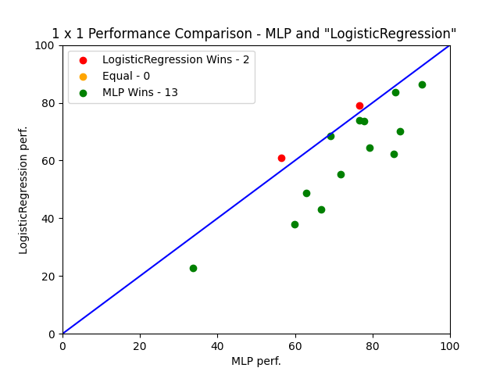
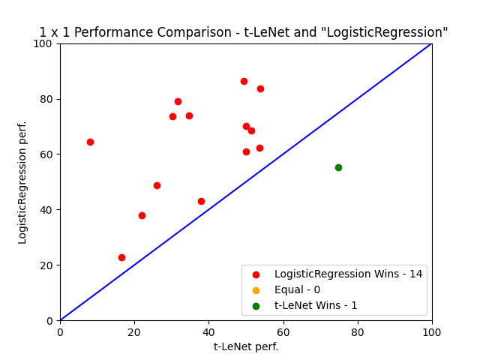
Implementation
Implemented logistic regression for training one neuron using a sigmoid activation function
Expanded the model's capabilities to predict multiclass outcomes, transcending its original binary classification function
Trained logistic regression model iteratively, repeating the process 10 times to refine performance on USR Archive datasets
Compared the results with those from the repository located at https://github.com/hfawaz/dl-4-tsc:

Slide 8
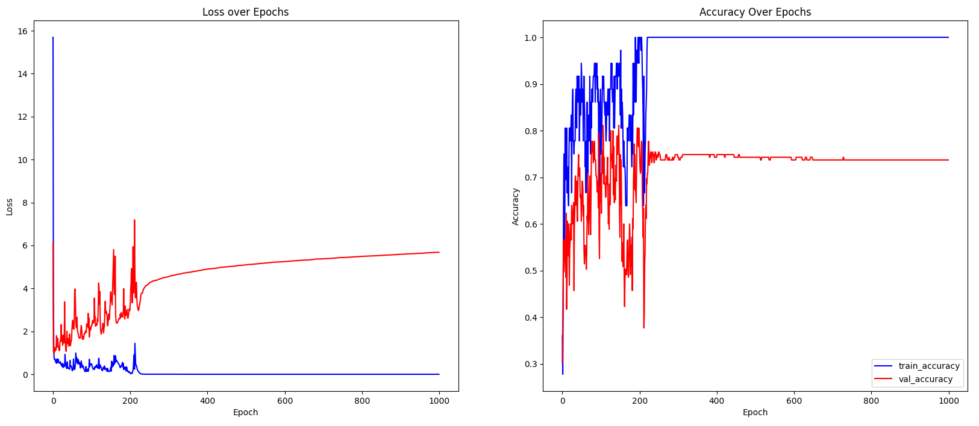
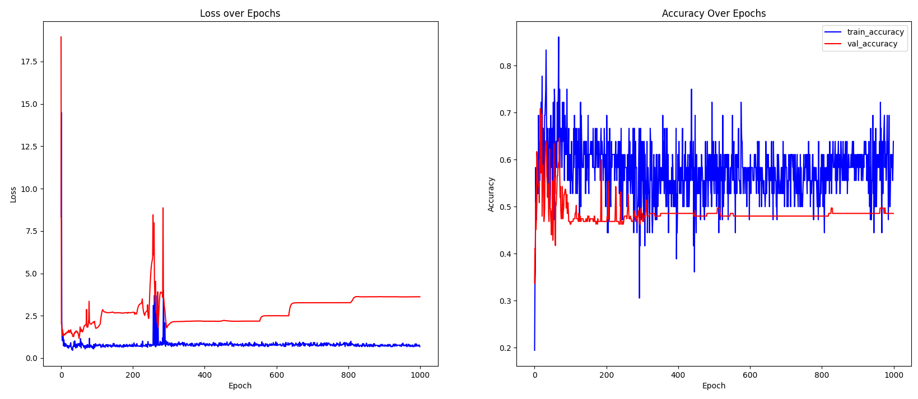
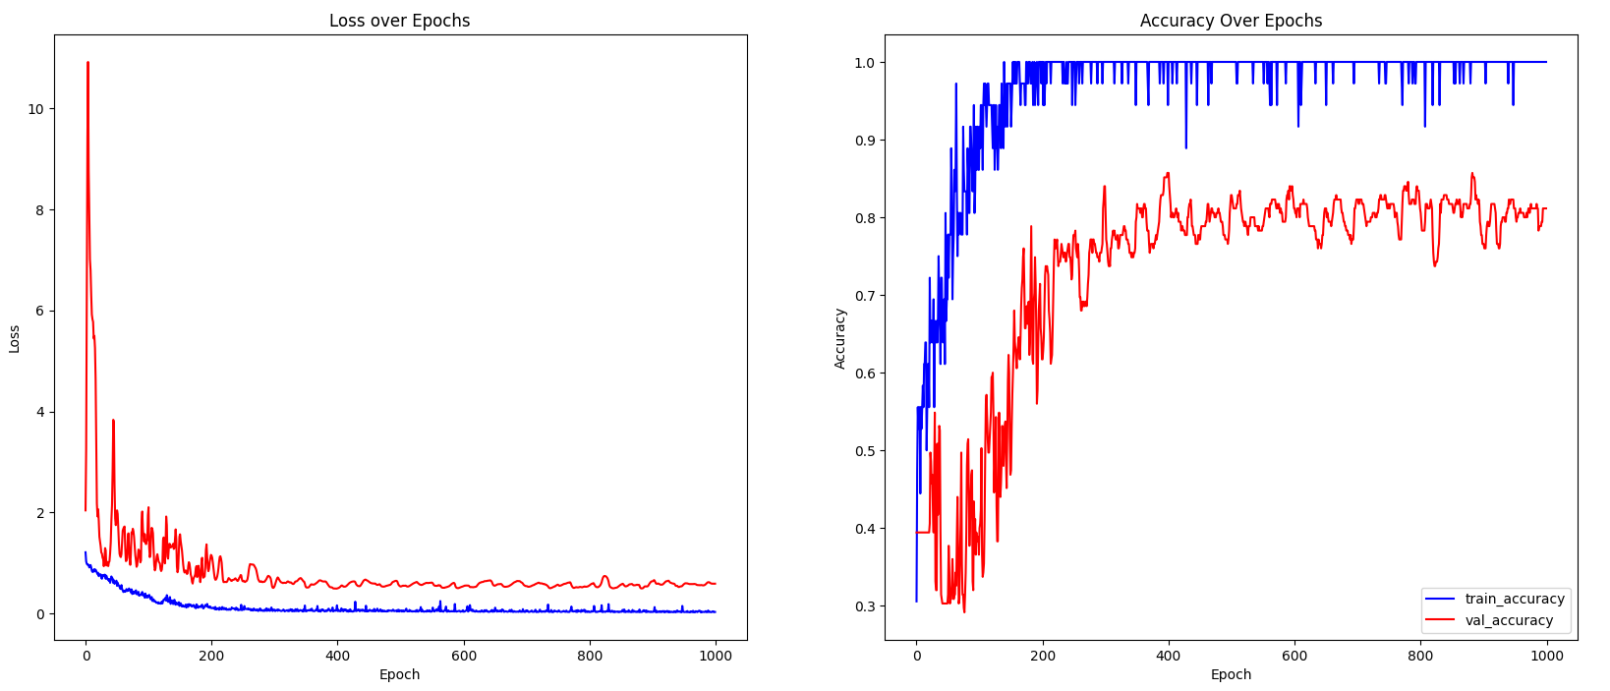
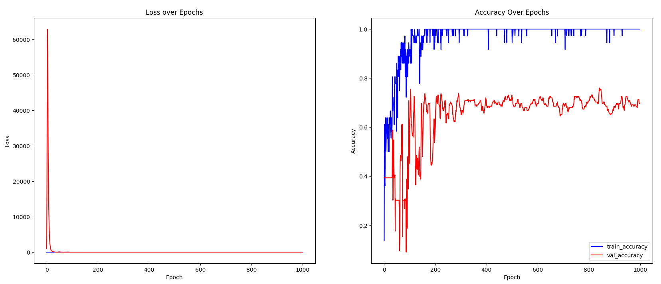
Implementation
Performances on ArrowHead dataset from UCR Archive
MLP architecture without dropout layers to understand baseline performance
MLP architecture by incorporating dropout layers to mitigate overfitting and improve generalization
ResNet architecture to leverage residual connections for deeper networks
FCN architecture to explore its potential advantages in capturing temporal dependencies in time series data

Slide 9
Filter analysis
Used Aeon library
Trained FCN, ResNet, Inception, LITE, and ROCKET models on 20 datasets from the UCR Archive, both on training and test sets
Employed t-Distributed Stochastic Neighbor Embedding (t-SNE) to visualize and compare the learned representations of the models' filters.
Compared models' filters for test and train sets individually
Compared filters of results between models for each dataset

Slide 10
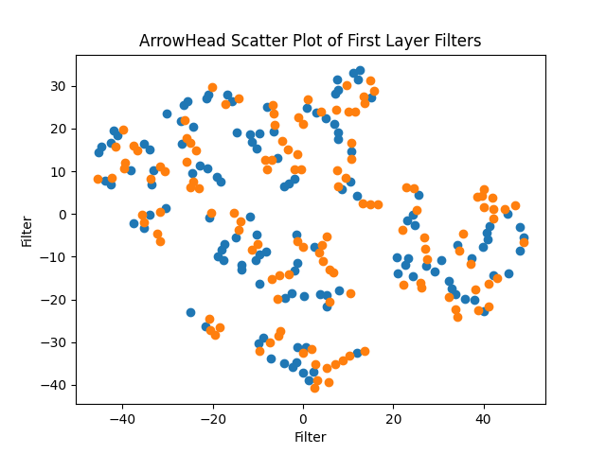
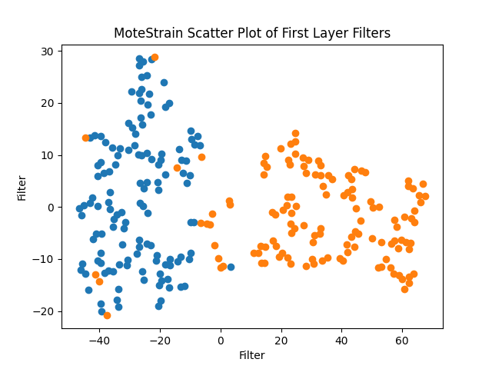
Filter analysis
Compared models' filters for test and train sets individually
Filters of first layer of FCN

Slide 11
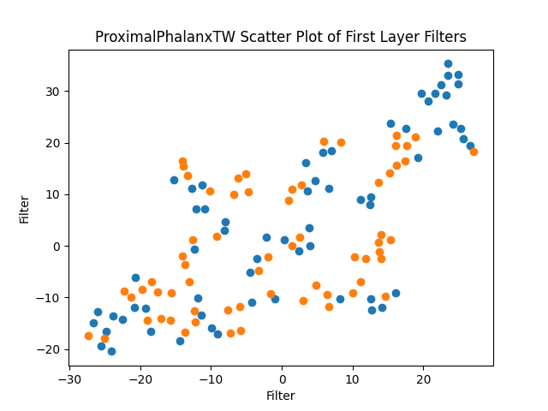
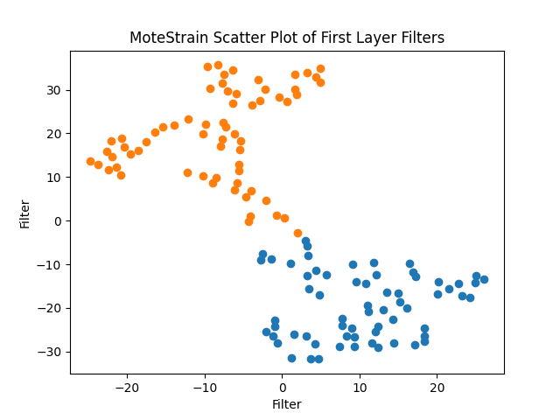
Filter analysis
Compared models' filters for test and train sets individually
Filters of first layer of ResNet

Slide 12
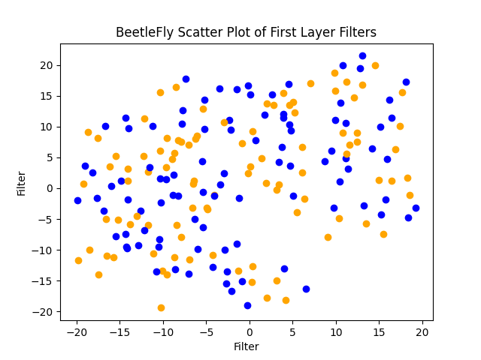
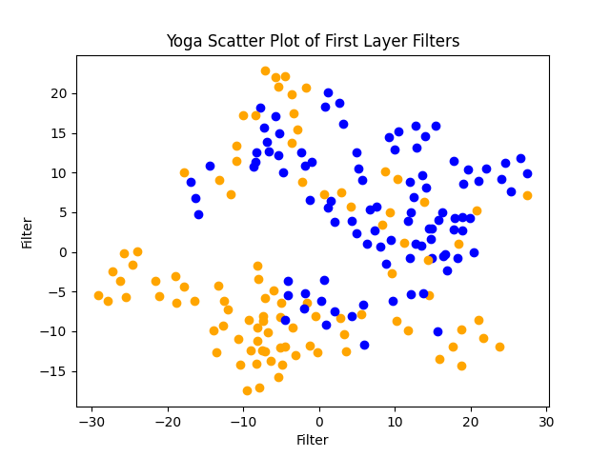
Filter analysis
Compared models' filters for test and train sets individually
Filters of first layer of Inception

Slide 13
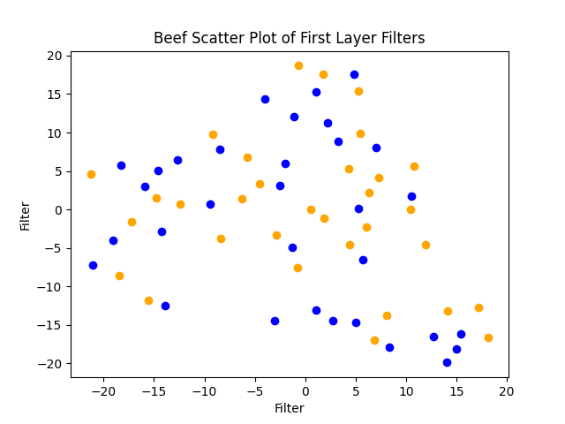
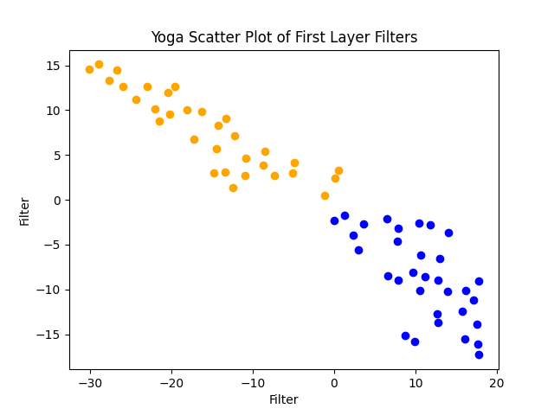
Filter analysis
Compared models' filters for test and train sets individually
Filters of first layer of LITE

Slide 14
Filter analysis
Compared filters of results between models for each dataset

Slide 15
Implementation

