Slide 1
Java Unit Testing
Java Marathon

Slide 2
Agenda Terminology What is Junit Annotations How to work with Junit Junit Test What is Maven
Java Marathon

Slide 3

Terminology
A test fixture sets up the data (both objects and primitives) that are needed to run tests
Example: If you are testing code that updates an employee record, you need an employee record to test it on
A unit test is a test of a single class
A test case tests the response of a single method to a particular set of inputs
A test suite is a collection of test cases
A test runner is software that runs tests and reports results
An integration test is a test of how well classes work together
JUnit provides some limited support for integration tests

Slide 4

Overview of Software Testing
Software testing is imperative to identify bugs and errors during software development and increase the quality of the product. Additionally, software testing is necessary to ensure that the software fulfills the client specifications, responds correctly to inputs (input validation), runs in a reasonable time (performance testing), is easy to install and run (deployment testing), and meets the stakeholder’s goals.
Test-Driven Development (TDD) is a key practice for extreme programming, it suggests that the code is developed or changed exclusively on the basis of the Unit Testing. TDD helps the programmer improve the code, side by side, increasing the programmer’s productivity.

Slide 5
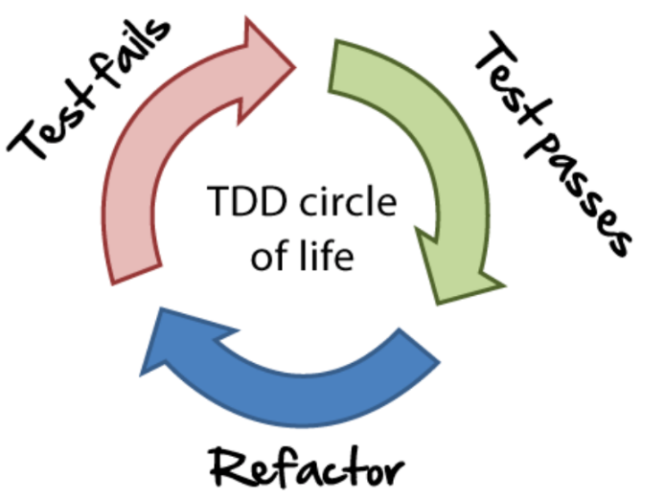
What is Test-Driven Development?
Test-Driven Development (TDD) is a software development process that includes test-first development. It means that the developer first writes a fully automated test case before writing the production code to fulfill that test and refactoring. Steps for the same are given below :
Firstly, add a test.
Run all the tests and see if any new test fails.
Update the code to make it pass the new tests.
Run the test again and if they fail then refactor again and repeat.

Slide 6

What is JUnit
JUnit is a Regression Testing Framework used by developers to implement unit testing in Java and accelerate programming speed and increase the quality of code. JUnit Framework can be easily integrated with either of the following:
Eclipse
Ant
Maven
JUnit 5 is composed of several different modules from three different sub-projects:
JUnit 5 = JUnit Platform + JUnit Jupiter + JUnit Vintage

Slide 7
What is JUnit
JUnit also defines the TestEngine API for developing a testing framework that runs on the platform. First-class support for the JUnit Platform also exists in popular IDEs:
IntelliJ IDEA,
Eclipse,
Visual Studio Code
JUnit Jupiter is the combination of the new programming model and extension model for writing tests and extensions in JUnit 5. The Jupiter sub-project provides a TestEngine for running Jupiter based tests on the platform.
JUnit Vintage provides a TestEngine for running JUnit 3 and JUnit 4 based tests on the platform. It requires JUnit 4.12 or later to be present on the class path or module path.

Slide 8

What is JUnit
JUnit 5 requires Java 8 (or higher) at runtime. However, you can still test code that has been compiled with previous versions of the JDK.
JUnit test framework provides the following important features:
Fixtures
Test suites
Test runners
JUnit classes

Slide 9
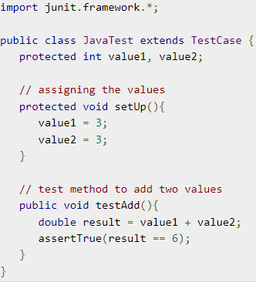
What is JUnit
Fixtures is a fixed state of a set of objects used as a baseline for running tests. The purpose of a test fixture is to ensure that there is a well-known and fixed environment in which tests are run so that results are repeatable. It includes −
setUp() method, which runs before every test invocation.
tearDown() method, which runs after every test method.

Slide 10
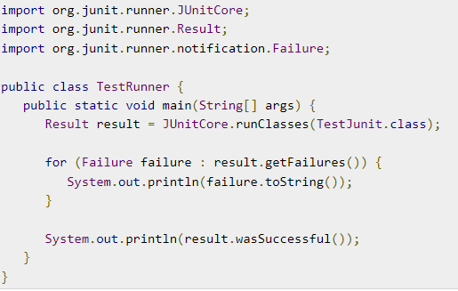
What is JUnit
A test suite bundles a few unit test cases and runs them together. In JUnit, both @RunWith and @Suite annotation are used to run the suite test.
A test runner is used for executing the test cases. Here is an example that assumes the test class TestJunit already exists.

Slide 11
What is JUnit
JUnit classes are important classes, used in writing and testing JUnits. Some of the important classes are :
Assert − Contains a set of assert methods.
TestCase − Contains a test case that defines the fixture to run multiple tests.
TestResult − Contains methods to collect the results of executing a test case.
TestSuite is a composite of tests.

Slide 12
Annotations
JUnit Jupiter supports the following annotations for configuring tests and extending the framework. Unless otherwise stated, all core annotations are located in the org.junit.jupiter.api package in the junit-jupiter-api module.
Annotation | Description
@Test | Denotes that a method is a test method. Unlike JUnit 4’s @Test annotation, this annotation does not declare any attributes, since test extensions in JUnit Jupiter operate based on their own dedicated annotations. Such methods are inherited unless they are overridden.
@ParameterizedTest | Denotes that a method is a parameterized test. Such methods are inherited unless they are overridden.
@RepeatedTest | Denotes that a method is a test template for a repeated test. Such methods are inherited unless they are overridden.
@TestFactory | Denotes that a method is a test factory for dynamic tests. Such methods are inherited unless they are overridden.

Slide 13
Annotations
Annotation | Description
@BeforeEach | Denotes that the annotated method should be executed before each @Test, @RepeatedTest, @ParameterizedTest, or @TestFactory method in the current class; analogous to JUnit 4’s @Before. Such methods are inherited unless they are overridden.
@AfterEach | Denotes that the annotated method should be executed after each @Test, @RepeatedTest, @ParameterizedTest, or @TestFactory method in the current class; analogous to JUnit 4’s @After. Such methods are inherited unless they are overridden.
@BeforeAll | Denotes that the annotated method should be executed before all @Test, @RepeatedTest, @ParameterizedTest, and @TestFactory methods in the current class; analogous to JUnit 4’s @BeforeClass. Such methods are inherited (unless they are hidden or overridden) and must be static (unless the "per-class" test instance lifecycle is used).

Slide 14
Annotations
Annotation | Description
@AfterAll | Denotes that the annotated method should be executed after all @Test, @RepeatedTest, @ParameterizedTest, and @TestFactory methods in the current class; analogous to JUnit 4’s @AfterClass. Such methods are inherited (unless they are hidden or overridden) and must be static (unless the "per-class" test instance lifecycle is used).
@Tag | Used to declare tags for filtering tests, either at the class or method level; analogous to test groups in TestNG or Categories in JUnit 4. Such annotations are inherited at the class level but not at the method level.
@Disabled | Used to disable a test class or test method; analogous to JUnit 4’s @Ignore. Such annotations are not inherited
@Timeout | Used to fail a test, test factory, test template, or lifecycle method if its execution exceeds a given duration. Such annotations are inherited

Slide 15
Test Classes and Methods
Test Class: any top-level class, static member class, or @Nested class that contains at least one test method. Test classes must not be abstract and must have a single constructor.
Test Method: any instance method that is directly annotated or meta-annotated with @Test, @RepeatedTest, @ParameterizedTest, @TestFactory, or @TestTemplate.
Lifecycle Method: any method that is directly annotated or meta-annotated with @BeforeAll, @AfterAll, @BeforeEach, or @AfterEach. Test methods and lifecycle methods may be declared locally within the current test class, inherited from superclasses, or inherited from interfaces.

Slide 16
Lifecycle Method
@BeforeAll @BeforeEach @Test @AfterEach @AfterAll
Setup before all
Tests
Setup before each
Tests
Tests
Clean after each
Tests
Clean after
all
Tests

Slide 17
A standard test class
class TestClass {
@BeforeAll
static void setUpBeforeClass() throws Exception {
System.out.println("BeforeAll");}
@AfterAll
static void tearDownAfterClass() throws Exception {
System.out.println("AfterAll");}
@BeforeEach
void setUp() throws Exception {
System.out.println("BeforeEach");}
@AfterEach
void tearDown() throws Exception {
System.out.println("AfterEach"); }
@Test void testSolution() {
System.out.println("Test"); }
}
Result:
BeforeAll
BeforeEach
Test
AfterEach
BeforeEach
AfterEach
AfterAll
Analyzing result:
The first to call the methods of annotation @BeforeAll. The following are test examples that are announced from the @Test annotation. All @BeforeEach annotation methods are called before each test case. After each test case, all @AfterEach annotation methods are called.
All methods of the @AfterAll annotation are called last.

Slide 18
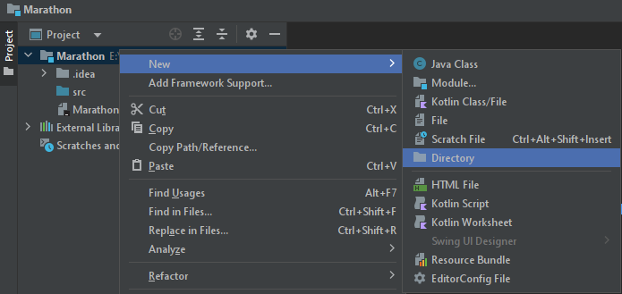

How to work with JUnit
Create a new Directory (Example for IntelliJ IDEA): Folder of Project → New → Directory → Name of Directory

Slide 19
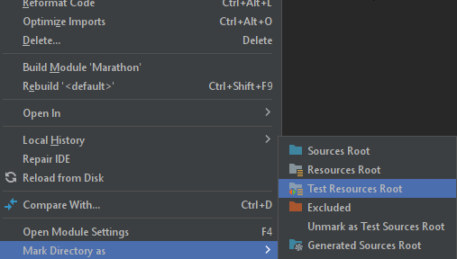
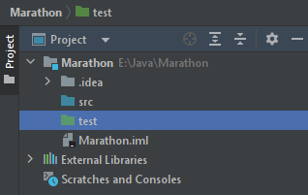
How to work with JUnit
Mark Directory “test” as Test Sources Root: Right Click on folder “tests” → Mark Directory as → Test Sources Root

Slide 20
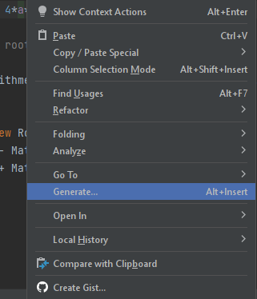
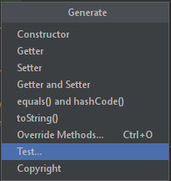
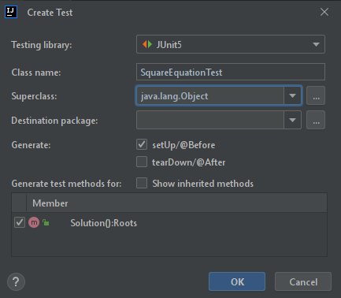
How to work with JUnit

Slide 21
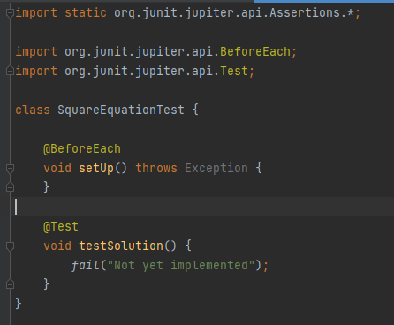
Junit Test
There are two methods in this code:
setUp () method with @BeforeEach annotation. This method will be used first in testing;
testSolution () method with @Test annotation. This method will be an important test of the Solution () function of the SquareEquation class.

Slide 22
Modification Junit Test
import static org.junit.jupiter.api.Assertions.*;
import org.junit.jupiter.api.BeforeEach;
import org.junit.jupiter.api.Test;
class SquareEquationTest {
// Class SquareEquation Reference
private SquareEquation se;
@BeforeEach
void setUp() throws Exception {
// This method is called first.
// Create an instance of the class SquareEquation
se = new SquareEquation(2, 1, -3);// 2*x^2 + x - 3 = 0
}
@Test
void testSolution() {
// Announce an instance of the class Roots
Roots rt = se.Solution();
assertEquals(rt.x1, -1.5); // Check the solution x1
assertEquals(rt.x2, 1.0); } // Check the solution x2
}
The solution is checked using the overloaded assertEquals () method of the org.junit.jupiter.api.Assertions class.
The solution in the variables rt.x1 and rt.x2 is compared with the pre-calculated (manually) solution of the current variant (a = 2, b = 1, c = -3) of the quadratic equation. If there is a match, the solution is correct.

Slide 23
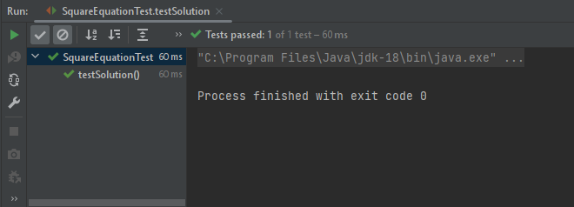
Run Junit Test
Once the code EquationTest class code has been generated, the developed test can be run. This is done by command “Run”. After starting, the test result will be displayed in the JUnit window. Result:

Slide 24
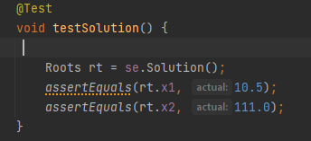
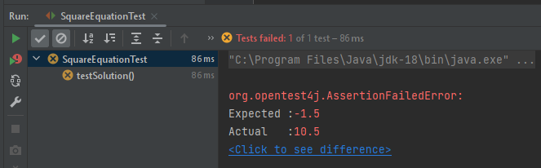
Run Junit Test
As you can see from the result, the correct solution is confirmed, and the test is passed. Therefore, the Solution () method of the SquareEquation class gives the correct result for the case when a = 2, b = 1, c = -3.
If you intentionally specify an incorrect answer in the TestSolution () method when calling assertEquals (), for example

Slide 25
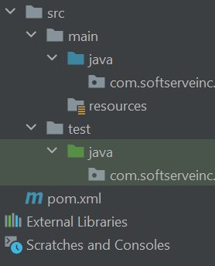
What is Maven
Apache Maven is a framework for building and managing dependencies.
Build in .war or .jar
The difference between the Maven project and the Java project is in the Intellij IDEA that the Maven project has a certain structure.

Slide 26

What is Maven
The most common default lifecycle phases are executed:
Validate: validate the project is correct and all necessary information is available
Compile: compile the source code of the project
Test: test the compiled source code using a suitable unit testing framework. These tests should not require the code to be packaged or deployed
package: take the compiled code and package it in its distributable format, such as a JAR.
integration-test: process and deploy the package if necessary into an environment where integration tests can be run

Slide 27

What is Maven
The most common default lifecycle phases are executed:
verify: run any checks to verify the package is valid and meets quality criteria
install: install the package into the local repository, for use as a dependency in other projects locally
deploy: done in an integration or release environment, copies the final package to the remote repository for sharing with other developers and projects.
There are two other Maven lifecycles of note beyond the default list above. They are:
clean: cleans up artifacts created by prior builds
site: generates site documentation for this project

Slide 28
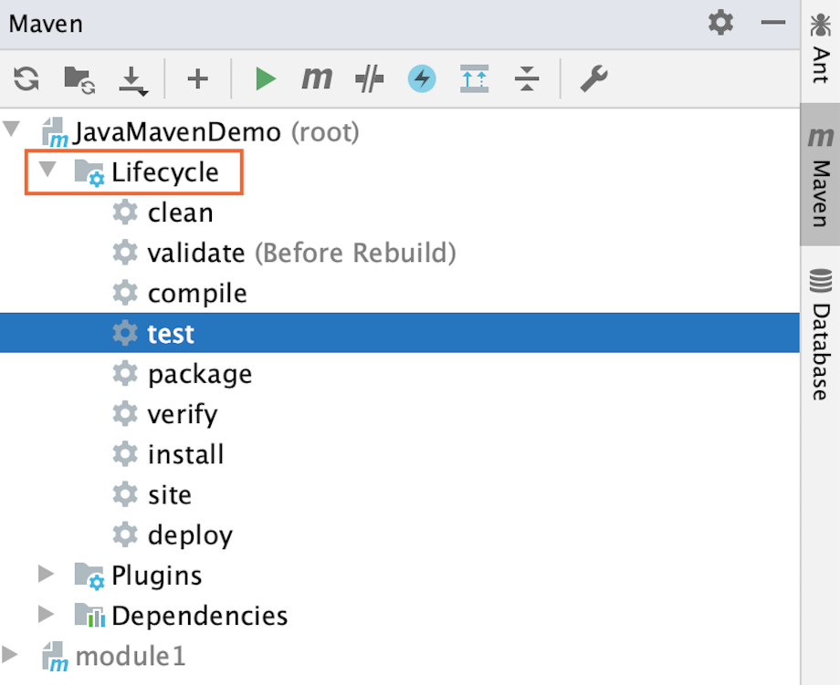
Testing is Maven
In the Maven project, you can create and run tests the same way you do in any other project using the default IntelliJ IDEA test runner.
Run tests﻿
Open the Maven tool window.
Under the Lifecycle node select test.

Slide 29
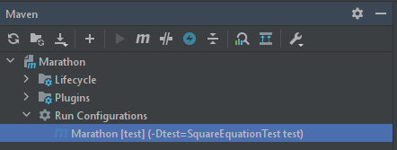
Testing is Maven
Run a single test﻿
To run just a single test instead of all the tests declared in a project, create a Maven run configuration for a single test with the Maven -Dtest=TestName test command. The run configuration will be saved under the Run Configurations node.
In the Maven tool window, under the Lifecycle node, right-click the test goal.
From the context menu, select Create 'name of the module/project and name of a goal'.
In the dialog that opens, specify a working directory that contains the test you want to run and in the Command line field, specify a phase (specified automatically) and the -Dtest=TestName test command.
Open the Run Configurations node and double-click your configuration to run.
Maven runs the test and displays the result in the Run tool window.

Slide 30
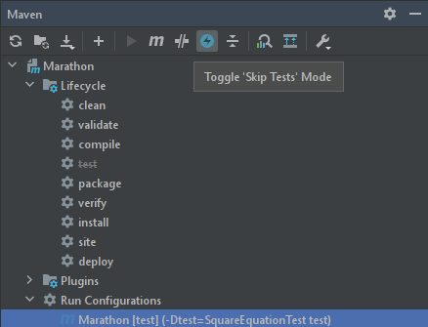
Testing is Maven
Skip test
You can skip running tests:
Click the “Skip test” icon in the Maven tool window.
IntelliJ IDEA de-activates the test goal under the Lifecycle node.

Slide 31


