Slide 1
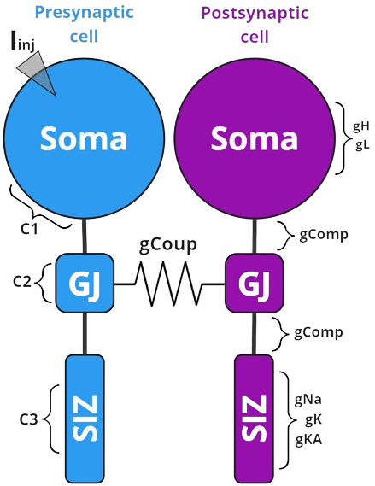
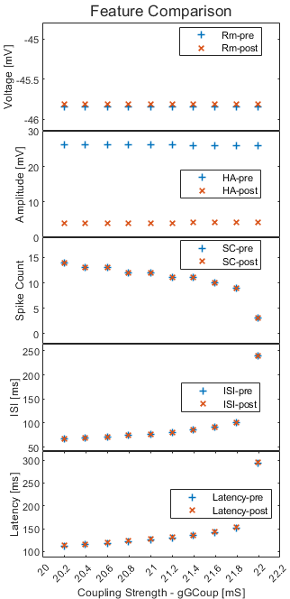
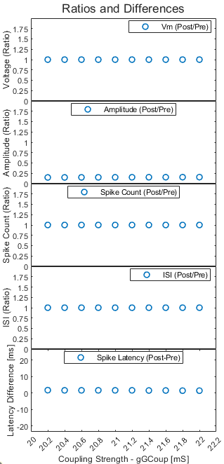
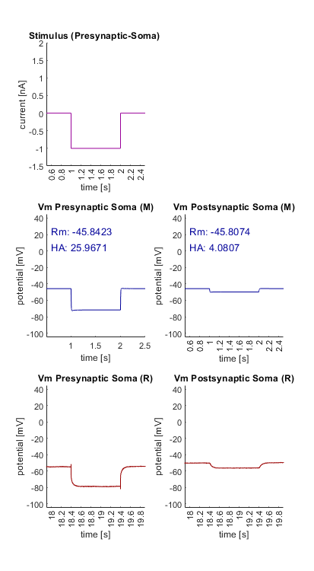
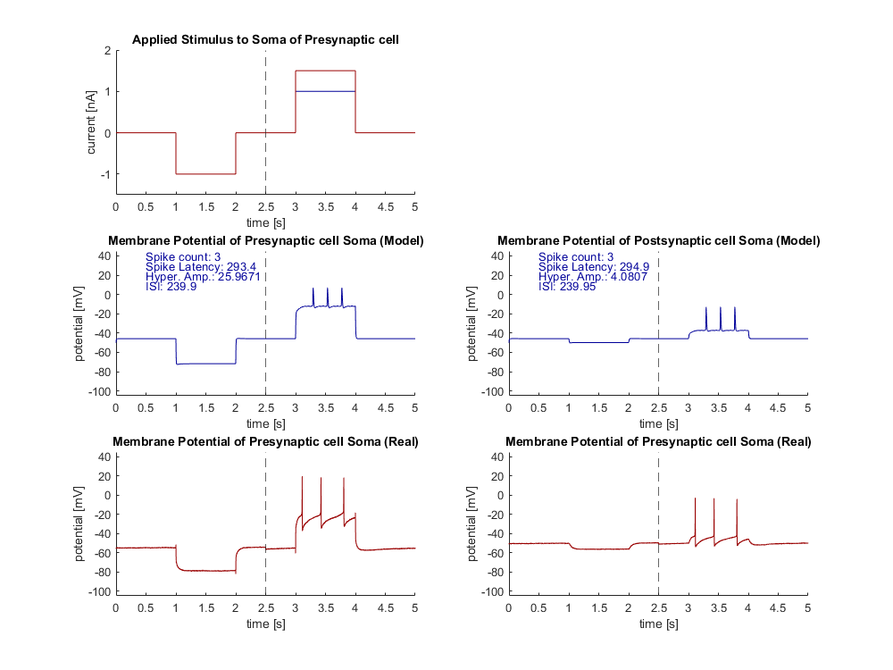
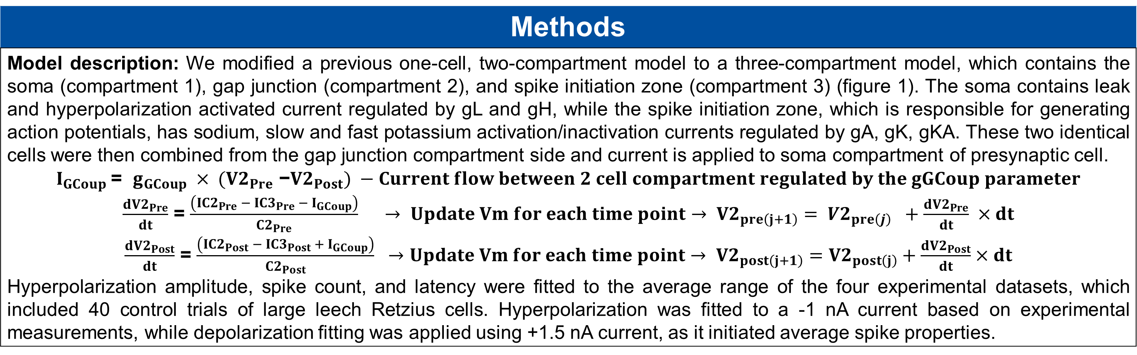
Coupleccino Model:
Coupling Strength effect on Features of HH Double Retzius Cell model
Elnur Imamaliyev and Maren Duken, 08.07.2024
Team Project (neu650) SS2024- Computational Neuroscience division
Introduction
Previous findings show that caffeine may have an affect on gap junctions of electrically coupled cells. Changes in coupling strength may also lead to variations in different physiological response parameters (features) such as hyperpolarization amplitude, spike count, spike latency, inter-spike interval (ISI). To investigate the effect of coupling strength on these features, we simulated a Hodgkin-Huxley (HH) type model.
Figure 1. HH Model of the electrically coupled Retzius cells
Injected current goes into the presynaptic gap junction compartment and then flows to the spike initiation zone (SIZ).
Methods
Model description: We modified a previous one-cell, two-compartment model to a three-compartment model, which contains the soma (compartment 1), gap junction (compartment 2), and spike initiation zone (compartment 3) (figure 1). The soma contains leak and hyperpolarization activated current regulated by gL and gH, while the spike initiation zone, which is responsible for generating action potentials, has sodium, slow and fast potassium activation/inactivation currents regulated by gA, gK, gKA. These two identical cells were then combined from the gap junction compartment side and current is applied to soma compartment of presynaptic cell. $I_{GCoup}$= $g_{GCoup} × {(V2}_{Pre}$ −${V2}_{Post}) −Current flow between 2 cell compartment regulated by the gGCoup parameter$ $\frac{d{V2}_{Pre}}{dt}$ = $\frac{\left({IC2}_{Pre} −{ IC3}_{Pre} − I_{GCoup}\right)}{{C2}_{Pre}}$ $→ Update Vm for each time point→ {V2}_{pre\left(j+1\right)}= {V2}_{pre\left(j\right)} +\frac{d{V2}_{Pre}}{dt} ×dt$ $\frac{d{V2}_{Post}}{dt}$ = $\frac{\left({IC2}_{Post} − {IC3}_{Post} + I_{GCoup}\right)}{{C2}_{Post}} →Update Vm for each time point→ {V2}_{post\left(j+1\right)}={V2}_{post\left(j\right)}+\frac{d{V2}_{Post}}{dt}×dt$ Hyperpolarization amplitude, spike count, and latency were fitted to the average range of the four experimental datasets, which included 40 control trials of large leech Retzius cells. Hyperpolarization was fitted to a -1 nA current based on experimental measurements, while depolarization fitting was applied using +1.5 nA current, as it initiated average spike properties.
*Iinj – Injected Current
**g – conductance
***C – capacitance
C1 >> C3 > C2
C1 = 119 µF
C2 = 10 µF
C3 = 20 µF
gComp = 55 mS
Result 1.1 – Model Retzius Parameter combinations
Changing other parameters
Type I and Type II responses (A and K ratio)
It’s possible to modify different classes of parameters
c1 (Soma Capacitance) ,c2 (Gap Junction Capacitance), c3 (SIZ Capacitance)
Conductance (gK, gA, gN, gL, gH, gComp, gGCoup)
Activation functions (steady-state function for Na activation/inactivation, K activation/inactivation, Ih activation)
Time Scale (Na inactivation, K activation/ inactivation, Ih activation)
Mainly by changing ratio of gA and gK it’s possible to change spike latency.
Which parameters include which is not
Parameter type
Channel Conductance | gK = 57 mS gA = 166 mS gN = 650 mS gL = 12 mS gH = 1 mS
Compartment Conductance | gComp = 55 gGCoup = (21:22)
Reversal Potentials | EL = -40 EH = -20 EN = +43 EK = -50
Time Scale in/activation functions | TauK = 19.55 TauKA = 20.1 TauIh = 70
Result 2 – Impact of Coupling strength (gGCoup) changes on Neural Features (as Caffeine Effect)
Figure 3. Figure explores how changes in gap junction conductance (gGCoup) affect various neural features. The left plot depicts pre- (blue) and post- (red) values of these features as a function of coupling strength. The right plot focuses on the ratio or difference changes between pre- and post- values for each feature induced by gGCoup.
Increasing gGCoup leads to a slight decrease in hyperpolarization amplitude, lower spike counts, higher spike latency, and an increase in ISI.
2. hyperpolarization amplitude, spike count, ISI ratios are not changing as well as difference of spike latency.
2.2.
What can be improved:
Only 3 or 4 concentration - ?
Note:
Try long simulation without stimulation.
Which features are represented well, which are not?
Table 1. Model coupled Retzius cell Parameters
Result 1.2 – Model Successfully shows similar responses to Real cells
Result 3
Passive responses
Active response parameters
Batman Spikes and Parameters
Active response parameters
Spike shapes (Such as, double spikes, and other traces) (optional)
Including pharma change
Compare real and model
Include the real membrane potential
Change the time windows
1 Hyper, 2 depolarization (normal, batman, high and low gGcoup)
(!) Combine with R1
Figure 2. Real and Model Cell Responses to injected Current
Current injected to Presynaptic soma compartment of cell and membrane potential is measured.
R stands for real, and M stands for Model.
Conclusion / Discussion
Conclude Limitation/applicability of model; future perspectives Passive and active responses of neurons are modulated by the dynamics if gating variables of ion channels. More fitting and optimization. Probably, using evolution algorithm for fitting parameters better.
Referencesß
1. https://link.springer.com/referenceworkentry/10.1007/978-1-4614-7320-6_151-1 2. Prescott, S.A. (2014). Excitability: Types I, II, and III. In: Jaeger, D., Jung, R. (eds) 3.

