Slide 1
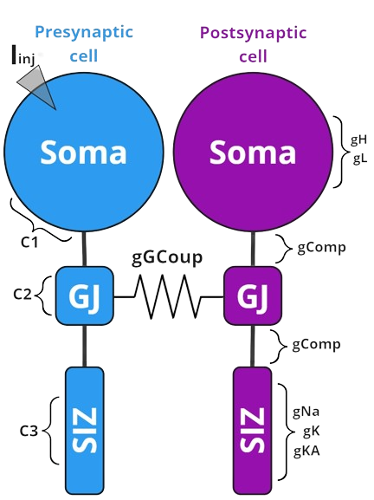
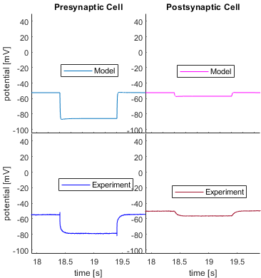
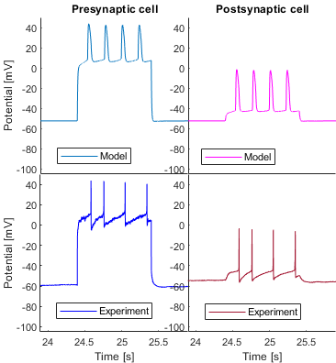
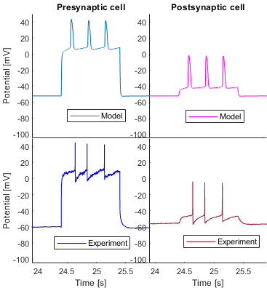
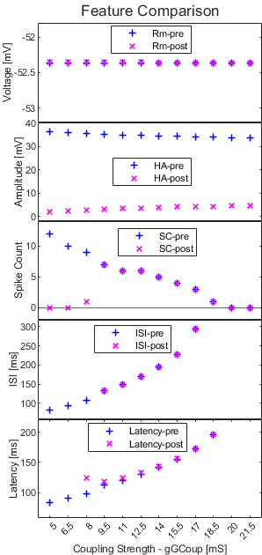
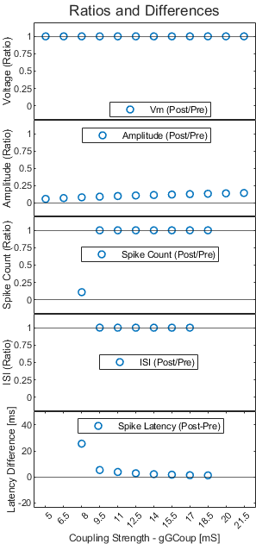
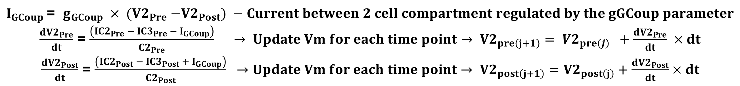
The experimental work of this project, alongside other previous findings, show that caffeine may influence the gap junctions of electrically coupled cells. Modifications to the coupling strength of such cells may also lead to variations in the features of the electrophysiological response - such as hyperpolarization amplitude, spike count, spike latency, inter-spike interval (ISI). To gauge the effects of this, a Hodgkin-Huxley (HH) type model was built to simulate coupled Retzius cells.
Latte for Leeches:
The Double-Coupleccino Model
Elnur Imamaliyev and Maren Duken, Based on Data from: Parvaneh Karami, Morvarid Etesami, Austin McNamara
Neu650 Team Project 2024 (Presented on 11.07.2024, supervised by Jutta Kretzberg and Go Ashida)
Introduction:
Methods:
Figure 1. Graphical representation of HH model for Retzius cells
A previous one-cell, two-compartment model was used to build to a three-compartment model, which mathematically represents the soma (compartment 1), gap junction (GJ - compartment 2), and spike initiation zone (SIZ - compartment 3) (figure 1). The soma contains leak and hyperpolarization activated current regulated by gL and gH, while the spike initiation zone, which is responsible for generating action potentials, has sodium alongside slow and fast potassium activation/inactivation currents, regulated by gA, gK, gKA respectively. These two identical cells were then combined at the gap junction compartment, and with current (Iinj) being applied to the soma compartment of the ‘presynaptic’ cell.
Injected current goes into the presynaptic soma compartment and then flows to the SIZ of presynaptic cell. This compartment initiates spikes based on the simulation of three parameters (Na activation, K activation, and KA inactivation). Initiated spikes appear in the soma of the presynaptic cell and pass through the GJs. If enough current flows to the SIZ of the postsynaptic cell and exceeds the threshold, it leads to the initiation of a spike in the postsynaptic cell, appearing in the soma.
$I_{GCoup}$= $g_{GCoup} × {(V2}_{Pre} −{V2}_{Post}) −Current between 2 cell compartment regulated by the gGCoup parameter$
$\frac{d{V2}_{Pre}}{dt}$ = $\frac{\left({IC2}_{Pre} −{ IC3}_{Pre} − I_{GCoup}\right)}{{C2}_{Pre}}$ $→ Update Vm for each time point→ {V2}_{pre\left(j+1\right)}= {V2}_{pre\left(j\right)} +\frac{d{V2}_{Pre}}{dt} ×dt$
$\frac{d{V2}_{Post}}{dt}$ = $\frac{\left({IC2}_{Post} − {IC3}_{Post} + I_{GCoup}\right)}{{C2}_{Post}} →Update Vm for each time point→ {V2}_{post\left(j+1\right)}={V2}_{post\left(j\right)}+\frac{d{V2}_{Post}}{dt}×dt$
Hyperpolarization amplitude, spike count, and latency were fitted to the average range of the experimental datasets of large leech Retzius cells. Passive features were fitted to a 1 s long, -1 nA current based on experimental measurements, while active features were fitted to 1 s long, +1.5 nA current, as it initiated analyzable spike properties.
*Iinj – Injected Current
**g – conductance
***C – capacitance
C1 >> C3 > C2
C1 = 130 µF
C2 = 20 µF
C3 = 30 µF
gComp = 35 mS
Result 1: Parameter Combinations
The simulation aimed to faithfully reproduce key electrophysiological features observed in large leech Retzius cells by strategically adjusting ion channel conductances, capacitances, and activation parameters. Critical combinations included gK (58 mS) for precise spike repolarization, gKA (162 mS) essential for spike frequency adaptation, and gN (645 mS) ensuring robust action potential initiation. Additionally, gL (10 mS) maintained resting membrane potential stability, while gH (1 mS) contributed to membrane potential dynamics during hyperpolarization.
Capacitance parameters, such as c1 (130 µF) influencing soma dynamics, and c2 (20 µF) supporting effective electrical coupling via gap junctions, were crucial. The SIZ capacitance, c3 (30 µF), produced higher spikes at lower values.
Activation times (Tau) like TauH (20) for Hyperpolarization channel kinetics and TauN (50 ms) for sodium channel inactivation were pivotal in shaping spike properties. These parameters collectively optimized through simulation, closely mirrored experimental data, capturing membrane potential dynamics, spike features (count, latency, ISI), and responses to current injections accurately.
Certain combinations of activation time parameters can lead to other electrophysiological phenomena, such as chattering and double spikes, which are also noticed in experimental caffeine trials.
Further parameter calibration could be done over a longer time, or, for example, by an evolutionary classification algorithm.
Parameter type | Values
Channel Conductance | gK = 58 mS gKA = 162 mS gN = 645 mS gL = 10 mS gH = 1 mS
Reversal Potentials | EL = -50 mV EH = -20 mV EN = +45 mV EK = -55 mV
Time Scale in/activation functions | TauH = 20 TauN = 50 TauIB = 30 TauZ = 100
Compartment Conductance | gComp = 35 gGCoup = (5.0:21.5)
Table 1. Coupled Retzius cell Model Parameters
Result 2: Comparison to Real Responses
Result 3: Impact of Coupling Strength
-1.0 nA Stimulus (1 s)
+1.5 nA Stimulus (1 s)
+1.5 nA Stimulus (1 s)
Figure 3. Figure shows how changes in gap junction conductance (gGCoup) affect various neural features.
The left plot depicts pre- (blue) and post- (magenta) values of these features as a function of coupling strength. The right plot focuses on the ratio or difference changes between pre- and post- values for each feature induced by gGCoup.
Increasing gGCoup leads to no change in resting membrane potential; a slight decrease in hyperpolarization amplitude of presynaptic cell and increase in postsynaptic cell (therefore increase in ratio); lower spike counts; an increase in ISI values, (ratio does not change); and higher spike latency (with the difference decreasing). Model breaks down at <= 6.5 mS and at >= 20 mS.
Values for spike count and latency pre- and post -synaptic differ at 8 mS, then gradually equal out with increasing coupling strength.
Model
Experiment
Passive responses
Lower gGCoup
Higher gGCoup
Figure 2. Model and Experimental Cell Responses to Injected Current: Model capabilities of passive and active response generation compared to biological responses. The first plot shows similar amplitude of hyperpolarization (33-35mV) and resting membrane potential (-50 to -55mV) to experimental examples. Second and third plots show active response properties to 1.5 nA stimulus; at lower and higher gGCoup values respectively, showing that higher gGCoup causes lower spike counts and higher spike latency as well as Inter-Spike Interval.
Conclusion:
Despite not fully representing expected action potential shapes, the model exhibits response features similar to real data. By adhering to Occam's razor—being as simple as possible while still capturing essential response characteristics—the model aids in deciphering which parameters are affected in pharmacological experiments. Further fine-tuning of activation/inactivation parameters could potentially yield the anticipated spike shapes.
Coupling changes the active response of cells more than passive responses within the range where the model works. Interestingly, when cells are not coupled in a 1:1 ratio but both cells still initiate spikes, there are fewer spikes on the postsynaptic side than on the presynaptic side, and the spike latency difference is significantly higher. This latency difference decreases as coupling strength increases. Additionally, we observe decreasing spike count values and higher latency values with increasing coupling strength, further indicating a negative correlation between these two features in our model.
Finally, from observing the ratios of around 1 in all parameters produced by the model at specific ranges of gGCoup values, it can be inferred that caffeine affects not only coupling strength but also the kinetics of each cell. Further optimization of compartments in the future could produce a more robust representation of electrically coupled cells.
References:
Prescott, S.A. (2014). Excitability: Types I, II, and III. In: Jaeger, D., Jung, R. (eds)
Lamb DG, Calabrese RL. Correlated conductance parameters in leech heart motor neurons contribute to motor pattern formation. PLoS One. 2013 Nov 18;8(11)
Synaptic Integration in Electrically Coupled Neurons, Elizabeth García-Pérez, et al. Biophysical Journal,

