Slide 1

Comparative Evaluation of CNN Models for Alzheimer’s Detection using Frequency-Domain EEG Features
Progress Report Presentation on
M. Tech (IT) Minor Project Presentation
11th December 2025
D
Presented by:
Name: Arkidaroi Sama
Roll No: MTECHIT_01
Department: Information Technology
Under the Supervision of:
Name: Mrs. Sangita Neog
Department: Information Technology

Slide 2
Contents
Problem Statement
Objectives
Introduction
Selected Models
Dataset
Proposed Methodology
Metadata Creation
EEG Preprocessing
Feature Extraction
Expected Outcome

Slide 3

Problem Statement
Numerous CNN architectures exist for EEG classification, but most are optimized for Brain-Computer Interface (BCI) tasks.
The effectiveness of these models for Alzheimer's Disease (AD) detection is not fully explored.
Specifically, their performance using Welch-based frequency-domain features remains a research gap.
"How do state-of-the-art CNNs perform when applied to frequency-domain EEG data for neurodegenerative disease detection?"

Slide 4
Objectives
Preprocess resting-state EEG signals from the OpenNeuro ds004504 dataset.
Extract frequency-domain features using the Welch PSD method.
Implement five CNN architectures for EEG classification.
Evaluate and compare model performance using subject-wise cross-validation.
Identify the most effective CNN model for Alzheimer’s detection.

Slide 5




Introduction
Alzheimer’s Disease
A progressive neurodegenerative disorder requiring early, non-invasive detection methods.
Deep Learning
Automates feature extraction and captures complex non-linear patterns in EEG data.
EEG as a Diagnostic Tool
Low-cost, non-invasive, and provides high temporal resolution of brain dynamics.
Frequency Domain Analysis
Welch PSD provides a robust estimation of spectral content, crucial for AD biomarkers.

Slide 6
Selected CNN Models
EEGNet
ShallowConvNet
DeepConvNet
SCCNet
FBCNet
EEGNet: Compact CNN for various EEG paradigms.
Shallow/DeepConvNet: Inspired by computer vision architectures.
FBCNet: Designed for multi-view frequency-domain features.

Slide 7
Dataset
Source: OpenNeuro ds004504
Type: Resting-state EEG (Eyes Closed)
Configuration: 19 Channels, 500 Hz Sampling Rate
Total Subjects: 88 (176 EEG files detected)
Class distribution: AD (36), CN (29), FTD (23)

Slide 8









Proposed Methodology
Phase 1
Data Source
OpenNeuro ds004504
Preprocessing
0.5-45Hz Filter
Segmentation
4s Epochs
Feature Extraction
Welch PSD
Phase 2
CNN Modeling
EEGNet, FBCNet, etc.
Training
Stratified K-Fold
Evaluation
Accuracy, F1, AUC
Comparative Analysis
Model Benchmarking

Slide 9
Metadata Creation
Extracted subject IDs from the BIDS dataset structure.
Labels mapped as:
AD = 0
CN = 1
FTD = 2
Created subject_metadata.csv for downstream processing.
// subject_metadata.csv preview
subject_id, label, class_name, eeg_file
sub-001, 0, AD, data\raw\ds004504\sub-001\eeg\sub-001_task-eyesclosed_eeg.set
sub-037, 1, CN, data\raw\ds004504\sub-037\eeg\sub-037_task-eyesclosed_eeg.set
sub-066, 2, FTD, data\raw\ds004504\sub-066\eeg\sub-066_task-eyesclosed_eeg.set

Slide 10
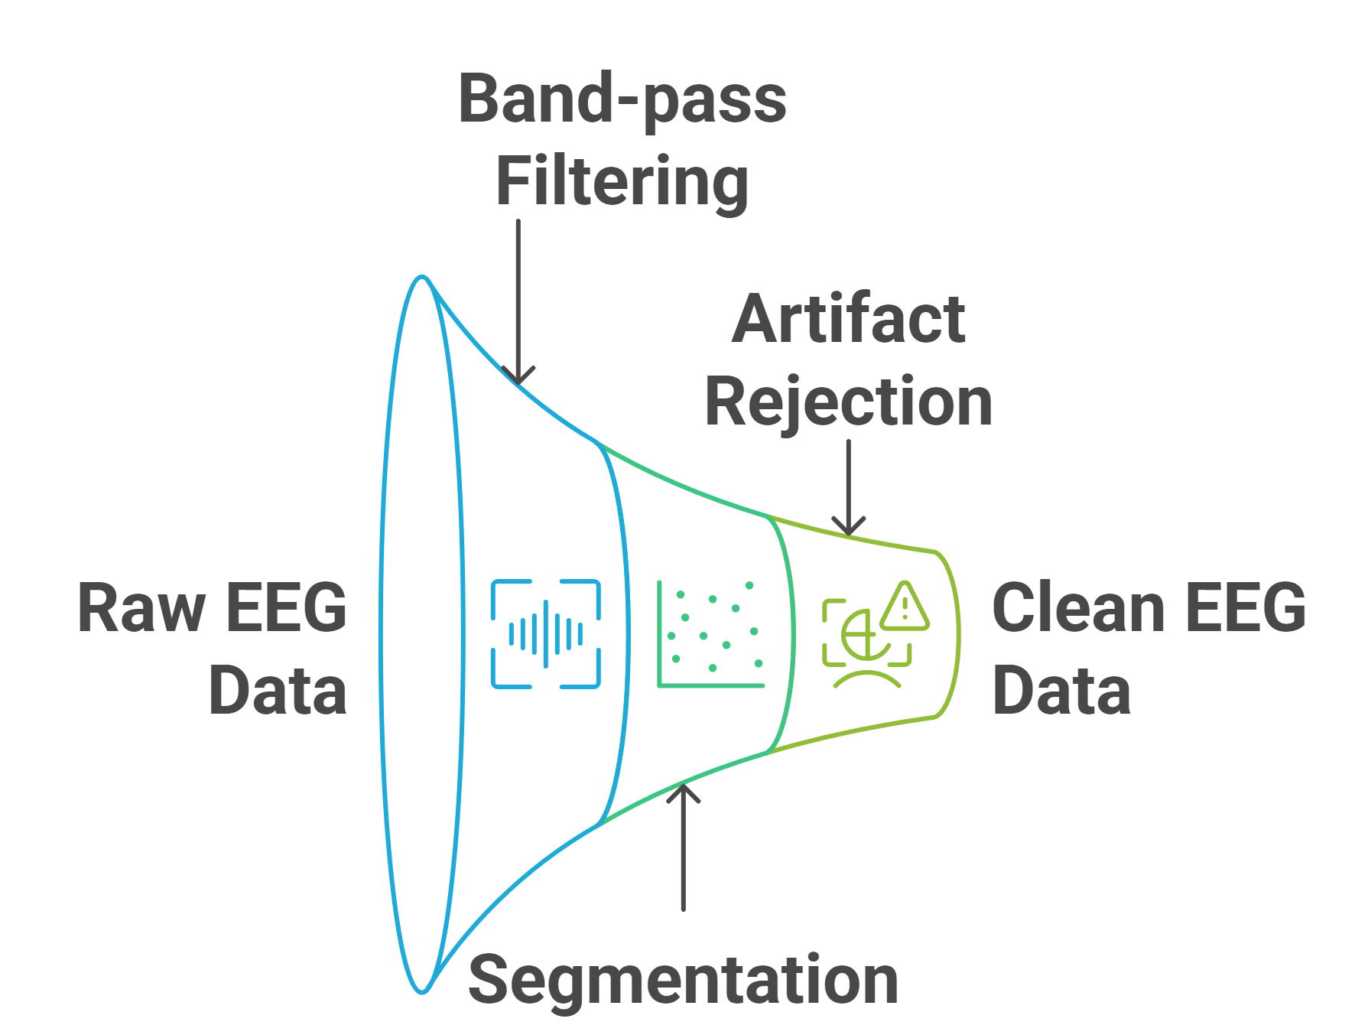
Preprocessing
Steps for EEG Preprocessing
Raw EEG Data
Band-pass Filtering
Segmentation
Artifact Rejection

Slide 11
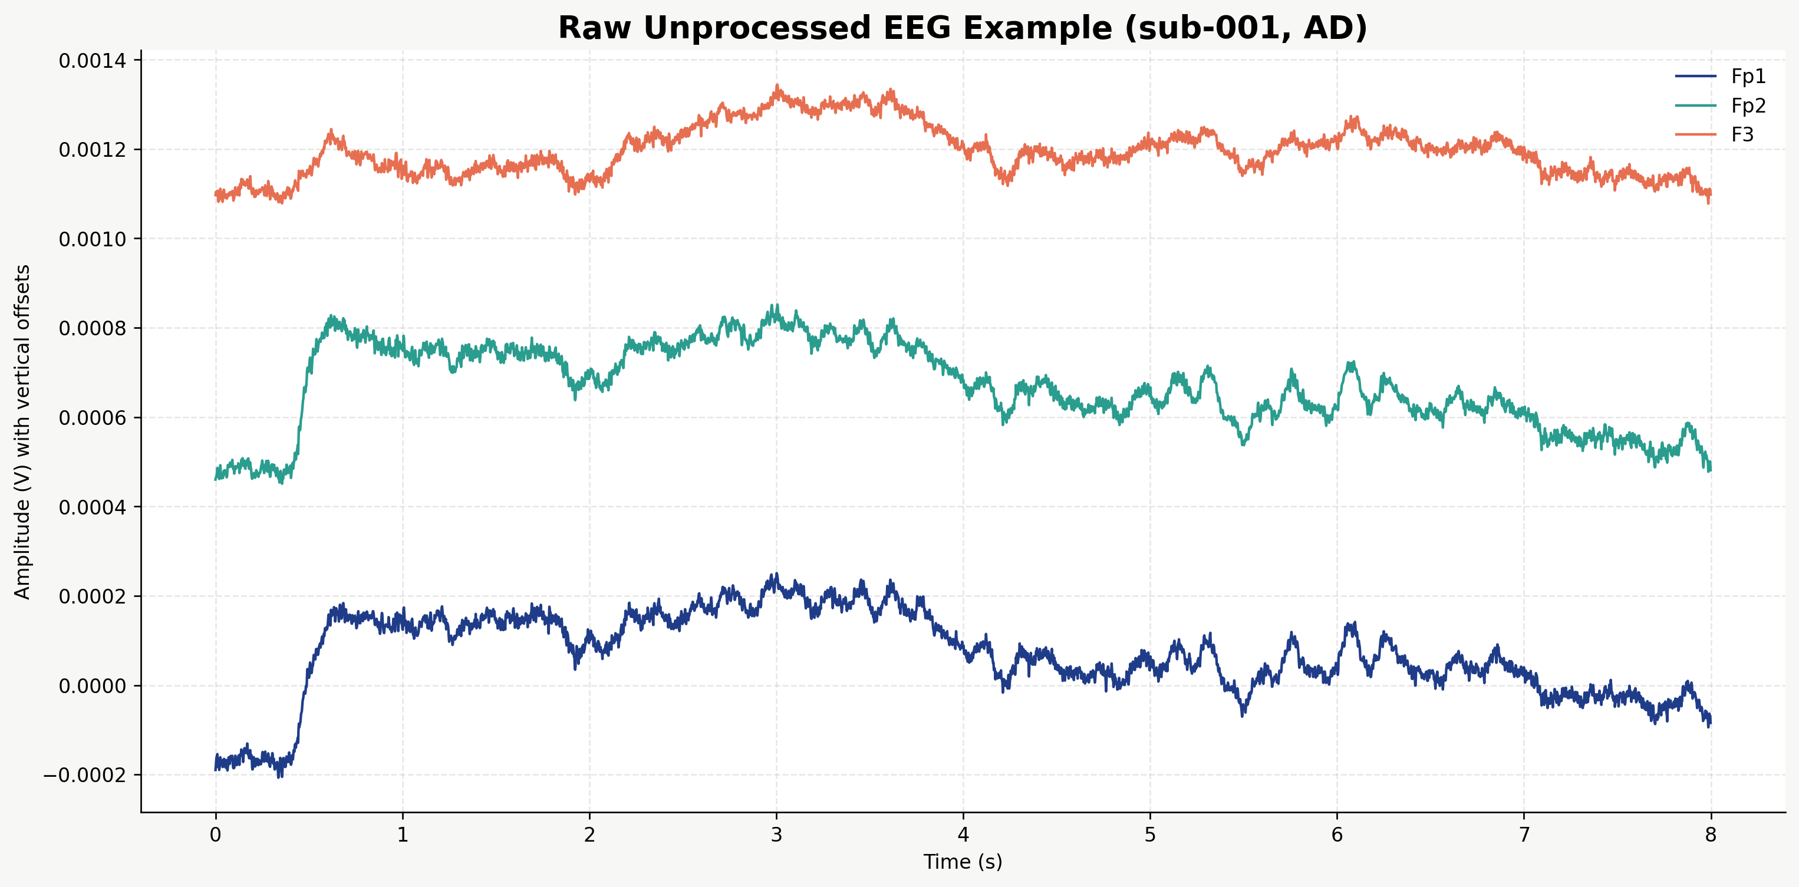
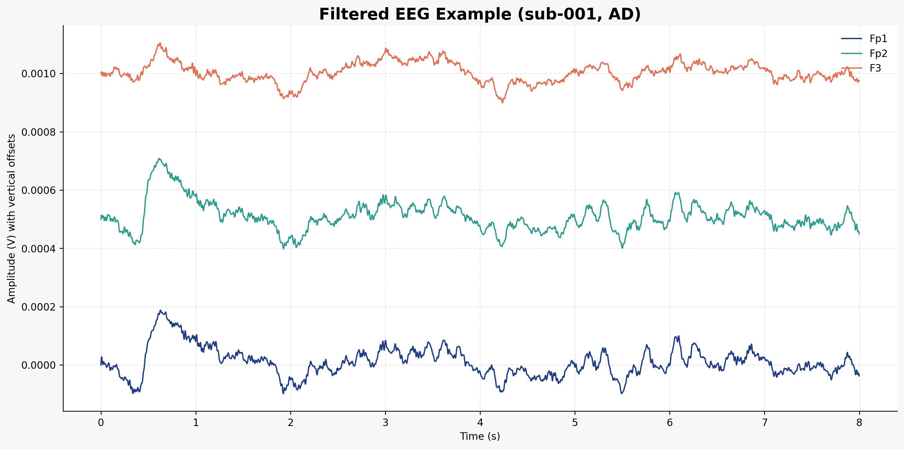
EEG Band-pass Filtering
Filtering
- Band-pass: 0.5 – 45 Hz
Sampling Frequncy
- Frequency: 500 Hz

Slide 12
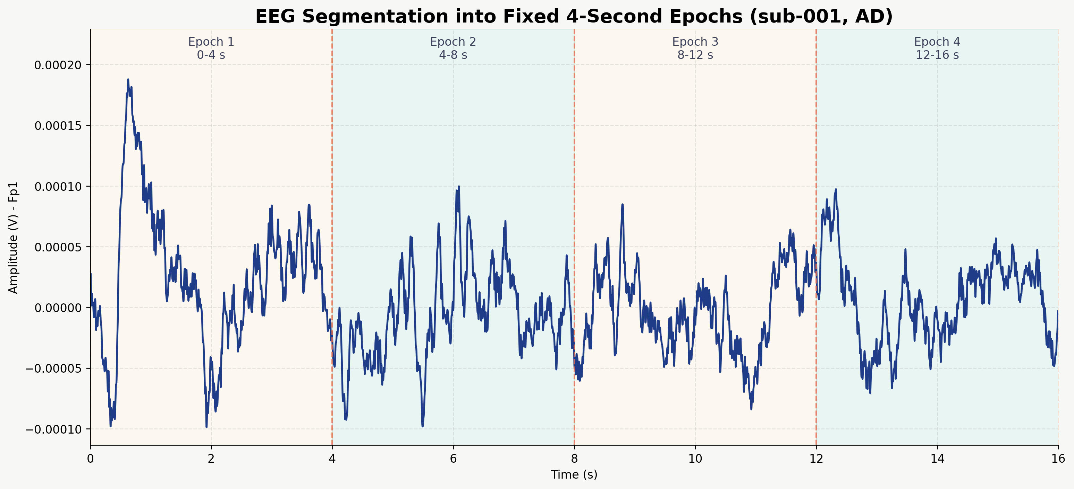
Epoch Segmentation
The filtered EEG was split into fixed 4-second parts.
These small parts are called epochs.
This makes feature extraction easier and consistent.

Slide 13
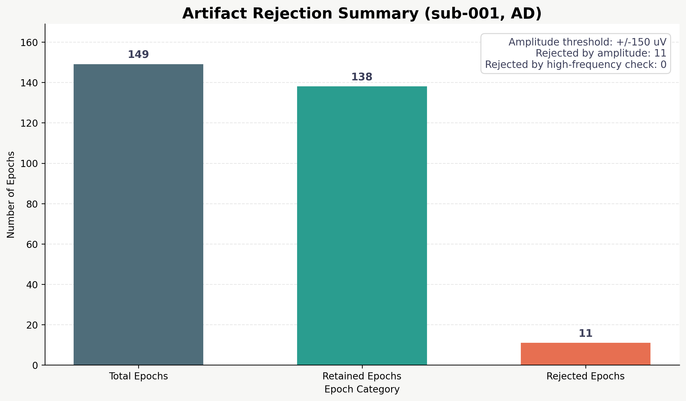
Artifact Rejection
Bad epochs were removed.
Rules used:
amplitude threshold: +/-150 uV
high-frequency check: 20-45 Hz
This helps keep only cleaner EEG data.

Slide 14
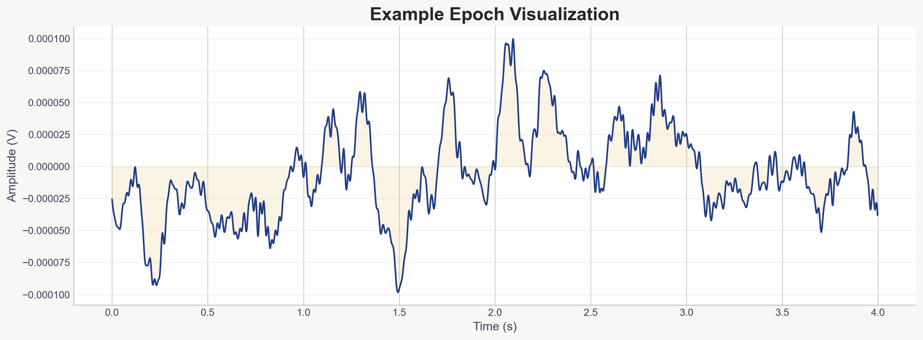
Preprocessing Output Example
Sample subject: sub-001
Sampling frequency: 500 Hz
Channels: 19
Retained epochs: 138
Epoch shape: (138, 19, 2000)

Slide 15
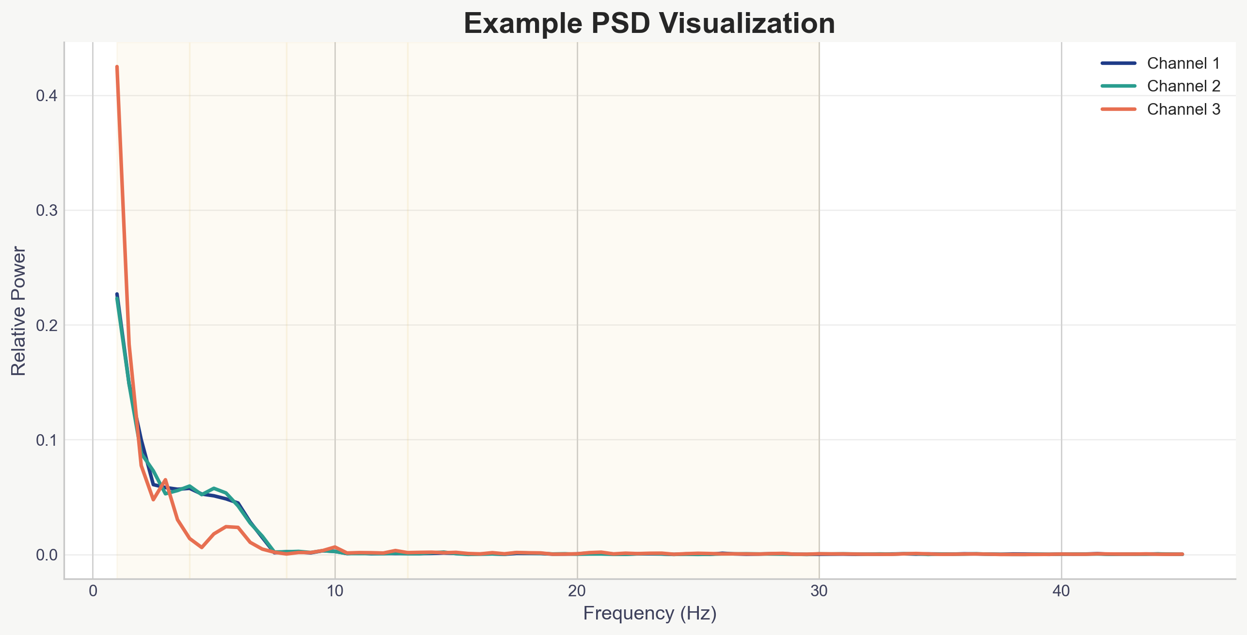
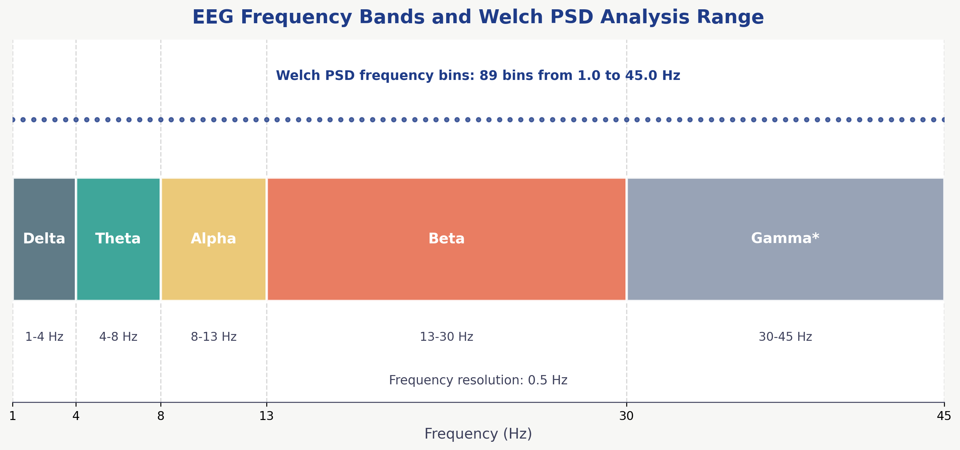
Feature Extraction: Welch PSD
Welch PSD was used to convert EEG into frequency-domain features.
It shows how signal power is distributed across frequencies.
EEG analyzed from 1 Hz to 45 Hz
Relative normalization was applied.
Output shape example: (138, 19, 89)
138 epochs
19 channels
89 frequency bins

Slide 16
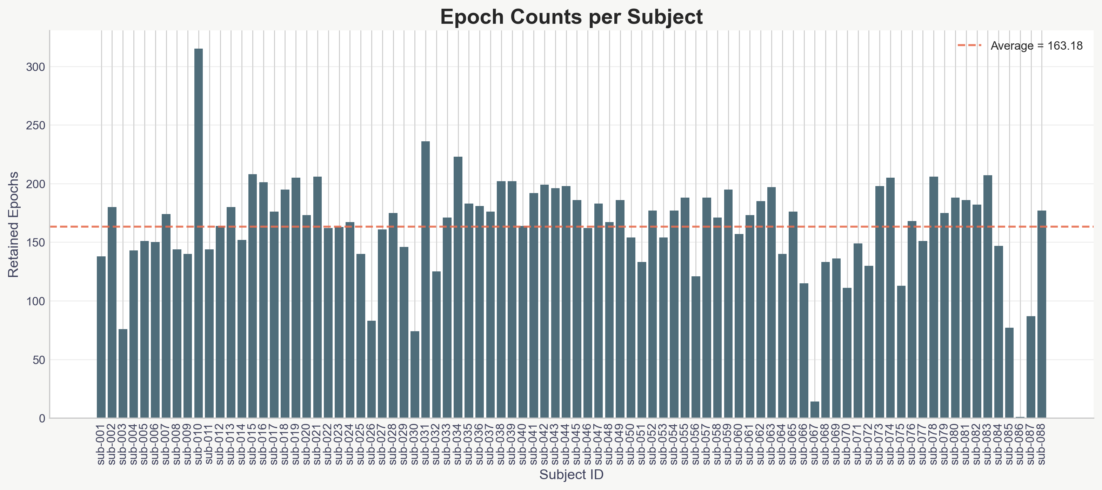
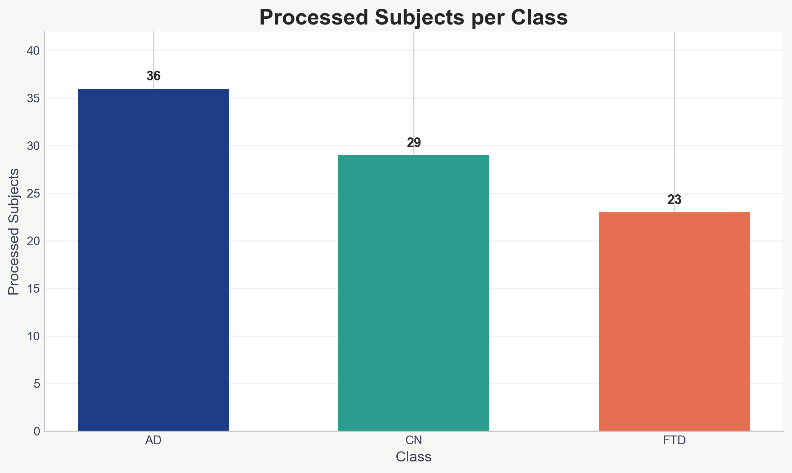
Full Dataset Results
Total subjects found: 88
Successfully processed: 88
Failed subjects: 0
Total rejected epochs: 3244
Average epochs per subject: 163.18

Slide 17
Future Work
Prepare subject-wise train, validation, and test splits
Implement CNN models such as EEGNet, ShallowConvNet, DeepConvNet, SCCNet, and FBCNet
Train and evaluate each model using the PSD features from Phase 1
Compare model performance and identify the best architecture

Slide 18
References
Lawhern, V. J., Solon, A. J., Waytowich, N. R., Gordon, S. M., Hung, C. P., & Lance, B. J. (2018). EEGNet: A Compact Convolutional Neural Network for EEG-based Brain–Computer Interfaces.
Schirrmeister, R. T., Springenberg, J. T., Fiederer, L. D., Glasstetter, M., Eggensperger, K., Tangermann, M., et al. (2017). Deep learning with convolutional neural networks for EEG decoding and visualization.
Hsu, Y. H., Chuang, Y. Y., & Huang, C. Y. (2018). SCCNet: Spatial Component-wise Convolutional Network for Motor-Imagery EEG Classification.
Mane, R., Chew, E., Chua, K., Ang, K. K., Robinson, N., Vinod, A. P., & Guan, C. (2021). FBCNet: A Multi-view Convolutional Neural Network for Brain-Computer Interface.
Welch, P. (1967). The use of fast Fourier transform for the estimation of power spectra: A method based on time averaging over short, modified periodograms.
Miltiadous, A., Tzimourta, K. D., Afrantou, T., Giannakeas, N., Tzallas, A. T., Tsipouras, M. G., & Tsalikakis, D. (2023). A dataset of EEG recordings from Alzheimer’s disease, Frontotemporal Dementia and Healthy Subjects.

Slide 19
References
Cassani, R., Estarellas, M., San-Martín, R., Fraga, F. J., & Falk, T. H. (2018). Systematic review on resting-state EEG for Alzheimer’s disease diagnosis.
Tzimourta, K. D., Giannakeas, N., Tzallas, A. T., Tsipouras, M. G., & Astrakas, L. G. (2019). EEG-based detection of Alzheimer’s disease using machine learning techniques.
Fraga, F. J., Falk, T. H., Kanda, P. A. M., & Anghinah, R. (2013). Characterizing Alzheimer’s disease severity using resting-awake EEG amplitude modulation analysis.
Tzallas, A. T., Tsipouras, M. G., & Fotiadis, D. I. (2009). Epileptic seizure detection in EEG signals using time-frequency analysis.
Roy, Y., Banville, H., Albuquerque, I., Gramfort, A., Falk, T. H., & Faubert, J. (2019). Deep learning-based electroencephalography analysis: a systematic review.
Craik, A., He, Y., & Contreras-Vidal, J. L. (2019). Deep learning for electroencephalogram classification: a review.

Slide 20
End
Thank You

