Slide 1
Capstone Project - The Battle of Neighborhoods
Final presentation
Author Eloisa Moreira de Lira

Slide 2
Introduction and Bussiness Aim
The global pharmaceutical market is expected to overcome $1.5 trillion by 2023, from the $1.2 trillion of 2018, at an annual growth rate of 3-6%. This increase should be paralleled by the increase in the number of launched products, that might reach 54 in 2023.
For those reasons this study shows how some Data Science tools can be useful in some bussiness stratregies. This report makes part of the final evaluation to Professional Certificate in Data Science in partnership with Coursera and IBM.

Slide 3
Task
A foreign group would like to install some pharmacies in LA in order to gain customers in not foreseen areas. This task was performed aiming to execute an areal study of new places and then expand pharmacies in Los Angeles. Today Los Angeles count with three main pharmacies spreaded such as Wallgreens, CVS and Wallmart pharmacy. However some place are covered by little few sorted pharmaceutical establishments making this fact a window to relevant success.

Slide 4
Data Wrangling
Before to perform the code. It’s necessary to find some prior information. Even more, it’s mister to ensure where to grab data in reliable sources. For sake to know, data conditioning or data wrangling the most time of cases spend the major part of time. The quality of data are linked.
Dataset used:
LA neighborhood data set
API forsquare of venues around the neighborhoode clean data

Slide 5
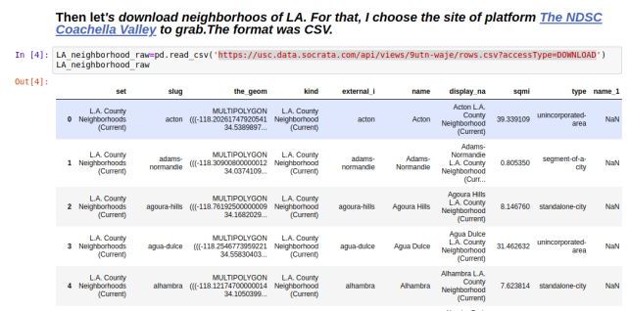
Raw Neighborhood data

Slide 6
Raw Neighborhood data

Slide 7
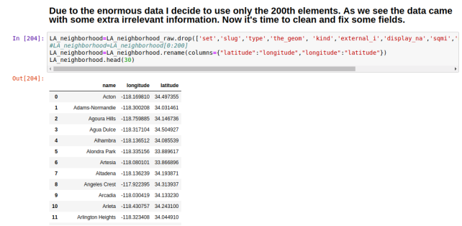
Data cleaned

Slide 8
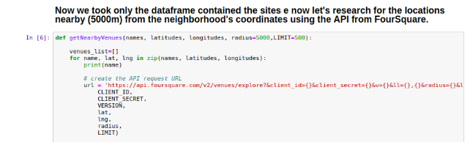
API Foursquare
The Foursquare Places API provides location based experiences with diverse information about venues, users, photos, and check-ins. The API supports real time access to places, Snap-to-Place that assigns users to specific locations, and Geo-tag. Additionally, Foursquare allows developers to build audience segments for analysis and measurement. JavaScript Serialized Object Notation (JSON) is the preferred response format.

Slide 9
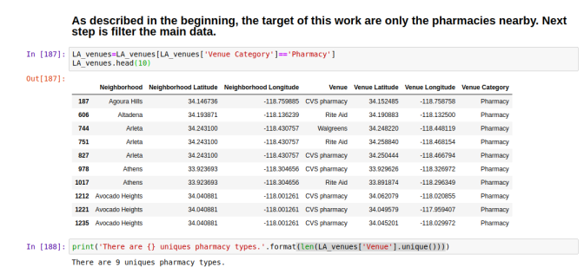
After merge the two data sets we have this table. It contain the venues plus the name and coordinates from neighborhhods.

Slide 10
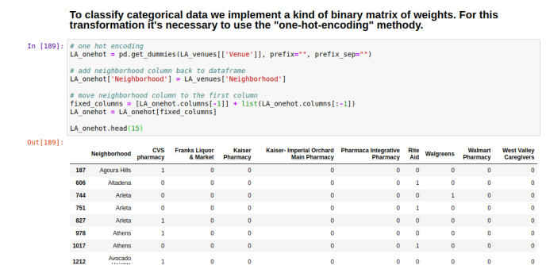
One-hot Encoding Method
One hot encoding is a process by which categorical variables are converted into a form that could be provided to ML algorithms to do a better job in prediction. The categorical value represents the numerical value of the entry in the dataset.

Slide 11
Clustering algorithms
Supervised machine learning
Supervised machine learning uses sample data that is well classified and labeled. It’s supervised because it involves a set of feedback data that indicates whether the predictions based on the sample data are correct or incorrect.
Clustering focuses on identifying groups of similar records and labeling the records according to the group to which they belong. This is done without prior knowledge about the groups and their characteristics. Types of clustering algorithms include the K-means, TwoStep and Kohonen clustering.

Slide 12
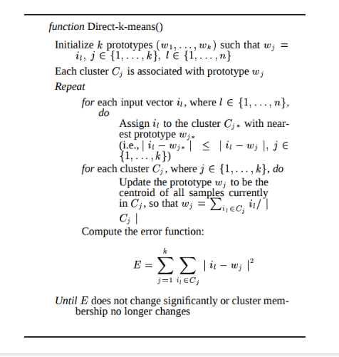
K means Algorithm code

Slide 13
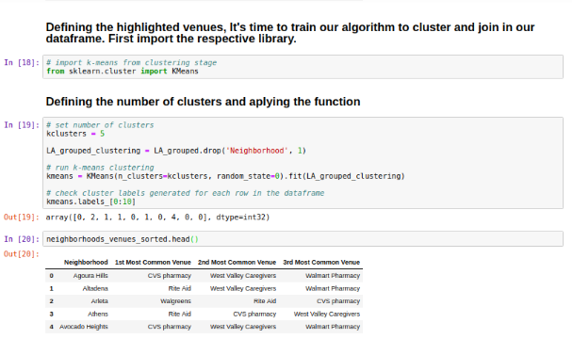
Fortunatelly there are some library that all Machine Learning algothims are implementes. It’s the case of Sklearn library.

Slide 14
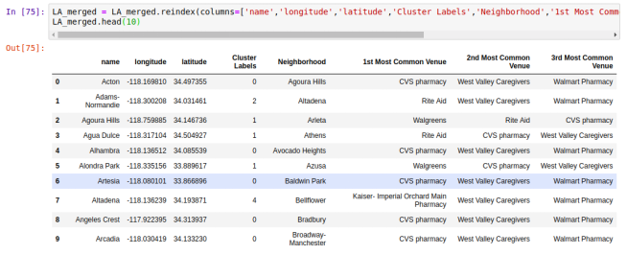
After merge all the favorite venues with respective Neighborhood names and coordinates It was insert the cluster label as well.

Slide 15
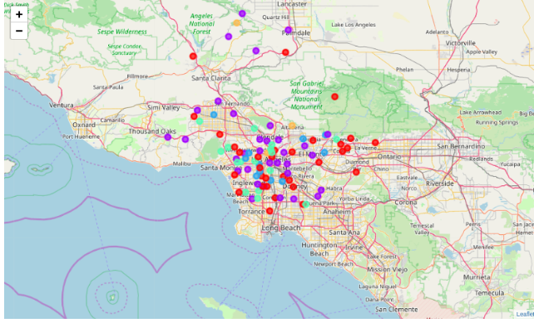
Each color represent an individual cluster. Naming by color: red-cluster0, violeta-cluster1, blue-cluster2, green-cluster3, orange-cluster4.

Slide 16
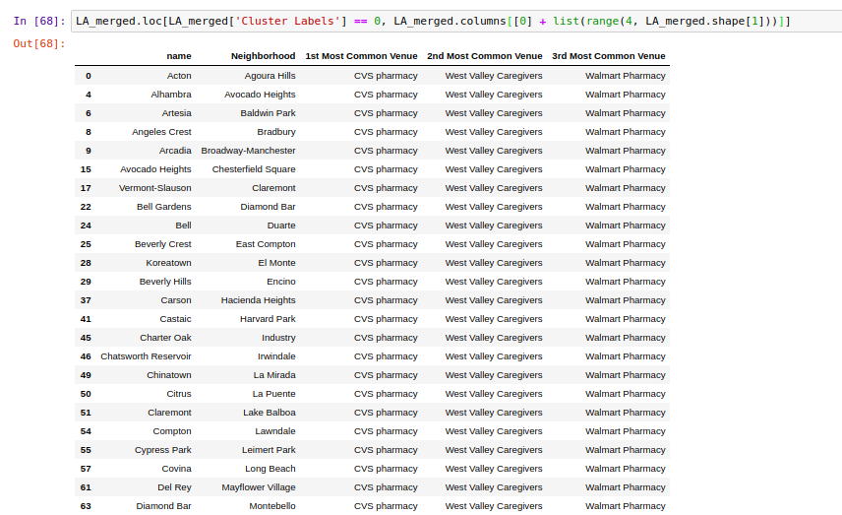
Cluster 00

Slide 17
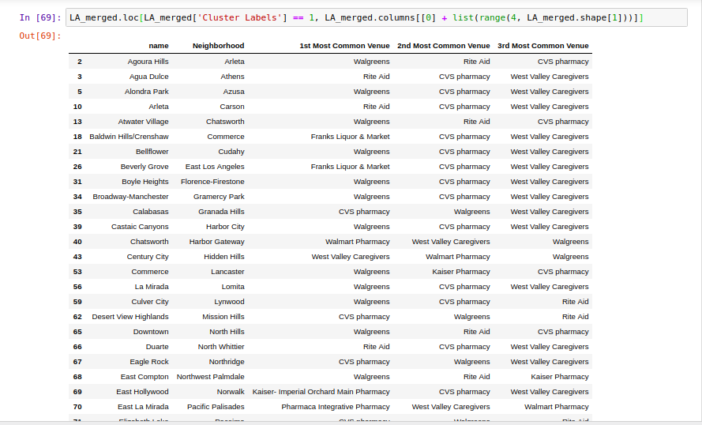
Cluster 01

Slide 18
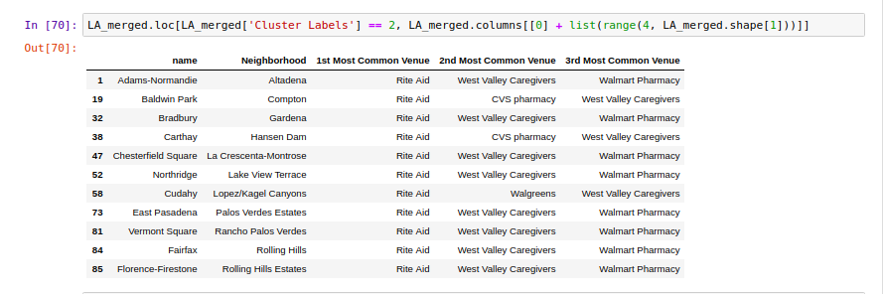
Cluster 02

Slide 19
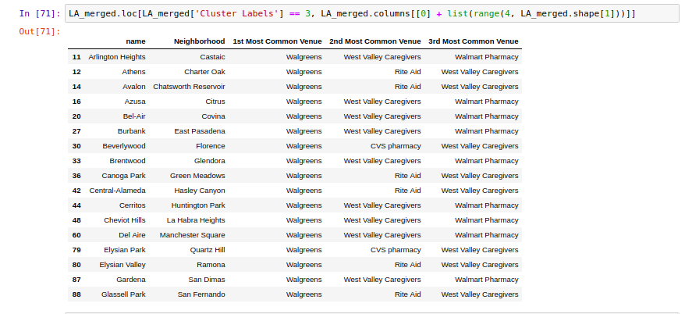
Cluster 03

Slide 20
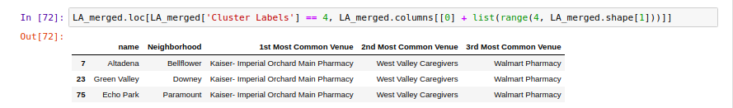
Cluster 04

Slide 21
Conclusions
As seen in the map it's clear that some areas are dominated by big pharmacies. But despite this fact it's possible see another areas lacking the of them thus is a opportunity to new comes.
1. Region of Palmdale are predominancy of Wallgreeens pharmacies but the low density of dots turns a good area to enter in.
2. Santa Clarita,Malibu, Glendale and West Hollywood regions does not enterend in the clusters or have fewer dots. May be there was many others little pharmacies not relevant to be weighted. Here area potencial area to install a store too.
3. Ranchos Palos Verdes until Long Beach seacost side area hot areas to new opportunities.
4.In overwall LA is dominatad buy to main pharmacies groups: Wallgreen and CVS as 1st Venues preferences. Despite this the city offer some opportunities to receiver a newer since that glimpse the statements above.

Slide 22
Bibliography
[1]( MacQueen, J. B. (1967). Some Methods for classification and Analysis of Multivariate Observations. Proceedings of 5th Berkeley Symposium on Mathematical Statistics and Probability. 1. University of California Press. pp. 281–297. MR 0214227. Zbl 0214.46201. Retrieved 2009-04-07.)
[2](Steinhaus, Hugo (1957). "Sur la division des corps matériels en parties". Bull. Acad. Polon. Sci. (in French). 4 (12): 801–804. MR 0090073. Zbl 0079.16403.)
[3]“The Global Use of Medicine in 2019 and Outlook to 2023” https://www.iqvia.com/insights/the-iqvia-institute/reports/the-global-use-of-medicine-in-2019-and-outlook-to-2023 (visited in April 7, 2020)
[4] https://en.wikipedia.org/wiki/K-means_clustering (visited in April 7, 2020)
https://www.programmableweb.com/api/foursquare
Machine Learning for Dummies (visited in April 6, 2020) Alsabti, Khaled; Ranka, Sanjay; and Singh, Vineet, "An efficient k-means clustering algorithm" (1997). Electrical Engineering and Computer Science. 43.
[9]Xilinx. "HDL Synthesis for FPGAs Design Guide". section 3.13: "Encoding State Machines". Appendix A: "Accelerate FPGA Macros with One-Hot Approach". 1995.
[10] Cohen, Ben (2002). Real Chip Design and Verification Using Verilog and VHDL. Palos Verdes Peninsula, CA, US: VhdlCohen Publishing. p. 48. ISBN 0-9705394-2-8.
[11] (visited in April 8, 2020)
[5]https://www.programmableweb.com/api/foursquare (visited in April 8, 2020)
[6]https://en.wikipedia.org/wiki/Machine_learning (visited in April 6, 2020)
[7]Machine Learning for Dummies https://www.ibm.com/downloads/cas/GB8ZMQZ3 (visited in April 6, 2020)
[8]Alsabti, Khaled; Ranka, Sanjay; and Singh, Vineet, "An efficient k-means clustering algorithm" (1997). Electrical Engineering and Computer Science. 43.
https://surface.syr.edu/eecs/43
[9][9]Xilinx. "HDL Synthesis for FPGAs Design Guide". section 3.13: "Encoding State Machines". Appendix A: "Accelerate FPGA Macros with One-Hot Approach". 1995.
[10][10] Cohen, Ben (2002). Real Chip Design and Verification Using Verilog and VHDL. Palos Verdes Peninsula, CA, US: VhdlCohen Publishing. p. 48. ISBN 0-9705394-2-8.
[11]https://hackernoon.com/what-is-one-hot-encoding-why-and-when-do-you-have-to-use-it-e3c6186d008f (visited in April 8, 2020)

