Slide 1
Microfrontend

Slide 2
Agenda
Introduction
Single SPA Framework
Getting Started Practically
Import Map and Systemjs
Layout Engine

Slide 3

Introduction

Slide 4
What is microfrontend ?

Slide 5
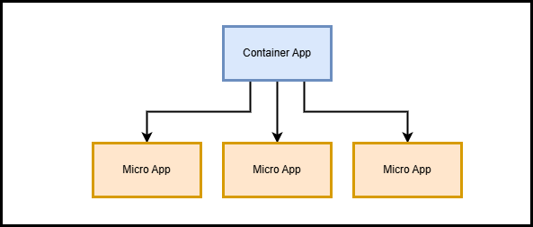
Microfrontend
A microfrontend is a microservice that exists within a browser.

Slide 6
Build Time vs In Browser Modules

Slide 7
Build Time Integration
Applications are bundled together during the build process (Compile Time).
Requires a full rebuild when changes are made.
Example: Webpack Module Federation.

Slide 8
In Browser Modules
Applications are loaded dynamically in the browser at runtime.
Allows independent deployment of each app.
Example: Single-Spa, SystemJS.
Applications are loaded dynamically in the browser at runtime.
Allows independent deployment of each app.
Example: Single-Spa, SystemJS.

Slide 9
Single SPA Framework

Slide 10
Single SPA Framework
Applications are loaded dynamically in the browser at runtime.
Allows independent deployment of each app.
Example: Single-Spa, SystemJS.
A JavaScript framework for combining multiple frontend applications into one.
Manages multiple frameworks like Angular, React, Vue together.
Independent deployments for each micro app.

Slide 11
Create-single-spa
Applications are loaded dynamically in the browser at runtime.
Allows independent deployment of each app.
Example: Single-Spa, SystemJS.
To Create Single SPA applications, we use create-single-spa package
Using create-single-spa we can create three types of applications
1- Root Config App (container)
2- Single SPA Applications (angular micro apps)
3- Utility Modules (shared functionalities)

Slide 12
Getting Started Practically

Slide 13
Create Root Config App
Applications are loaded dynamically in the browser at runtime.
Allows independent deployment of each app.
Example: Single-Spa, SystemJS.
npm install -g create-single-spa@4.1.6
create-single-spa
or
npx create-single-spa@4.1.6

Slide 14
Create Single SPA Application
create-single-spa (choose type “single spa application” then angular) Problem !!! (not working)
We will take another approach. First, create angular project then make it single spa application.
npm install @angular/cli@13
npx ng new my-angular-app

Slide 15
Convert to single spa application
Applications are loaded dynamically in the browser at runtime.
Allows independent deployment of each app.
Example: Single-Spa, SystemJS.
To make angular application a single spa application. We need to implement lifecycle function (bootstrap – mount – unmount).
No need to implement them manually.
Single-Spa Schematics will take this responsibility.

Slide 16
Single-SPA Schematics
To make angular application a single spa application. We need to implement lifecycle function (bootstrap – mount – unmount).
These schematics are provided by the single-spa-angular library and allow you to automate the creation of Angular applications that are compatible with the Single-Spa framework.
They help in setting up the necessary configuration, lifecycle functions, and other boilerplate code that makes an Angular app work as part of a microfrontend in a single-spa setup.
ng add single-spa-angular

Slide 17
Single-spa-angular changes
Generate a main.single-spa.ts in your project src/.
Generate an EmptyRouteComponent in src/app/empty-route/, to be used in app-routing.module.ts.
Add npm scripts.
Since Angular 8 they use @angular-builders/custom-webpack to modify the webpack configs.
The schematics also create an extra-webpack.config.js file in your project where you can modify the configuration further.

Slide 18
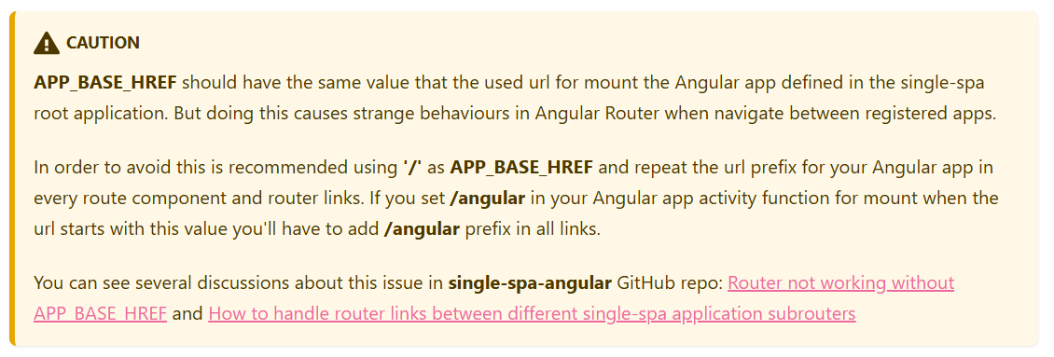
Configure Routes
Add providers: [{ provide: APP_BASE_HREF, useValue: '/' }] to app-routing.module.ts
Add { path: '**', component: EmptyRouteComponent } to your app-routing.module.ts routes. Add npm scripts.

Slide 19
Register Micro Applications
The app is registered with a name, loaded dynamically using SystemJS, and made active based on the URL path.
With Single-Spa Layout Engine, you don't need to manually register apps using registerApplication.
Instead, the apps are automatically registered through the import map and the root-config's layout.html (single-spa-layout).

Slide 20
Import Map And SystemJS

Slide 21
Import Map
Import Maps are a way to control how JavaScript modules are resolved and loaded in the browser.
Import maps help the root-config know where each microfrontend is located.
Import maps dynamically load apps at runtime.
You can update microfrontends independently by just changing the import map URL.

Slide 22
SystemJS
SystemJS is a JavaScript module loader that allows the browser to load JavaScript files dynamically at runtime.
It works with Import Maps to determine where to fetch and execute JavaScript modules.
SystemJS handles dynamic loading for each app when required.

Slide 23
SystemJS Flow
Reads the Import Map: Looks for the name @angular-app in the import map.
Fetches the App: Downloads the main.js file from http://localhost:4201/main.js.
Executes the Code: Runs the JavaScript and applies lifecycle functions like bootstrap, mount, and unmount.

Slide 24
Layout Engine

Slide 25
Layout Engine Elements

Slide 26
<single-spa-router>
The root component that defines the entire routing system.
It helps manage which microfrontend should be displayed based on the URL path.

Slide 27
<route>
The <route> element is used inside <single-spa-router> to define path-based navigation for microfrontends.
It specifies when a microfrontend should be loaded based on the URL.
There is some attributes related to <route> element
1- path: Defines the URL path where the microfrontend will be active.
2- exact: (Optional) Ensures the path matches exactly.

Slide 28
<application>
The <application> element is used inside a <route> in single-spa-router.
It specifies which microfrontend to load for a given route.
There is some attributes related to <route> element
name: Specifies the registered name of the microfrontend matching the name in the import map.

Slide 29
Layout Engine APIs

Slide 30
constructRoutes Method
The constructRoutes function in Single-Spa Layout Engine is used to define the application's route structure. It accepts a required parameter: routes.
routes parameter is An object defining the layout structure using <single-spa-router>, <route>, and <application> tags.
It transforms the defined layout object into a format usable by Single-Spa Layout Engine for dynamic routing.

Slide 31
constructApplications Method
Prepares a list of registerObjects containing the necessary data to register microfrontends.
constructApplications only prepares the applications; it does not register them directly.

Slide 32
Thank you
Mostafa Ahmed
masobhy@ejada.com

