Slide 1
Group 9: SwoleAF
By: Patrick Maier, Eloy Gonzalez, Alex Matasa, William Gross, Troy Houston, Alexander Alvarez

Slide 2
Members - Roles
Patrick Maier - App Java
Eloy Gonzalez - Web UI
Alex Matasa - PHP Person
William Gross - Database Dude
Troy Houston - App Java
Alexander Alvarez - App Java

Slide 3
Idea
Our application will focus on helping people achieve a higher level of physical fitness and track and manage their workouts
Will make it easier for gyms to streamline their business model by allowing members and trainers to create public routines to help users
Keep gym members engaged to encourage paid membership
Will help users be better informed as to how to properly perform exercises
Will help fitness enthusiast focus their efforts on particular muscle groups

Slide 4
App Description
SwoleAF is fitness application that focuses on physical fitness and workout management
It allows users to browse routines made by trusted users
Navigate and view your weekly schedule
The website and application allows you to track your progress and create new workout routines

Slide 5
Description
SwoleAF is an app that allows users to create custom workout schedules.
Users can create new routines for themselves or choose from a selection of public ones.
Exercises are split into muscle group for easier browsing.
Each workout has a description, a photo, and a video for visual guidance
Users can customize their schedule from the website and look it up from their phone.

Slide 6
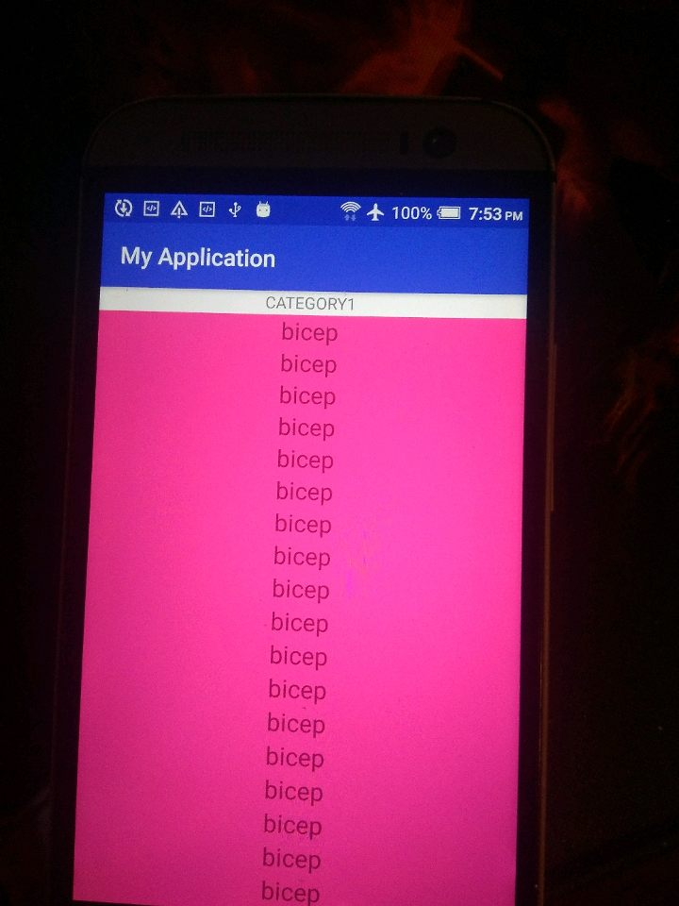
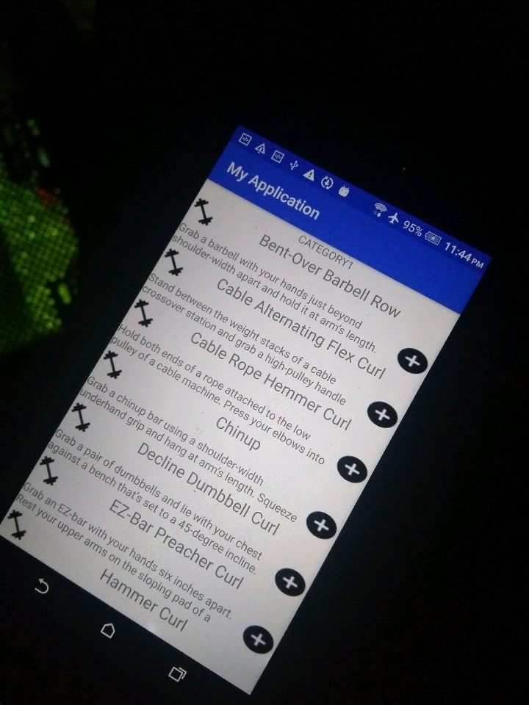
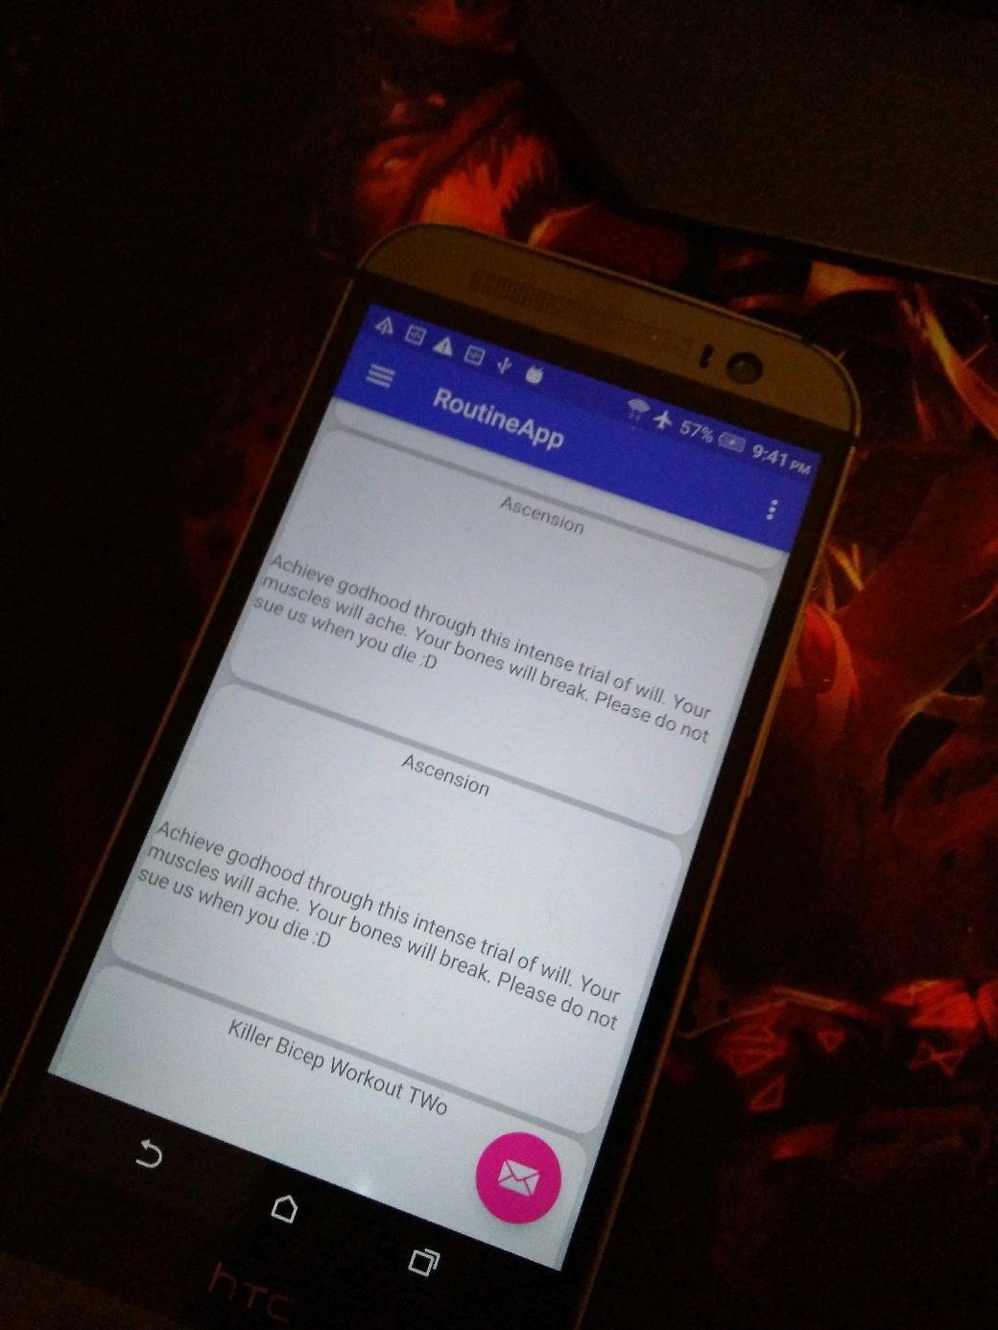
App Design Evolution

Slide 7
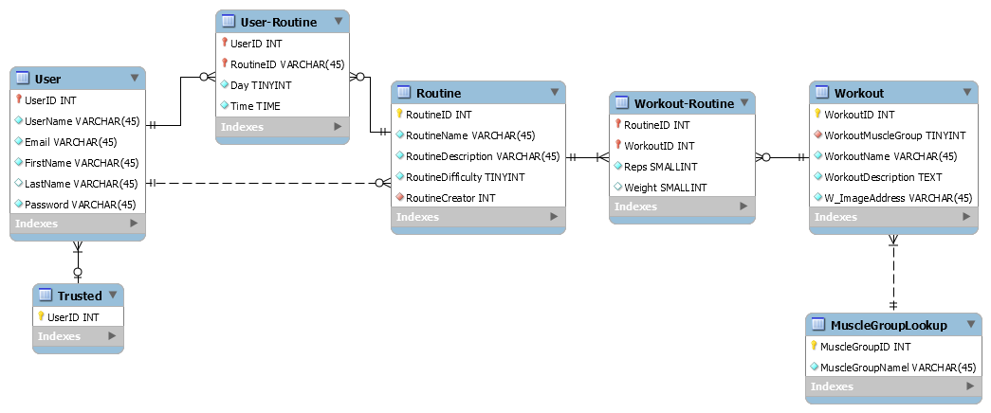
Diagrams

Slide 8
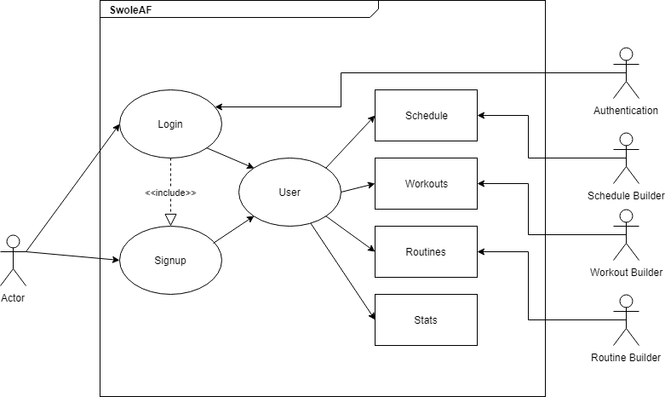
Use Case

Slide 9
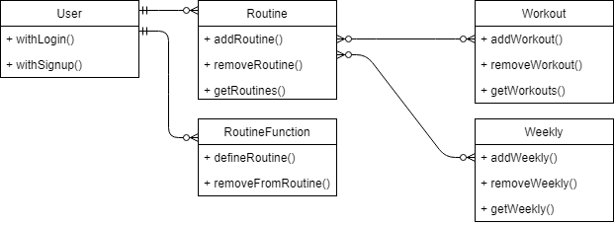
Class Diagram

Slide 10
Tools & APIs
The website is written in HTML and CSS and uses mySQL for the database along with Google’s web YouTube API for videos
The graphical information on the website uses Google's graph API to display a statistical analysis of a user's activity
The Android application will be built using Android studio and is designed to target API level 23 and higher
The Android application will mirror the websites functionality
PHP will be used to communicate with the database

Slide 11
Design Decisions
For the website we chose to use HTML and CSS for simplicity and compatibility
We are using the LAMP stack as we have grown familiar with it and can therefore focus more on features and implementation rather than learning a new stack
We chose the Android platform for it's open source nature and ability to test and develop our application on a variety of different machines
Android also allows us to have experience with the most widely used operating system worldwide

Slide 12
Demo
http://cop4331.hosted.nfoservers.com/main/main.php

Slide 13
Development Issues
Not enough time spent planning
Our internal terminology is confusing
Our hosting service is using an old version MySQL
Originally planned on handling JSON conversions in the database
None of us had any experience developing mobile applications
Compile time on android studio is abysmal
Huge learning curve for Android Development

Slide 14
Future Additions
Show statistical analysis of activities for each user
Allow trainers to create private routines
Expand on the trainer system

Slide 15
Questions?
?

