Slide 1

PyErasure Tutorial
Foteini Karetsi
PhD candidate
University of Ioannina, Greece

Slide 2
Outline
Introduction to PyErasure library
Installation guide
Module structure
Source code overview
Helper classes analysis
Block-based approach
Sliding Window approach
Working with test examples
Demos walk-through
Building a test scenario step-by-step

Slide 3
Outline
Introduction to PyErasure library
Installation guide
Module structure
Source code overview
Helper classes analysis
Block-based approach
Sliding Window approach
Working with test examples
Demos walk-through
Building a test scenario step-by-step

Slide 4
What is PyErasure?
Educational tool to familiarize with FEC techniques
Particularly RLNC
Written in Python
Easy installation and usage
Out of the box encoding and decoding functionalities
Notes:
Developed by Steinwurf ApS

Slide 5
PyErasure Setup
Prerequisites: Python version 3.7 and above
Extract zip file
In main directory build module using command:
To run an example: python3 path/filename.py
python3 –m pip install .

Slide 6
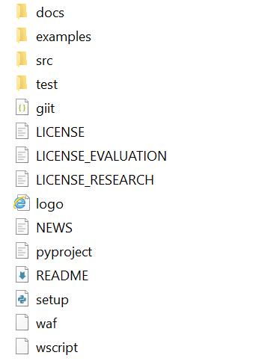
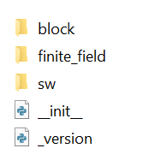
Module Structure & Extension
src/pyerasure: Contains library’s source code
block: includes the block-based RLNC implementation
sw: refers to sliding window RLNC implementation
examples: Contains test scripts for both block-based and SW implementations
Changes in source code require compiling
Using command python3 –m pip install .
Build source code after every modification
Notes:
Available under the company’s research license

Slide 7
Outline
Introduction to PyErasure library
Installation guide
Module structure
Source code overview
Helper classes analysis
Block-based approach
Sliding Window approach
Working with test examples
Demos walk-through
Building a test scenario step-by-step

Slide 8
Source Code Overview
API including the following classes:
Encoder
Decoder
RandomUniform
Finite Field submodule
Common structure in both block-based and sliding window implementations

Slide 9
Finite Field
Implements math operations between field elements (e.g., +, - , *)
Using predefined look-up tables for multiplication and division
Several finite field classes available
class Binary → GF(2)
class Binary4 → GF(2⁴)
class Binary8 → GF(2⁸)

Slide 10
Class RandomUniform
Generates uniform random coefficients for the encoding vector over a given GF
Input: finite field, symbols
Field: BinaryX object
Symbols: The number of coefficients to generate (int)
Main Methods
generate() → bytes
generate_partial(rank: int) → bytes
Notes:
Generate() for BB mostly
Generate_partial() for SW

Slide 11
Class Encoder (Block-based)
Provides main API for reading source packets and RLNC encoding
Input:
Field: BinaryX object
Symbols: Block (or generation) size
Symbol_bytes: Size of a packet (in bytes)
Main methods
set_symbols(block_data: bytes): stores the whole block of data (@ _symbols_data buffer)
set_symbol(index: int, symbol_data: bytes): sets a packet at specific index of block
encode_symbol(coefficients: bytes) → bytearray: generates a coded packet
Notes:
Encode_symbol(): Following RLNC principles

Slide 12
Class Decoder (Block-based)
Implements Gaussian elimination over a block of packets using the algorithm of Heide et al. (2009)^{[1]}
Forward Substitution (FS)
Backward Substitution (BS)
Same input parameters as BB Encoder: field, symbols (block size) and symbol_bytes (packet size)
Main data structures
_symbols_data: stores the received source and coded packets
_coefficients: keeps the encoding vectors
_symbol_status: info regarding packet status → MISSING, PARTIALLY_DECODED or DECODED
Properly adjusted to higher GF sizes!
[1] J. Heide, M. V. Pedersen, F. H. P. Fitzek and T. Larsen, "Network Coding for Mobile Devices - Systematic Binary Random Rateless Codes," 2009 IEEE International Conference on Communications Workshops, Dresden, Germany, 2009, pp. 1-6, doi: 10.1109/ICCW.2009.5208076.
Notes:
FS: find first pivot index and eliminate non zero coefficients at previous indexes of a given encoding vector
BS: subtract newly received packets from previously stored ones

Slide 13
BB Decoder – Main Methods (1/2)
decode_symbol(symbol_data: bytearray, coefficients: bytearray)
Feeds a coded packet (symbol_data) and its encoding vector (coefficients) to the decoder
Applies FS, BS and for larger GF sizes appropriate normalization func
FS and BS implemented as private functions; FS split into two functions (coding convention) → Functionality remains the same!
If coded packet useful: store packet and enc. vector at the decoder
Recovered packets (through coding) not available until the reception of the whole block (status PARTIALLY DECODED)

Slide 14
BB Decoder – Main Methods (2/2)
decode_systematic_symbol(symbol_data: bytearray, index: int)
Func to process a source (systematic) packet (symbol_data) of a given id (index) at the decoder
Assumes id = index of the packet in _symbols_data buffer
Buffer index starts from 0
Convention: Source packet always preferred against coded as pivot for specific index
Replaces coded pivot if existing (with __swap_decode())
Due to computational overhead
If received in-order, packet can be delivered immediately to the application (status DECODED)

Slide 15
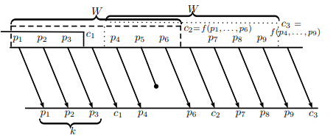
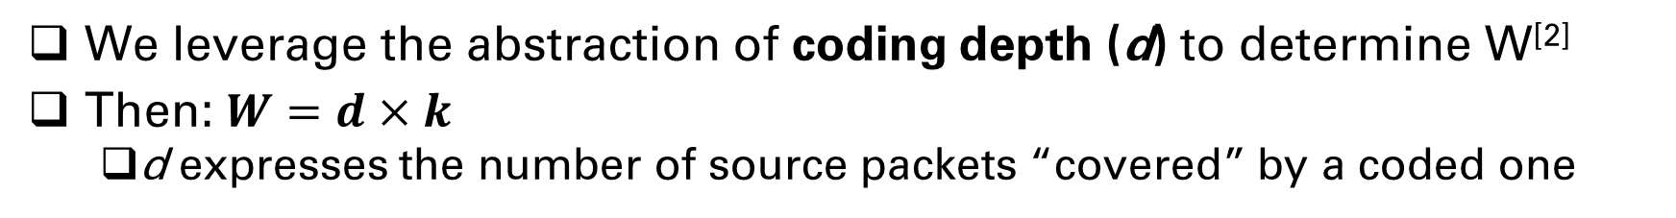
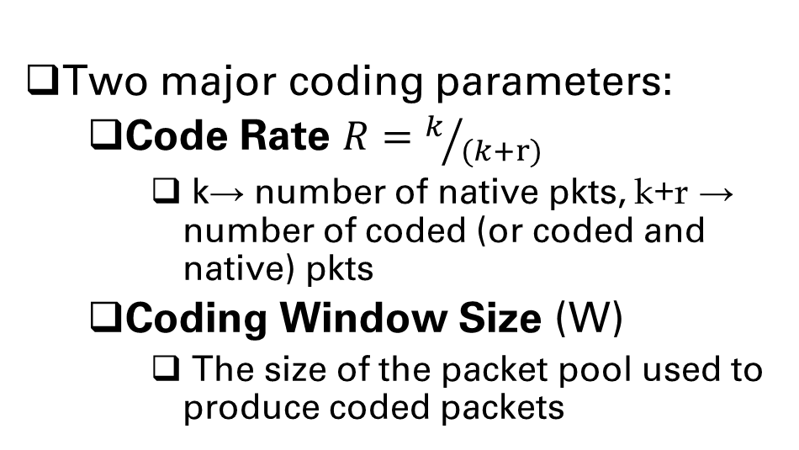
Sliding Window RLNC Fundamentals
Two major coding parameters:
Code Rate $R=k/{(k+r)}$
k→ number of native pkts, k+r → number of coded (or coded and native) pkts
Coding Window Size (W)
The size of the packet pool used to produce coded packets
Systematic SW RLNC
We leverage the abstraction of coding depth (d) to determine W^{[2]}
Then: $W=d×k$
d expresses the number of source packets “covered” by a coded one
[2] Karetsi, Foteini, and Evangelos Papapetrou. "A low complexity network-coded ARQ protocol for ultra-reliable low latency communication." 2021 IEEE 22nd International Symposium on a World of Wireless, Mobile and Multimedia Networks (WoWMoM). IEEE, 2021.

Slide 16
Class Encoder (SW) (1/3)
API for reading source packets, performing SW RLNC encoding and updating coding window
Definition incorporates the coding parameters discussed earlier
source_per_cycle (k)
repair_per_cycle (r)
coding_depth (d)
Additional input:
Field: BinaryX object
Packets: Total number of transmitted packets
Packet_size_bytes: Size of a packet (in bytes)
Hence: W = source_per_cycle * coding_depth

Slide 17
Class Encoder (SW) (2/3)
Main methods
set_packets(block_data: bytes): reads and stores the total number of packets to be transmitted (_packets_data buffer)
set_packet(index: int, packet_data: bytes): reads and stores a single packet on the buffer
encode_packet(coefficients: bytes) → bytearray: generates a coded packet

Slide 18
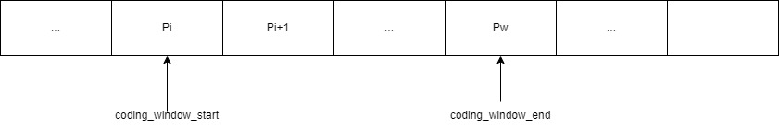
Class Encoder (SW) (3/3)
Handling Coding Window
Pointers indicating window’s lower and upper bounds
coding_window_start
coding_window_end
_packets_data
Pointers updated using update_coding_window(index: int)
Every new source always placed at the end of the window (coding_window_end ++)
If window full: “slide” active window (coding_window_start ++, coding_window_end ++)

Slide 19
Class Decoder (SW)
Similar functionality and structures as BB decoder – Major difference: how to handle the decoding window bounds
Input parameters:
field, packets and packet_size_bytes
coding_depth and source_per_cycle (k) → Coding Window W
parameter decoding_depth: defines maximum allowed size of decoding window as a function of W
Assume coding_depth = decoding_depth
Active decoding window accessed via pointers
min_index: lower decoding window bound
max_index: upper decoding window bound
Notes:
_symbols_data: stores the received source and coded packets
_coefficients: keeps the encoding vectors
_symbol_status: info regarding packet status → MISSING, PARTIALLY_DECODED or DECODED

Slide 20
SW Decoder – Main Methods (1/2)
decode_packet(packet_data: bytearray, coefficients: bytearray, window_bounds: Tuple[int,int])
Feeds a coded packet (packet_data) and its encoding vector (coefficients) to the decoder – window_bounds refers to range of involved src packets
Typical FS and BS (Heide et al.) - applied only on active decoding window [min_index, max_index]
Recovered packets CAN be available after decoding if in-order (unlike BB)
Additional step: check if decoding window can slide!

Slide 21
SW Decoder – Main Methods (2/2)
decode_systematic_packet(packet_data: bytearray, index: int)
Func to process a source (systematic) packet (symbol_data) of a given id (index) at the decoder
Same principles as in BB approach
Additional step: update the decoding window bounds

Slide 22
Outline
Introduction to PyErasure library
Installation guide
Module structure
Source code overview
Helper classes analysis
Block-based approach
Sliding Window approach
Working with test examples
Demos walk-through
Building a test scenario step-by-step

Slide 23
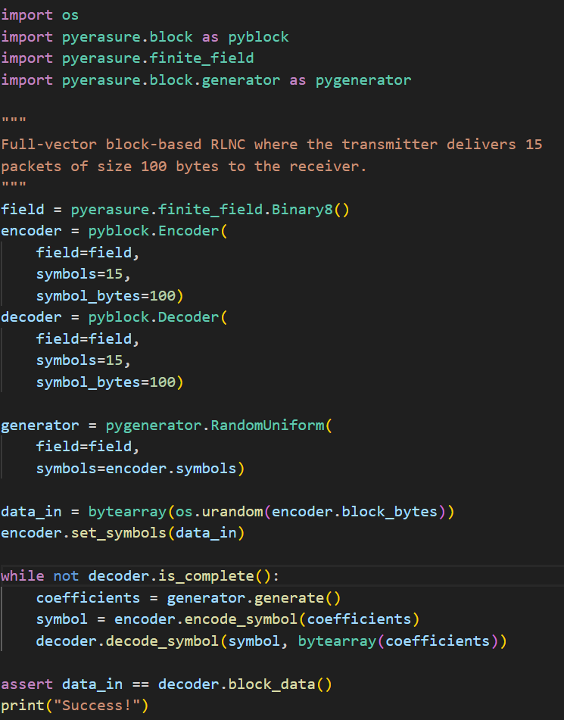
Demo 1 – full_vector.py
Full-vector encoding

Slide 24
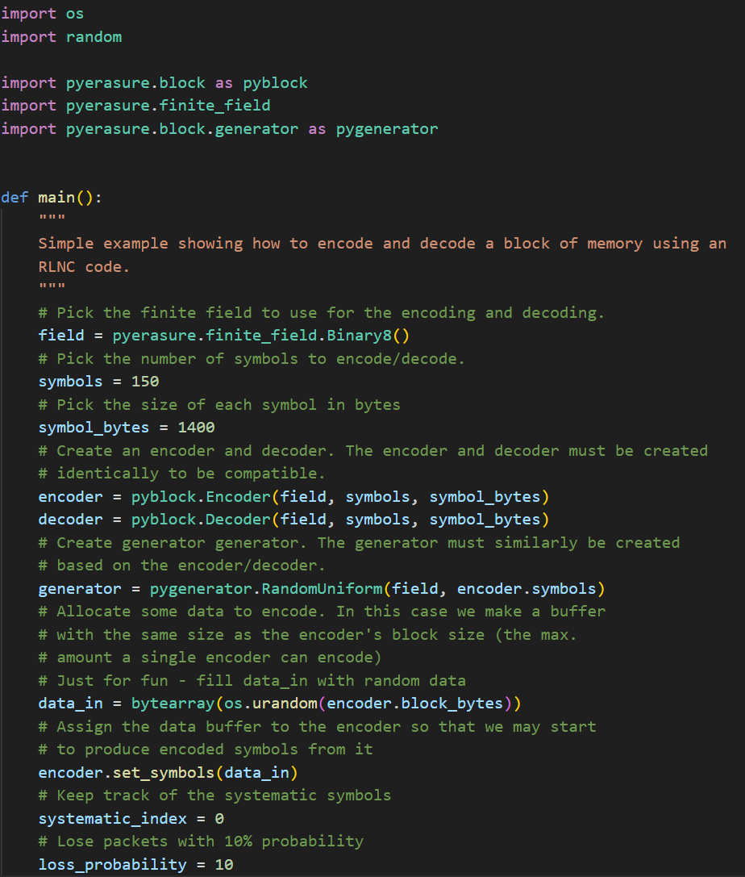
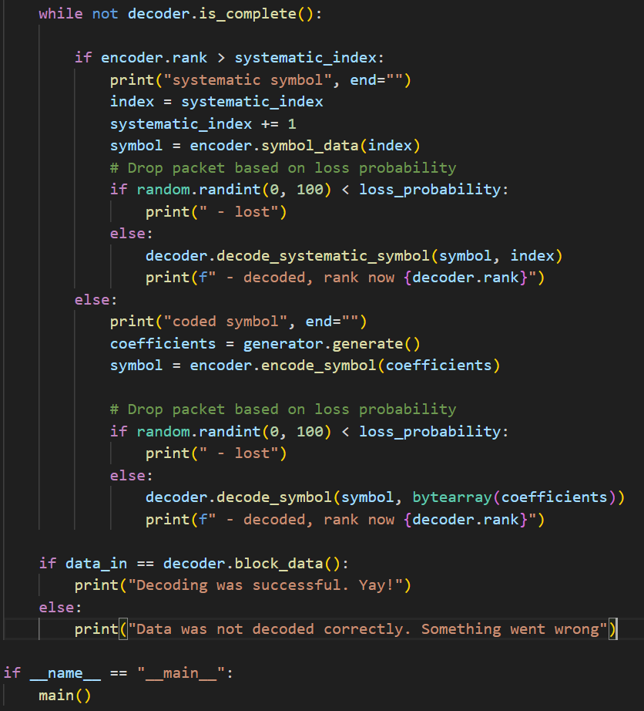
Demo 2 – rlnc_encode_decode.py
Systematic Block-based scheme over a lossy channel

Slide 25
Building a script step-by-step
Main steps
Determine input parameters, e.g., packet size, GF, block size etc.
Define proper encoder/decoder/generator objects
Assign input data to encoder
Set up an error model (e.g., uniform or bursty losses)
Answer the following questions:
What type of packets should I send? Source, coded, both?
When should I send redundancy?
When will the simulation stop?
Calculate appropriate metrics
More examples in sw folder

Slide 26
Additional Notes
Recoding also available in BB approach – not in SW!
DON’T share this code publicly – protected by Steinwurf’s license
Online Documentation: https://pyerasure.steinwurf.com/1.3.0/
Only for block-based implementation
Contact me for any questions on the library
Email: fkaretsi@cse.uoi.gr

Slide 27
Thank you!

