Slide 1

Aide
memoire
A-m

Slide 2
A-m

Slide 3
Navigation Bar
All links that point here are:
Note View
Section View
User View (Settings)
It requires authentication
It defaults to the welcome note
Tree
View
Username
Note
or
Section
Small Custom Navigation

Slide 4
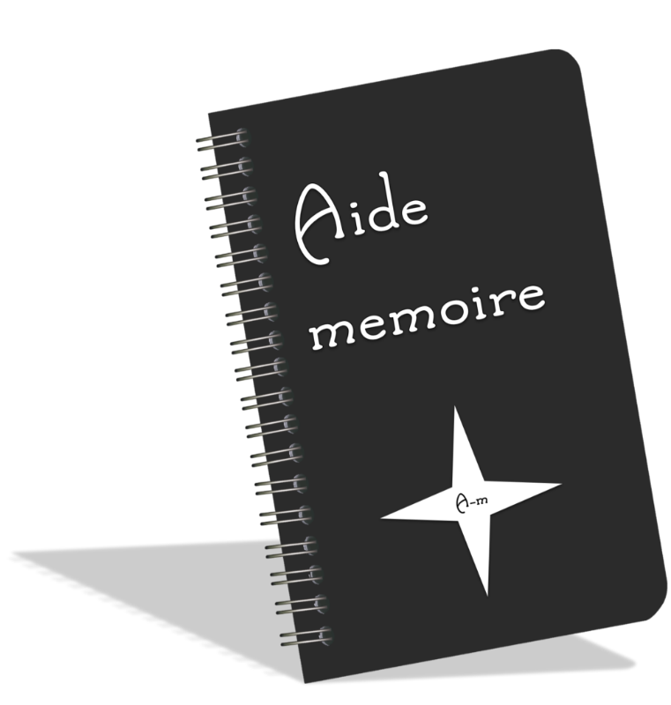
Sign up
Or
Login
It queries for signup or login
Then animates the chosen form
Absence of navbar

Slide 5
Store your notes and memories with us.

