Slide 1



























$$\vec{x_{4}}$$
$$\vec{y_{0}}′$$
$$\vec{y_{1}}$$
$$\vec{x_{1}}$$
$$\vec{y_{0}}′$$
$$β$$
$$\vec{x_{0}}′$$
1
$$\vec{z_{0}}′$$
3
4
$$A$$
2
$$\vec{y_{0}}′$$
$$\vec{y_{4}}$$
$$B$$
$$C$$
$$\vec{x_{4}}$$
$$\vec{x_{1}}$$
$$θ′$$
$$β$$
$$\vec{x_{0}}′$$
$$\vec{z_{0}}′$$
$$θ(t)$$
$$D$$
$$\vec{x_{0}}$$
$$\vec{AD}=a⋅{\vec{x_{0}}}^{′}=c\vec{x_{0}}+d\vec{y_{0}}$$
$$θ^{′}(t)$$
$$\vec{DC}=b⋅\vec{x_{4}}$$
0
$$α$$
$$\vec{x_{0}}′$$
$$\vec{AC}=λ⋅\vec{x_{1}}$$

Slide 2
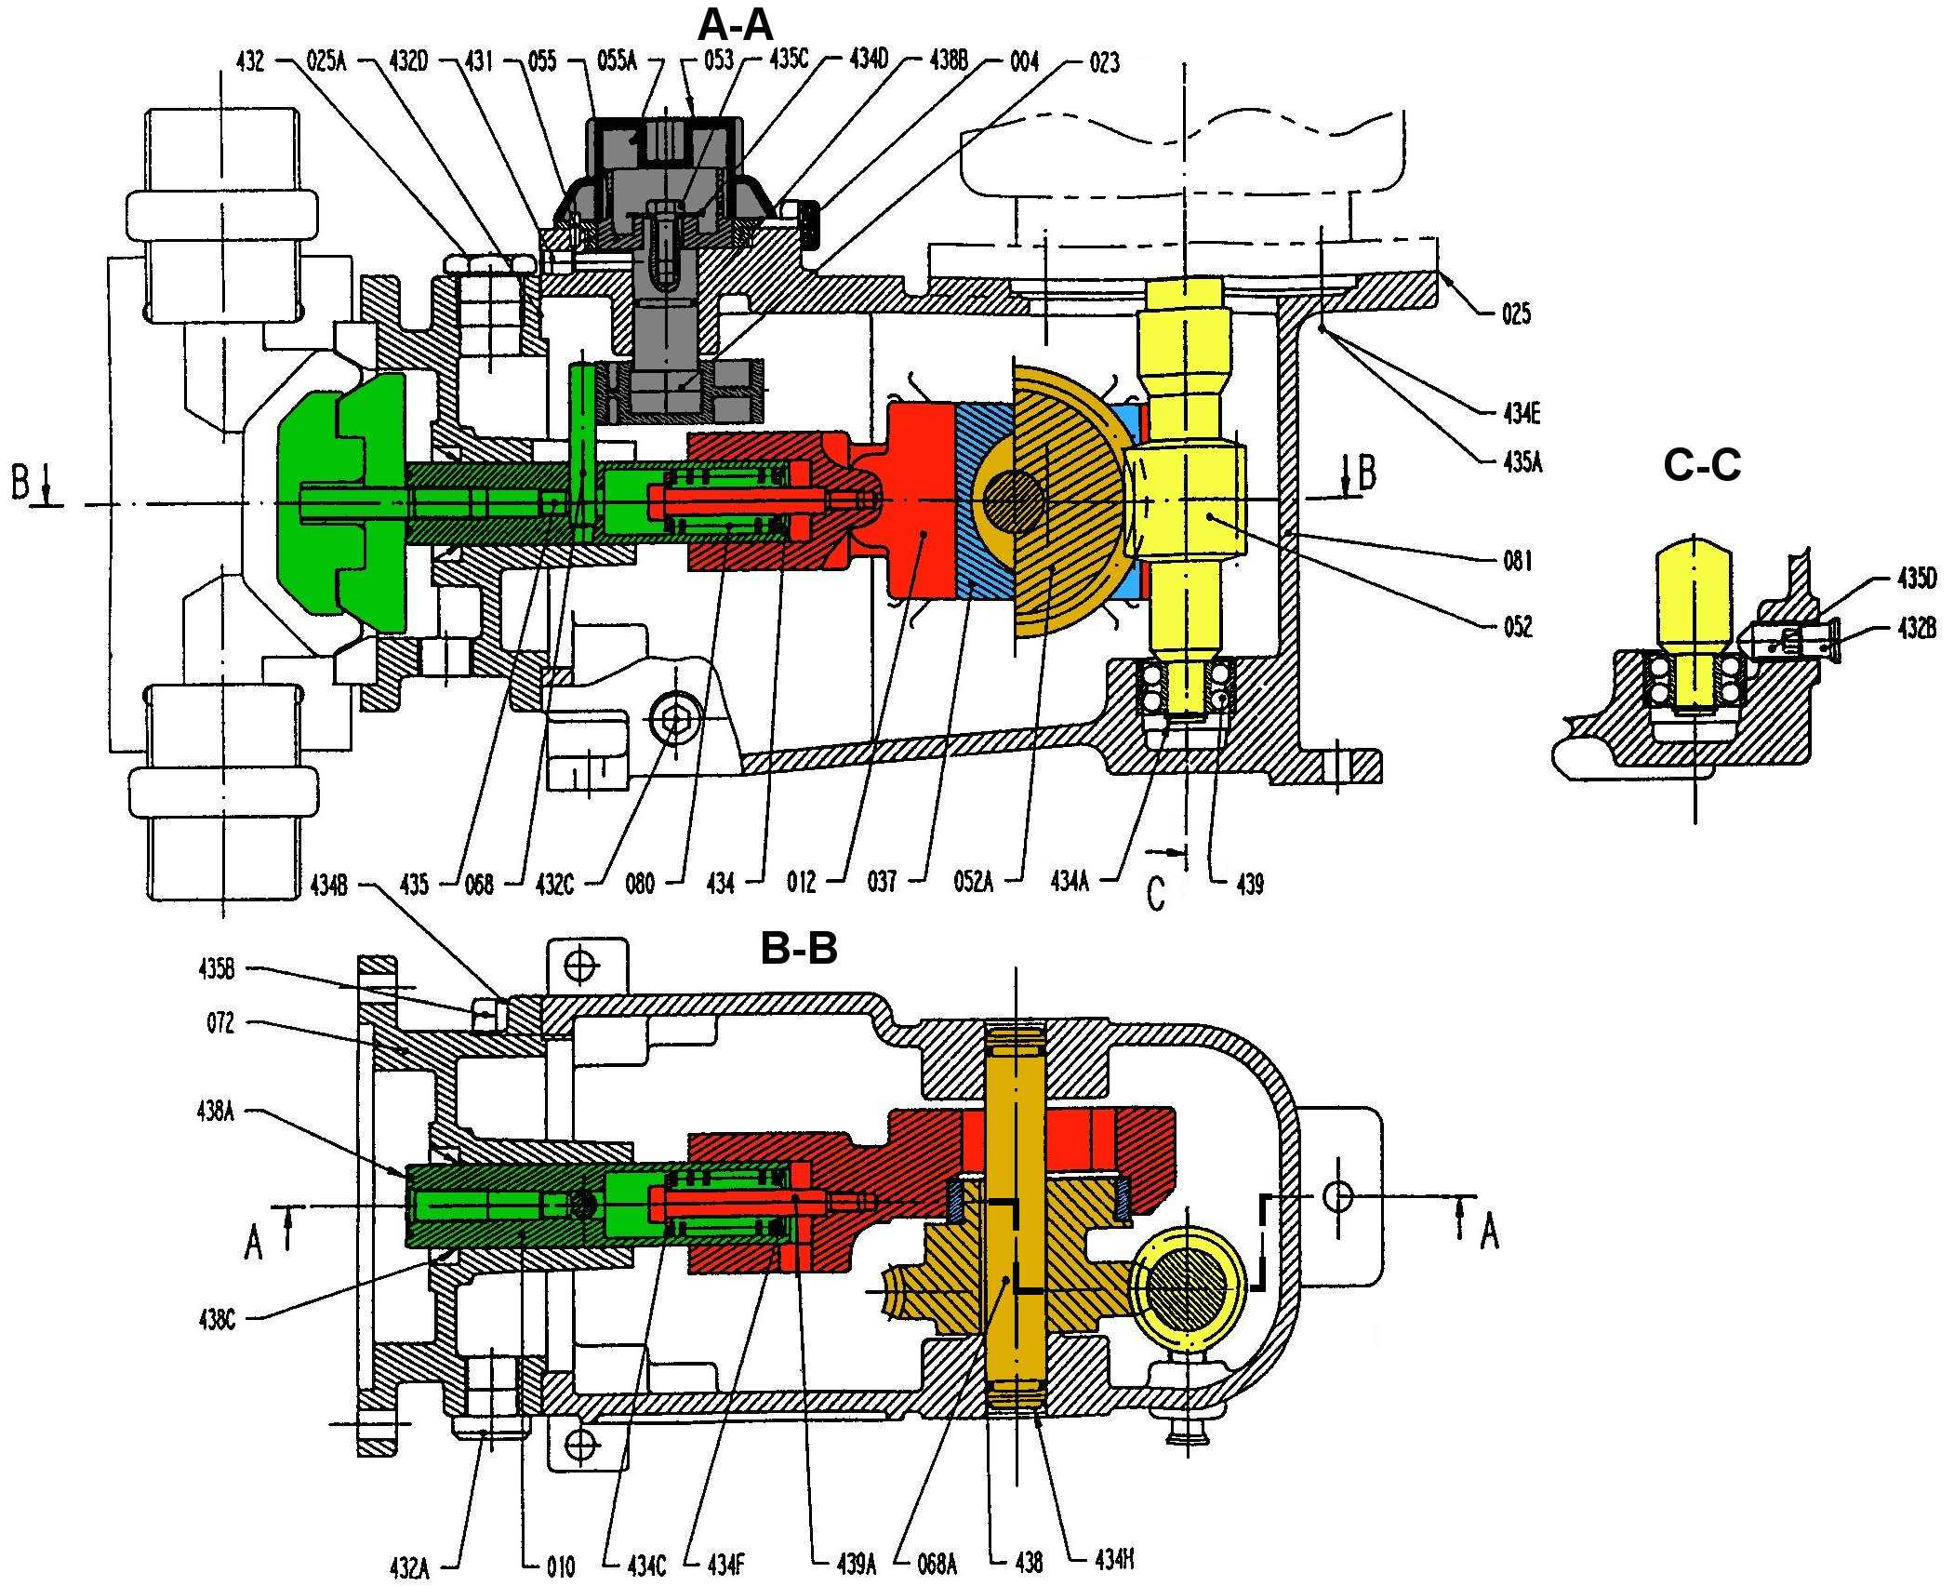

Slide 4


















$$\vec{x_{0}}$$
5
3
1
$$\vec{x_{1}}$$
$$A$$
$$\vec{z_{1}}$$
4
$$θ$$
$$\vec{x_{2}}$$
$$\vec{z_{0}}$$
$$\vec{y_{0}}$$
$$\vec{y_{0}}$$
$$O_{2}$$
$$\vec{y_{0}}$$
5
$$B$$
$$O_{0}$$
$$\vec{y_{2}}$$
$$\vec{x_{2}}$$
0
$$\vec{x_{0}}$$
2
$$φ$$
$$\vec{x_{0}}$$
$$\vec{z_{0}}$$

